Slide 1
How Does the Law, Past and Present, Affect Health Equity?
Part 1 of Exploring the Social Determinants of Health, Health Equity, and the Law

Slide 2
ChangeLab Solutions Disclaimer
The information provided in this discussion is for informational purposes only and does not constitute legal advice. ChangeLab Solutions does not enter into attorney-client relationships.
ChangeLab Solutions is a nonpartisan nonprofit organization that educates and informs the public through objective, nonpartisan analysis, study, and research. The primary purpose of this discussion is to address legal and policy options to improve public health. There is no intent to reflect a view on specific legislation.
© 2024 ChangeLab Solutions

Slide 3
CDC Disclaimer
These course materials are for instructional use only and are not intended as a substitute for professional legal or other advice. While every effort has been made to verify the accuracy of these materials, legal authorities and requirements may vary from jurisdiction to jurisdiction. Always seek the advice of an attorney or other qualified professional on any questions you may have regarding a legal matter.
The findings and conclusions in this training are those of the author(s) and do not necessarily represent the official position of the Centers for Disease Control and Prevention.

Slide 4
Content Warning
This training contains sensitive topics.
Some of the material in this training discusses violence, racism, and violations of civil rights.
We encourage you to take breaks or step away as needed, and to move through this material at a comfortable pace.

Slide 5
What We’ll Discuss
What is health equity?
What can history teach us about structural discrimination?
How does the law contribute to health inequity?
How can inequities be repaired?

Slide 6

Centering Equity
We’ll use this icon to highlight opportunities to center equity in your work.
Equity practice tip!

Slide 7
What We’ll Discuss: What is Health Equity?
What is health equity?
What can history teach us about structural discrimination?
How does the law contribute to health inequity?
How can inequities be repaired?

Slide 8
Example:
Maternal and Infant Health

Slide 9
What Do We Mean by the Social Determinants Of Health?
“the nonmedical factors that influence health outcomes. They are the conditions in which people are born, grow, work, live, and age, and the wider set of forces and systems shaping the conditions of daily life. These forces and systems include economic policies and systems, development agendas, social norms, social policies, racism, climate change, and political systems.”
—Centers for Disease Control and Prevention (CDC)

Slide 10
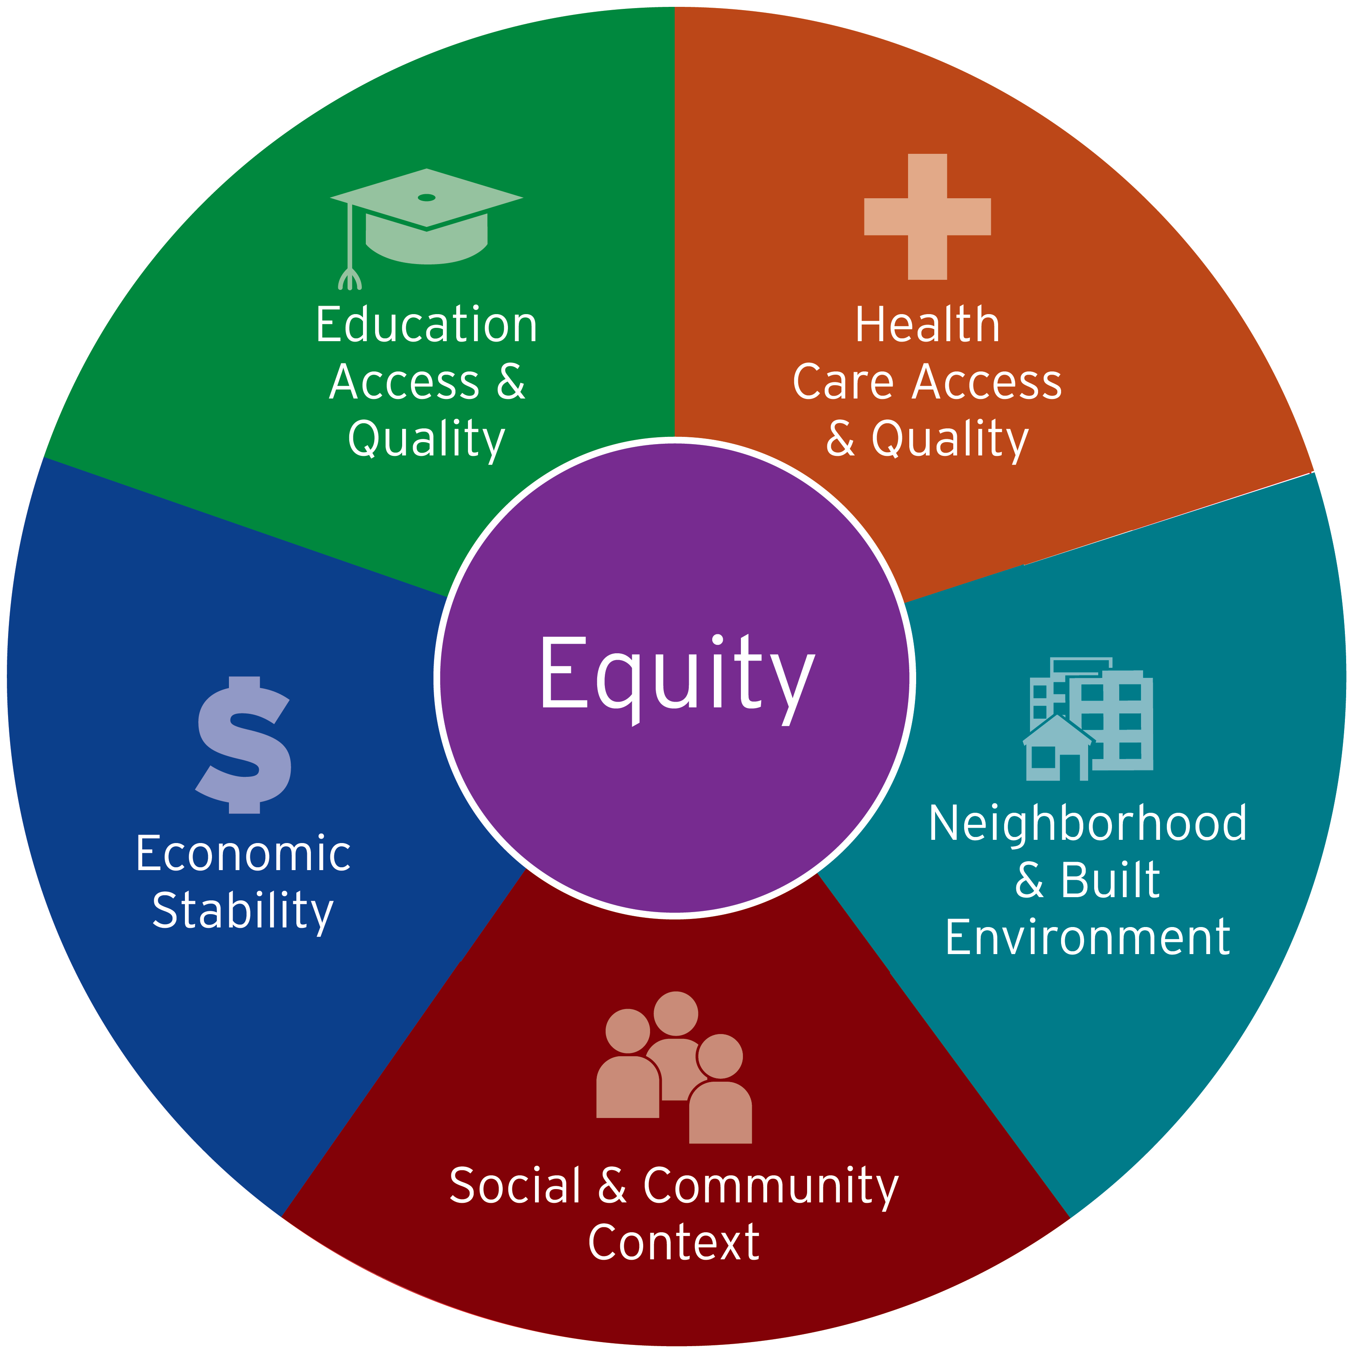
Healthy People 2030
Notes:
Pie chart with "Equity" at the center. The 5 slices of the pie are labeled with the social determinants of health: economic stability, education access and quality, health care access and quality, neighborhood and built environment, and social and community context.
Diagram illustrating that equity is at the center of the social determinants of health; shaped like a wheel. At the center of the wheel is “Equity,” emphasizing its foundational role. The five spokes each represent a social determinant of health: economic stability, education access and quality, health care access and quality, neighborhood and built environment, and social and community context.
The purpose of the diagram is to show how each determinant of health is important to people’s health, well-being, and quality of life.

Slide 11
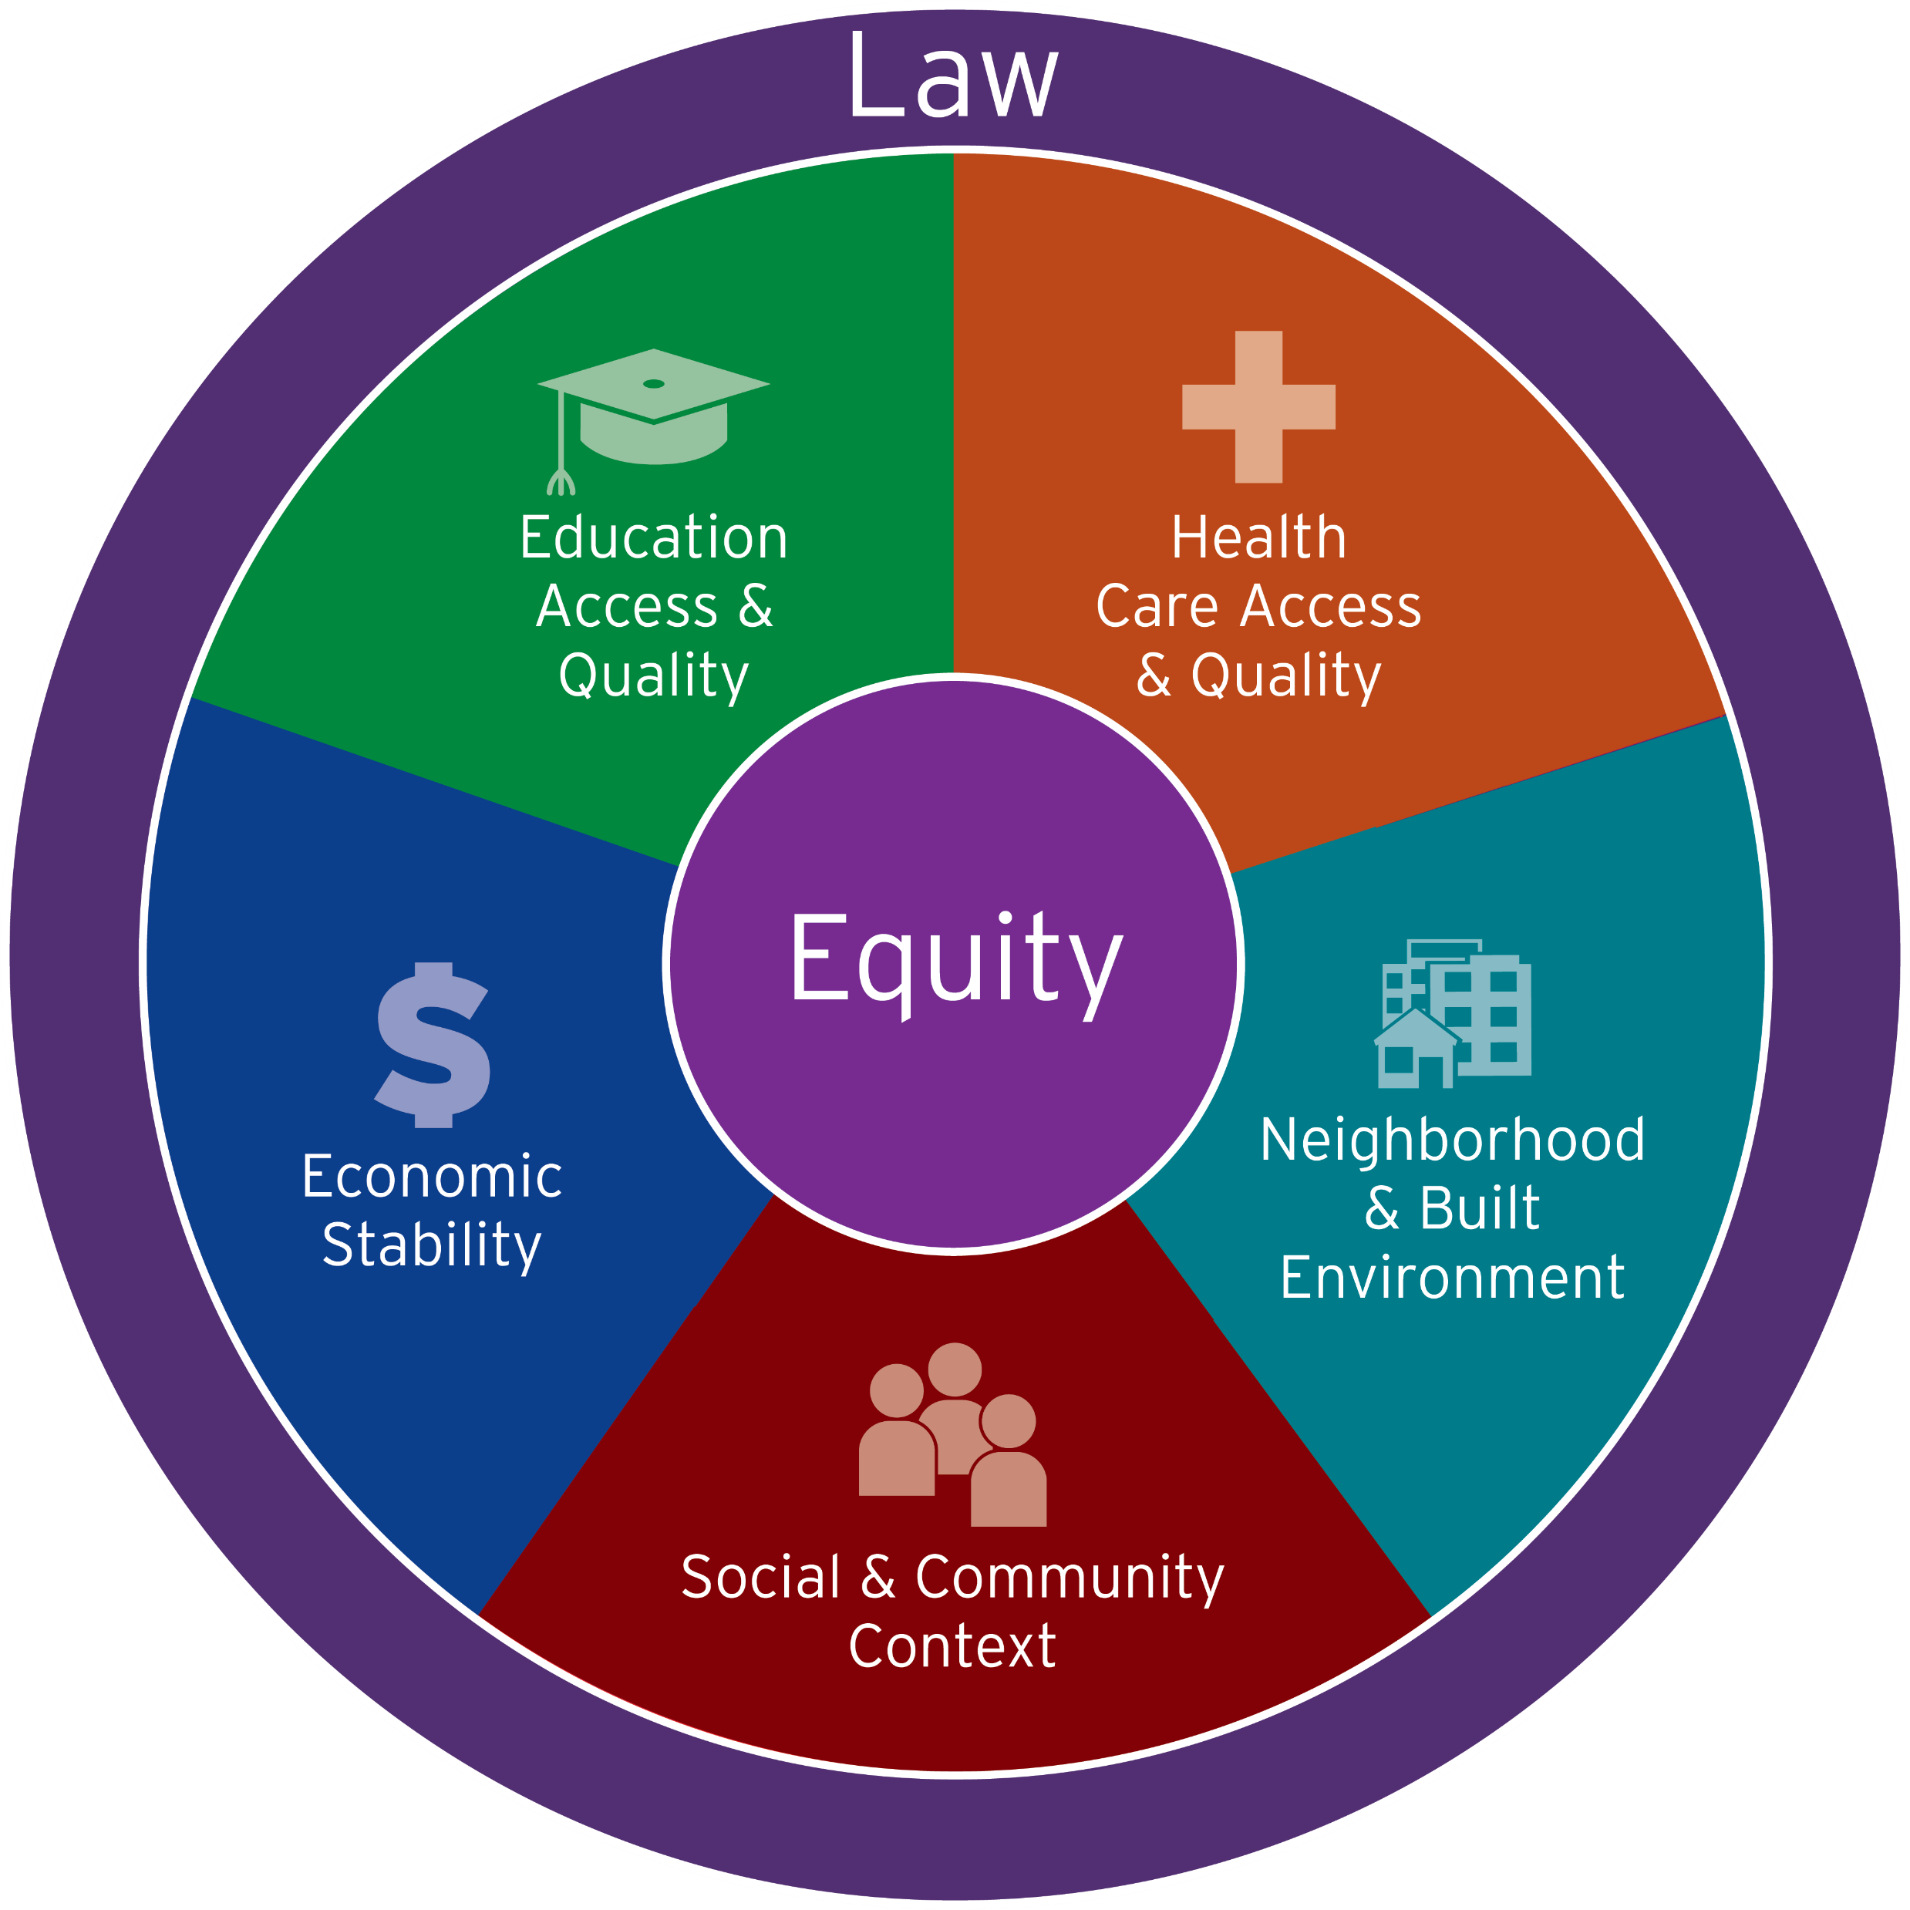
The Law as a Determinant
Law plays a powerful role in determining the distribution of money, power, and resources.
This role shapes the social determinants of health.
We will explore how the law, past and present, has shaped differences in health outcomes and continues to do so.

Slide 12
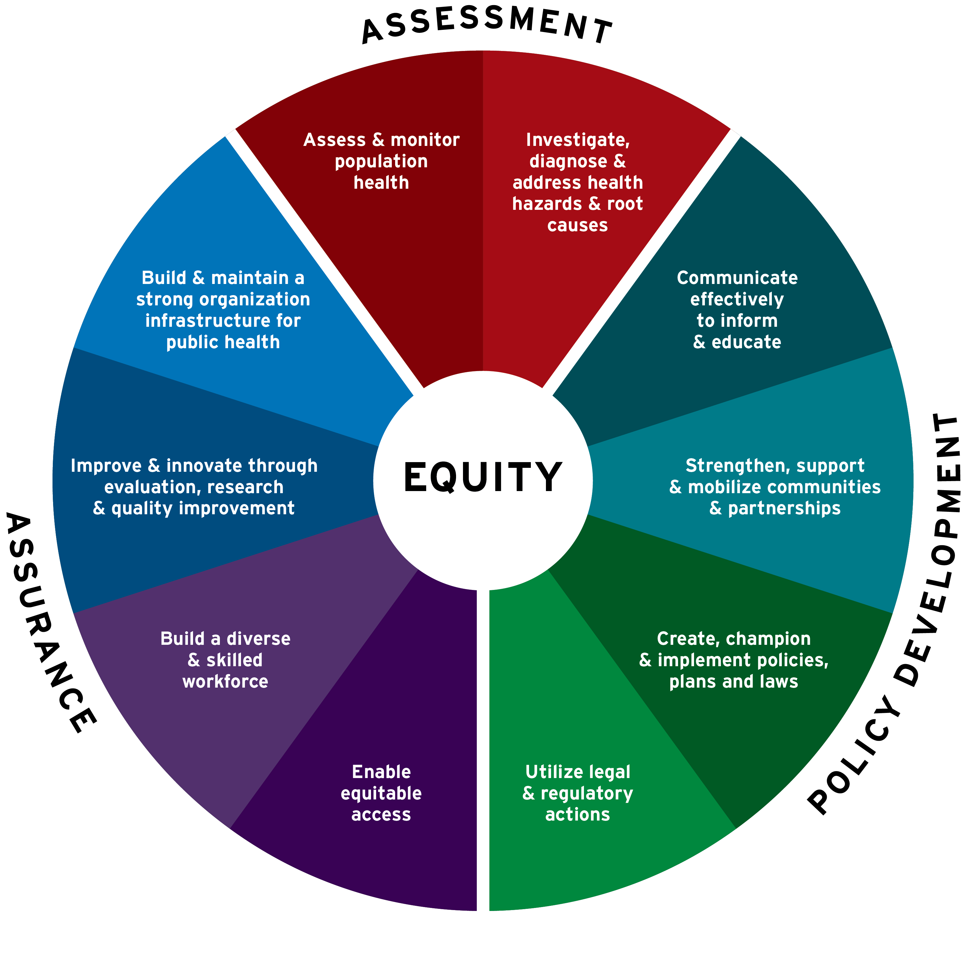
10 Essential Public Health Services:
Core Functions

Slide 13
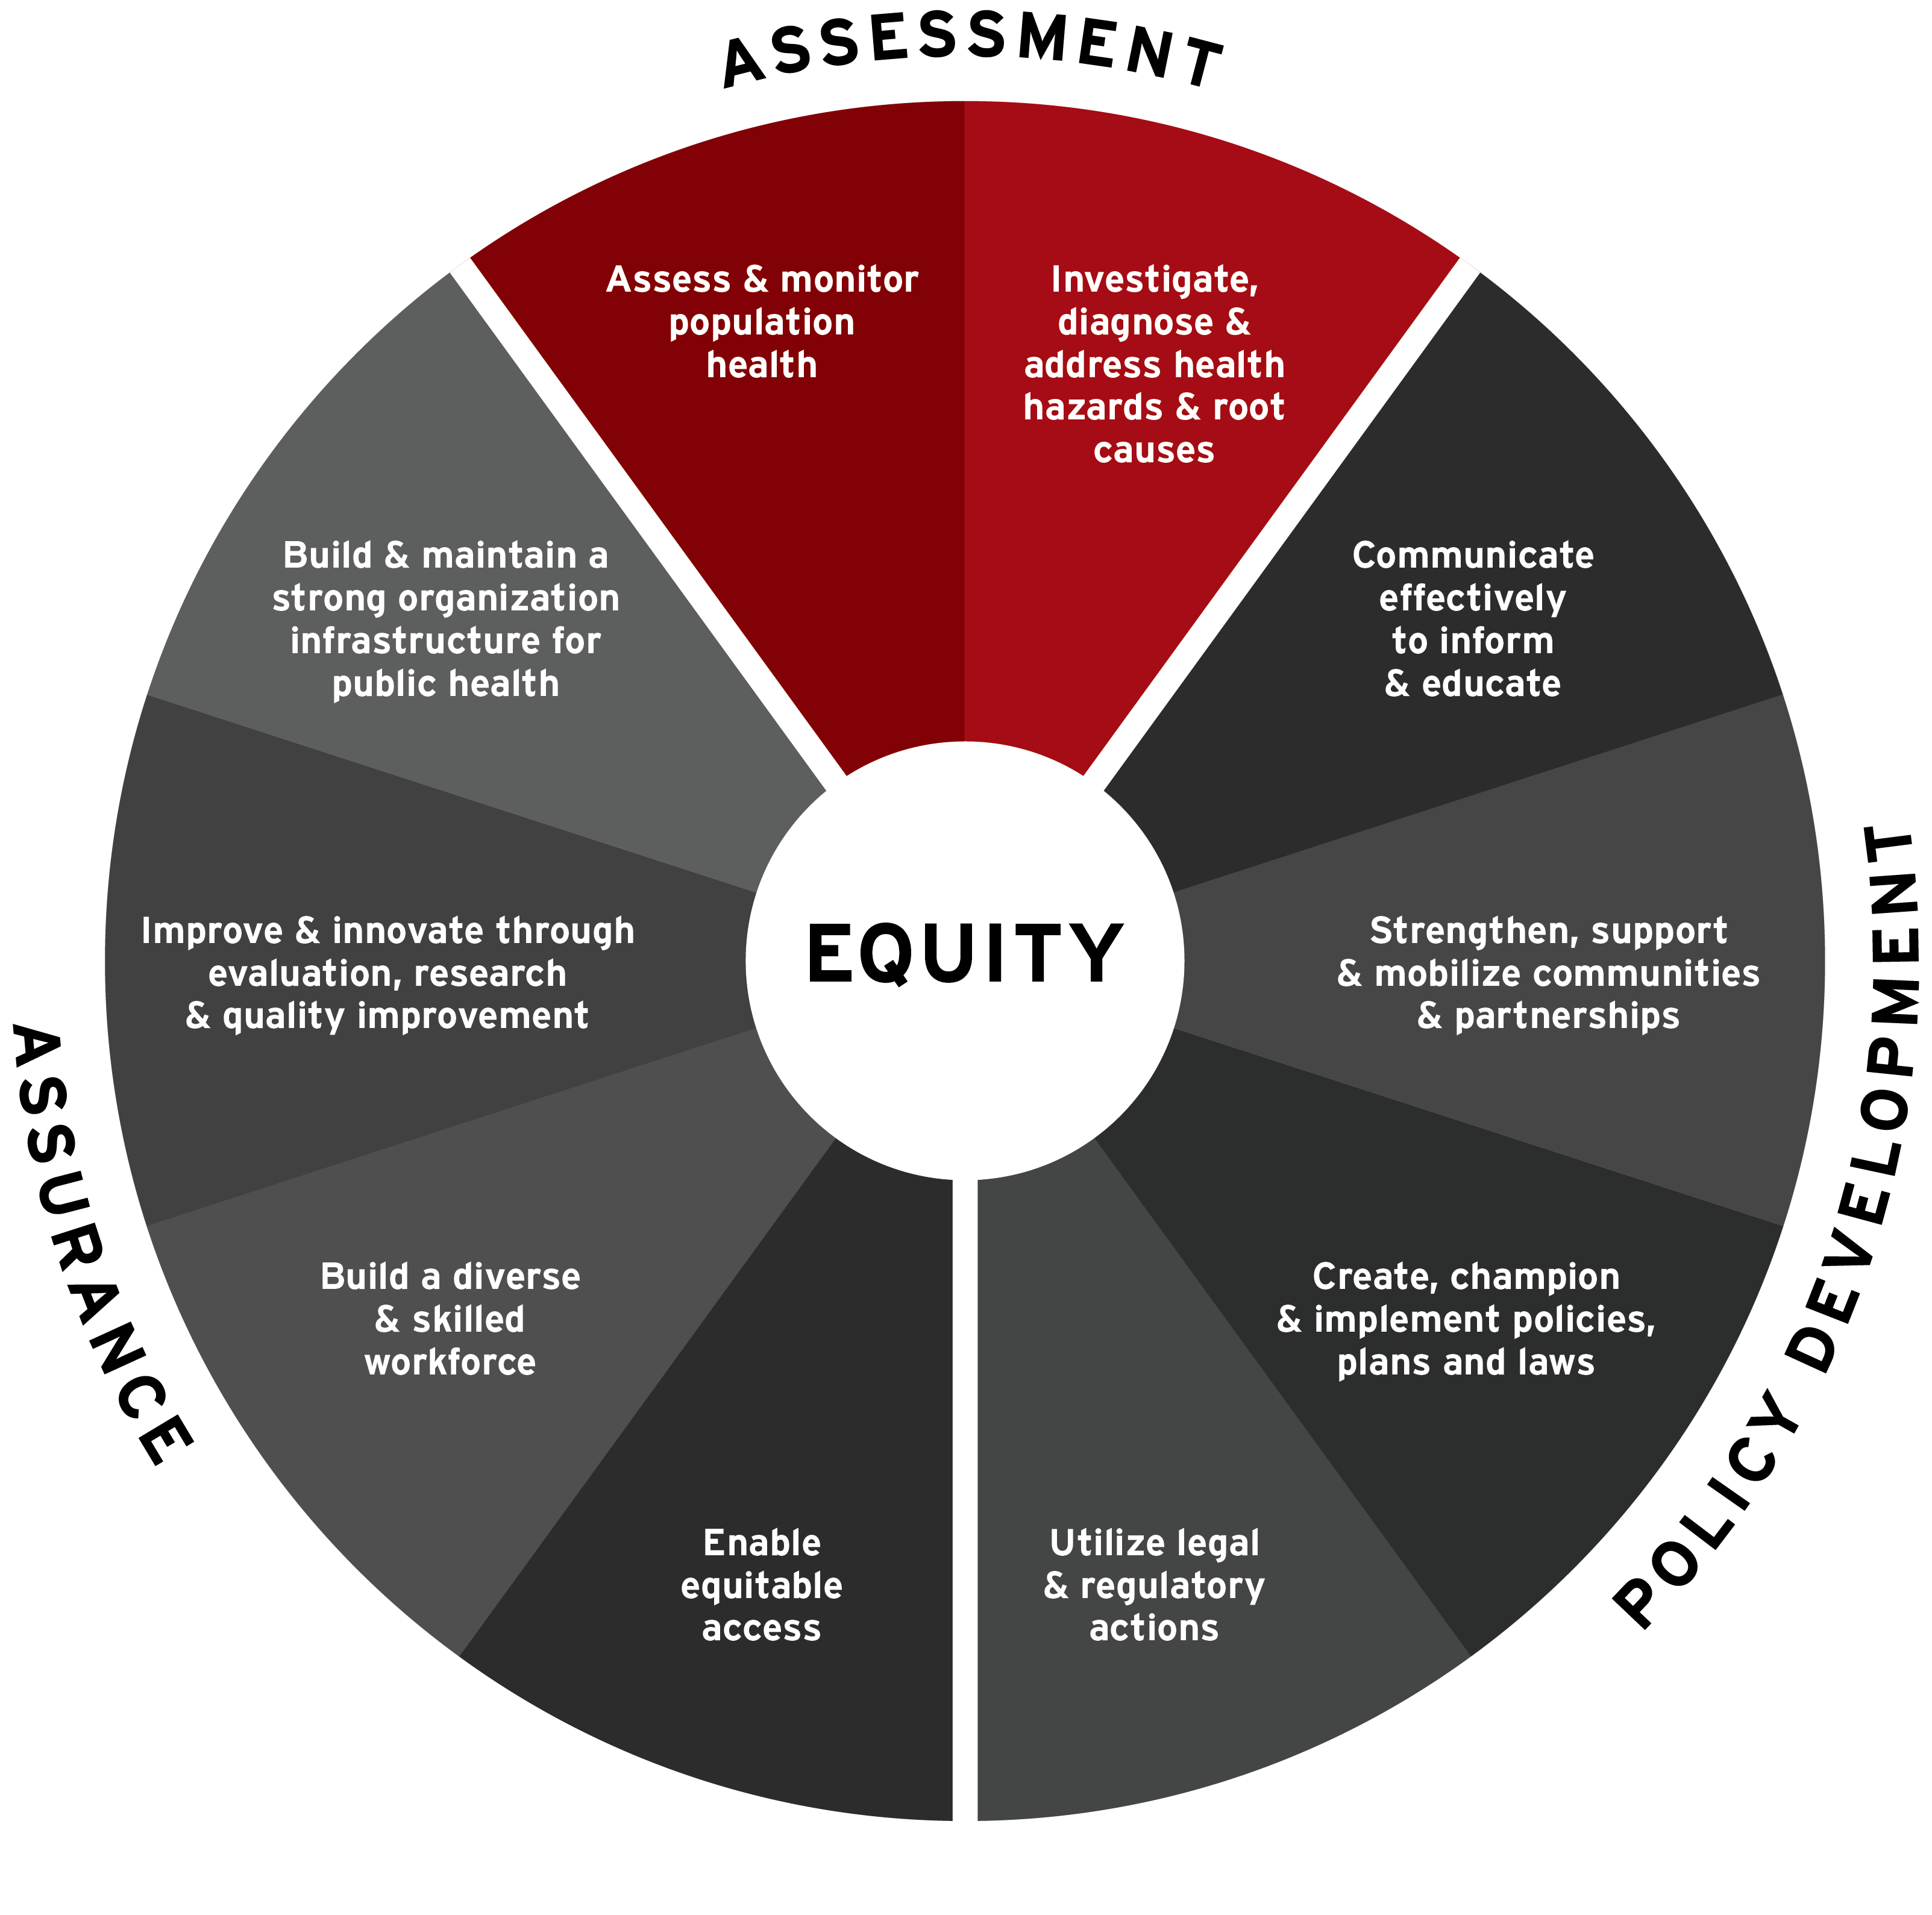
10 Essential Public Health Services:
Assessment

Slide 14
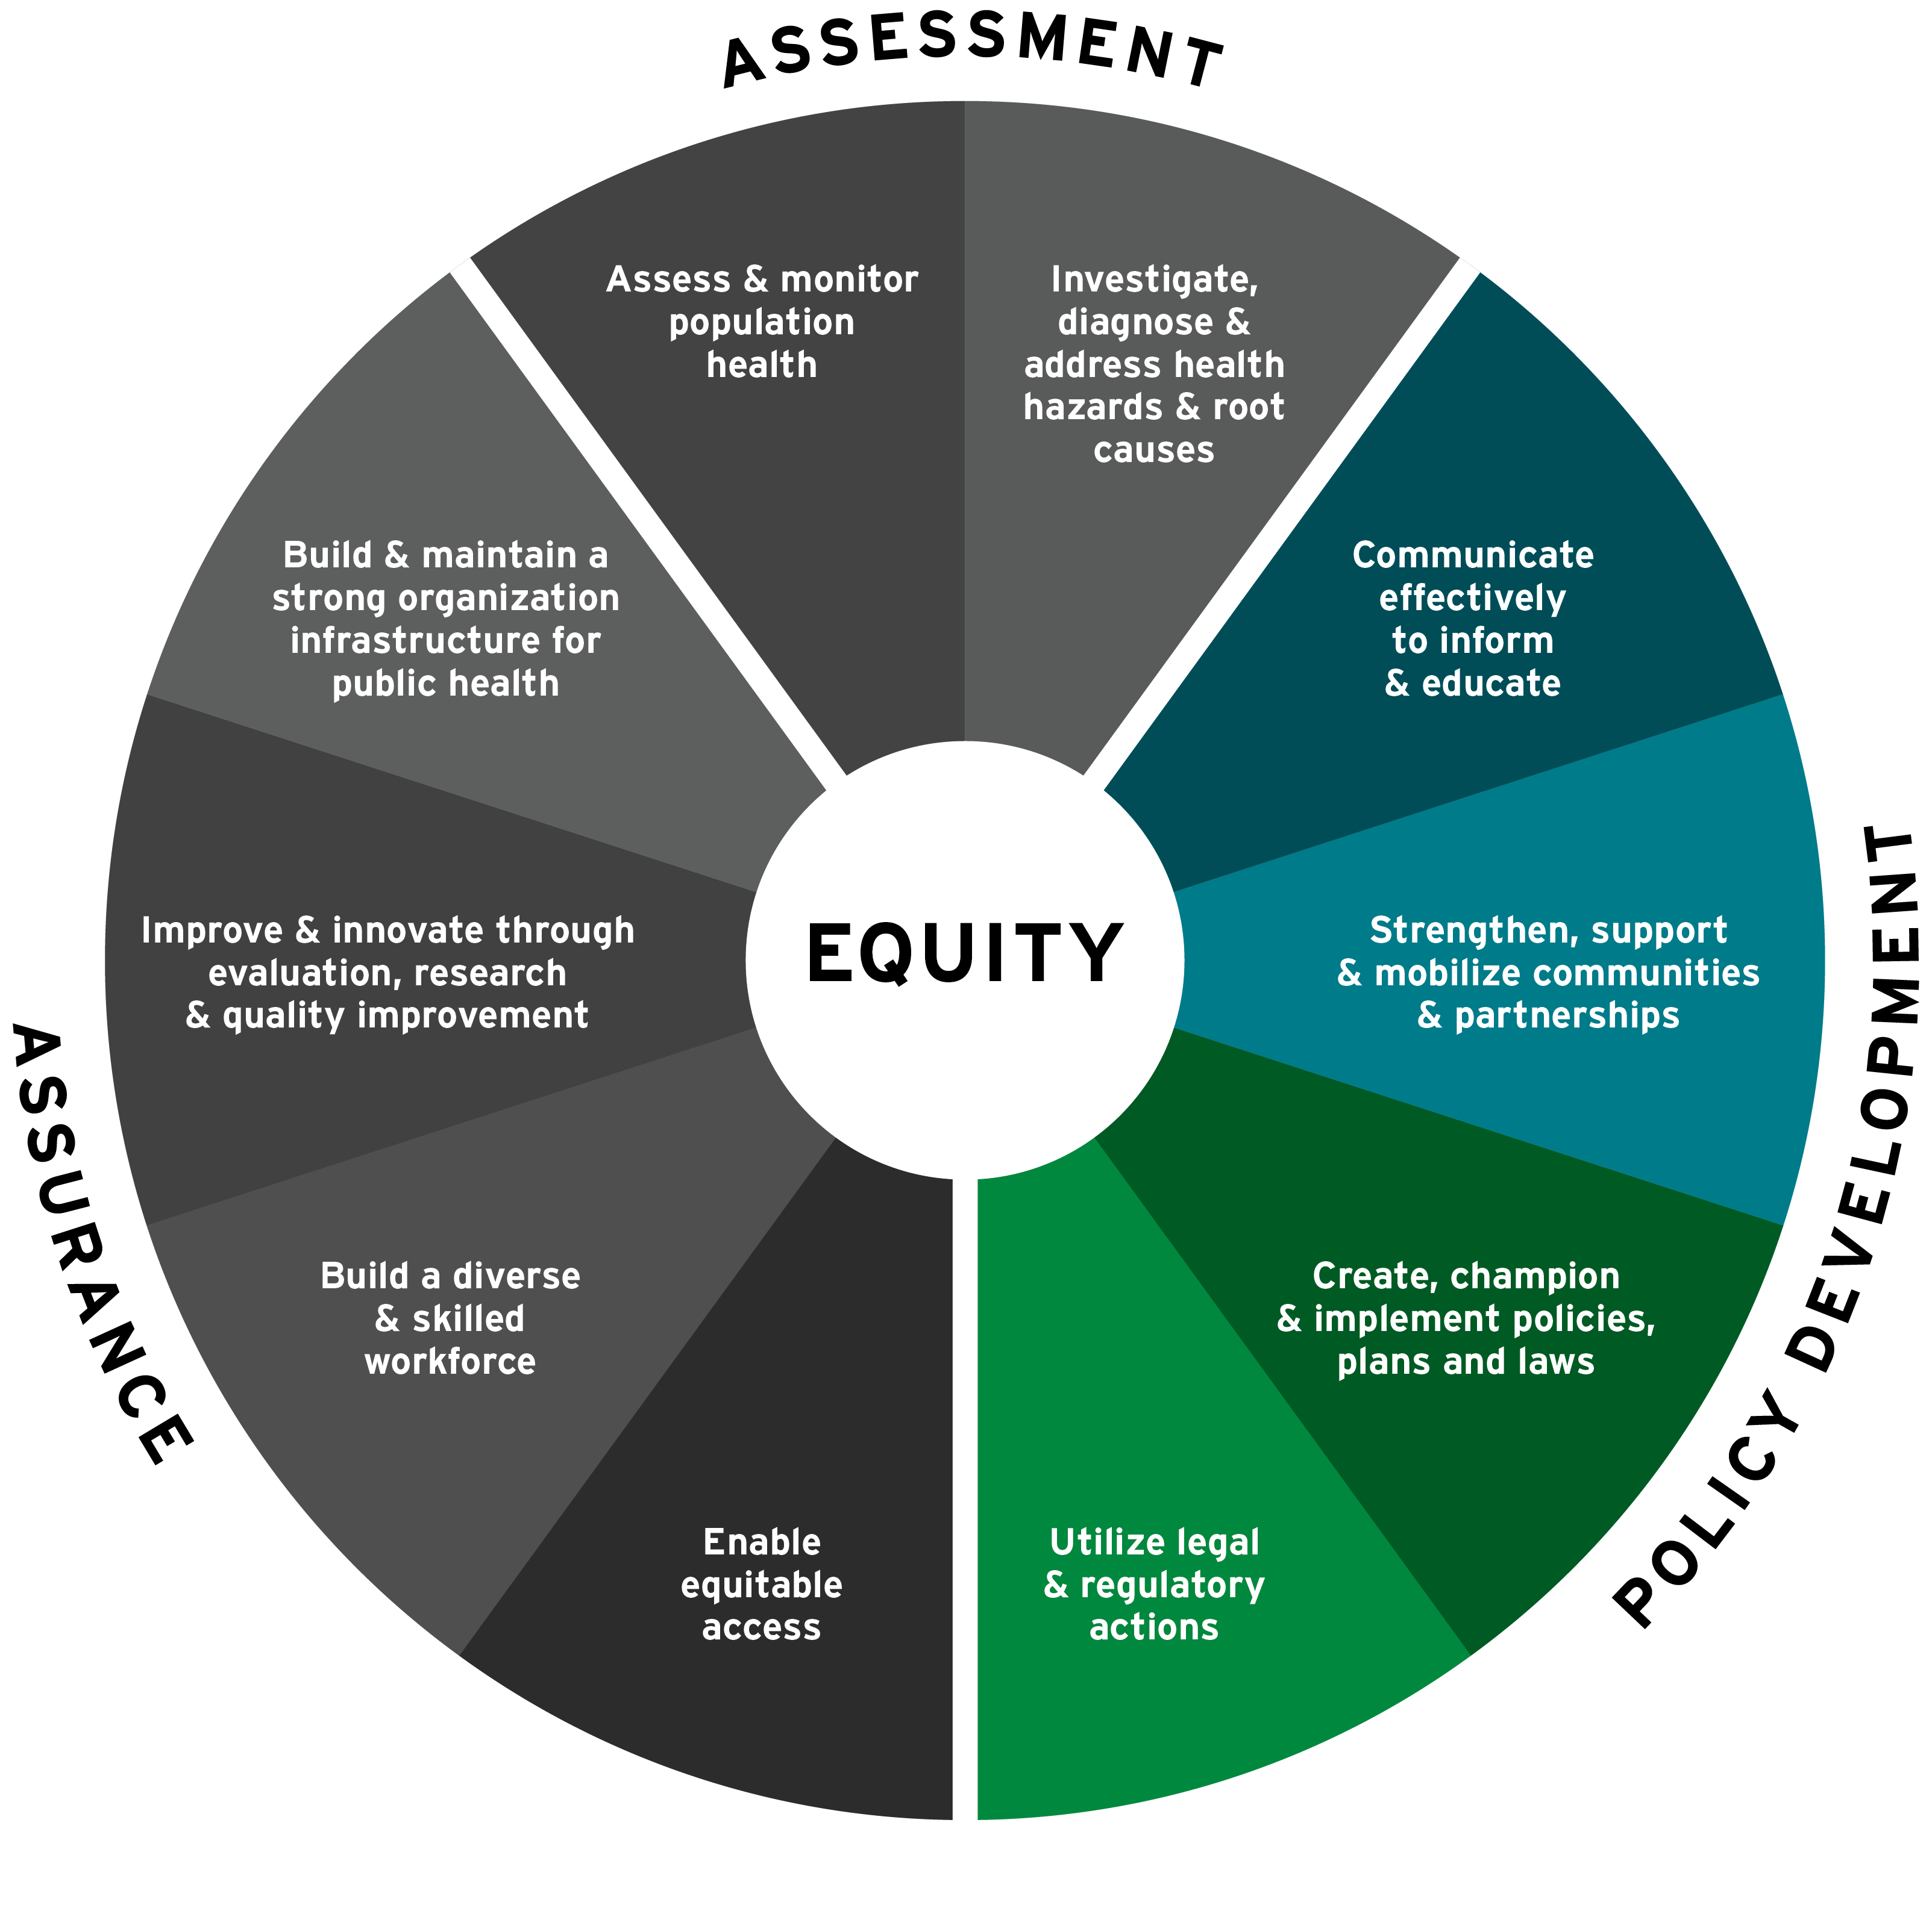
10 Essential Public Health Services:
Policy Development

Slide 15
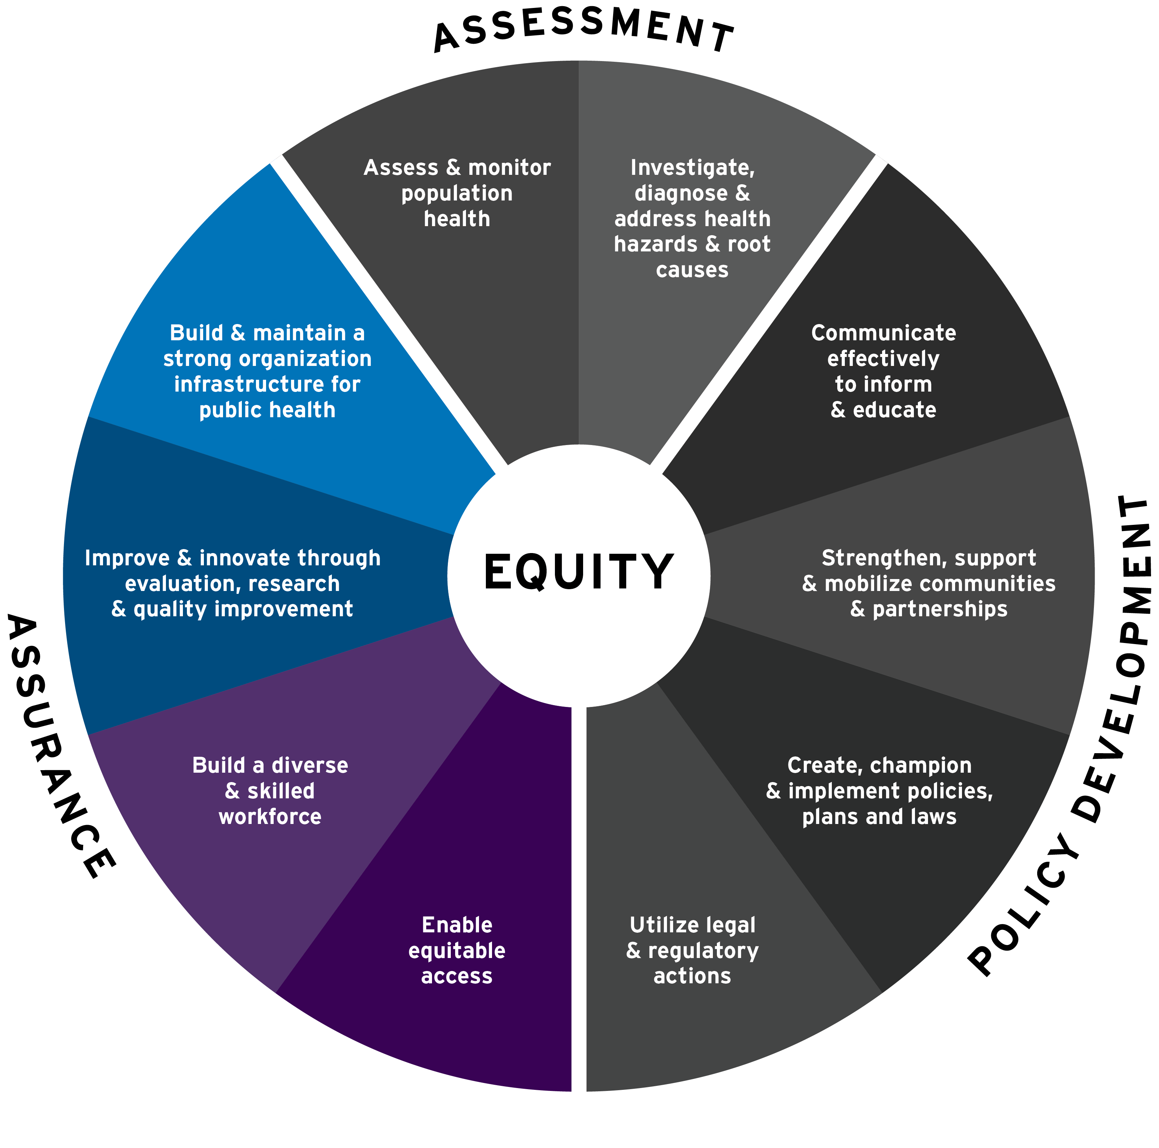
10 Essential Public Health Services:
Assurance

Slide 16
10 Essential Public Health Services:
Equity

Slide 17

Law as a Factor That Affects Health
This map shows life expectancy along a highway in California with multiple freeway exits that illustrate a wide range of life spans, ranging from 75 years to 87 years.
What accounts for these differences across jurisdictions?
Possible factors: laws and policies affecting housing, zoning, smoking, road safety, or clean water

Slide 18
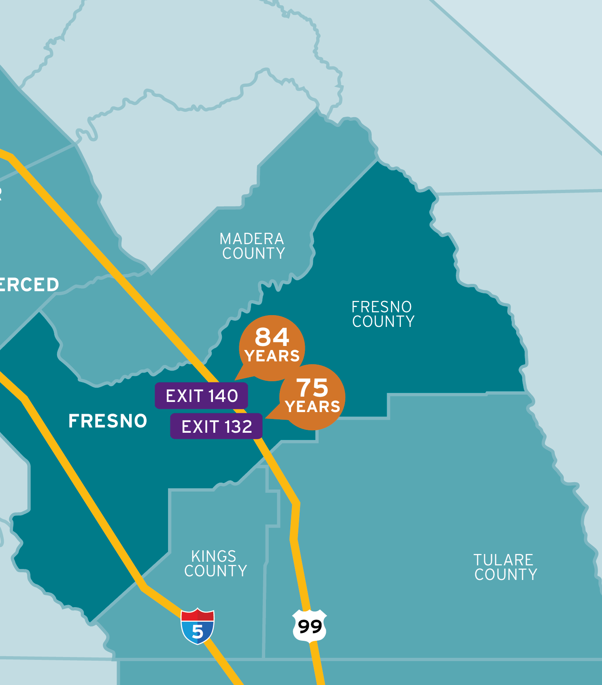
Law as a Factor That Affects Health (Continued)
Stark differences exist within jurisdictions, too.
In Fresno County the life expectancy for residents living off exit 140 is nine years more than residents living off exit 132.
Why?
Possible factors: Historical (e.g. redlining policies), environmental (e.g. air quality), and socioeconomic (e.g. poverty rates or educational disparities)

Slide 19
Quiz 1: True or False?
Individual choices determine our health outcomes far less than we think.
  True
  False

Slide 20
Quiz 1: Answer
Individual choices determine our health outcomes far less than we think.
  True – CORRECT ANSWER
  False

Slide 21
What Do We Mean By
Health Disparities?
Preventable differences in health outcomes

Slide 22
What Do We Mean By
Health Inequity?
“…differences in health that are not only avoidable and unnecessary but, in addition, are considered unjust and unfair [emphasis added].”
—Margaret Whitehead

Slide 23
The Cumulative Health Effects
Weathering: The health effects that result from coping with ongoing social adversity and marginalization
Allostatic load: The physiological cost of chronic, or repeated, exposure to stress, which can stem from adverse childhood experiences (ACEs), intergenerational trauma, or racism.

Slide 24
Example:
Double Jeopardy

Slide 25
What is Health Equity?
“Health equity means that everyone has a fair and just opportunity to be as healthy as possible. This requires removing obstacles to health such as poverty, discrimination, and their consequences. . . . ”
—Paula Braveman

Slide 26
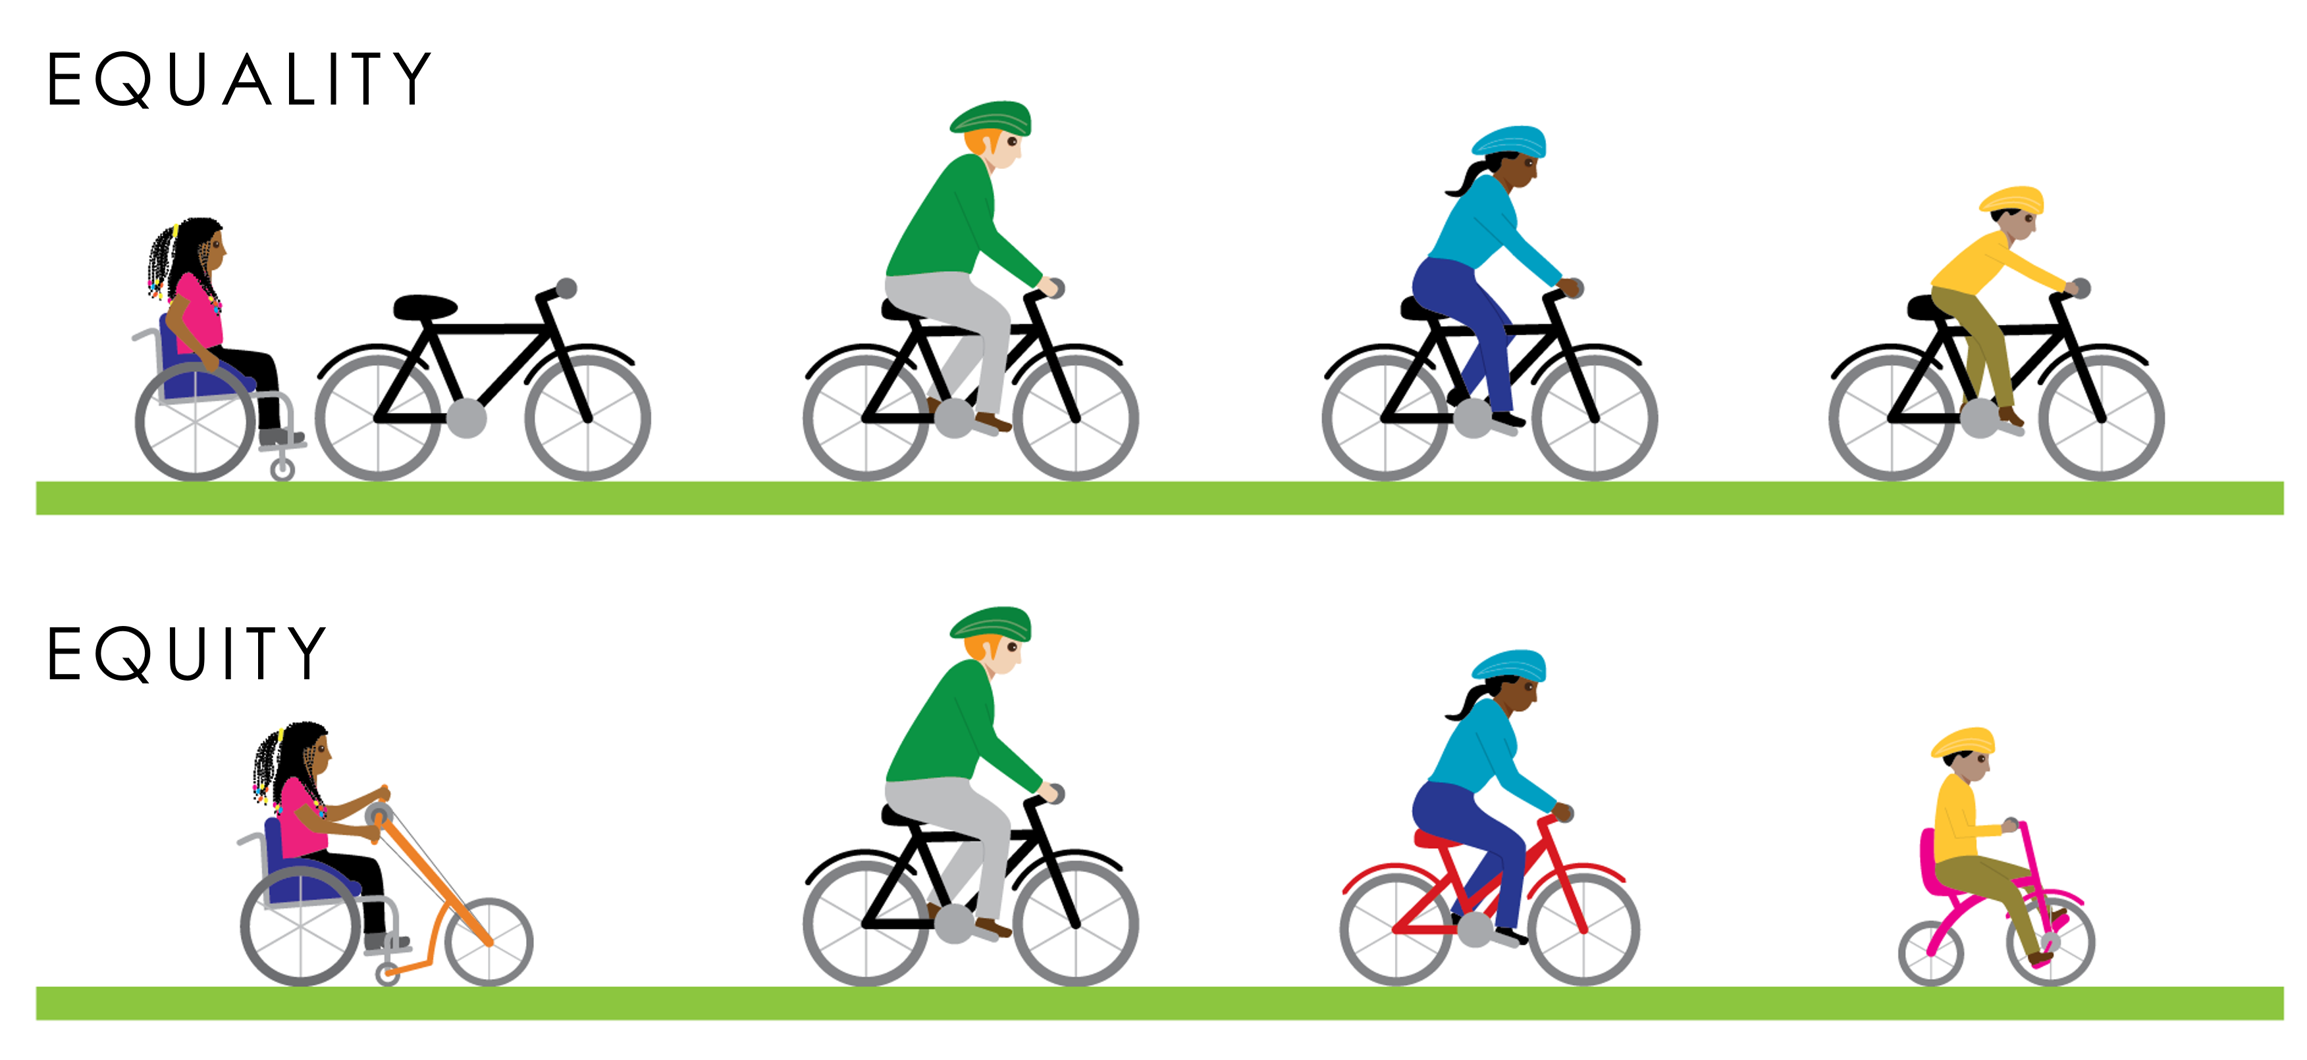
Moving Towards True Equity

Slide 27
Why Do These Definitions Matter?

Slide 28
Quiz 2: True or False?
Adopting an equal approach to health benefits everyone equally.
  True
  False

Slide 29
Quiz 2: Answer
Adopting an equal approach to health benefits everyone equally.
  True
  False – CORRECT ANSWER

Slide 30
Why is Health Equity Important to Public Health Practice?

Slide 31
Pause and Process
Health equity means social justice in health.
Individual choices determine our health outcomes far less than we think.
Law and policy are key determinants of health.
Designing and implementing laws and policies with health equity in mind is vital.

Slide 32
What We’ll Discuss: What History Teaches Us About Structural Discrimination
What is health equity?
What can history teach us about structural discrimination?
How does the law contribute to health inequity?
How can inequities be repaired?

Slide 33
The Role of Law
We’ll use this icon to illustrate how certain laws and policies have influenced health outcomes.

Slide 34
Quiz 3: True or False?
While understanding the legal legacy of structural discrimination is important, it is not directly related to public health practice today.
  True
  False

Slide 35
Quiz 3: Answer
While understanding the legal legacy of structural discrimination is important, it is not directly related to public health practice today.
  True
  False – CORRECT ANSWER

Slide 36
Why is the History Important?
The legacy of unfair and unjust laws and policies is still with us today and contributes to growing health inequity.
The communities that many health departments work with face deep challenges.
Understanding and acknowledging this history is essential to redressing structural discrimination and achieving health equity.

Slide 37
Structural Discrimination
Structural discrimination occurs when systems (rather than individuals) unjustly deny wealth, opportunity, power, or government representation on the basis of characteristics such as race, gender, sexual orientation, social class, and immigration status.

Slide 38
Guiding Questions
Equity practice tip!
Who has been harmed or omitted?
Who stands to benefit, and how?
How can inequity be repaired?

Slide 39
Content Warning
We are about to cover historical events such as:
  the Indian Removal Act of 1830 (and Trail of Tears),
  assimilationist and elimination policies of the 19th and 20th century (including the Boarding School Experiences),
  Jim Crow era laws and violence, as well as other examples.
The content is graphic and intense.
We encourage you to take breaks or step away as needed, and to move through this material at a comfortable pace.

Slide 40
Colonialism and Origins of Structural Discrimination

Slide 41
Indian Removal Act of 1830

Slide 42
Assimilationist Policies of the 19th and 20th Centuries

Slide 43
The Federal Trust Responsibility
“The United States expects all nations to live up to their treaty obligations; it should live up to its own.”
–The United States Commission on Civil Rights, 2018

Slide 44
Boarding School Experiences

Slide 45
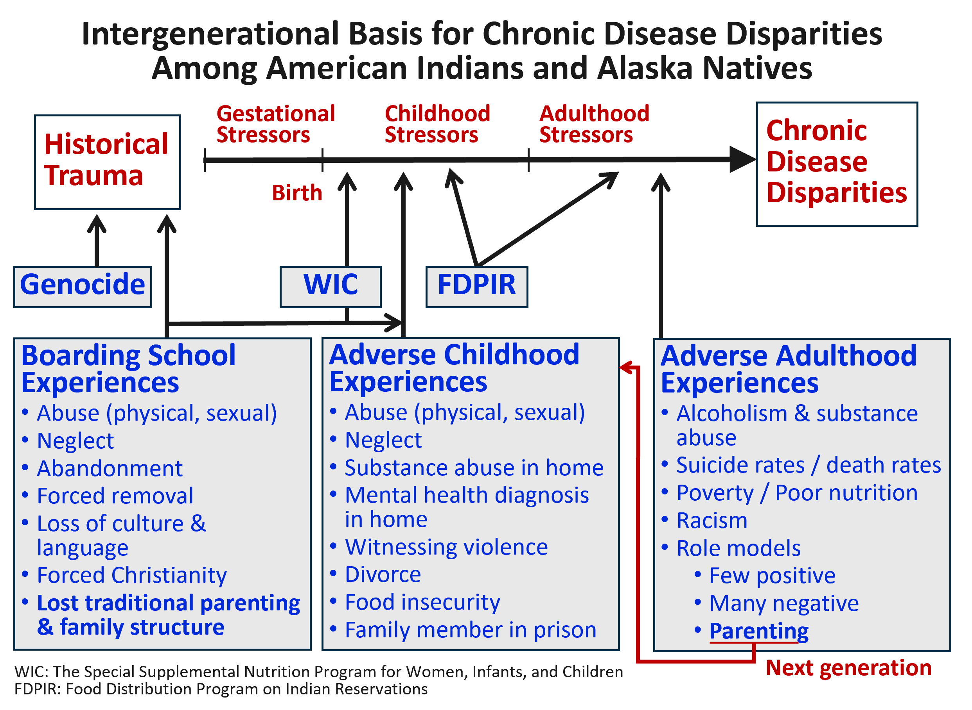
Intergenerational Trauma
This model shows how intergenerational trauma has contributed to the chronic disease inequity among American Indian and Alaska Native communities today.
Source: Warne D. and Lajimodiere D. (2015)

Slide 46
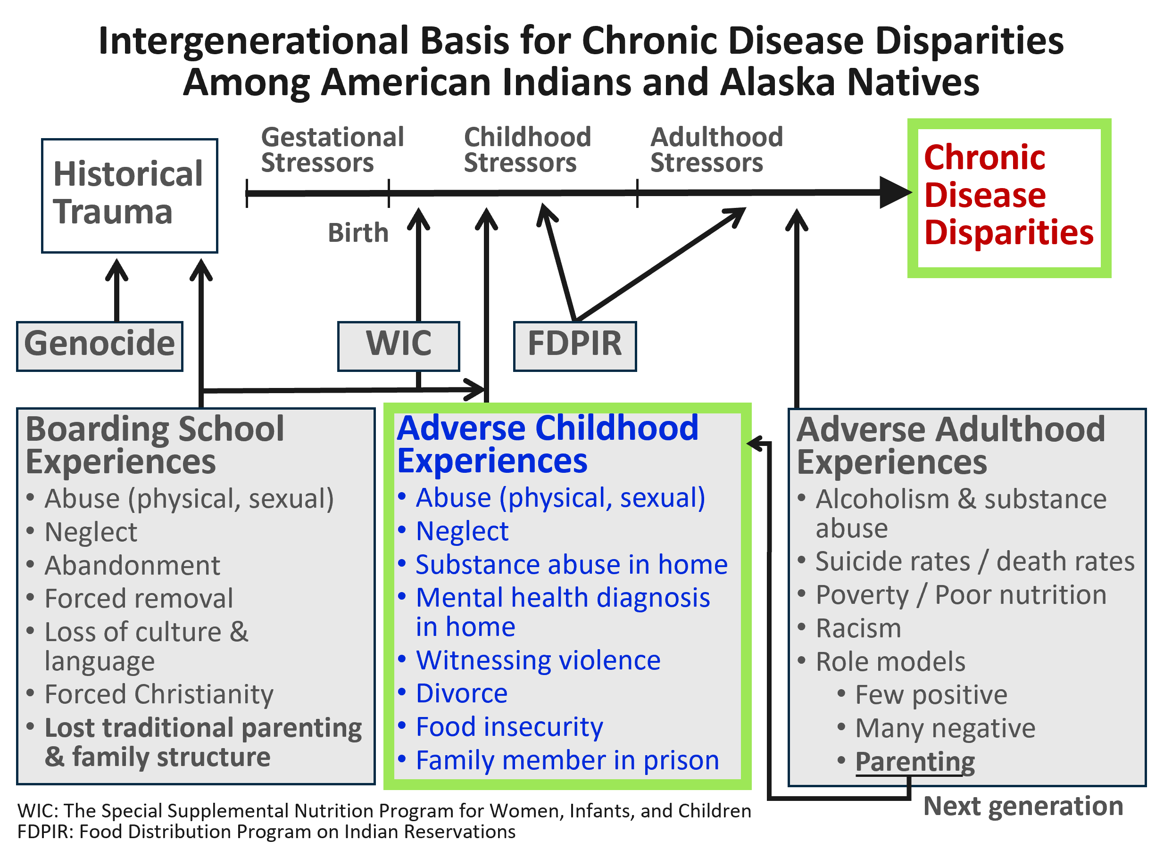
Adverse Childhood Experiences
Poor mental health outcomes — including adverse childhood experiences — are a strong predictor of risk for numerous chronic and behavioral health conditions, including heart disease, diabetes, cancer, depression, suicide attempts, and tobacco use.
Source: Warne D. and Lajimodiere D. (2015)

Slide 47
Education as a Social Determinant of Health

Slide 48
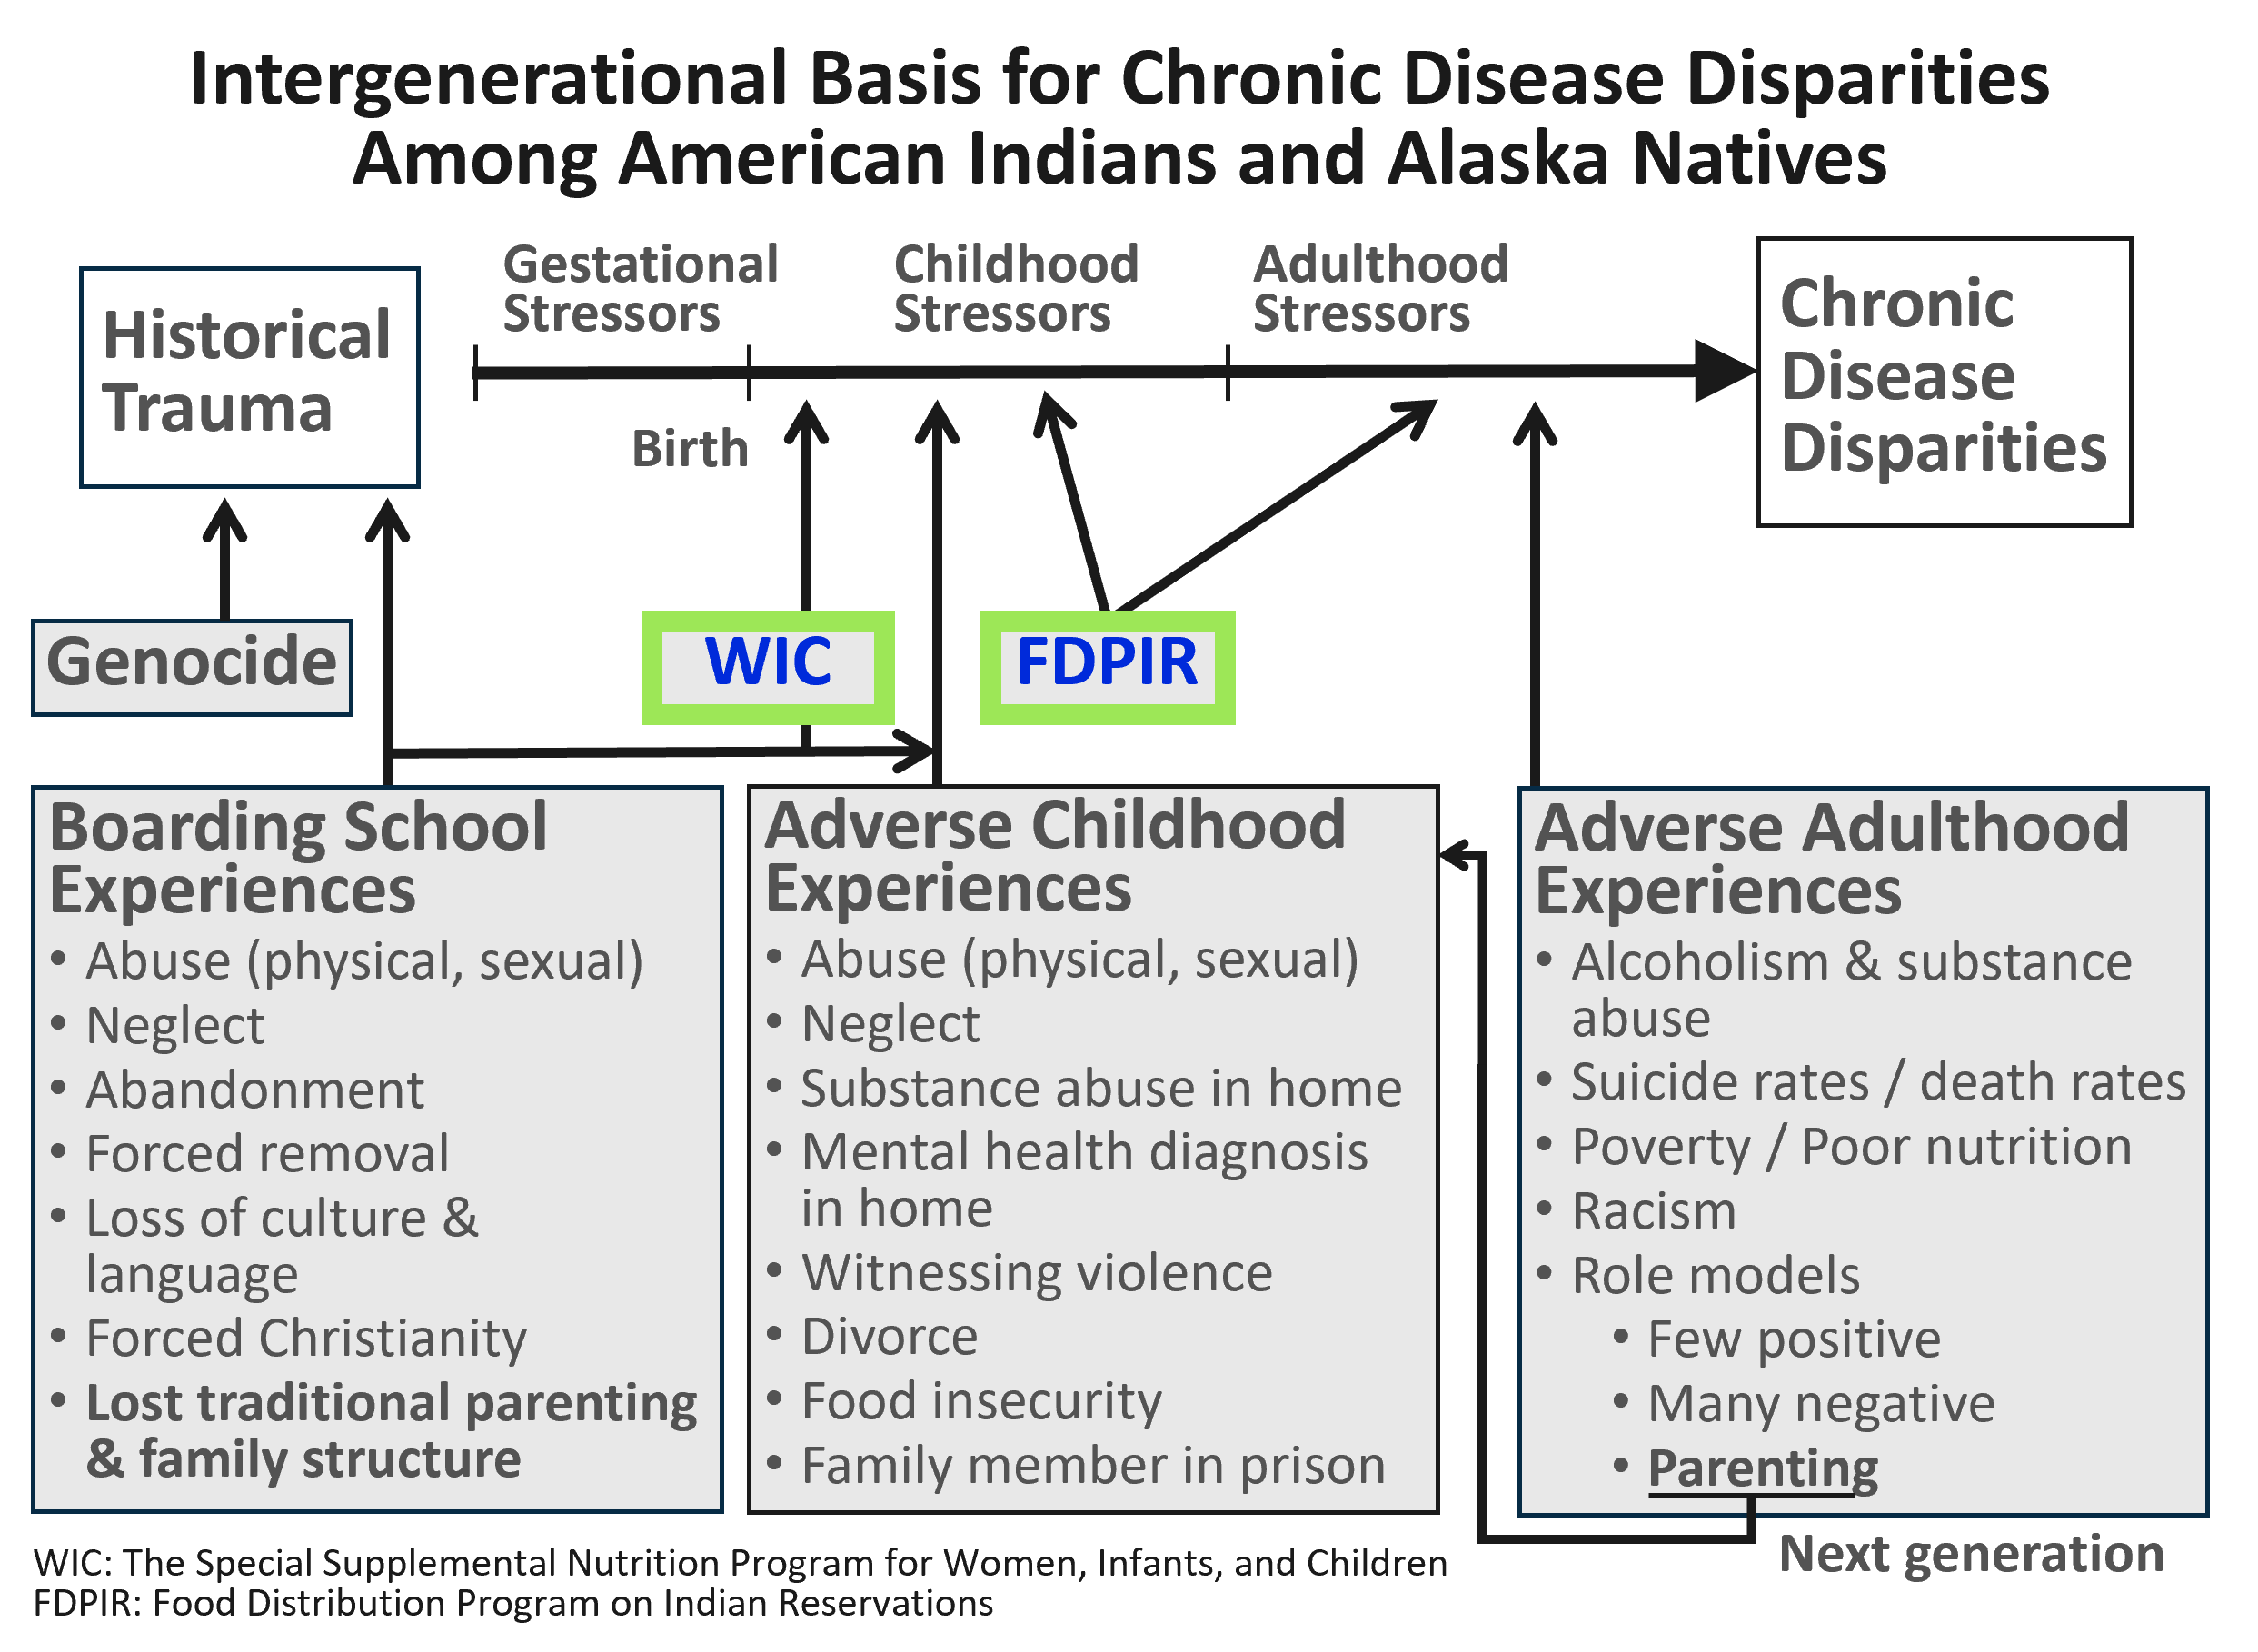
Food Policies and Chronic Disease
Genocide, land displacement, and continually broken promises from the US government have forced many American Indian communities and people into poverty.
This has led to increased dependence on federal food programs, which historically has not offered healthy food choices.
Researchers believe the poor food choices contributed to the rise of chronic disease and mortality rates among American Indian populations.
Source: Warne D. and Lajimodiere D. (2015)

Slide 49
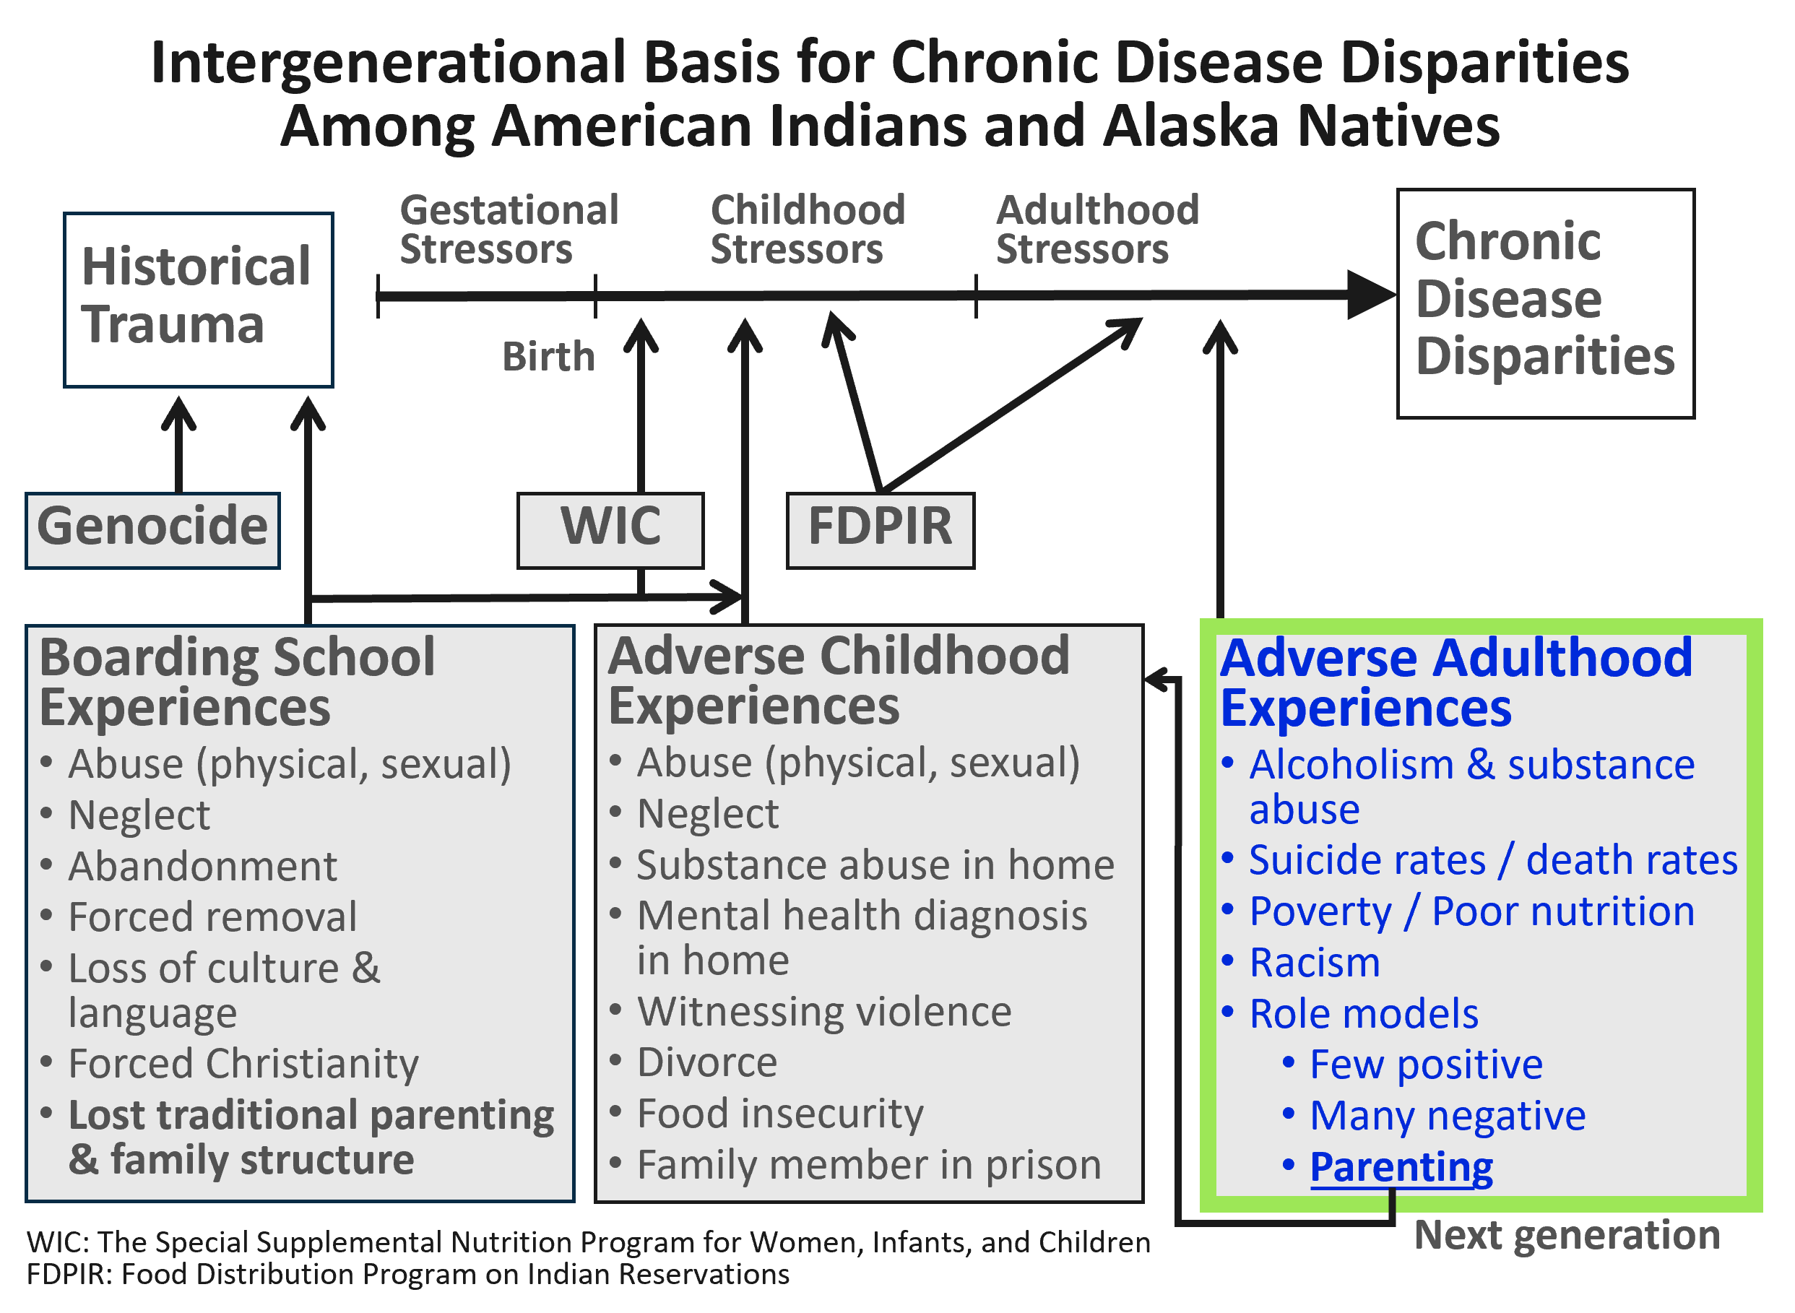
Adverse Adulthood Experiences
Adverse childhood experiences are strongly linked to adverse adulthood experiences.
98% of people incarcerated in US prisons experienced at least one adverse childhood experience (ACE).
This and adverse adult experiences lead to poor health outcomes.
These social circumstances also weaken the social fabric of families, leading to continued intergenerational health inequity.
Source: Warne D. and Lajimodiere D. (2015)

Slide 50
1619 and the Origins of Slavery

Slide 51
Reconstruction Era Laws (1865–1877)
1865
End of the Civil War and adoption of the 13th Amendment abolishing slavery and involuntary servitude except for those convicted of a crime.
1870
Adoption of the 15th Amendment prohibiting any state from depriving a male citizen of his vote because of race, color, or previous condition of servitude.
  1866
  The Civil Rights Act of 1866 prohibiting not only legal bondage but any “badge or servitude.”

Slide 52
Reconstruction Era Laws (1865–1877) (continued)
“We are not prodded to contemplate what it means
to achieve freedom without a home to live in, without food to eat, a bed to sleep on, clothes for your children or money to buy any of it.”
—Nikole Hannah-Jones

Slide 53
Homestead Act (1862)
Under the Homestead Act of 1862, more than 1.5 million white families received a total of 246 acres of land – approximately 10% of all the land in the US – for free.

Slide 54
Throughout the 1900s:
Government-sanctioned
Violence and Theft

Slide 55
Jim Crow Laws (1877–1950s)

Slide 56
Violence and Segregation in the South Led to the Great Migration
(1916–1970)

Slide 57
Racial Zoning Codes in the North

Slide 58
The Role of Public Health
Just as public health played an essential role in the housing policy of the 19th and 20th centuries, it needs to play an essential role today.

Slide 59
Weaponization of Public Health
Example:
Los Angeles, California
Late 19th–early 20th century

Slide 60
Buchanan v. Warley (1917)
RULING
REALITY
Supreme Court struck down explicitly race-based zoning as unconstitutional
Localities continued to create new ways to perpetuate residential segregation

Slide 61
Racial Covenants
“No property… shall at any time be sold, conveyed, rented, or leased in whole or in part to any person or persons not of the White or Caucasian race.”
—Protective Restrictions, Hugh Russell Realty Company (1941)

Slide 62
Residential Segregation
At the same time, the federal government was implementing New Deal loan programs, which fueled residential segregation and furthered structural discrimination in northern cities.

Slide 63
The Federal Housing Administration and Redlining

Slide 64
The End of World War II and the GI Bill

Slide 65
The Civil Rights Movement

Slide 66
Kerner Commission Final Report (1967)
“Segregation and poverty have created in the racial ghetto a destructive environment totally unknown to most white Americans.”
“.…white society is deeply implicated in the ghetto. White institutions created it, white institutions maintain it, and white society condones it.”
“This is our basic conclusion: Our nation is moving toward two societies, one black, one white — separate and unequal.”

Slide 67
Fair Housing Act of 1968

Slide 68
From 1960s to Today
Many social, economic, and health inequity still look the same today.
Black, indigenous, and people of color continue to face discrimination, social exclusion, poverty, disenfranchisement, structural violence, and inequity in opportunities for education, jobs, and housing.
This continued inequity was illuminated by the COVID-19 pandemic, which disproportionately killed and sickened people of color.

Slide 69
Quiz 4: True or False?
The legacy of unfair and unjust laws and policies is still with us today and contributes to growing health inequity.
  True
  False

Slide 70
Quiz 4: Answer
The legacy of unfair and unjust laws and policies is still with us today and contributes to growing health inequity.
  True – CORRECT ANSWER
  False

Slide 71
Quiz 5: Multiple Choice
Which of the following are examples of structural discrimination?
  Indian Boarding Schools
  Jim Crow Laws
  New Deal Loan Programs
  A and B
  A, B, and C

Slide 72
Quiz 5: Answer
Which of the following are examples of structural discrimination?
  Indian Boarding Schools
  Jim Crow Laws
  New Deal Loan Programs
  A and B
  A, B, and C – CORRECT ANSWER

Slide 73
Pause and Process: Review
Structural discrimination in our laws is pervasive throughout our history.
What have seemed like legal “wins” on their face have not been enough to stop other forms of structural discrimination in our laws to take shape.
Our history reveals that we live in a vastly unfair — yet legal — system that has benefited white Americans for generations at the cost of oppressing communities of color.

Slide 74
What We’ll Discuss: How the Law Contributes to Health Inequity
What is health equity?
What can history teach us about structural discrimination?
How does the law contribute to health inequity?
How can inequities be repaired?

Slide 75
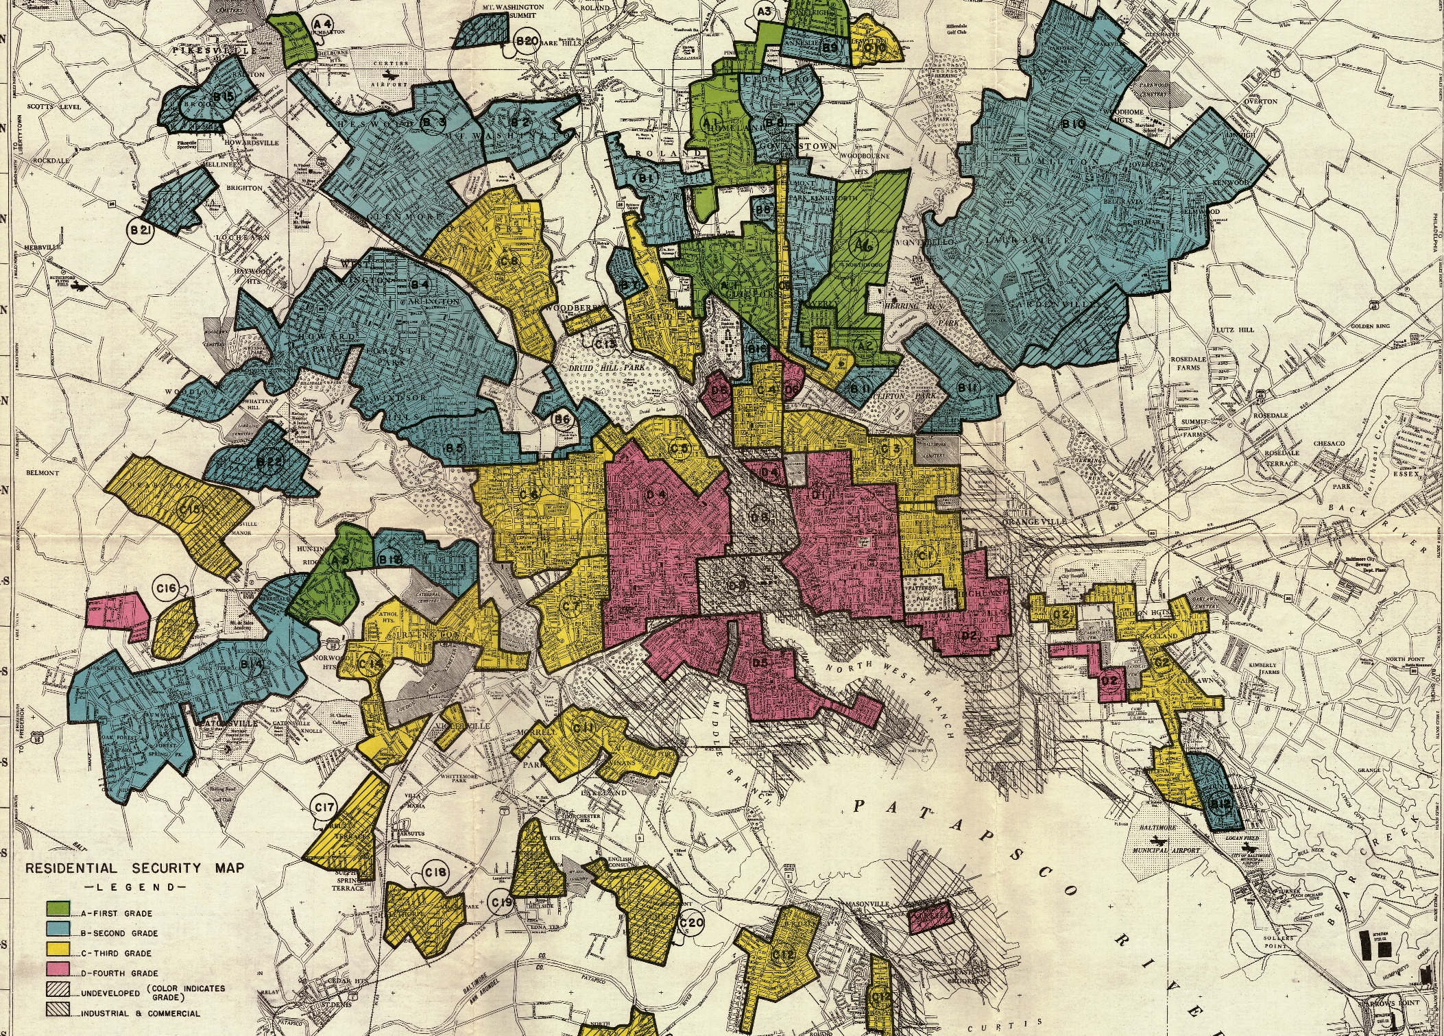
Baltimore Case Study:
Structural Discrimination

Slide 76
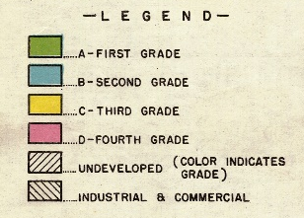
Redlining Maps

Slide 77
Policy-Driven Disinvestment

Slide 78
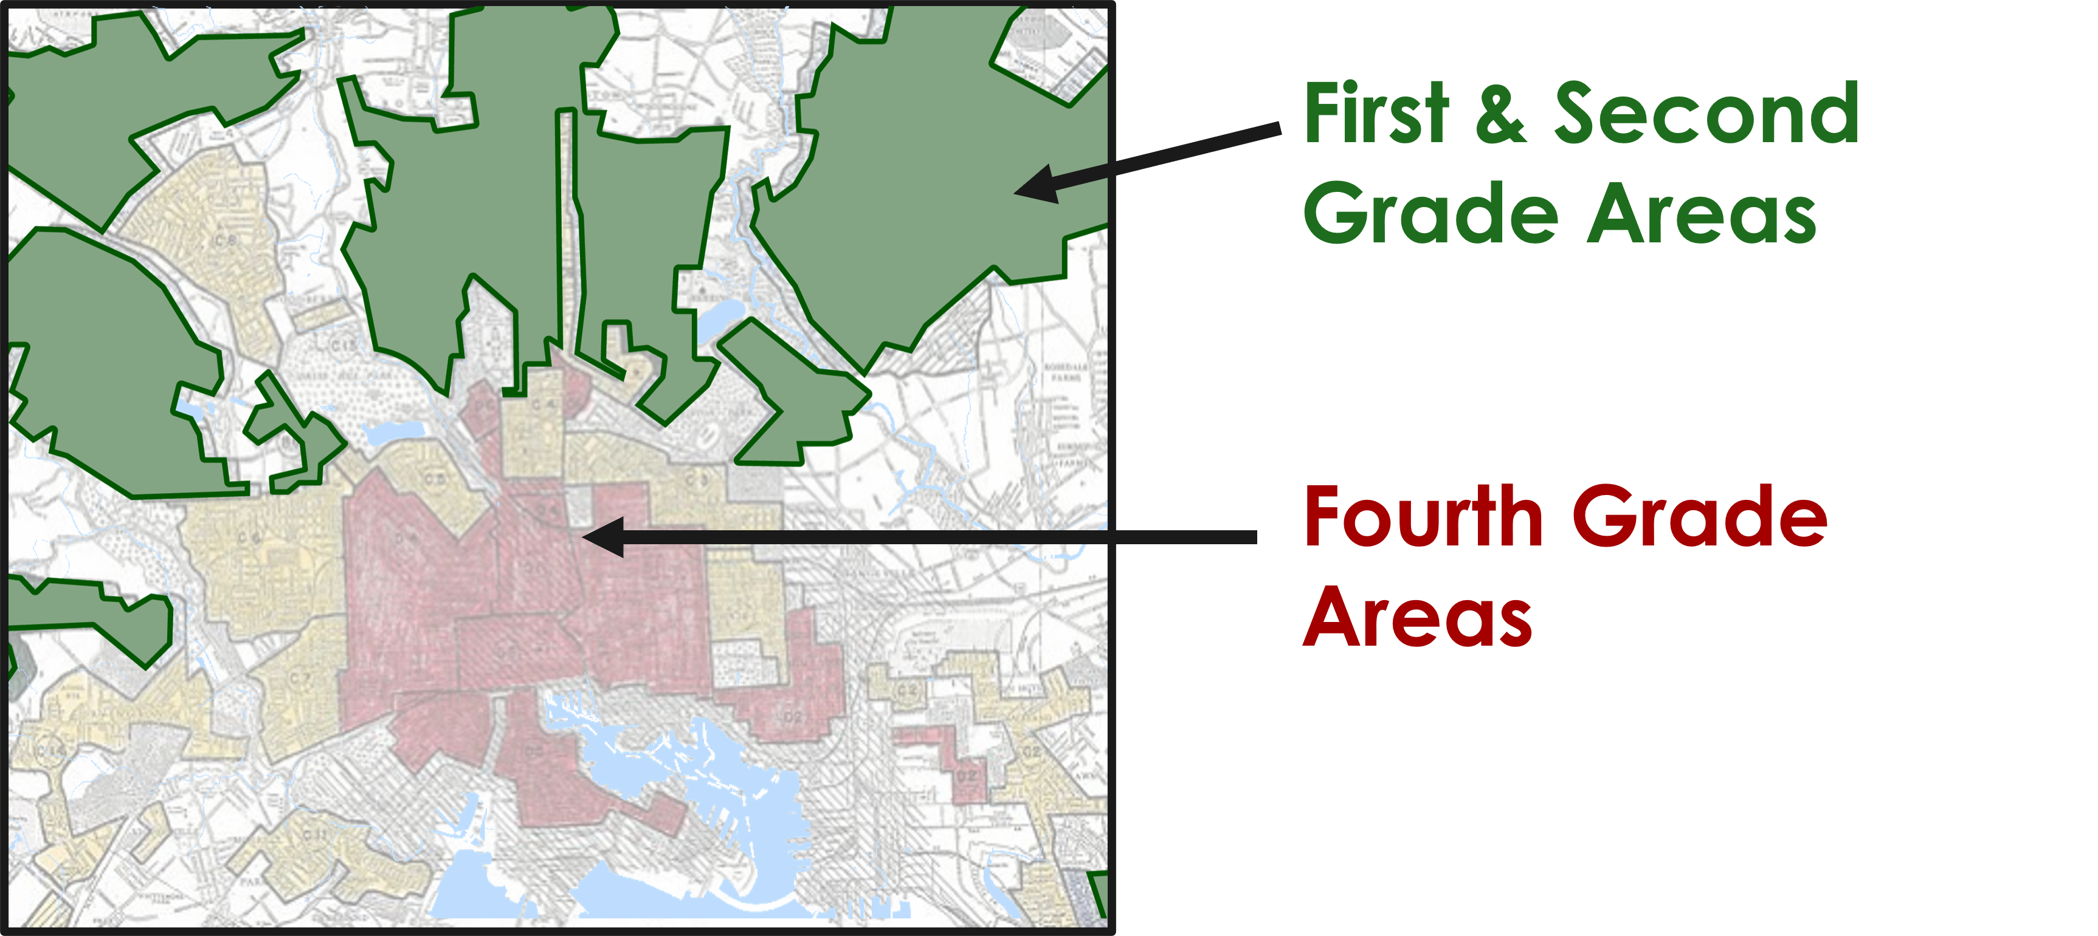
Desirable versus Declining Areas

Slide 79
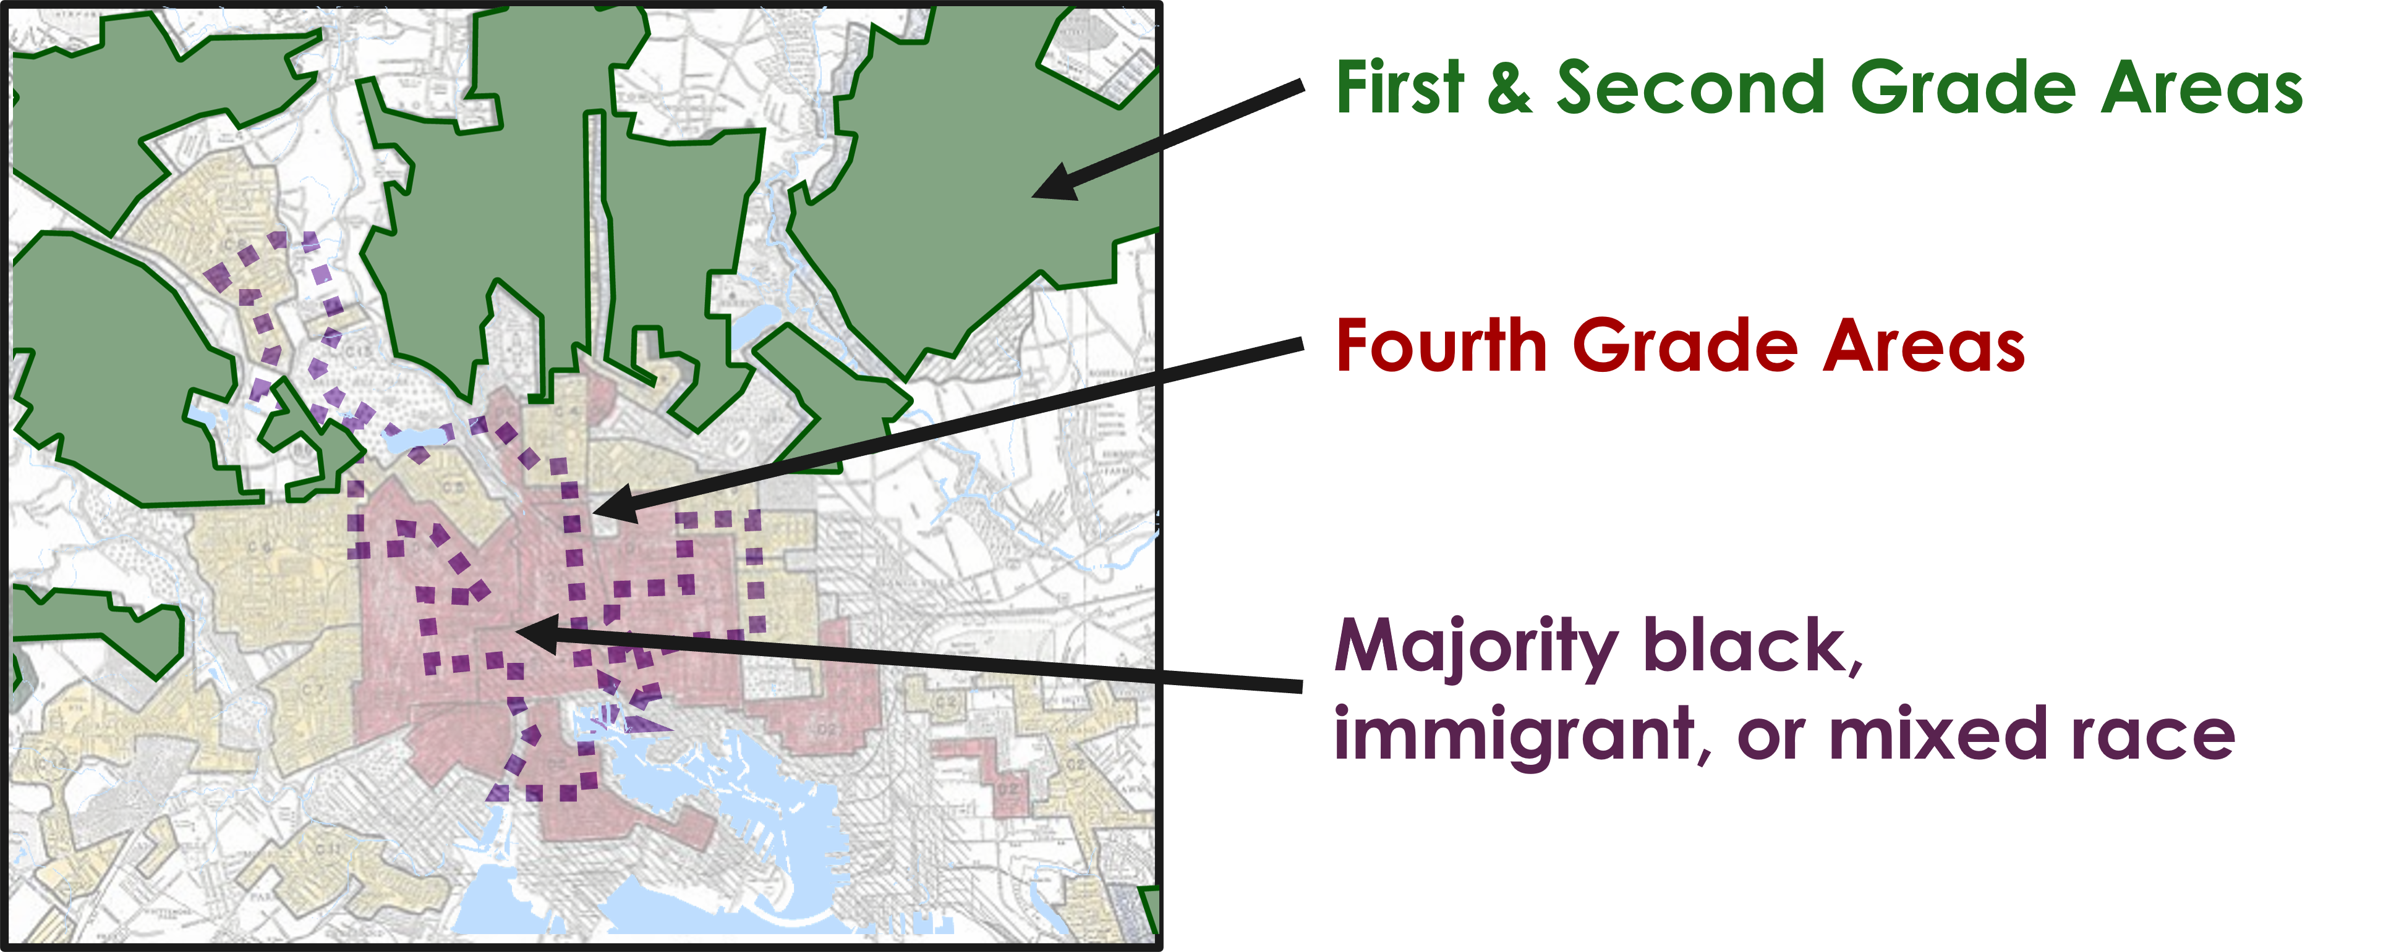
Discrimination

Slide 80
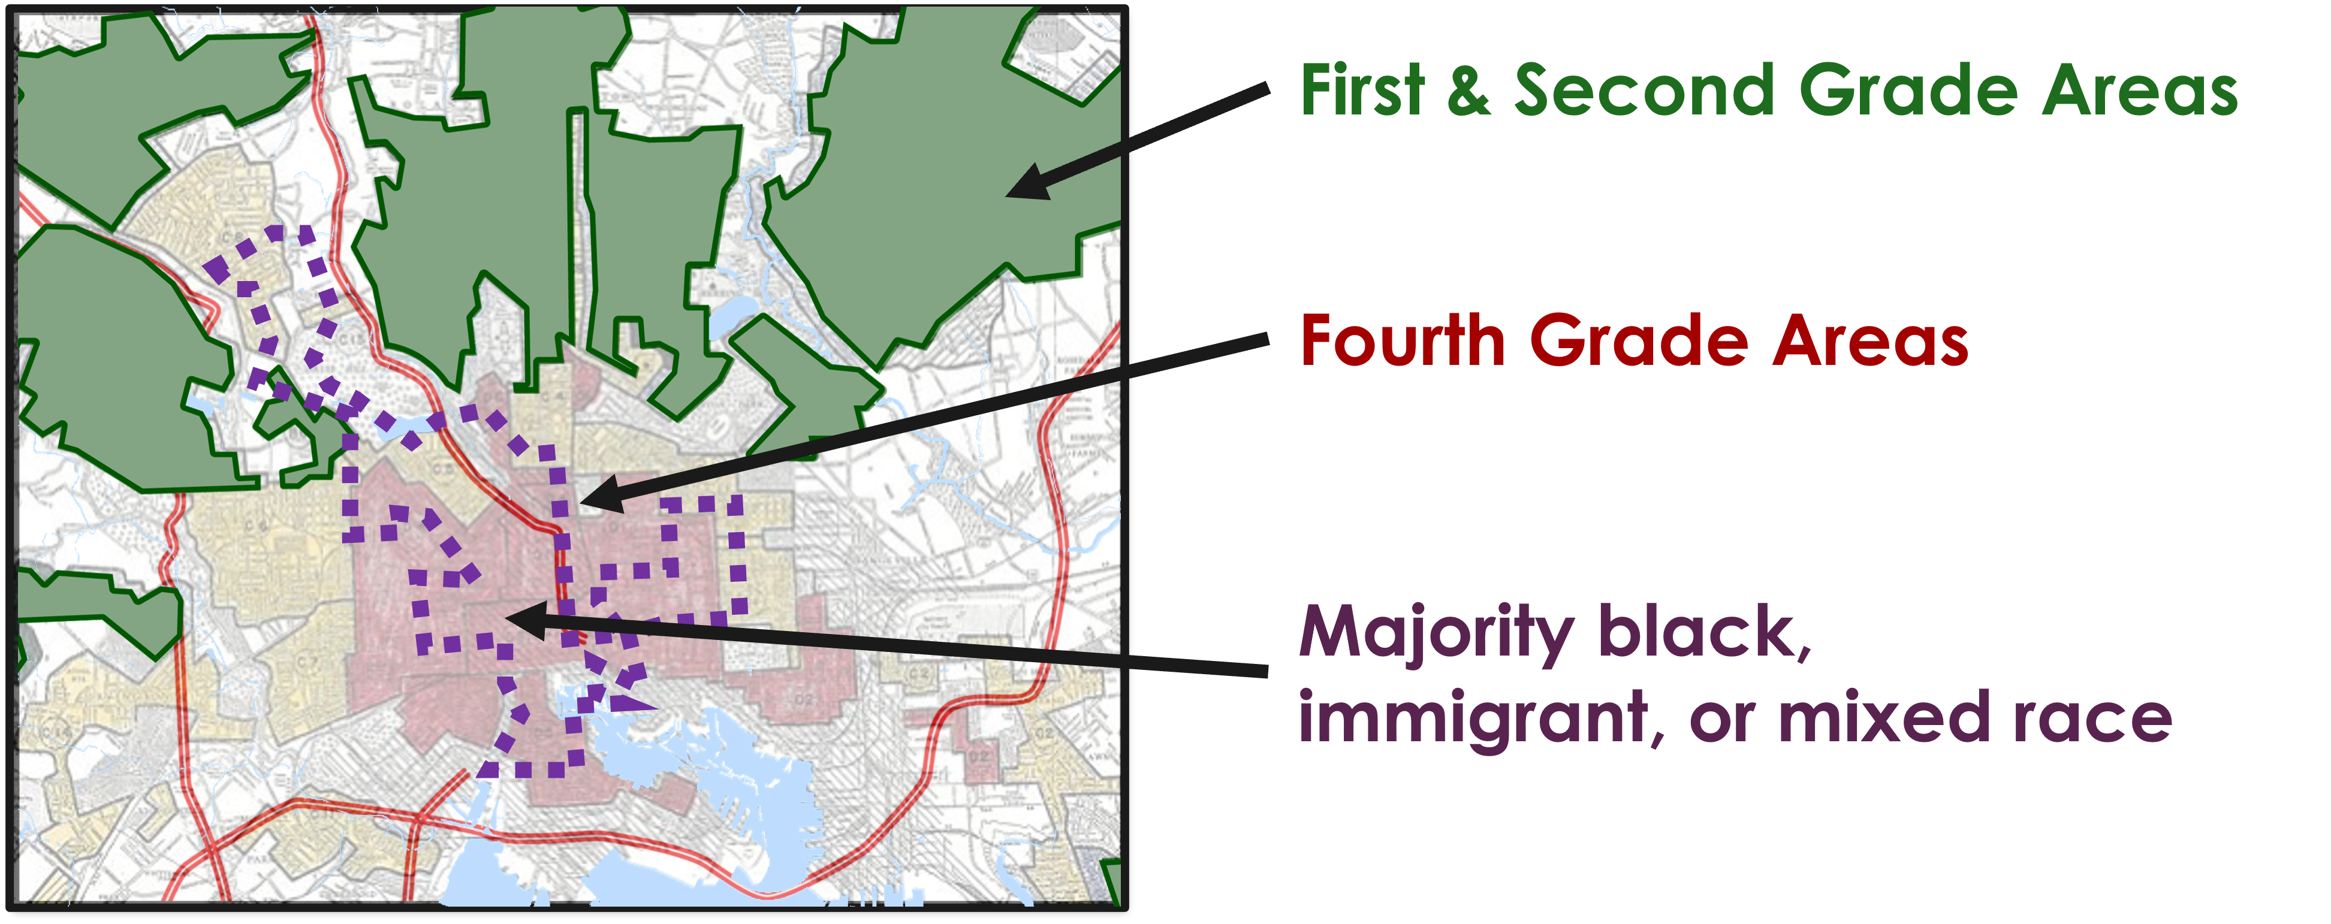
Highway Development

Slide 81
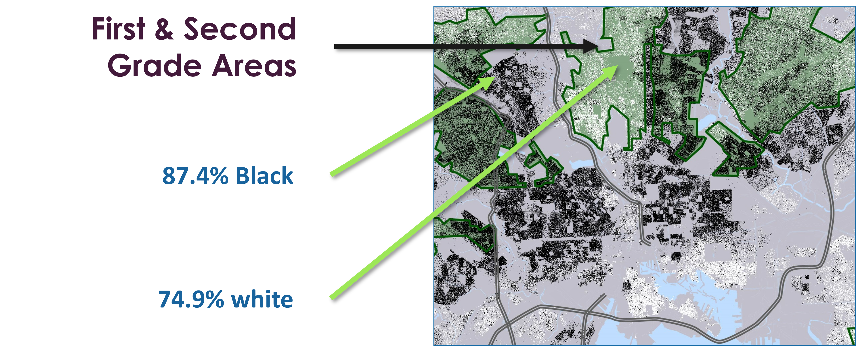
Segregation

Slide 82
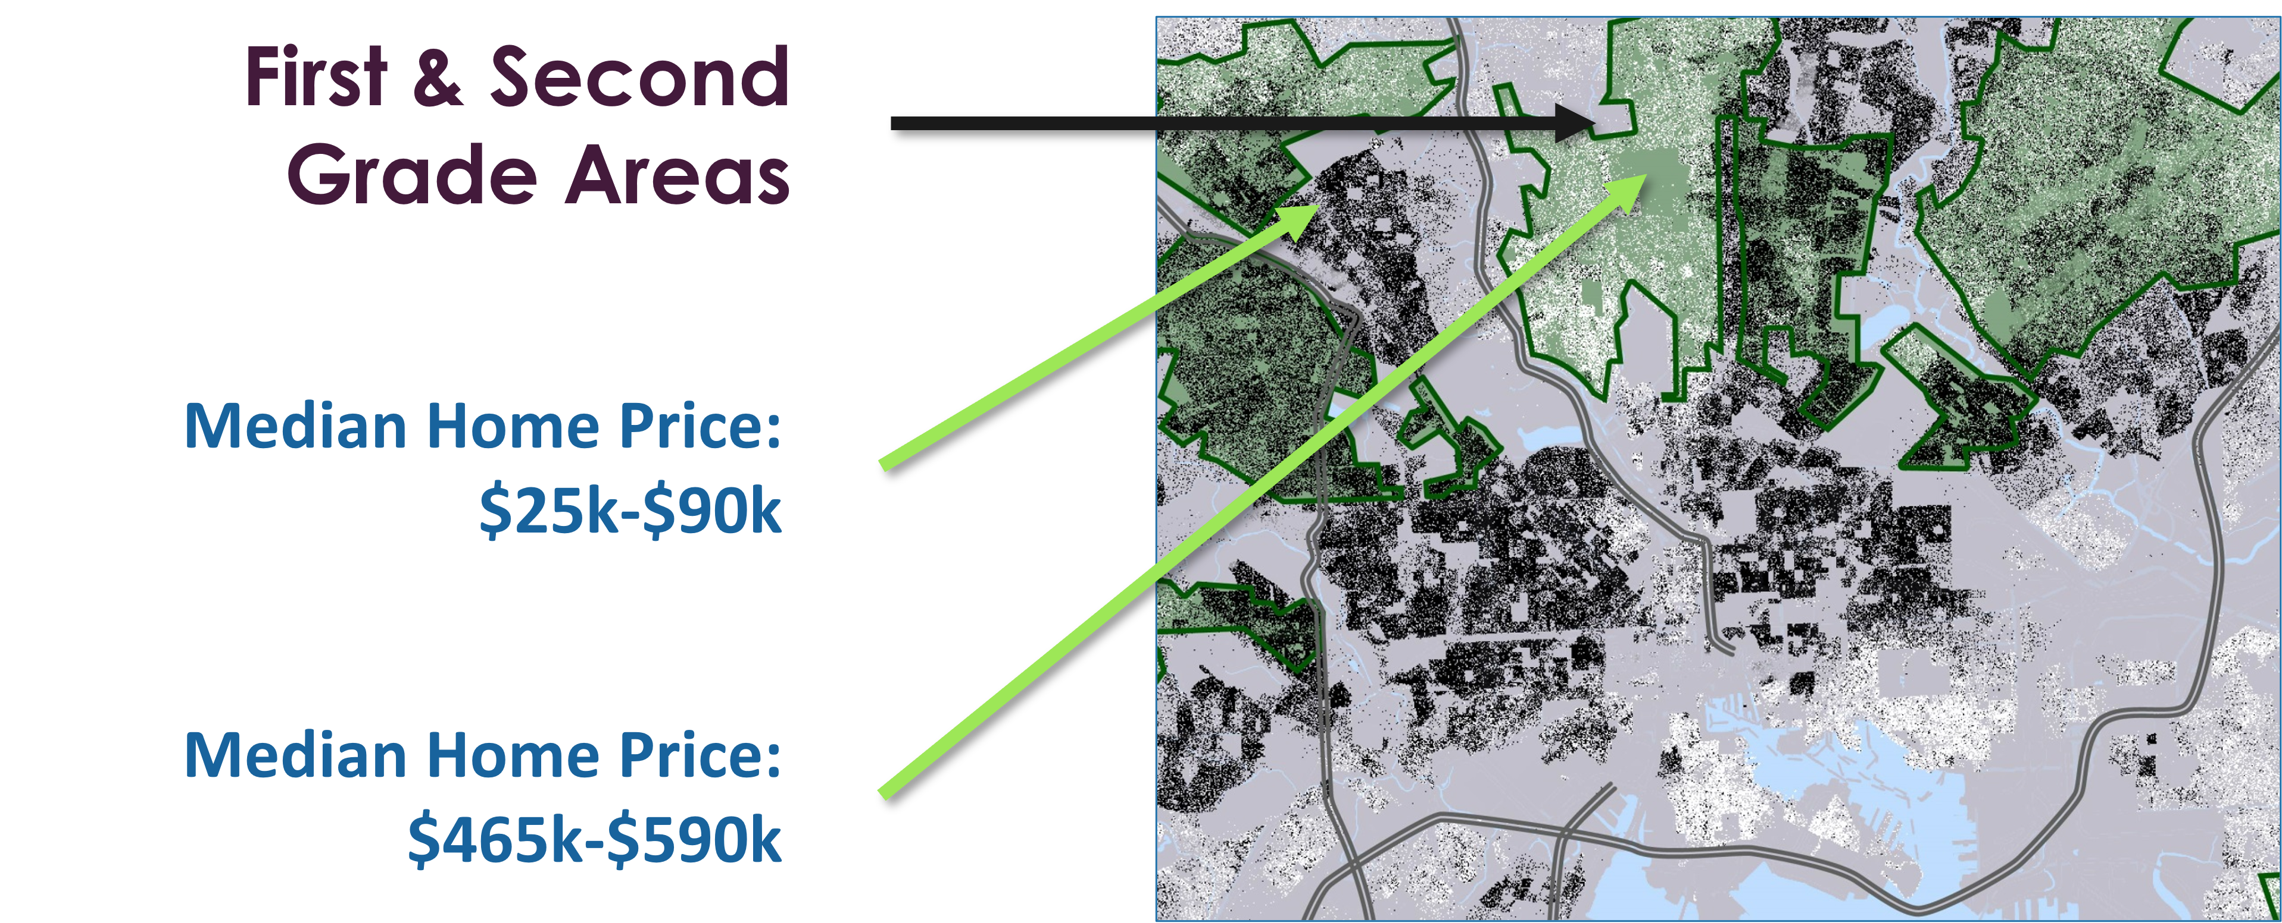
Property-based Wealth

Slide 83
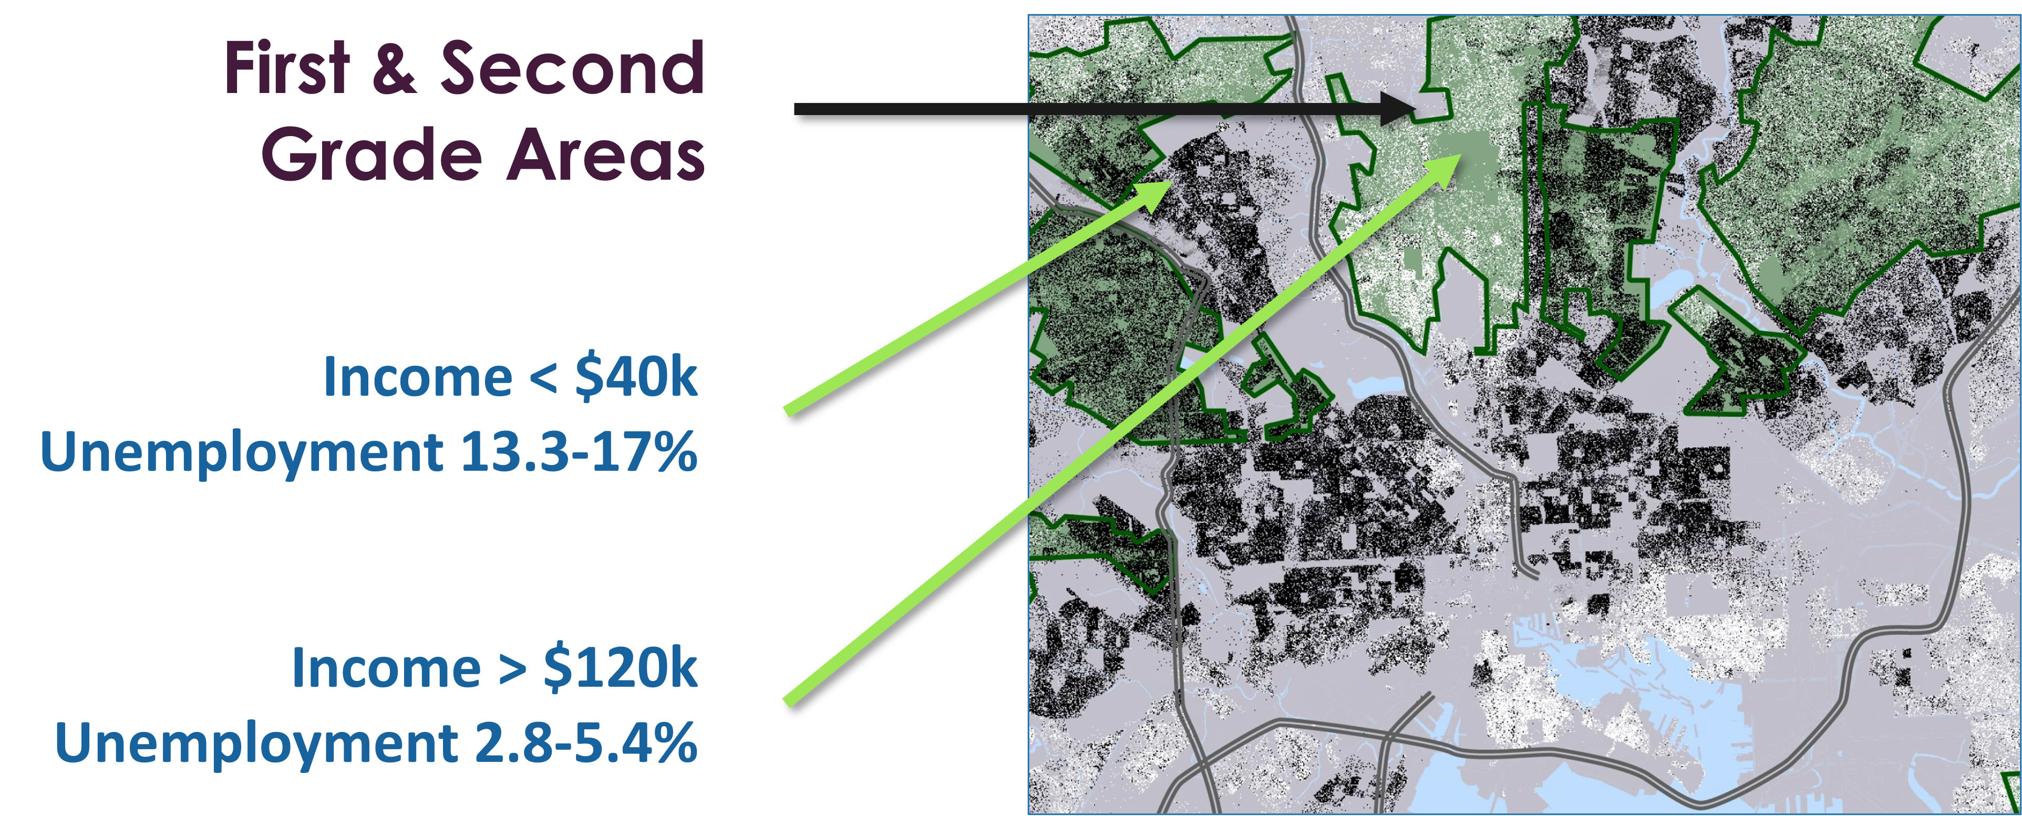
Employment & Opportunity:
Income & Unemployment

Slide 84
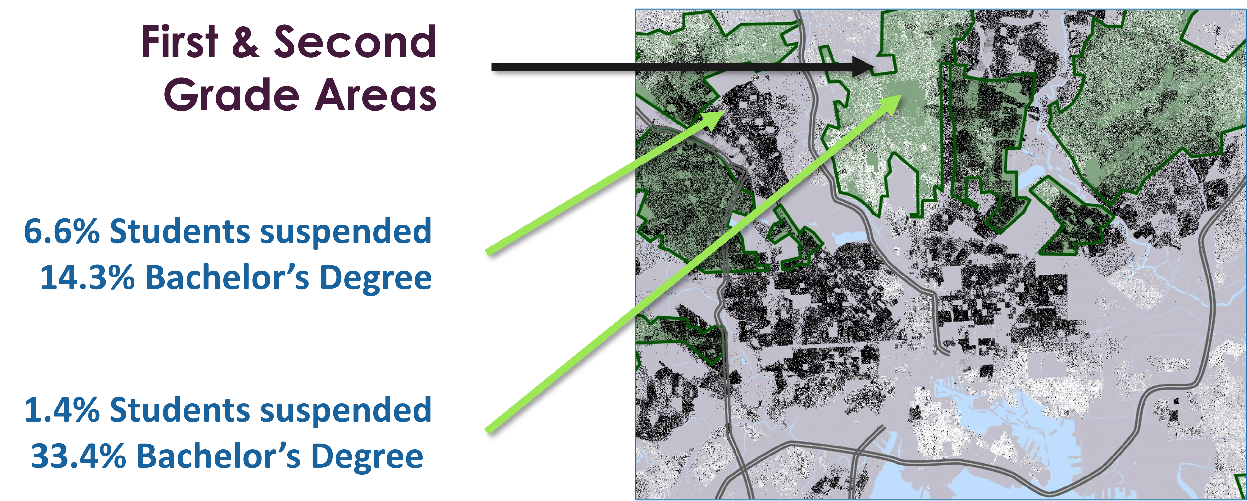
Employment & Opportunity:
Suspensions & Education

Slide 85
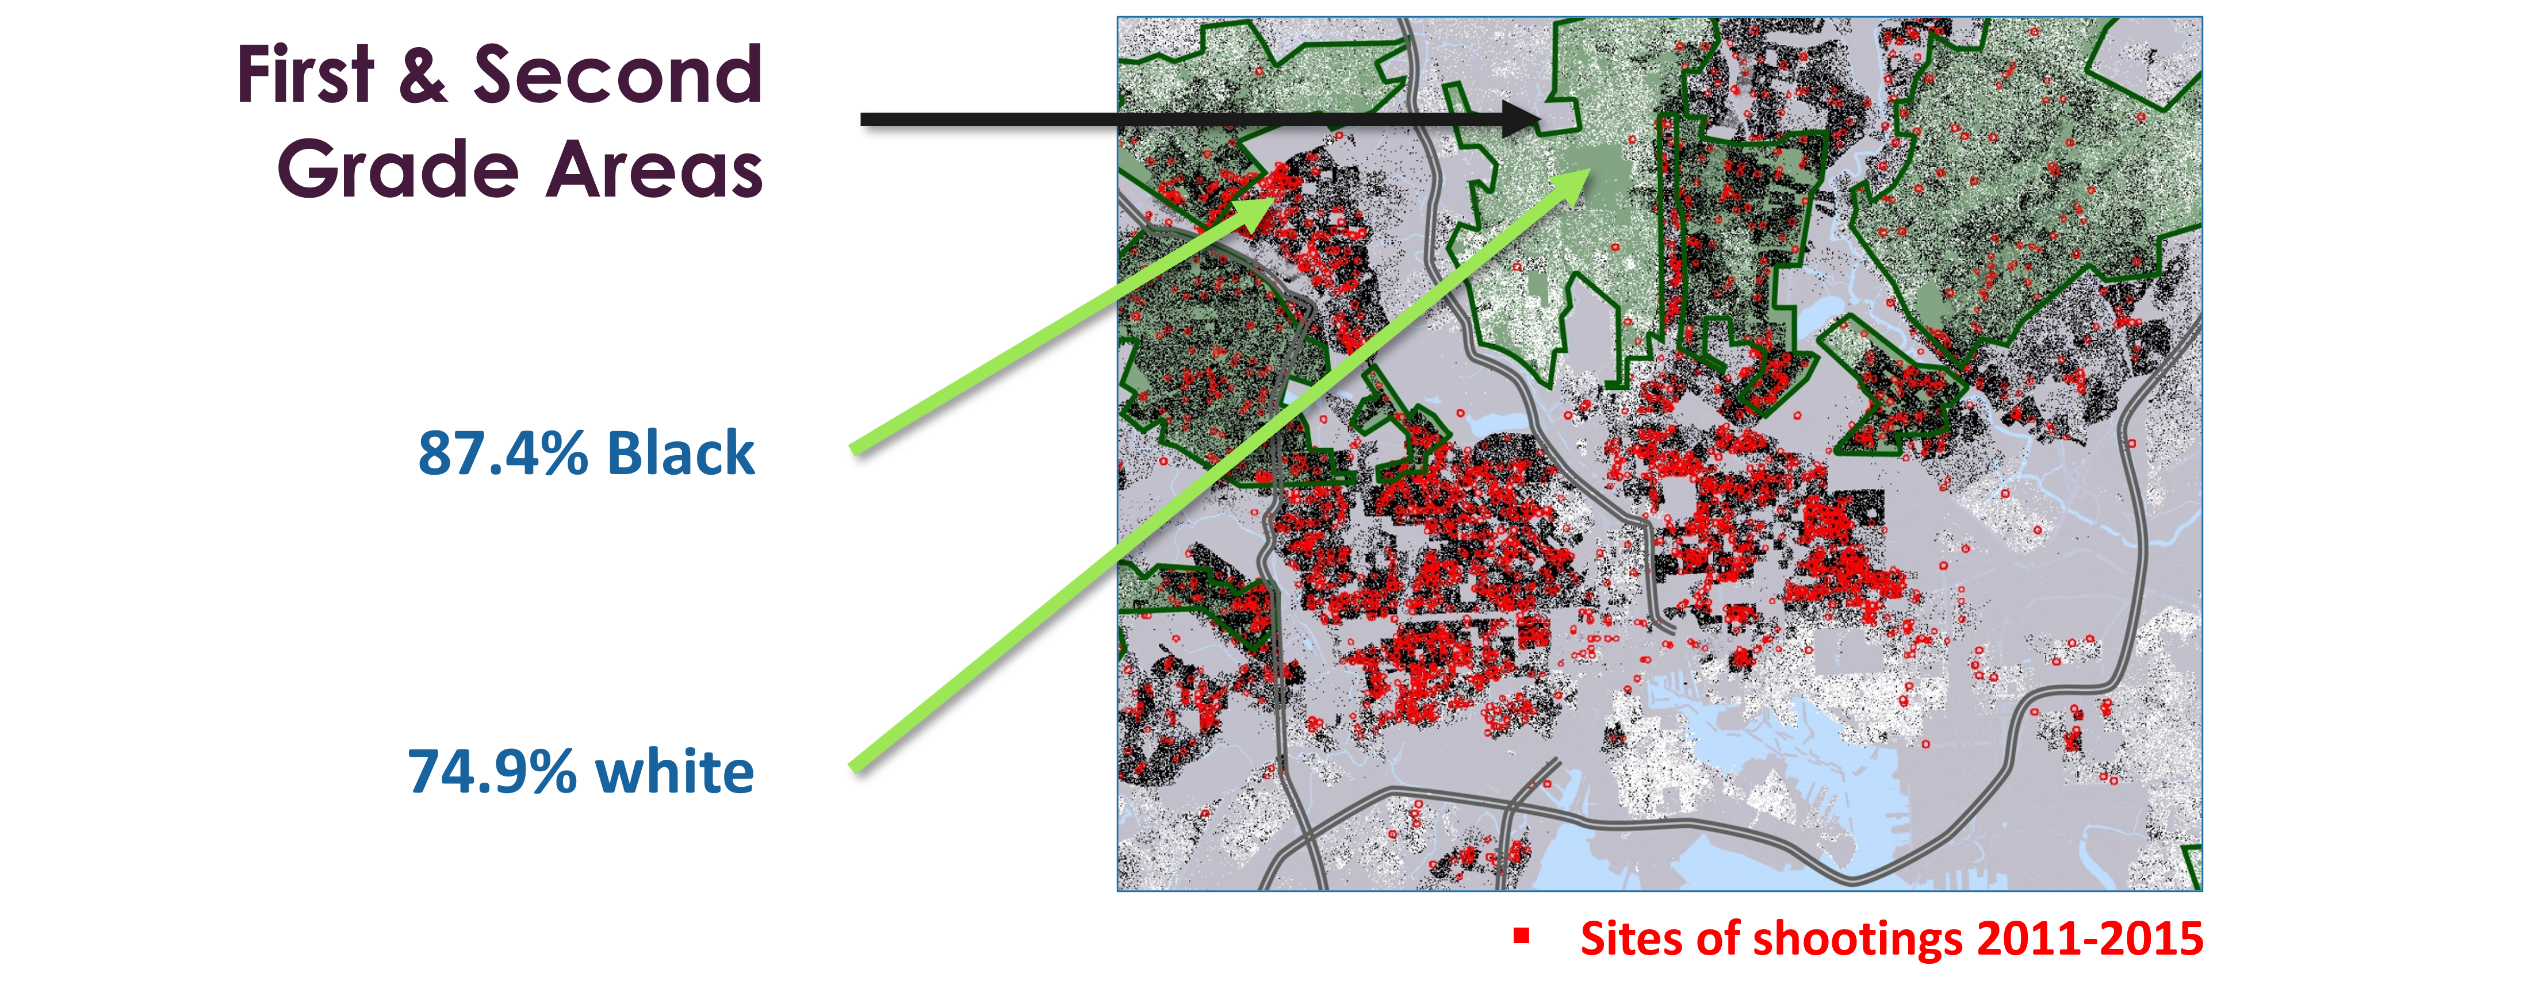
Exposure to Violence

Slide 86

Health Disparities:
Chronic Obstructive Pulmonary Disease (COPD), Coronary Heart Disease (CHD), and Life Expectancy

Slide 87
Let’s Revisit:
Law as a Factor That Affects Health

Slide 88
How Does This All Fit Together?

Slide 89
Addressing Structural Racism to Achieve Health Equity

Slide 90
What We’ll Discuss: How Can Inequities Be Repaired
What is health equity?
What can history teach us about structural discrimination?
How does the law contribute to health inequity?
How can inequities be repaired?

Slide 91
Guiding Questions: Review
Equity practice tip!
Who has been harmed or omitted?
Who stands to benefit, and how?
How can inequity be repaired?

Slide 92
An Effective and Anti-racist Health Equity Approach
Equity practice tip!
Addresses the root causes of poor health
Names racism and identifies the levels in which it operates
Promotes systems-thinking
Acknowledges our role in creating and perpetuating inequities
Centers healing and supports community resilience

Slide 93

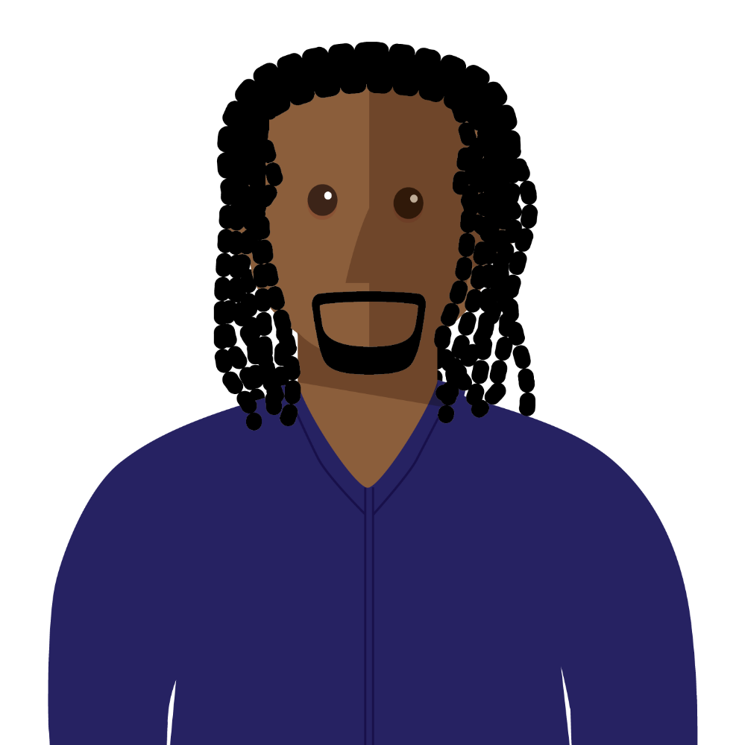
Meet Omari, a county health official
Omari is leading a project to explore the connection between park access and public health.

Slide 94
An Effective and Anti-racist Health Equity Approach 1
Equity practice tip!
Addresses the root causes of poor health
Names racism and identifies the levels in which it operates
Promotes systems-thinking
Acknowledges our role in creating and perpetuating inequities
Centers healing and supports community resilience

Slide 95
Understanding the Root Causes

Slide 96
An Effective and Anti-racist Health Equity Approach 2
Equity practice tip!
Addresses the root causes of poor health
Names racism and identifies the levels in which it operates
Promotes systems-thinking
Acknowledges our role in creating and perpetuating inequities
Centers healing and supports community resilience

Slide 97
At the Community Meeting
Omari and his team describe how institutionalized racism has led to inequity in park access.

Slide 98
An Effective and Anti-racist Health Equity Approach 3
Equity practice tip!
Addresses the root causes of poor health
Names racism and identifies the levels in which it operates
Promotes systems-thinking
Acknowledges our role in creating and perpetuating inequities
Centers healing and supports community resilience

Slide 99
An Effective and Anti-racist Health Equity Approach 4
Equity practice tip!
Addresses the root causes of poor health
Names racism and identifies the levels in which it operates
Promotes systems-thinking
Acknowledges our role in creating and perpetuating inequities
Centers healing and supports community resilience

Slide 100
Back to Omari
Community members share their frustrations.

Slide 101
What Could Omari’s Team Have Done Differently?

Slide 102
An Effective and Anti-racist Health Equity Approach 5
Equity practice tip!
Addresses the root causes of poor health
Names racism and identifies the levels in which it operates
Promotes systems-thinking
Acknowledges our role in creating and perpetuating inequities
Centers healing and supports community resilience

Slide 103
What are the Takeaways From This Example?

Slide 104
Quiz 6: Multiple Choice
Which of the following are important elements in repairing inequities?
  Addressing the root causes of poor health
  Supporting community resilience
  Acknowledging past harms
  A and C
  A, B, and C

Slide 105
Quiz 6: Answer
Which of the following are important elements in repairing inequities?
  Addressing the root causes of poor health
  Supporting community resilience
  Acknowledging past harms
  A and C
  A, B, and C – CORRECT ANSWER

Slide 106
Recap: What We Discussed
What is health equity?
What can history teach us about structural discrimination?
How does the law contribute to health inequity?
How can inequities be repaired?

Slide 107
Healthy Communities For All
Through Equitable Laws & Policies

Slide 108
CDC’s Public Health Law Program
What we do
  Advance the use of law as a public health tool
How we do it
  Training and workforce development
  Communication and partnerships
  Legal epidemiology
  Research and translation
Whom we serve
  CDC programs and state, tribal, local, and territorial communities
To submit a request or learn more about public health law,
visit us at www.cdc.gov/phlp

Slide 109
Public Health Law Competencies
Define basic constitutional concepts framing the practice of public health.
Describe public health agency authority and limits on
that authority.
Identify legal tools and enforcement procedures to address day-to-day public health issues.
Distinguish public health agency powers from those of other agencies, legislatures, and courts.

Slide 110
Funding Acknowledgment
This training was supported by the Centers for Disease Control and Prevention of the US Department of Health and Human Services (HHS) as part of a financial assistance award totaling $250,000, with 100 percent funded by CDC/HHS.
The contents are those of the author(s) and do not necessarily represent the official views of, or an endorsement by, CDC/HHS or the US Government.

Slide 111
Credits
Narration: Cia Court
Illustrations: Karen Parry | Black Graphics

Slide 112
Thank you!

