Slide 1
Public Health Law
Past and Present

Slide 2
ChangeLab Solutions Disclaimer
The information provided in this discussion is for informational purposes only and does not constitute legal advice. ChangeLab Solutions does not enter into attorney-client relationships.
ChangeLab Solutions is a nonprofit organization that educates and informs the public through objective, nonpartisan analysis, study, and research. The primary purpose of this discussion is to address legal and policy options to improve public health. There is no intent to reflect a view on specific legislation.
Copyright © 2023 ChangeLab Solutions

Slide 3
CDC Disclaimer
These course materials are for instructional use only and are not intended as a substitute for professional legal or other advice. While every effort has been made to verify the accuracy of these materials, legal authorities and requirements may vary from jurisdiction to jurisdiction. Always seek the advice of an attorney or other qualified professional with any questions you may have regarding a legal matter.
The contents of this presentation have not been formally disseminated by the Centers for Disease Control and Prevention and should not be construed to represent any agency determination or policy.

Slide 4
What We’ll Discuss
What is public health law?
How does legal history shape public health practice today?
How do law and policy relate to health equity?
Who has the power to shape public policy to improve public health?
What limitations does the Constitution place on public health powers?

Slide 5
What We’ll Discuss 1
What is public health law?
How does legal history shape public health practice today?
How do law and policy relate to health equity?
Who has the power to shape public policy to improve public health?
What limitations does the Constitution place on public health powers?

Slide 6
What is public health law?
“The science and art of preventing disease, prolonging life, and promoting health through the organized efforts and informed choices of society, organizations, public and private communities, and individuals”
—CEA Winslow, founder, Yale School of Public Health

Slide 7
Public health law
addresses the state’s legal powers and duties to advance public health and the limitations on state power to constrain individual rights for the common good.

Slide 8
Law vs. Policy
All laws are policies, but not all policies are laws.
Law includes . . .
Ordinances
Statutes
Regulations that codify and institutionalize a government policy
Policy includes . . .
Laws
Regulations
Procedures
Administrative actions
Incentives
Voluntary practices of governments and other institutions

Slide 9
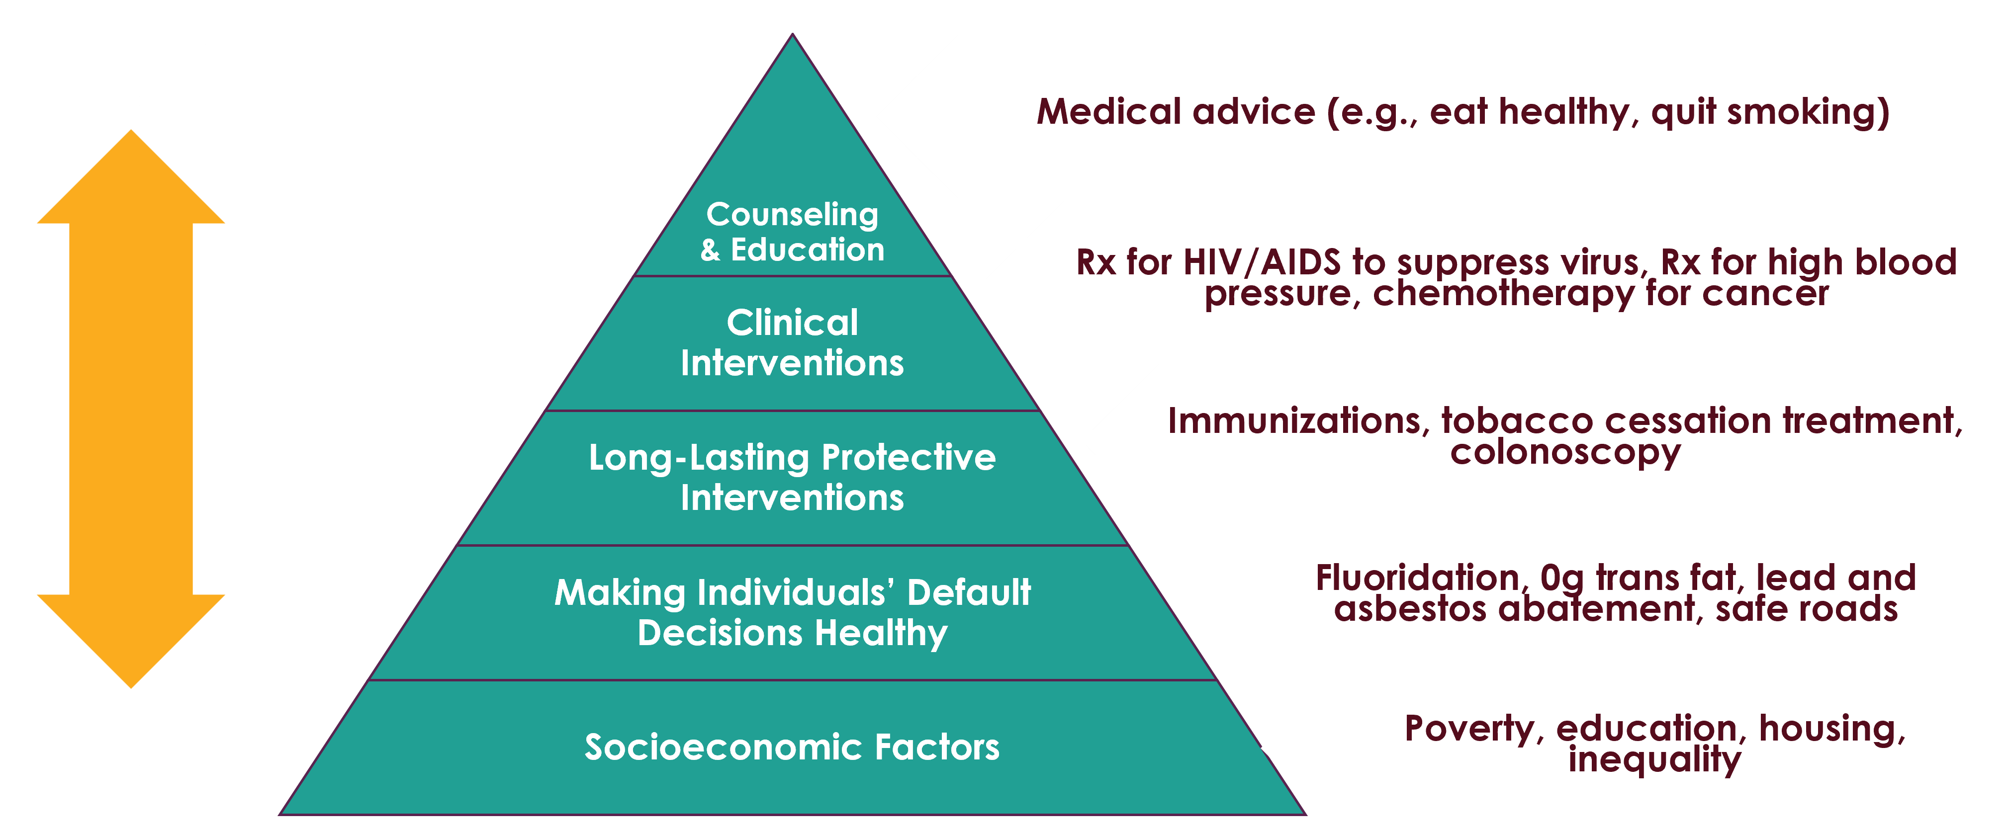
Factors That Affect Health
Source: Frieden TR. A framework for public health action: the health impact pyramid. Am J Public Health. 2010;100(4):591.

Slide 10
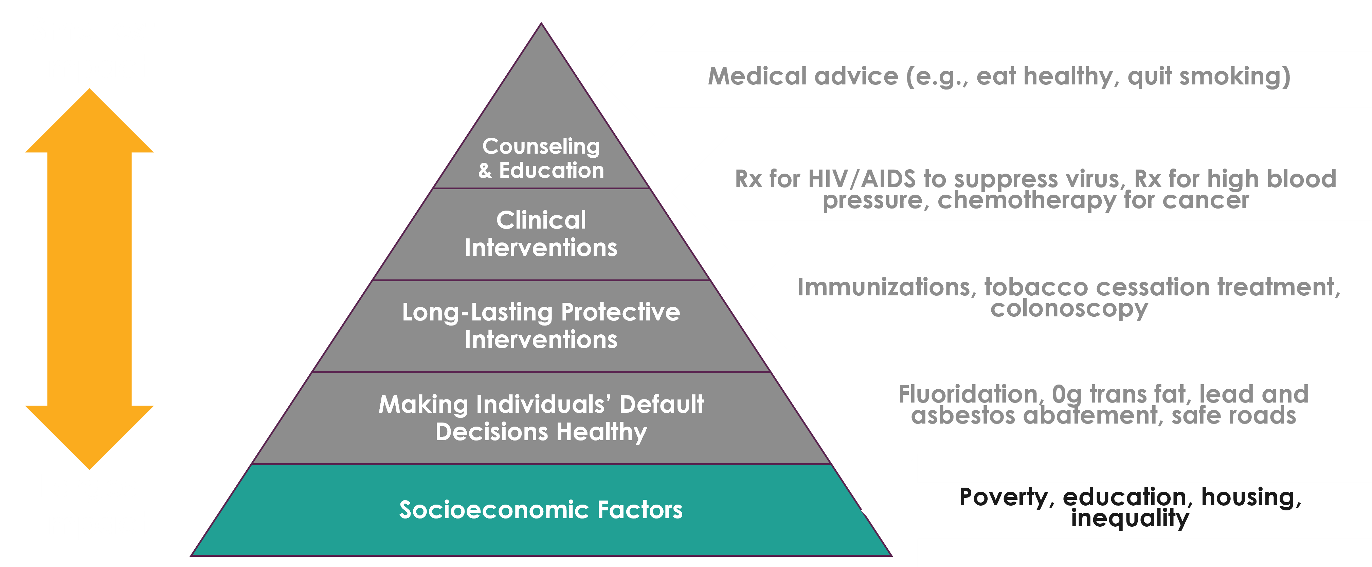
Factors That Affect Health:
Socioeconomic Factors
Source: Frieden TR. A framework for public health action: the health impact pyramid. Am J Public Health. 2010;100(4):591.

Slide 11
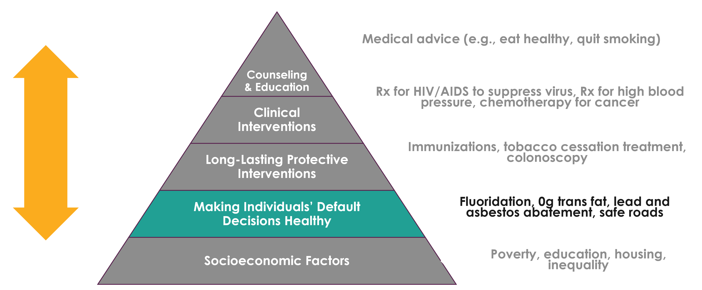
Factors That Affect Health:
Making Individuals’ Default Decisions Healthy
Source: Frieden TR. A framework for public health action: the health impact pyramid. Am J Public Health. 2010;100(4):591.

Slide 12
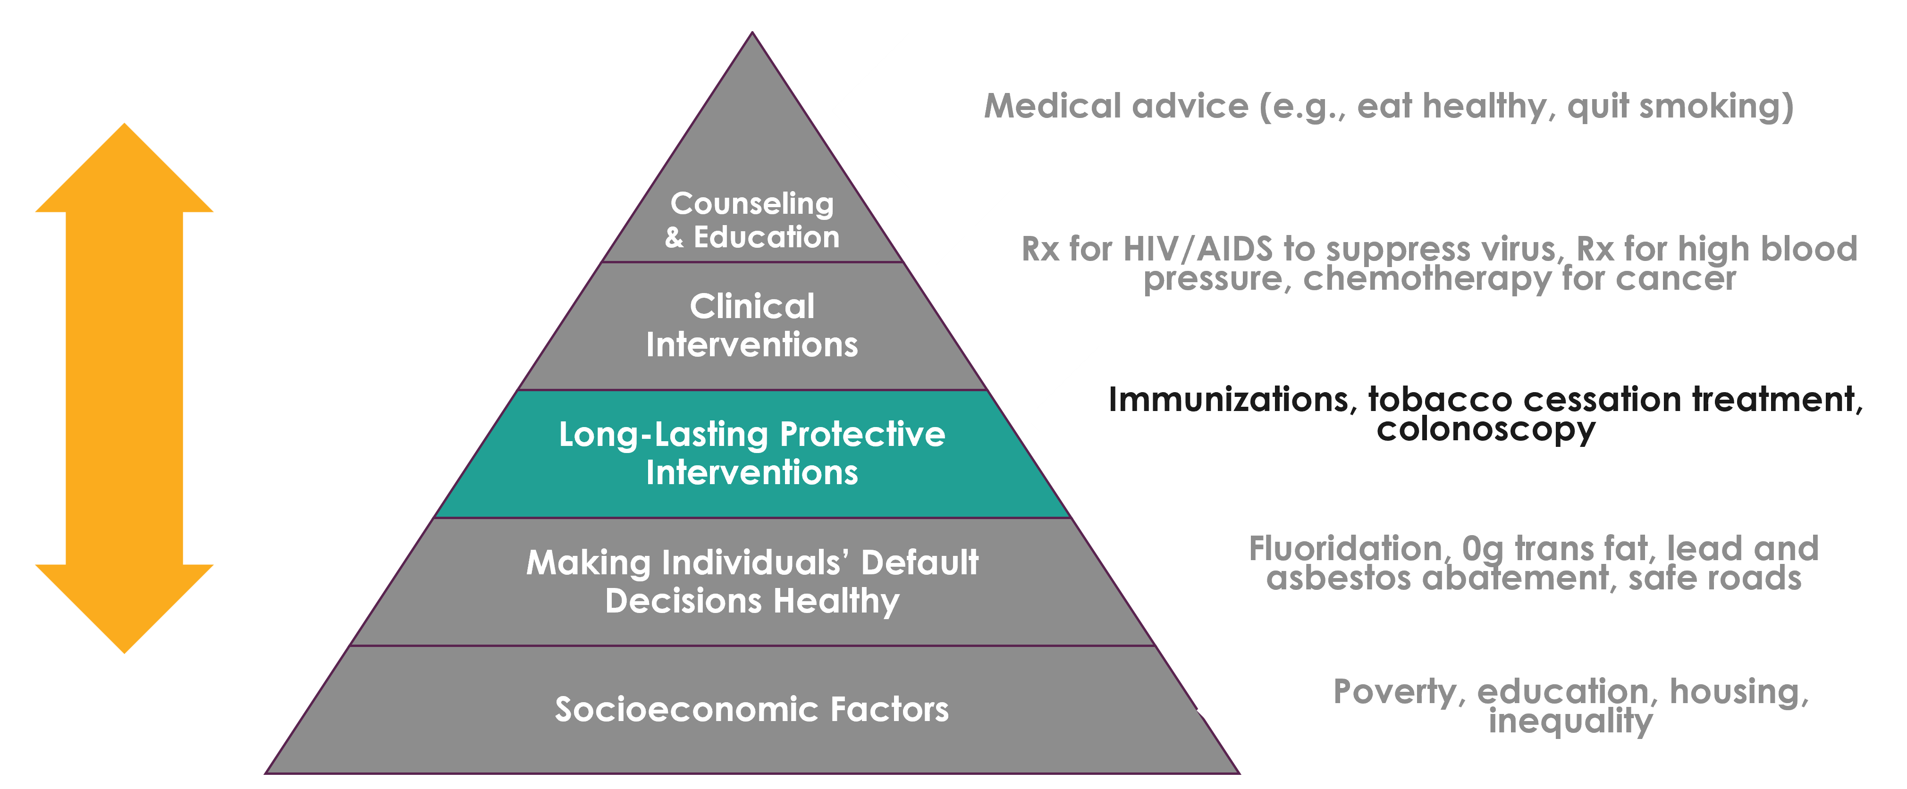
Factors That Affect Health:
Long-Lasting Protective Interventions
Source: Frieden TR. A framework for public health action: the health impact pyramid. Am J Public Health. 2010;100(4):591.

Slide 13
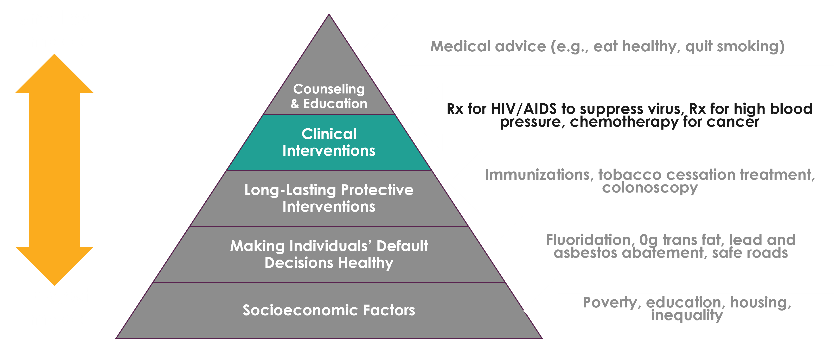
Factors That Affect Health:
Clinical Interventions
Source: Frieden TR. A framework for public health action: the health impact pyramid. Am J Public Health. 2010;100(4):591.

Slide 14
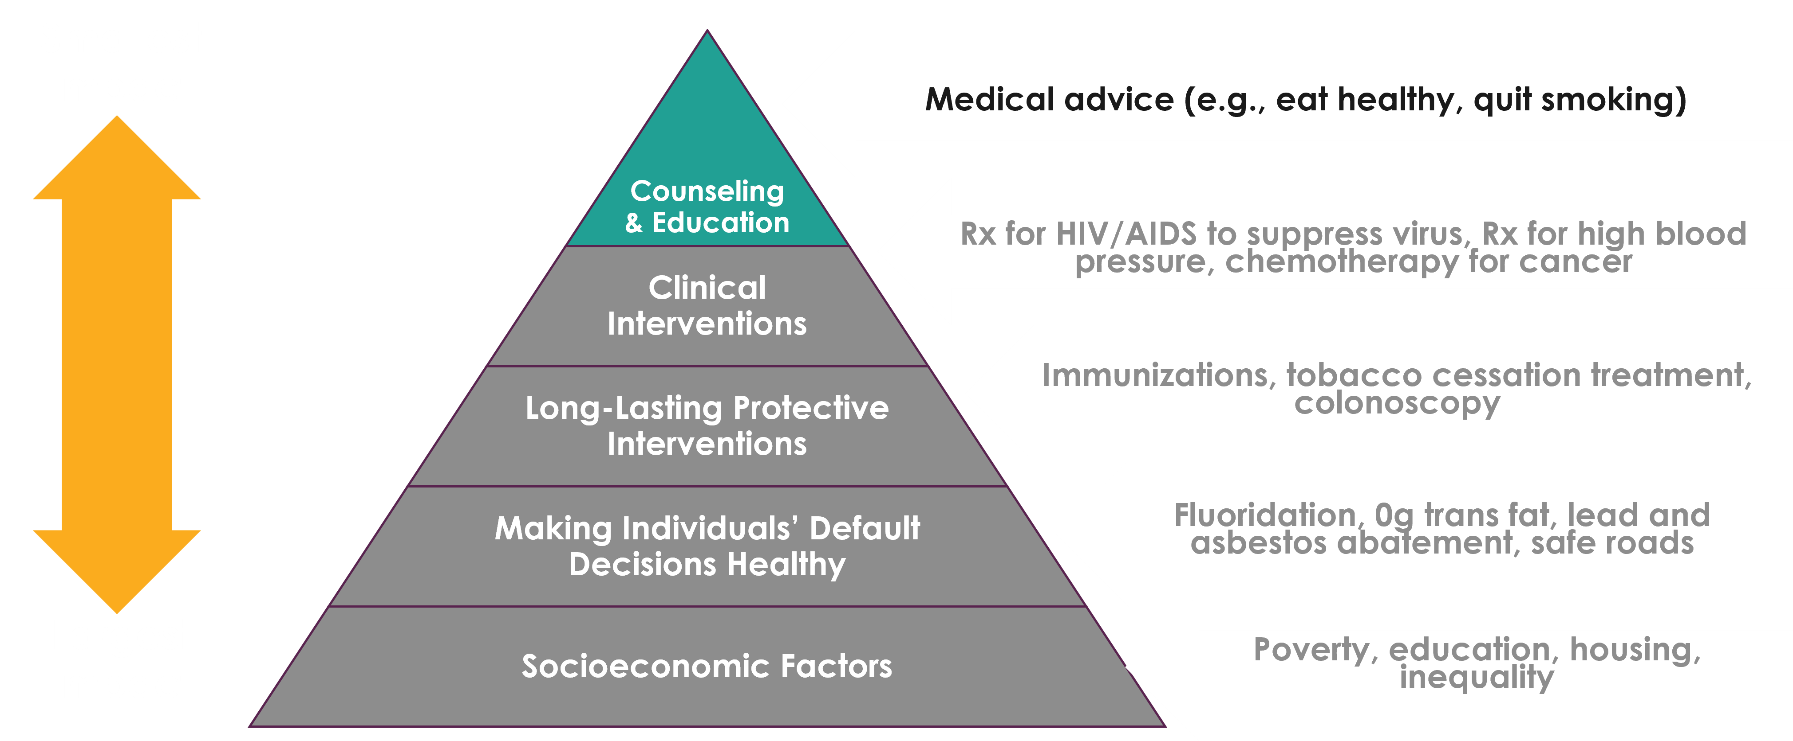
Factors That Affect Health:
Counseling & Education
Source: Frieden TR. A framework for public health action: the health impact pyramid. Am J Public Health. 2010;100(4):591.

Slide 15
Law and policy
are important vehicles for public health intervention because they operate at the societal rather than the individual level.

Slide 16
Quiz 1: Multiple choice
A policy to increase the minimum wage is an example of what tier of the pyramid of public health interventions?
Long-lasting protective intervention
Counseling and education
Changing socioeconomic factors
Making the default decision healthy

Slide 17
Quiz 1: Answer
A policy to increase the minimum wage is an example of what tier of the pyramid of public health interventions?
Long-lasting protective intervention
Counseling and education
Changing socioeconomic factors – CORRECT ANSWER
Making the default decision healthy

Slide 18
What We’ll Discuss 2
What is public health law?
How does legal history shape public health practice today?
How do law and policy relate to health equity?
Who has the power to shape public policy to improve public health?
What limitations does the Constitution place on public health powers?

Slide 19
The Mayflower Compact (1620)

Slide 20
Securing the Common Good
“. . . to enact, constitute, and frame such just and equal laws, ordinances, acts, constitutions and offices, from time to time, as shall be thought most meet and convenient for the general good of the colony . . . ”
—The Mayflower Compact

Slide 21
The Broad Street Pump

Slide 22
New York before sanitation reform

Slide 23
. . . and New York after the reform

Slide 24
The story of
Jacobson v. Massachusetts

Slide 25
Mandatory vaccination law
“But the liberty secured by the Constitution of the United States to every person within its jurisdiction does not import an absolute right in each person to be, at all times and in all circumstances, wholly freed from restraint. There are manifold restraints to which every person is necessarily subject for the common good. On any other basis, organized society could not exist with safety to its members.”
—Jacobson v. Massachusetts (1905)

Slide 26
Quiz 2: True or false
The government can regulate individual behavior to protect health.
True
False

Slide 27
Quiz 2: Answer
The government can regulate individual behavior to protect health.
True – CORRECT ANSWER
False

Slide 28
What We’ll Discuss 3
What is public health law?
How does legal history shape public health practice today?
How do law and policy relate to health equity?
Who has the power to shape public policy to improve public health?
What limitations does the Constitution place on public health powers?

Slide 29
What is health equity?
“Health equity means that everyone has a fair and just opportunity to be as healthy as possible. This requires removing obstacles to health such as poverty, discrimination, and their consequences. . . . ”

Slide 30
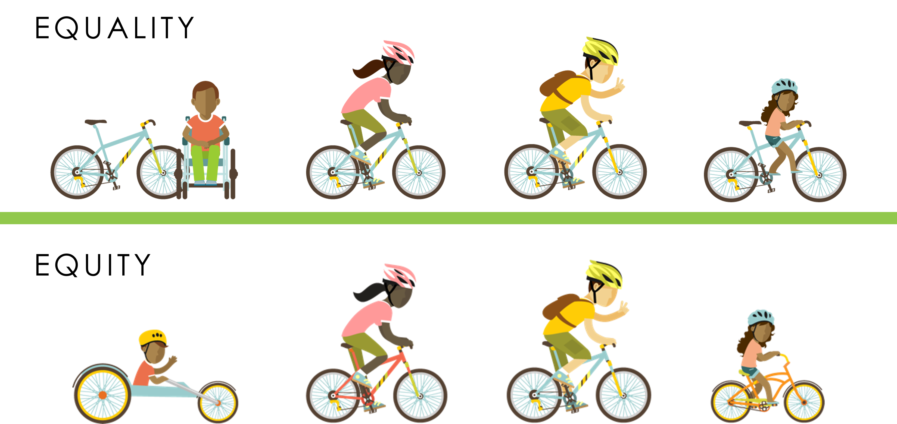
Moving toward true equity
Illustration adapted from Visualizing health equity: one size does not fit all infographic. Robert Wood Johnson Foundation; 2017.
rwjf.org/en/library/infographics/visualizing-health-equity.html

Slide 31
Tobacco control
A public health success . . . but not always for everyone

Slide 32
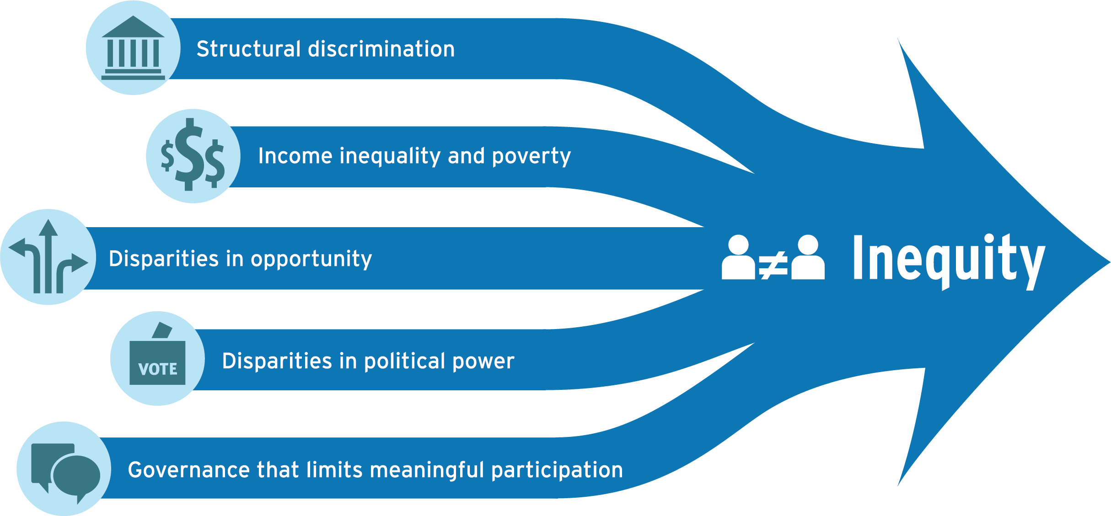
A Framework for Policy Interventions:
Five Drivers of Health Inequity

Slide 33
Paid sick leave laws
address income inequality and poverty.

Slide 34
Quiz 3: True or false
Structural discrimination is a fundamental driver of health inequity.
True
False

Slide 35
Quiz 3: Answer
Structural discrimination is a fundamental driver of health inequity.
True – CORRECT ANSWER
False

Slide 36
Meet Wendy, deputy health commissioner for a city.
Wendy is leading a project to identify potential policy interventions to combat childhood lead poisoning in the community.

Slide 37
Wendy convenes a community coalition.

Slide 38
Proactive Rental Inspection
Who has the power to take actions such as mandating proactive rental inspection in the interest of public health?
What limitations does the Constitution place on this authority?

Slide 39
What We’ll Discuss 4
What is public health law?
How does legal history shape public health practice today?
How do law and policy relate to health equity?
Who has the power to shape public policy to improve public health?
What limitations does the Constitution place on public health powers?

Slide 40
Refer to the US Constitution

Slide 41
What are the public health powers of the federal government?

Slide 42
Quiz 4: Multiple choice
Which of the following are examples of the federal government’s enumerated powers?
Taxing
Regulating interstate commerce
Zoning
A and B
A and C
A, B, and C

Slide 43
Quiz 4: Answer
Which of the following are examples of the federal government’s enumerated powers?
Taxing
Regulating interstate commerce
Zoning
A and B – CORRECT ANSWER
A and C
A, B, and C

Slide 44
Quiz 5: True or false
If the federal government shares a power with the states, that is an exclusive power.
True
False

Slide 45
Quiz 5: Answer
If the federal government shares a power with the states, that is an exclusive power.
True
False – CORRECT ANSWER

Slide 46
Federal regulations can incentivize local action.

Slide 47
Federal government can also prohibit or preempt action.

Slide 48
The states have primary responsibility for public health.

Slide 49
What is police power?
Promotes public health, safety, and general well-being of the community
Enacts and enforces laws for general welfare
Regulates private rights in the public interest

Slide 50
Police Power: Requirements
Must be reasonably designed to correct a condition adversely affecting the public good;
Must be rationally related to promoting the public health, safety, or general welfare;
Cannot violate any state or federal laws or constitutions; and it
Cannot be arbitrary or oppressive.

Slide 51
States can delegate police power to local governments
“A county or city may make and enforce within its limits all local, police, sanitary, and other ordinances and regulations not in conflict with general laws.”

Slide 52
What about tribal sovereignty?

Slide 53
Quiz 6: True or false
Local governments have legislative independence apart from states.
True
False

Slide 54
Quiz 6: Answer
Local governments have legislative independence apart from states.
True
False – CORRECT ANSWER

Slide 55
Quiz 7: True or false
The federal government can control all aspects of state and local laws.
True
False

Slide 56
Quiz 7: Answer
The federal government can control all aspects of state and local laws.
True
False – CORRECT ANSWER

Slide 57
State & local government can . . .

Slide 58
Investigate disease outbreaks

Slide 59
Set minimum wage requirements

Slide 60
Adopt inclusionary zoning policies

Slide 61
Protect LGBTQ+ students from bullying

Slide 62
Require kids to wear helmets

Slide 63
How can Wendy’s health department address racial disparities without running into legal barriers?

Slide 64
What We’ll Discuss 5
What is public health law?
How does legal history shape public health practice today?
How do law and policy relate to health equity?
Who has the power to shape public policy to improve public health?
What limitations does the Constitution place on public health powers?

Slide 65
Balancing Public Health Authority & Individual Liberty

Slide 66
The Bill of Rights

Slide 67
Constitutional Rights
Freedom of speech & religion
Right to bear arms
Freedom from search & seizure
Due process
Equal protection

Slide 68
According to the Fifth & Fourteenth amendments, the government cannot deprive people of life, liberty, or property without due process of law.

Slide 69
Procedural Due Process
Did the government allow the right to fair and impartial legal proceedings before depriving someone of life, liberty, or property?

Slide 70
Substantive Due Process
Does the government have an appropriate justification for depriving someone of life, liberty, or property?

Slide 71
Some things are more difficult for the government to regulate than others.

Slide 72
When fundamental liberties are NOT involved

Slide 73
The Rational Basis Test
Is the government action reasonably related to a legitimate government goal?

Slide 74
When fundamental liberties ARE involved

Slide 75
The Strict Scrutiny Test
Is the government action narrowly tailored, or is it the least restrictive alternative to achieve a compelling goal?

Slide 76
The government must tread carefully if a regulation affects fundamental liberties.
 | Rational Basis Test | Strict Scrutiny Test
Individual’s interest is . . . | Minimal | Fundamental
Government’s goal must be. . . | Legitimate | Compelling
Fit between action & goal must be . . . | Reasonable | Narrowly tailored or least restrictive alternative

Slide 77
Can the government require children to be vaccinated? 1
Can the government require children to be vaccinated to attend public school?
What about to attend private school?
What about all children?

Slide 78
Can the government require children to be vaccinated? 2
Can the government require children to be vaccinated to attend public school?
What about to attend private school?
What about all children?

Slide 79
Can the government require children to be vaccinated? 3
Can the government require children to be vaccinated to attend public school?
What about to attend private school?
What about all children?

Slide 80
Quiz 8: Multiple choice
Which of the following is required for the government to prohibit unvaccinated children from attending public school?
A compelling government interest
A public health emergency
Exceptions for personal beliefs
A and B
A, B, and C

Slide 81
Quiz 8: Answer
Which of the following is required for the government to prohibit unvaccinated children from attending public school?
A compelling government interest – CORRECT ANSWER
A public health emergency
Exceptions for personal beliefs
A and B
A, B, and C

Slide 82
Quiz 9: Multiple choice
Which of the following is needed for the government to require children to wear bicycle helmets?
A compelling government interest
A public health emergency
A legitimate government interest
A and B
A, B, and C

Slide 83
Quiz 9: Answer
Which of the following is needed for the government to require children to wear bicycle helmets?
A compelling government interest
A public health emergency
A legitimate government interest – CORRECT ANSWER
A and B
A, B, and C

Slide 84
Under the Fifth & Fourteenth Amendments,
the government shall not deny individuals equal protection of the law.

Slide 85
Non-protected classes

Slide 86
The Rational Basis Test (Recap)
Is the government action reasonably related to a legitimate government goal?

Slide 87
Can the government pass a law that requires overtime pay for some types of employees but not others?

Slide 88
Overtime Exemptions
A law that applies to certain types of businesses or employees but not others needs only to be reasonably related to a legitimate government goal.

Slide 89
Protected classes

Slide 90
The Strict Scrutiny Test (Recap)
Is the government action narrowly tailored to achieve a compelling goal?

Slide 91
More Equal Protection Scenarios to Consider
Can the government quarantine citizens of another country who are suspected of having been exposed to a viral respiratory disease?
What about limiting the number of fast-food restaurants in certain parts of a city?
What about putting an age restriction on buying harmful products?

Slide 92
More Equal Protection Scenarios to Consider 1
Can the government quarantine citizens of another country who are suspected of having been exposed to a viral respiratory disease?
What about limiting the number of fast-food restaurants in certain parts of a city?
What about putting an age restriction on buying harmful products?

Slide 93
More Equal Protection Scenarios to Consider 2
Can the government quarantine citizens of another country who are suspected of having been exposed to a viral respiratory disease?
What about limiting the number of fast-food restaurants in certain parts of a city?
What about putting an age restriction on buying harmful products?

Slide 94
More Equal Protection Scenarios to Consider 3
Can the government quarantine citizens of another country who are suspected of having been exposed to a viral respiratory disease?
What about limiting the number of fast-food restaurants in certain parts of a city?
What about putting an age restriction on buying harmful products?

Slide 95
Proactive Rental Inspection:
Legal Considerations
Use race-neutral criteria to address health disparities
Ensure adequate Fourth Amendment safeguards (e.g., obtain tenants’ consent prior to entering their home or develop processes for obtaining warrants to enter)

Slide 96
Proactive Rental Inspection:
Community Engagement & Equity Considerations
Engage in inclusive community engagement efforts to help generate community buy-in
Ensure that equity considerations inform enforcement actions and policies

Slide 97
RECAP: What We Discussed
What is public health law?
How does legal history shape public health practice today?
How do law and policy relate to health equity?
Who has the power to shape public policy to improve public health?
What limitations does the Constitution place on public health powers?

Slide 98
ChangeLab Solutions
Healthier communities for all through equitable laws & policies

Slide 99
CDC’s Public Health Law Program
What we do
Advance the use of law as a public health tool
How we do it
Legal epidemiology: legal mapping and legal evaluation
Workforce development: webinars, trainings, training materials, fellowships, internships, and externships
Partnerships and outreach
Whom we serve
CDC programs and state, tribal, local, and territorial communities
To submit a request or learn more about public health law, visit us at www.cdc.gov/phlp

Slide 100
Public health law competencies
Define basic constitutional concepts framing the practice of public health
Describe public health agency authority and limits on
that authority
Identify legal tools and enforcement procedures to address day-to-day public health issues
Distinguish public health agency powers from those of other agencies, legislatures, and courts

Slide 101
Funding Acknowledgment
This training was supported by the Centers for Disease Control and Prevention of the US Department of Health and Human Services (HHS) as part of a financial assistance award totaling $250,000 with 100 percent funded by CDC/HHS.
The contents are those of the authors and do not necessarily represent the official views of, nor an endorsement, by CDC/HHS or the US Government.

Slide 102
Credits
Narration: Cia Court
Illustrations: Karen Parry | Black Graphics
Photographs:
Unless otherwise stated, the photographs in this training are royalty-free, in the public domain, or owned by ChangeLab Solutions.

Slide 103
Public Health Law
Past and Present
[END]

