Slide 1
Public Health Threats & the US Constitution
What Responders Need to Know About Equity, Law, and Public Health Authority

Slide 2
ChangeLab Solutions Disclaimer
The information provided in this discussion is for informational purposes only and does not constitute legal advice. ChangeLab Solutions does not enter into attorney-client relationships.
ChangeLab Solutions is a nonprofit organization that educates and informs the public through objective, nonpartisan analysis, study, and research. The primary purpose of this discussion is to address legal and policy options to improve public health. There is no intent to reflect a view on specific legislation.
Copyright © 2021 ChangeLab Solutions

Slide 3
CDC Disclaimer
These course materials are for instructional use only and are not intended as a substitute for professional legal or other advice. While every effort has been made to verify the accuracy of these materials, legal authorities and requirements may vary from jurisdiction to jurisdiction. Always seek the advice of an attorney or other qualified professional on any questions you may have regarding a legal matter.
The findings and conclusions in this training are those of the authors and do not necessarily represent the official position of the Centers for Disease Control and Prevention.

Slide 4
Roadmap
How does emergency preparedness relate to health equity?
Why public health law?
What are the major sources and limits of public health authority?
What do responders need to know?

Slide 5
Content Warning
This training touches on content that may be upsetting.

Slide 6
Roadmap - 1
How does emergency preparedness relate to health equity?
Why public health law?
What are the major sources and limits of public health authority?
What do responders need to know?

Slide 7
What Is Health Equity?
“No one is denied the possibility to be healthy for belonging to a group that has historically been economically or socially disadvantaged.”
Source: Braveman P. What are health disparities and health equity? We need to be clear. Public Health Rep. 2014:129(1_Suppl 2):5-8. doi:10.1177/00333549141291S203.

Slide 8
Moving Toward Health Equity
An intervention focused on equality would apply the same one-size-fits-all solution to everyone, irrespective of need.
An equitable approach, on the other hand, means that we’re focused on ensuring that people have what they need to thrive.

Slide 9
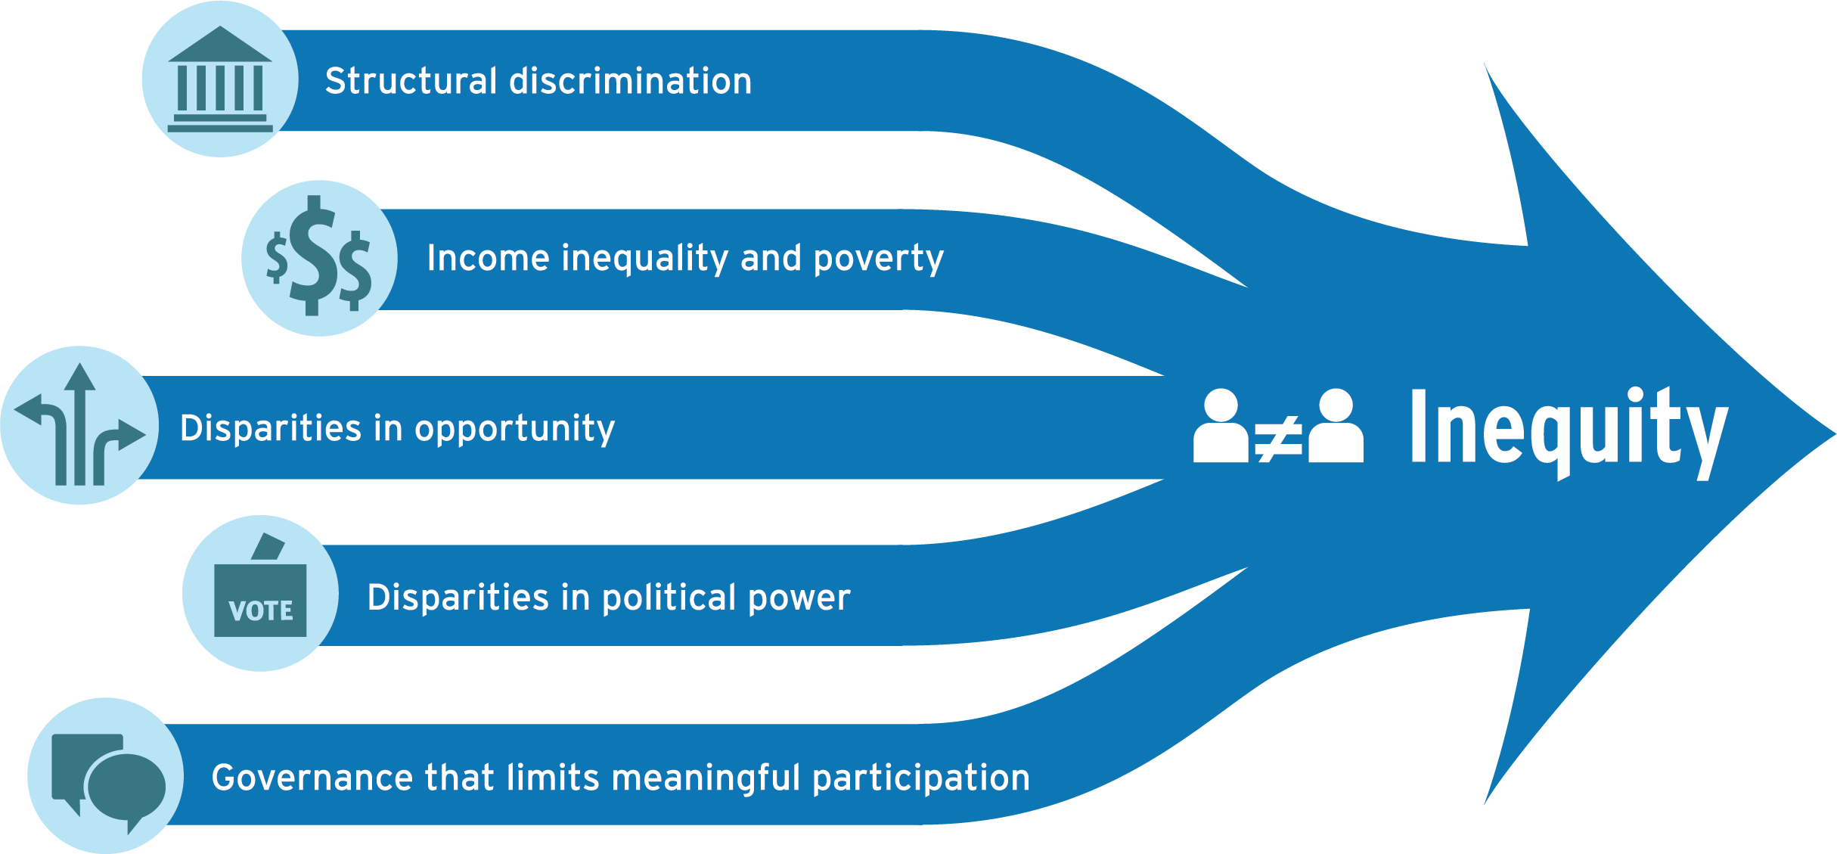
A Framework for Policy Interventions:
Five Drivers of Inequity
https://www.changelabsolutions.org/product/blueprint-changemakers

Slide 10
Equity-Forward
Emergency Responses

Slide 11
Roadmap - 2
How does emergency preparedness relate to health equity?
Why public health law?
What are the major sources and limits of public health authority?
What do responders need to know?

Slide 12
Public Health Emergencies
Disease outbreaks
Technological disasters
Intentional acts
Natural disasters

Slide 13
Imagine . . .
There is an outbreak of measles across the United States. Thousands of children are getting sick, and some are dying.

Slide 14
Meet Wendy
Wendy is the deputy health commissioner for a city.
One day, Wendy gets a call from a parent who says that many children at a local school are sick with a fever and have developed a rash—telltale signs of measles.
The school is run by a faith community that does not believe in medical care or immunizations.
None of the children in the school have been vaccinated.

Slide 15
What Can Wendy Do?
What can Wendy do?
What if parents refuse to have their kids vaccinated or treated for religious reasons?
Can Wendy force parents to have their children vaccinated?
Can Wendy impose a quarantine or isolate sick kids?

Slide 16
Roadmap - 3
How does emergency preparedness relate to health equity?
Why public health law?
What are the major sources and limits of public health authority?
What do responders need to know?

Slide 17
What are the major sources and limits of public health authority?

Slide 18
The U.S. Constitution
“Supreme law of the land”
Distributes power between federal and state governments
Provides a framework for balancing public health and individual interests

Slide 19
The Tenth Amendment on
States’ Police Powers
“The powers not delegated to the United States by
the Constitution, nor prohibited to it by
the States, are reserved to the States respectively, or to
the people.”

Slide 20
What Does Police Power Mean in Terms of Public Health? (Part 1)
Isolation and quarantine
Social distancing
Public health surveillance
Public health reporting
Epidemiological investigation

Slide 21
What Does Police Power Mean in Terms of Public Health? (Part 2)
Vaccination
Treatment
Powers over property
Evacuation

Slide 22
While states have the authority to restrict liberty to protect the public good, their actions must be reasonable.

Slide 23
Introduction to Jacobson v. Massachusetts
Jacobson v. Massachusetts 197 U.S. 11 (1905)
1902 smallpox outbreak in Cambridge, MA
Defendant Jacobson convicted for refusal to be vaccinated and to pay the $5 fine

Slide 24
Jacobson v. Massachusetts
“But the liberty secured by the Constitution of the United States to every person within its jurisdiction does not import an absolute right in each person to be, at all times and in all circumstances, wholly freed from restraint. There are manifold restraints to which every person is necessarily subject for the common good. On any other basis, organized society could not exist with safety to its members.”

Slide 25
Basic Requirements for Police Power
Cannot be arbitrary or oppressive
Must be rationally related to public health, safety, or general welfare
Must be reasonably designed to correct a condition adversely affecting the public good
Cannot violate state or federal laws or constitutions

Slide 26
What are the major sources and limits of public health authority?

Slide 27
Protecting Individual Liberties
Constitutional Safeguards

Slide 28
Multiple Choice Question
Which constitutional amendment(s) guarantee the right to due process?
  First Amendment
  Fifth Amendment
  Fourteenth Amendment
  First & Fourteenth Amendments
  Fifth & Fourteenth Amendments

Slide 29
Multiple Choice Answer
Which constitutional amendment(s) guarantee the right to due process?
  First Amendment
  Fifth Amendment
  Fourteenth Amendment
  First & Fourteenth Amendments
  Fifth & Fourteenth Amendments → CORRECT ANSWER

Slide 30
Due Process: Fifth & Fourteenth Amendments
The government cannot deprive people of life, liberty, or property without acting fairly and reasonably.
The power of government to engage in disease control activities must be balanced with the rights of affected people.

Slide 31
Procedural Due Process
Did the government provide an individual with access to fair and impartial legal proceedings before depriving that person of life, liberty, or property?

Slide 32
Substantive Due Process
Does the government have an appropriate justification for depriving someone of life, liberty, or property?

Slide 33
Content Warning - 1
The following slides contain disturbing details from a mandatory isolation case. In this case, the plaintiff was wrongfully incarcerated, against her will, in a county jail, under a quarantine and isolation order. The details of the case illustrate violence, racism, and violations of state law and individual liberties guaranteed by the US Constitution.

Slide 34
Intro to Souvannarath v. Hadden (2002)
A woman who was a Laotian refugee was diagnosed with multidrug-resistant tuberculosis (MDR-TB).
Under local policy, she was incarcerated in county jail for noncompliance with a quarantine and isolation order.

Slide 35
Court Decision for
Souvannarath v. Hadden (2002)
Numerous violations of a patient’s procedural and substantive due process rights:
  Failure to provide adequate notice
  Forcible removal to jail at gunpoint
  Failure to provide basic necessities, including heat, light, a bed, or a toilet
  Imposition of same restrictions as for jail inmates

Slide 36
Souvannarath v. Hadden (2002)
The California Court of Appeals found the series of missteps by county officials to be in violation of state law and Souvannarath’s individual liberties.
This case has important implications for health equity.

Slide 37
Multiple Choice Question
Which of the following government actions violate due process?
  Providing a Notice and Order for Examination
  Issuing an Order of Quarantine and Isolation that does not state any specific reason for detention
  A & B
  None of the above

Slide 38
Multiple Choice Answer
Which of the following government actions violate due process?
  Providing a Notice and Order for Examination
  Issuing an Order of Quarantine and Isolation that does not state any specific reason for detention → CORRECT ANSWER
  A & B
  None of the above

Slide 39
Multiple Choice Question
Which of the following actions are violations of procedural due process?
  Failing to provide proper notice for detention
  Detaining the patient at gunpoint
  Quarantining the patient in a jail cell without water, heat, light, a bed, or a toilet
  A & B
  A, B & C

Slide 40
Multiple Choice Answer
Which of the following actions are violations of procedural due process?
  Failing to provide proper notice for detention → CORRECT ANSWER
  Detaining the patient at gunpoint
  Quarantining the patient in a jail cell without water, heat, light, a bed, or a toilet
  A & B
  A, B & C

Slide 41
Free Exercise of Religion: First Amendment
“Congress shall make no law respecting an establishment of religion, or prohibiting the free exercise thereof; or abridging the freedom of speech, or of the press; or the right of the people peaceably to assemble, and to petition the Government for a redress of grievances.”

Slide 42
Free Exercise of Religion:
Employment Division v. Smith (1990)
“The government’s ability to enforce generally applicable prohibitions of socially harmful conduct . . . ‘cannot depend on measuring the effects of a governmental action on a religious objector’s spiritual development.’”

Slide 43
Equal Protection
Fifth & Fourteenth Amendments
The right to equal protection of the law

Slide 44
Content Warning - 2
The following slide discusses a racially motivated quarantine imposed on Chinese American citizens. The details of the case depict racism, xenophobia, and violations of state law and individual liberties guaranteed by the US Constitution.

Slide 45
Equal Protection:
Intro to Jew Ho v. Williamson (1900)
1900: Bubonic plague outbreak in San Francisco, California
Quarantine orders must be reasonable and not discriminatory.
Reasonable means effective in preventing the spread of disease (which the San Francisco order was not; it was blatant discrimination).

Slide 46
True or False Question - 1
Country X is experiencing an outbreak of a viral respiratory disease that kills 40% of the people infected. The US government may issue a quarantine order exclusively for citizens of Country X who come to the United States.
  ☐ True
  ☐ False

Slide 47
True or False Answer - 1
Country X is experiencing an outbreak of a viral respiratory disease that kills 40% of the people infected. The US government may issue a quarantine order exclusively for citizens of Country X who come to the United States.
  ☐ True
  ☒ False → CORRECT ANSWER

Slide 48
Balancing Public Health Authority
& Individual Liberty
The government’s power to engage in disease control activities must be balanced against the rights of affected individuals.
That balance is what the Constitution—and, more specifically, the Bill of Rights—requires.

Slide 49
Roadmap - 4
How does emergency preparedness relate to health equity?
Why public health law?
What are the major sources and limits of public health authority?
What do responders need to know?

Slide 50
Balancing Public Health Authority & Individual Liberty
Social distancing
Isolation & quarantine
Mandatory examination & treatment

Slide 51
Social Distancing Measures: Overview
Social distancing is a common public health control measure that has been used many times in the past as a response to communicable disease outbreaks.

Slide 52
Social Distancing Measures: What are they?
A spectrum of options
Closing schools & day care centers (á la snow days)
Canceling large public gatherings
Working from home
Limiting other public contacts

Slide 53
Social Distancing Measures
Social distancing measures are often appropriate options to choose before resorting to isolation or quarantine because they have fewer constitutional implications.
Less-restrictive options should be considered first.

Slide 54
Isolation & Quarantine: Overview
If less-restrictive social distancing measures are not feasible or appropriate, given the situation, isolation or quarantine might be required to stop the spread of an illness.
Isolation and quarantine involve many important considerations.

Slide 55
Isolation & Quarantine: What are they?
ISOLATION separates sick people with a contagious disease from people who are not sick.
QUARANTINE separates and restricts the movement of people who were exposed to a contagious disease to see if they become sick.

Slide 56
Isolation & Quarantine: Who has authority?
Epidemiologists and scientists
Health officials
Judges

Slide 57
Isolation & Quarantine: What is the federal government’s role?
The Secretary of HHS has authority to order international & interstate isolation & quarantine orders only for communicable diseases that have been designated in a presidential executive order, such as these:
Cholera
Diphtheria
Infectious tuberculosis
Plague
Smallpox
Yellow fever
Viral hemorrhagic fevers (Ebola, Lassa, etc.)
Severe Acute Respiratory Syndrome (SARS)
Influenza with potential to cause a pandemic

Slide 58
Isolation & Quarantine
What are the constitutional implications?

Slide 59
Basic Due Process - 1
Rational or reasonable basis for detention: supporting affidavits and factual findings

Slide 60
Basic Due Process - 2
Rational or reasonable basis for detention: supporting affidavits and factual findings
Least restrictive means: possible confinement in a person’s residence or another public or private place

Slide 61
Basic Due Process - 3
Rational or reasonable basis for detention: supporting affidavits and factual findings
Least restrictive means: possible confinement in a person’s residence or another public or private place
Right to notice: includes explanation of due process procedures

Slide 62
Basic Due Process - 4
Rational or reasonable basis for detention: supporting affidavits and factual findings
Least restrictive means: possible confinement in a person’s residence or another public or private place
Right to notice: includes explanation of due process procedures
Right to counsel: allows legal representation when contesting an isolation or quarantine order

Slide 63
Basic Due Process - 5
Rational or reasonable basis for detention: supporting affidavits and factual findings
Least restrictive means: possible confinement in a person’s residence or another public or private place
Right to notice: includes explanation of due process procedures
Right to counsel: allows legal representation when contesting an isolation or quarantine order
Right to a hearing upon request: State laws generally allow detainment prior to the hearing if public health is in jeopardy.

Slide 64
Equitable Enforcement
Educate the public about health guidelines and educate enforcement officers by issuing guidance documents that clarify enforcement strategies and reduce the use of criminal penalties for violation of public health orders
Reduce court fees and fines
Redirect enforcement activities toward businesses and institutions
https://www.changelabsolutions.org/product/equitable-enforcement-achieve-health-equity

Slide 65
Obligations to Those Confined: Basic Needs
Food, medical care, safety, and items to meet sanitary needs
Separation of isolated people from quarantined people
Medical treatment during confinement
Habitable accommodations
Protection from known threats

Slide 66
Question
What five requirements usually constitute due process for isolation and quarantine?
________________________________________________
________________________________________________
________________________________________________
________________________________________________
________________________________________________

Slide 67
Answer
What five requirements usually constitute due process for isolation and quarantine?
Reasonable basis for detention
Least restrictive means
Written notice
Notification of right to counsel
Hearing upon request

Slide 68
True or False Question - 2
Whether a detention has a reasonable basis can depend on the science.
  ☐ True
  ☐ False

Slide 69
True or False Answer - 2
Whether a detention has a reasonable basis can depend on the science.
  ☒ True → CORRECT ANSWER
  ☐ False

Slide 70
True or False Question - 3
When possible, a person subject to isolation or quarantine should be given the choice of confinement in their own home.
  ☐ True
  ☐ False

Slide 71
True or False Answer - 3
When possible, a person subject to isolation or quarantine should be given the choice of confinement in their own home.
  ☒ True → CORRECT ANSWER
  ☐ False

Slide 72
True or False Question - 4
The right to counsel means that you can have an attorney present during legal proceedings.
  ☐ True
  ☐ False

Slide 73
True or False Answer - 4
The right to counsel means that you can have an attorney present during legal proceedings.
  ☒ True → CORRECT ANSWER
  ☐ False

Slide 74
True or False Question - 5
It is a violation of due process to detain someone before they are given a fair hearing.
  ☐ True
  ☐ False

Slide 75
True or False Answer - 5
It is a violation of due process to detain someone before they are given a fair hearing.
  ☐ True
  ☒ False → CORRECT ANSWER

Slide 76
Using Public Health Law During Public Health Emergencies
Measles Outbreak Scenario
What considerations must the government address in order to isolate the children who are sick or quarantine those who have been exposed to their sick classmates?

Slide 77
Isolation & Quarantine Checklist
☐ Actual threat?
☐ Is isolation or quarantine reasonable, effective, and the least restrictive means?
☐ Adequate notice, the right to counsel, a hearing, and an appeal?
☐ Access to adequate food, shelter, clothing, and medical care?

Slide 78
Mandatory Examination & Treatment
Generally, states can obtain consent from people who have been exposed to a communicable disease.

Slide 79
Iowa Example
In a public health disaster, Iowa state law says,
the health department may take the following actions:
Order physical exam, testing, and collection of specimens, unless the tests are “reasonably likely to lead to serious harm to the affected individual”
Apply an alternative sanction―such as isolation or quarantine―if a person refuses

Slide 80
Mandatory Treatment: Whose authority?
Varies from state to state
Generally, state/local official or public health official
No existing general authority for federal government to mandate vaccination

Slide 81
Mandatory Treatment: When is it permitted?
Depends on the health threat . . .
In some jurisdictions, limited to infections and contagious diseases

Slide 82
Best v. Bellevue Hospital (2004)
A patient with tuberculosis was properly confined when he refused to cooperate with treatment.
Procedures were followed, and there were adequate grounds for confinement.

Slide 83
Mandatory Treatment of Children
When can the government interfere with a person’s fundamental right to act as a parent?

Slide 84
Religious Considerations
Prince v. Massachusetts (1944): “Parents may be free to become martyrs themselves. But it does not follow [that] they are free . . . to make martyrs of their children.”

Slide 85
Using Public Health Law During Public Health Emergencies: Measles Outbreak Scenario
Can Wendy require vaccinations for children at the school where the outbreak has occurred, regardless of their parents’ wishes?

Slide 86
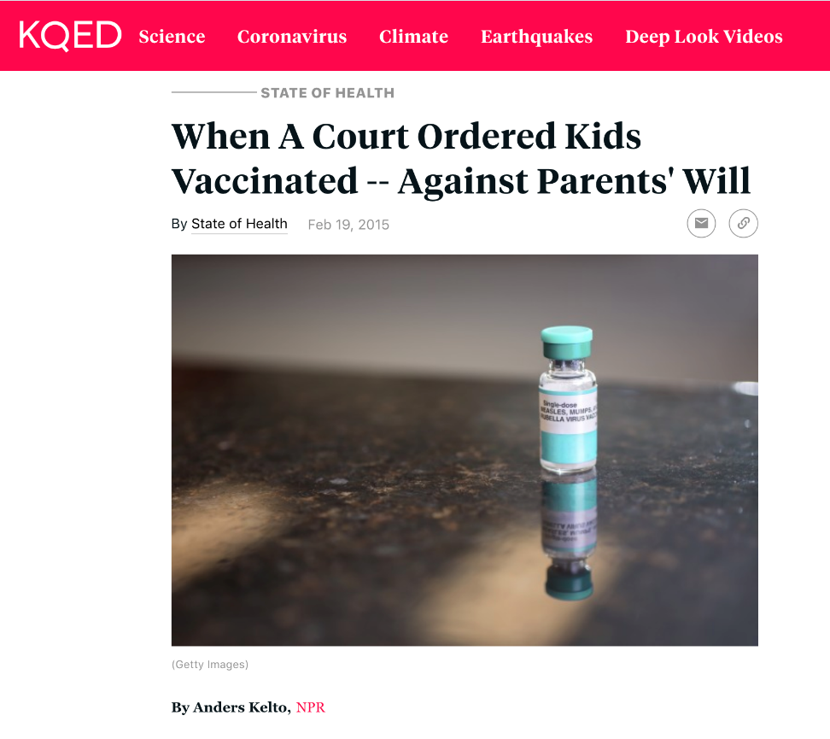
With respect to the “hypothetical” scenario we’ve been discussing . . .
“It sounds like something that might have happened a hundred years ago.
“But this was 1991—and the disease was measles.”

Slide 87
True or False Question - 6
Children can be required to be vaccinated in order to attend school, regardless of their parents’ wishes.
  ☐ True
  ☐ False

Slide 88
True or False Answer - 6
Children can be required to be vaccinated in order to attend school, regardless of their parents’ wishes.
  ☒ True → CORRECT ANSWER
  ☐ False

Slide 89
Permitted Exemptions from School & Child Care Immunization Requirements
All states allow students to attend school without standard vaccinations if they have a medical reason for the exemption.
Most states (approx. 45) exempt kids for religious reasons and/or on account of their parents’ personal beliefs.
5 states (CA, ME, MS, NY, WV) allow exemptions from school vaccination requirements only for medical reasons.

Slide 90
Final Takeaways
When responding to public health emergencies, it is important for agencies to think about their response from an equity perspective.
Public health law is central to emergency preparedness and response.
The Constitution defines both the powers and limits of public health authority.
The power to protect the common good must be balanced against the rights of affected individuals.

Slide 91
Resources
To learn more, visit these websites:
Public Health Emergency Law Online Training: https://www.cdc.gov/phlp/publications/topic/trainings/ph-emergencylaw.html
Law and Epidemic Emergency Preparedness (LEEP) Online Training: https://www.cdc.gov/phlp/publications/topic/trainings/leep.html

Slide 92
Public Health Emergency Law (PHEL) Competency Model
Domain 3: Management and Protection of Persons
Competency 3.1: Implement the use of relevant legal information, tools, procedures, and remedies related to social distancing, including evacuation, quarantine and isolation orders, closure of public places, and curfews
Competency 3.2: Recognize the sources of potential civil and criminal liability of public health personnel and consider due process issues before taking legal action

Slide 93
How would you ask your attorney to help you achieve Competencies 3.1 and 3.2?
Competency 3.1: Implement the use of relevant legal information, tools, procedures, and remedies related to social distancing, including evacuation, quarantine and isolation orders, closure of public places, and curfews
Competency 3.2: Recognize the sources of potential civil and criminal liability of public health personnel and consider due process issues before taking legal action

Slide 94
Funding Acknowledgment
This training was supported by the Centers for Disease Control and Prevention of the US Department of Health and Human Services (HHS) as part of a financial assistance award totaling $210,000 that was 100 percent funded by CDC/HHS. The contents are those of the authors and do not necessarily represent the official views of, nor an endorsement, by CDC/HHS or the US Government.

Slide 95
Thank you for attending
Public Health Threats & the US Constitution: What Responders Need to Know About Equity, Law, and Public Health Authority
To learn more about other public health law topics, visit
www.publichealthlawacademy.org

