Slide 1

Collaborative
HEALTH
Notes:
Instructions for presenters:
Obtaining buy-in from leadership is critical to the success of a Health in All Policies initiative. This presentation is designed to help make the case for Health in All Policies and build support for an initiative among community leaders and community members. Both the slides and the script can be tailored to target a particular audience or a community’s specific needs and interests.
When preparing for this presentation, presenters should first review “From Start o Finish: How to Permanently Improve Government through Health in All Policies” available at: http://changelabsolutions.org/publications/HiAP_Start-to-Finish
We strongly encourage presenters to provide examples from their own community. This can ensure Health in All Policies isn’t an abstract concept, but rather something that is visibly and tangibly needed in the audience’s community. This is a strategy many communities have used when promoting Health in All Policies in their own communities. For example, in Richmond, CA staff are conducting internal trainings to build the capacity of city staff to understand how health equity impacts the community in Richmond and how different government projects can impact health equity. They include real life examples of how health equity impacts Richmond residents in all of their trainings.
Presenters may wish to rename this presentation in a way that resonates with their audience. Because there is sometimes a perception that health departments and health care providers are the only groups responsible for health, many communities have chosen to frame their initiative in more inclusive ways, using frameworks like equity, sustainability, or wellness. However, when thinking about how to frame an initiative, it’s important to consider not only what is politically palatable but also what you hope to achieve. For example, sustainability doesn’t always address health. A health-focused initiative does not always address sustainability. And, both of these frames don’t always tackle equity. ChangeLab Solutions uses a health equity frame, because health equity addresses sustainability, health, and equity. For more information about why sustainability is a health equity issue, refer to the Health in All Policies: A Guide for State and Local Governments available at: http://www.phi.org/resources/?resource=hiapguide

Slide 2
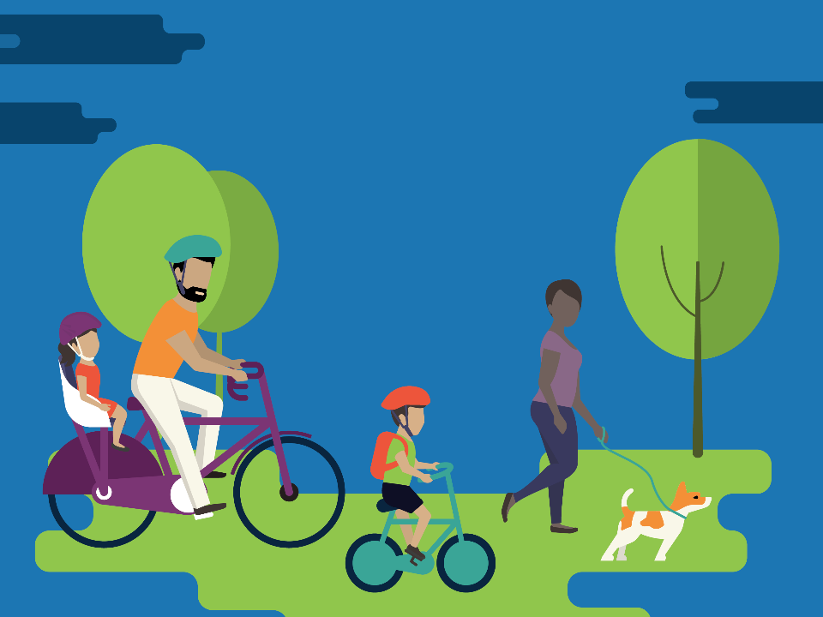
How do you build a
healthy community?
Notes:
Script:
Health is one of our most precious resources. People everywhere want their families and communities to experience well-being and to thrive. But, how do you build a healthy community?

Slide 3
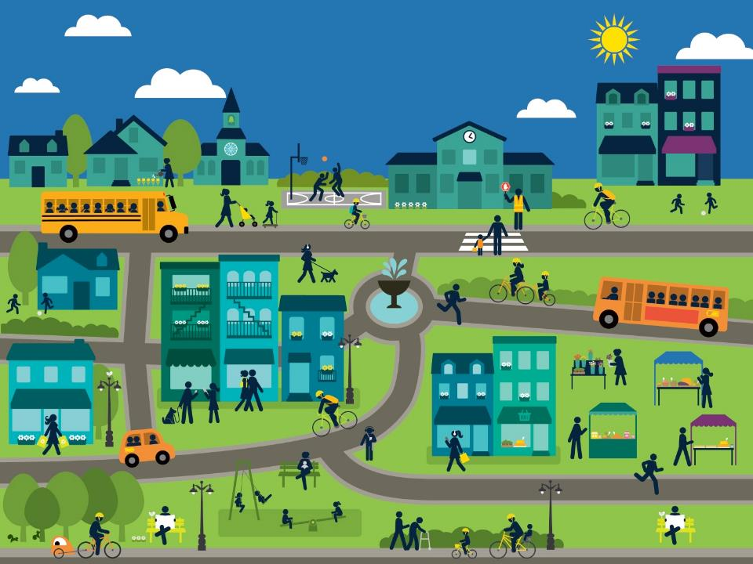
Environment is
everything
Notes:
Script:
The fact is, health is influenced by the interaction of many factors – not simply genetics, individual behavior, or even access to health care. What do we need to be healthy?
Instructions for presenters:
When preparing for this presentation, presenters are encouraged to include information about the local environment and how it affects the health of your local community. For more background reading on the role of the environment on health, visit: http://www.countyhealthrankings.org/our-approach

Slide 4
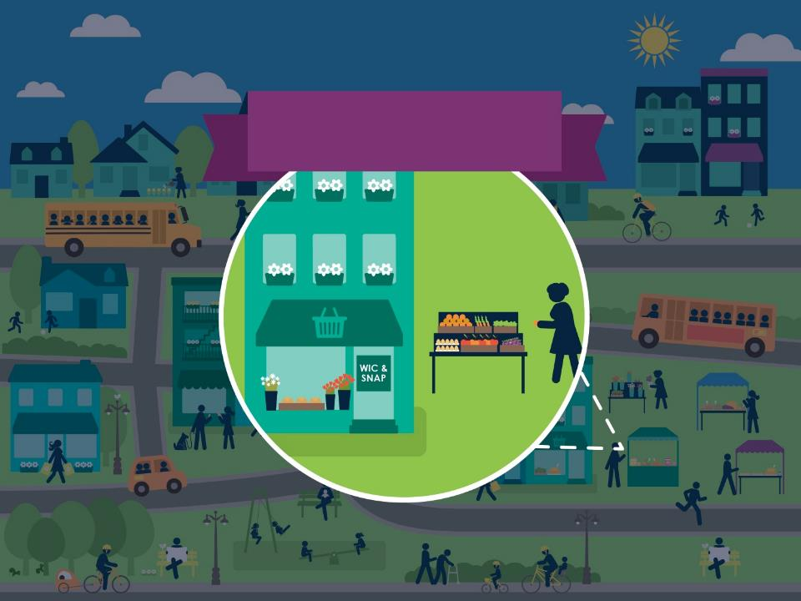
Food
Notes:
Script:
We need healthy food.

Slide 5
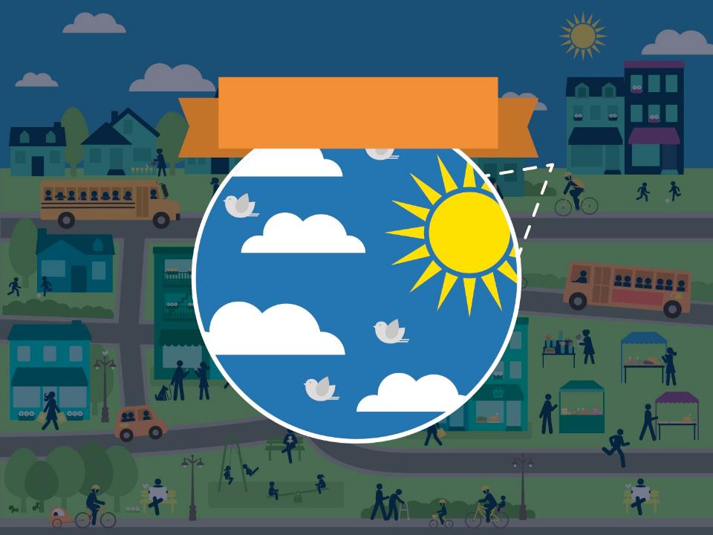
Air & Water
Notes:
Script:
We need clean water and air.

Slide 6
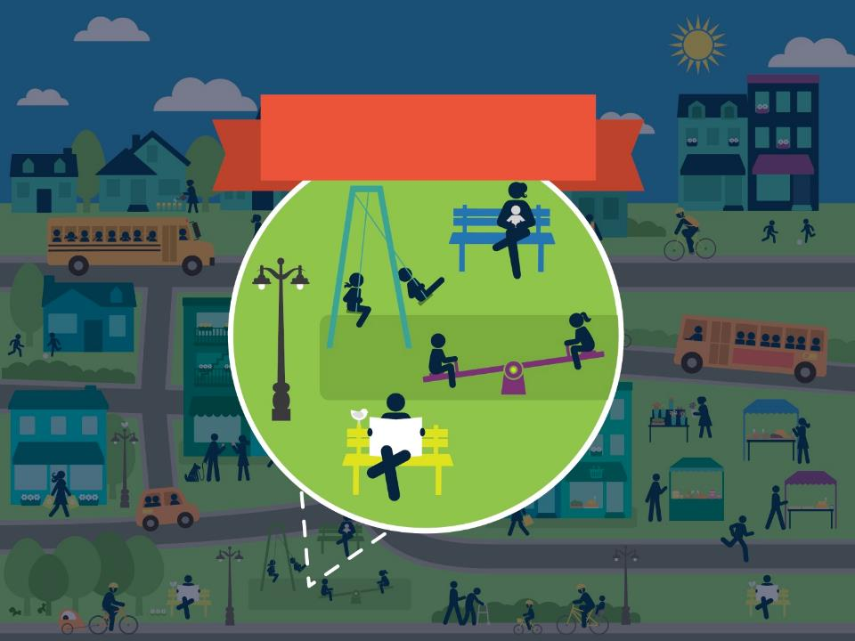
Recreation
Notes:
Script:
We need safe parks and green spaces for recreation and play.

Slide 7
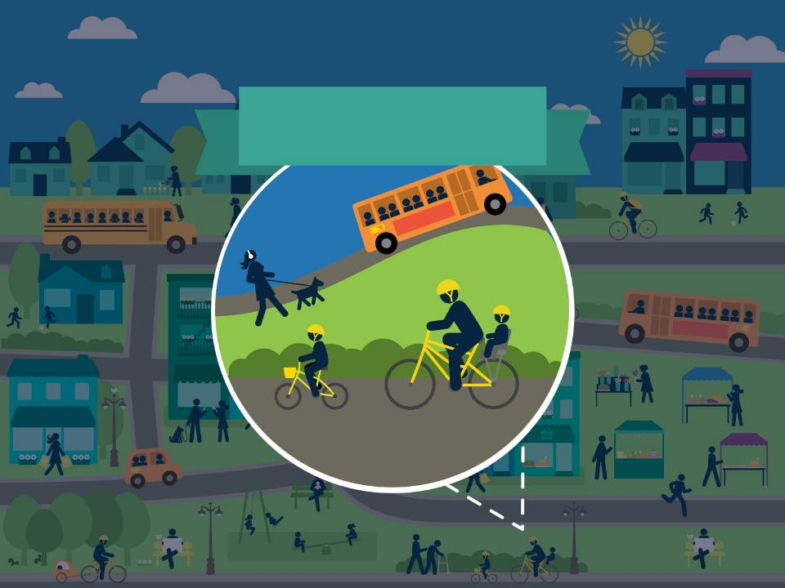
Transportation
Notes:
Script:
We need to be able get around safely on foot or bicycle.

Slide 8
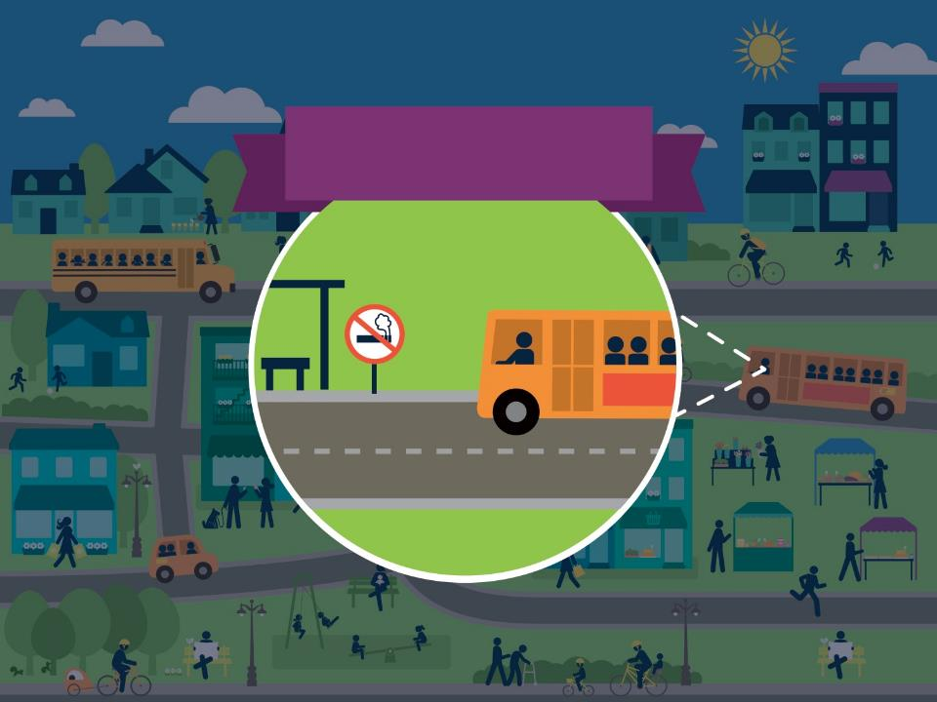
Toxin & Tobacco free
Notes:
Script:
We need tobacco-free places to live, study, work, and play.

Slide 9
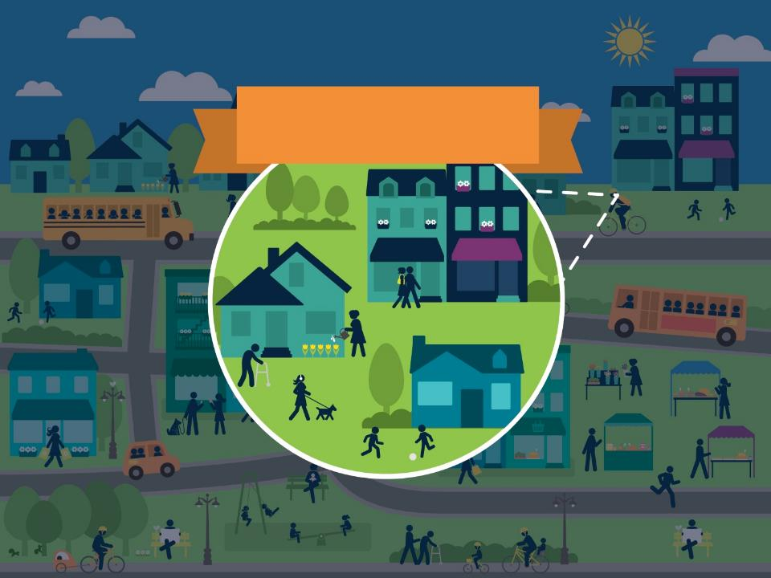
Housing
Notes:
Script:
We need homes that are safe and well maintained, affordable, and located in neighborhoods that provide access to daily needs.

Slide 10
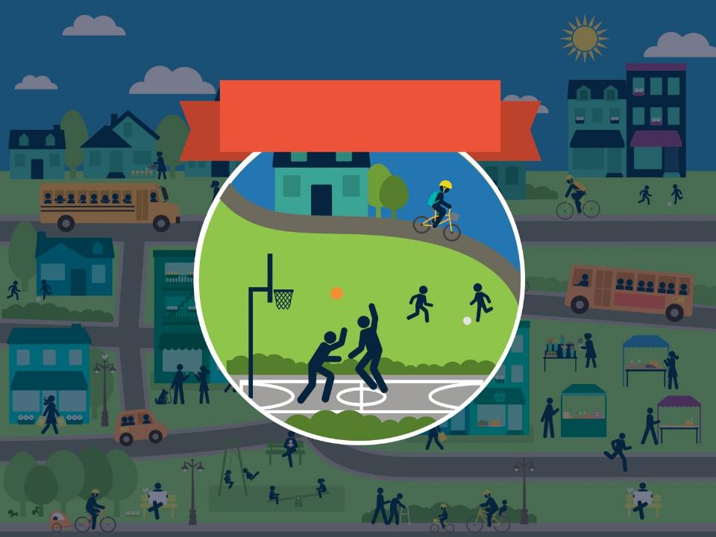
Community
Notes:
Script:
We need communities that are violence-free.

Slide 11
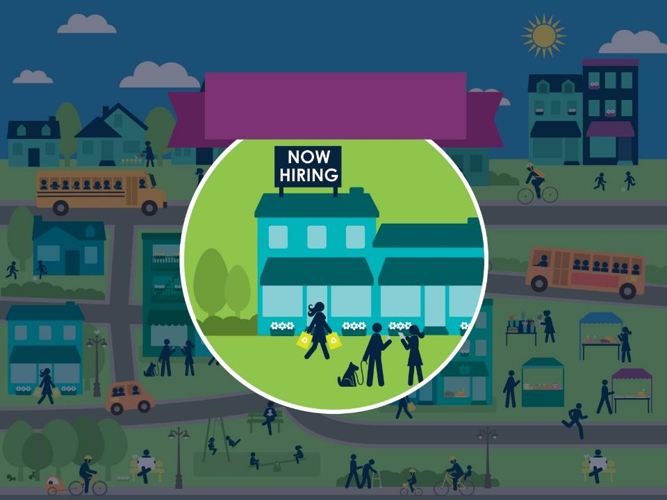
Jobs & Opportunities
Notes:
Script:
We need good jobs and opportunities to start and grow our own businesses.

Slide 12
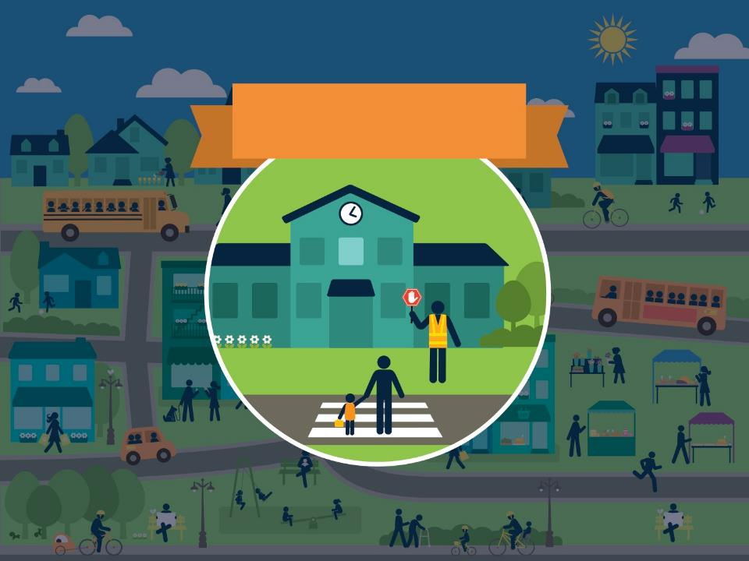
Schools
Notes:
Script:
We need healthy schools where our kids can learn, grow and succeed.

Slide 13
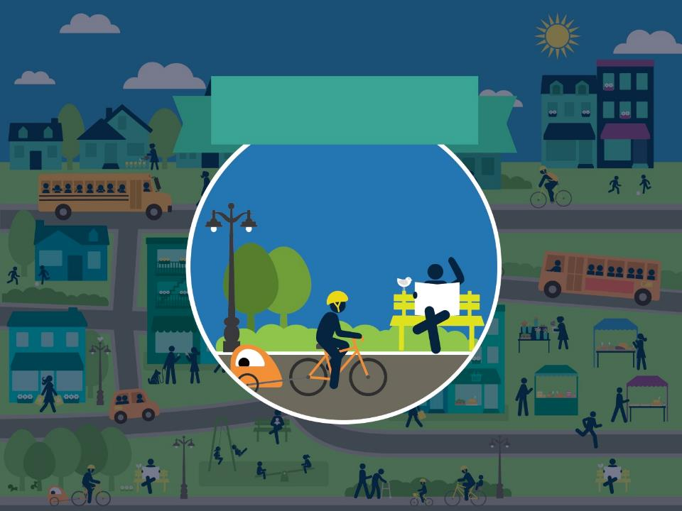
Connectedness
Notes:
Script:
We need to feel connected to our neighbors and our communities.

Slide 14

Our health is affected by the places we
live, work, & play
Notes:
Script:
It is now widely accepted that the environments in which people are born, live, learn, work, play, and age have the greatest impact on health outcomes across populations.

Slide 15

How can we create
HEALTHY
ENVIRONMENTS?
Notes:
Script:
But whose job is it to create those healthy environments?

Slide 16

Experts like
the CDC
agree that the best way to achieve health is to change environmental factors
Notes:
Script:
Experts like the Centers for Disease Control and Prevention agree that one of the best ways to achieve health is by changing the environmental factors that drive health outcomes.
Instructions for presenters:
For background reading about why policies are important to health, refer to:
Frieden TR. A framework for public health action: the health impact pyramid. Am J Public Health. 2010;100(4):590–5. doi:10.2105/AJPH.2009.185652. Available at: http://www.ncbi.nlm.nih.gov/pmc/articles/PMC2836340/

Slide 17

To create
change,
there must be policy
Notes:
Script:
And to create this kind of change, there must be policy.

Slide 18

Policies
provide the framework
Notes:
Script:
Policies provide the framework for achieving healthy environments. Policies affect everything including access to healthy food, clean water and air, physical activity, housing, jobs and schools.

Slide 19

Healthy Eating
Notes:
Script:
How do policies improve our access to healthy food?
Policies ensure public financing goes to support new grocery stores in neighborhoods that need fresh food.
Policies such as zoning ordinances make it possible for communities to have farmers’ markets and community gardens.
Or, policies that set rules for libraries or parks and recreation departments ensure that vending machines have healthy options instead of only sugary drinks.
These decisions affect whether we have access to healthy food and whether or not we are more likely to be obese or develop diabetes.

Slide 20
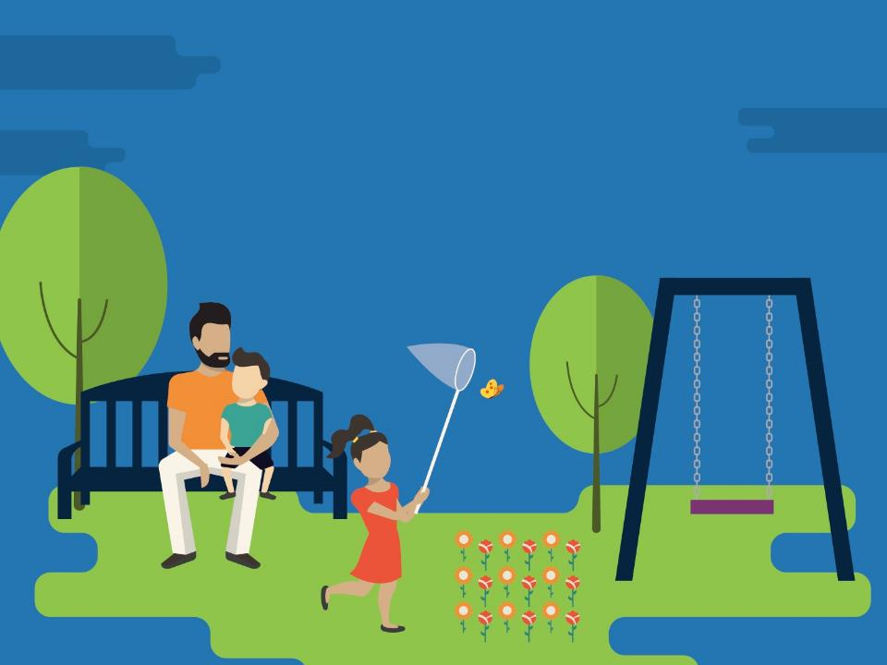
Parks & Recreation
Notes:
Script:
Policies can create healthy, safe parks in our neighborhoods by ensuring new developments provide green space and existing parks are well-maintained.
These kinds of policies help us stay physically active and connect with our neighbors.

Slide 21
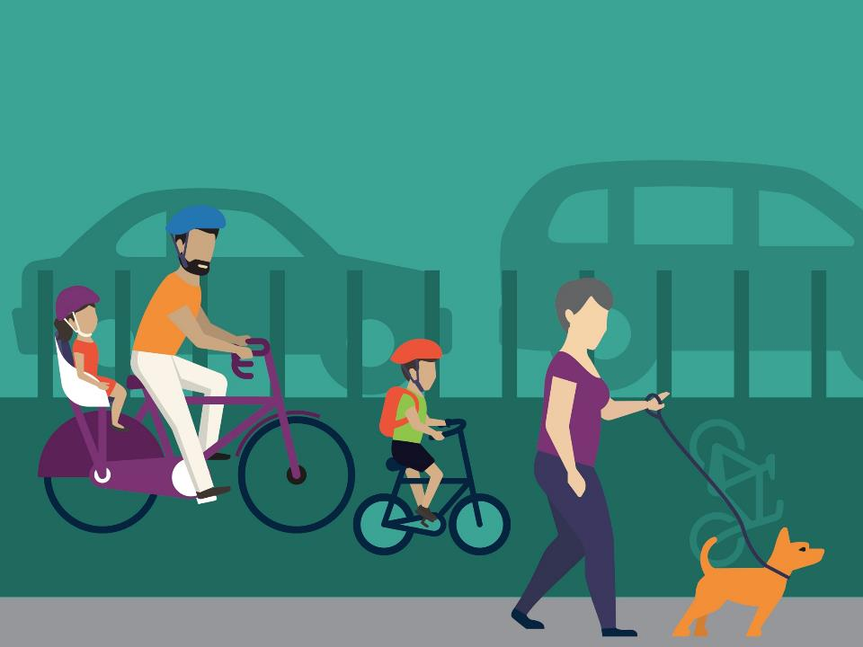
Transportation
Notes:
Script:
Policies make it possible for us to safely walk or bike to meet our daily needs.
For example, street design standards determine if there are sidewalks to walk on or bike lanes for us to ride on, which affects:
How often we walk, run, or bike,
How physically fit we are,
What the quality of air we breathe is, or
Whether or not we have asthma.

Slide 22

Tobacco Free
Environments
Notes:
Script:
Policies make it possible to have smokefree air by creating tobacco free workplaces, public spaces, and apartment buildings.
These kinds of policies improve the quality of air we breath and protect us against respiratory disease or cancer.

Slide 23
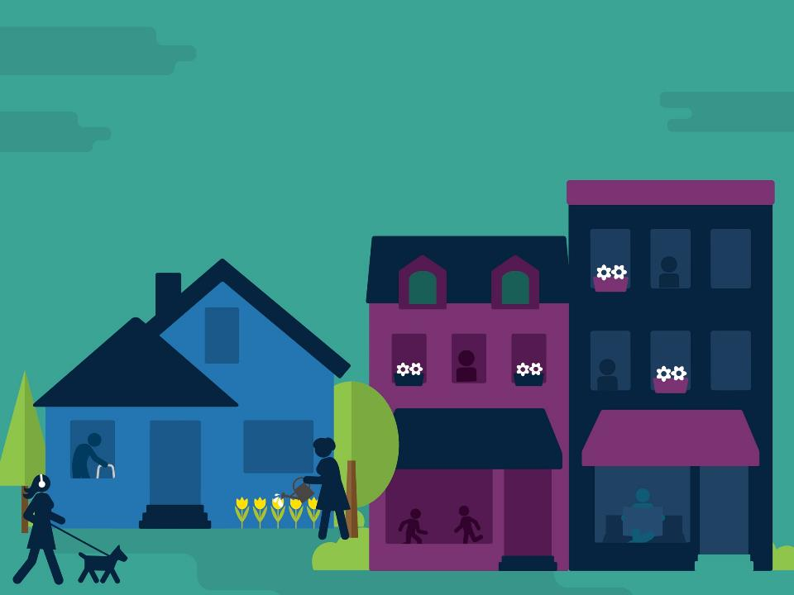
Housing
Notes:
Script:
Housing policies make it possible for our homes to be healthy.
Like building standards that protect us from unsafe designs, insects, rodents, or mold.
These kinds of policies affect the health of the homes we live in and whether or not we are likely to be in a fire or fall down a flight of stairs.
Housing policies also make it possible for our homes to be affordable by protecting, preserving and promoting affordable housing.
These kinds of policies ensure that we have a safe place to live and money left for food, healthcare, and childcare.
Over the long term, housing policies that make our homes healthy and affordable can affect whether or not we experience stress, develop asthma, or suffer from other forms of chronic disease.

Slide 24
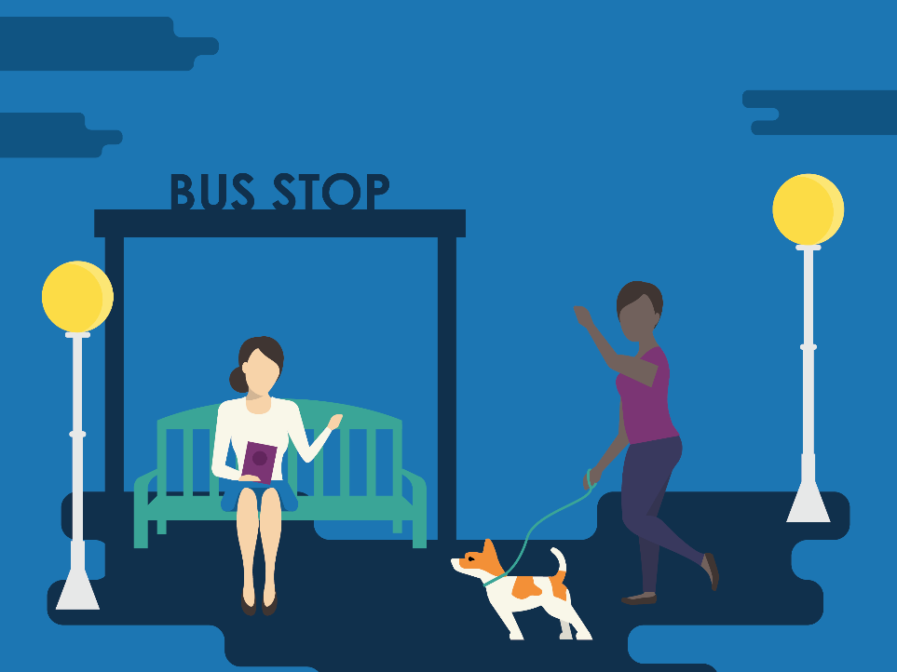
Public Safety
Notes:
Script:
Policies make it possible for communities to be safe and violence-free by requiring lighting at bus stops or in parks and by requiring buildings to have windows that face out onto the street.
These kinds of policies make it possible for people to safely walk to the bus stop at night.

Slide 25

Economic Opportunity
Notes:
Script:
Policies make it possible for people to find and keep good jobs.
Economic development agencies can make policies that attract businesses that pay a living wage.
Transportation agencies can plan transit routes that provide better access to employment.
These kinds of policies make it possible for people have the resources they need to live longer, healthier lives.

Slide 26
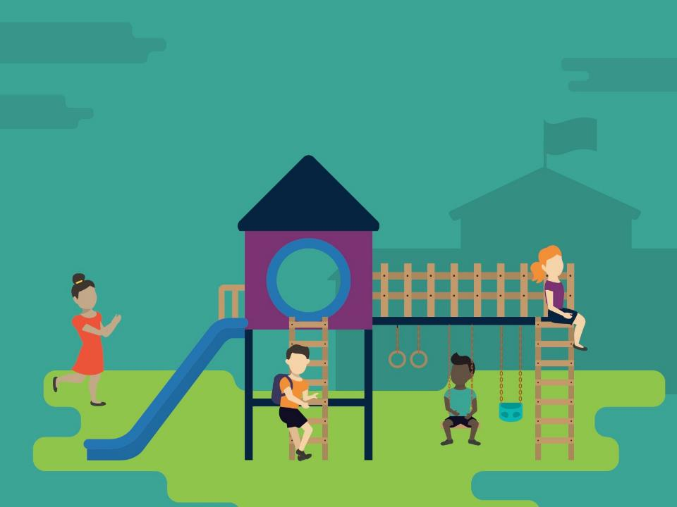
Schools
Notes:
Script:
Policies make it possible for our schools to be healthy:
By setting standards for what’s served in school cafeterias and vending machines
By making sure that drinking water is clean and available
By making it possible for kids to walk or ride their bikes to school.
By opening up school playgrounds for community use after school hours
These kinds of policies affect what kids eat, how physically active they are, and if they can focus during school.

Slide 27

100+ years
OF POLICY HAS
ACCOMPLISHED A LOT
Notes:
Script:
For more than a century, we’ve used policy to protect people’s health. This has resulted in some big successes.

Slide 28
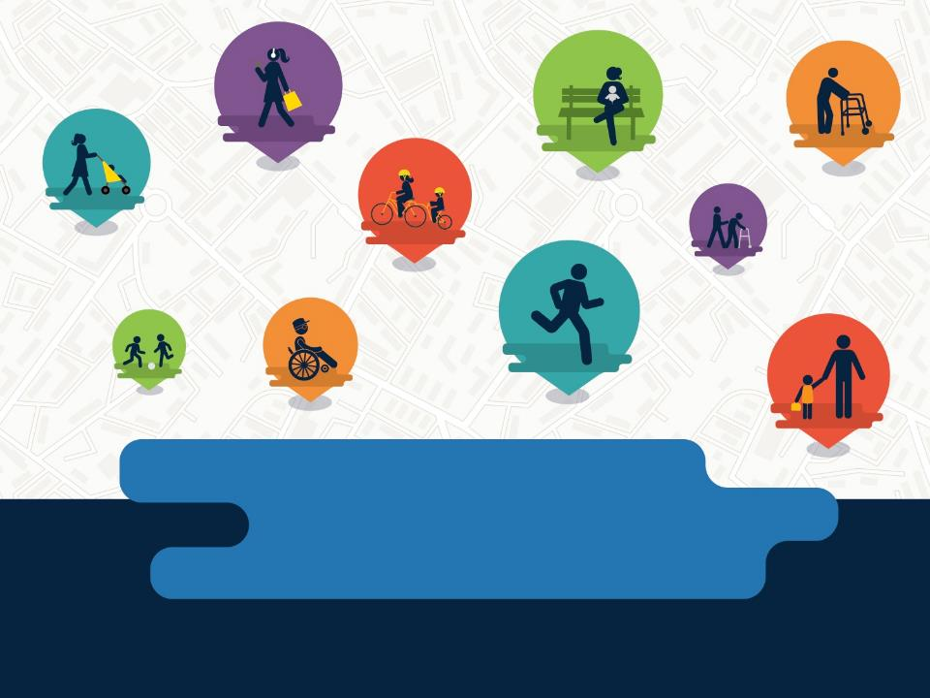
millions
of lives saved, for instance
Notes:
Script:
For example, laws that prohibit smoking in public places and raised the price of tobacco products have helped save more than 1.6 million lives since 1964.
Or another example is seat belt laws, which have saved more than a quarter of million lives since 1975.

Slide 29

Sometimes policy doesn’t take health into account
Notes:
Script:
However, we have also made many policies without ever taking health into account.

Slide 30

Isolated
Uncoordinated
Inconsistent
Notes:
Script:
Making isolated changes to our environments, without ensuring they are coordinated or consistently applied.

Slide 31
PREVENTING US FROM SOLVING
our biggest challenges
Notes:
Script:
Disjointed or uncoordinated policies prevent us from effectively tackling major societal challenges…

Slide 32

Violence
Poverty
Chronic disease
Climate change
Notes:
Script:
…such as violence, poverty, climate change, and chronic disease.

Slide 33

Consider one
beautiful park
Notes:
Script:
For example, a parks and recreation department might invest in a new park.

Slide 34

What happens when park policy is disconnected from housing policy?
Notes:
Script:
Which contributes to rising property values for nearby homes.
The parks and recreation department might do this without working with the local housing agency to ensure that as property values rise, current residents can still afford to live in the neighborhood.
When parks and recreation departments make changes without coordinating with the housing department, the community misses an opportunity to make a healthy neighborhood for all residents.

Slide 35
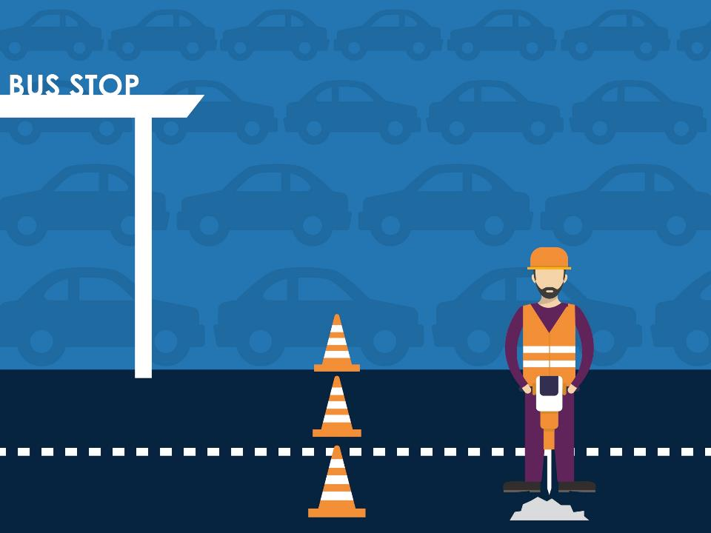
Consider a
new roadway
Notes:
Script:
Or, a transportation department might be focused on reducing congestion by expanding a roadway.

Slide 36
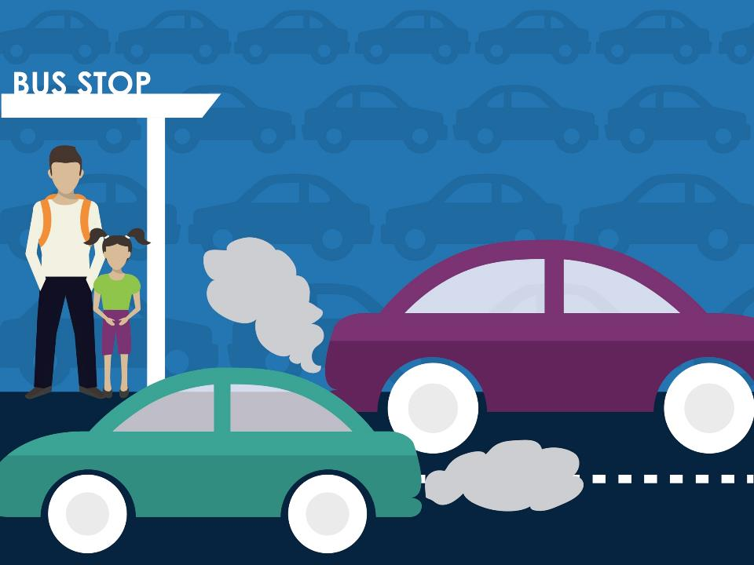
What happens when transportation agencies
are disconnected from air quality agencies & the local health department?
Notes:
Script:
The department may have decided to add new lanes without considering how the additional cars will increase air pollution, which could exacerbate nearby residents’ asthma.
They may also have missed research on how designing streets that encourage people to walk, bike, and take transit could both help residents be healthier and reduce congestion.
When the transportation department’s policies don’t routinely take health into account, the community misses the opportunity to create a safer and more effective transportation network.

Slide 37
WHAT IF WE COULD
change it?
Notes:
Script:
But, what if we could change all of this?

Slide 38

Working together to tackle our
biggest problems
Notes:
Script:
By working together to tackle our biggest problems.

Slide 39
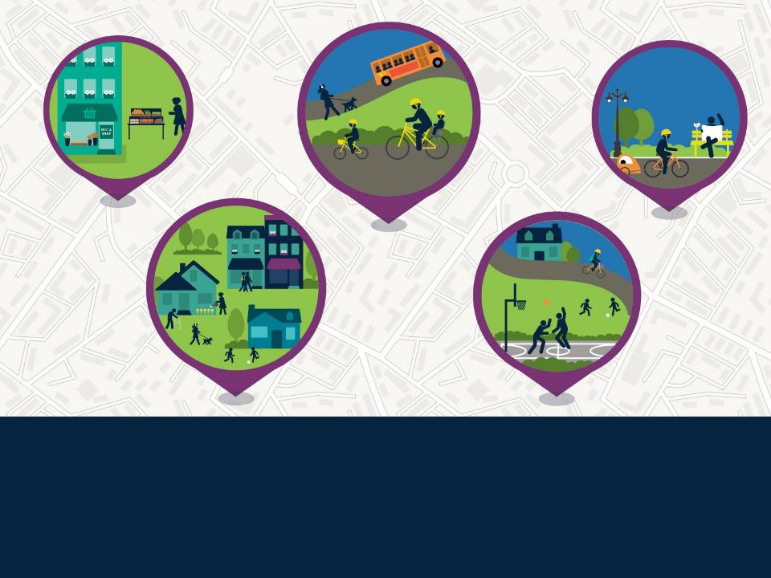
What would it look like?
Notes:
Script:
What would it look like?

Slide 40
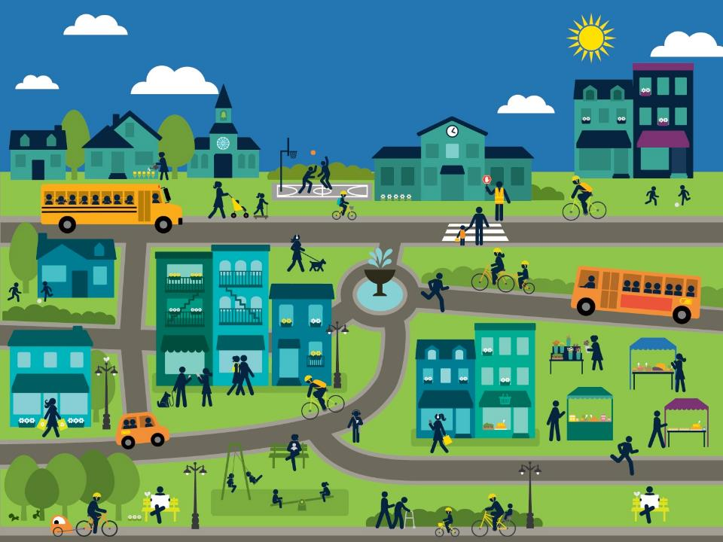
A new
approach
Notes:
Script:
It would mean a new approach.

Slide 41
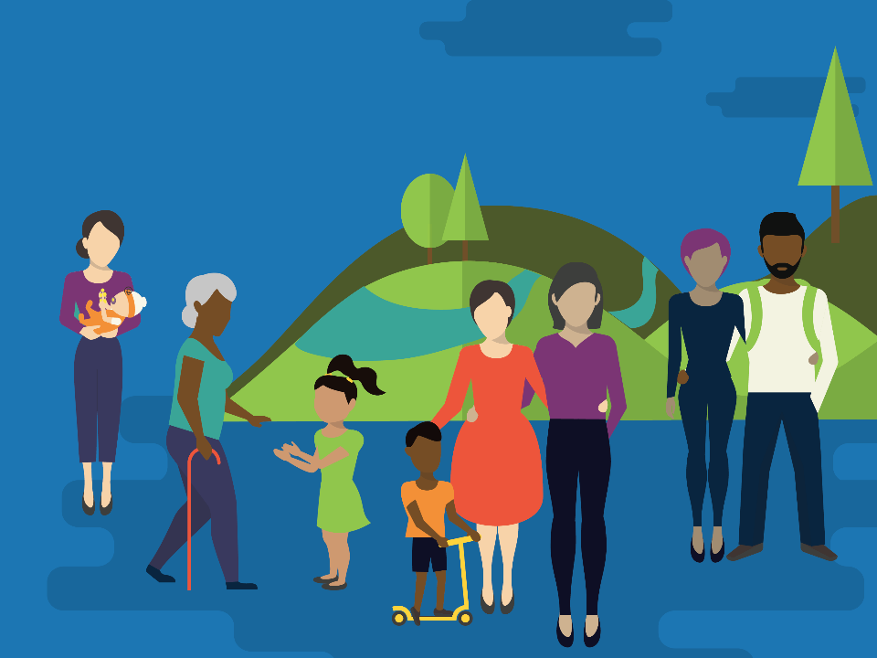
Health
in all polices
Notes:
Script:
Some have called it joined up governance, whole of government, or even Health in All Policies
Instructions for presenters:
This slide and the next two slides can be relabeled to reflect what will resonate the best in your community.

Slide 42
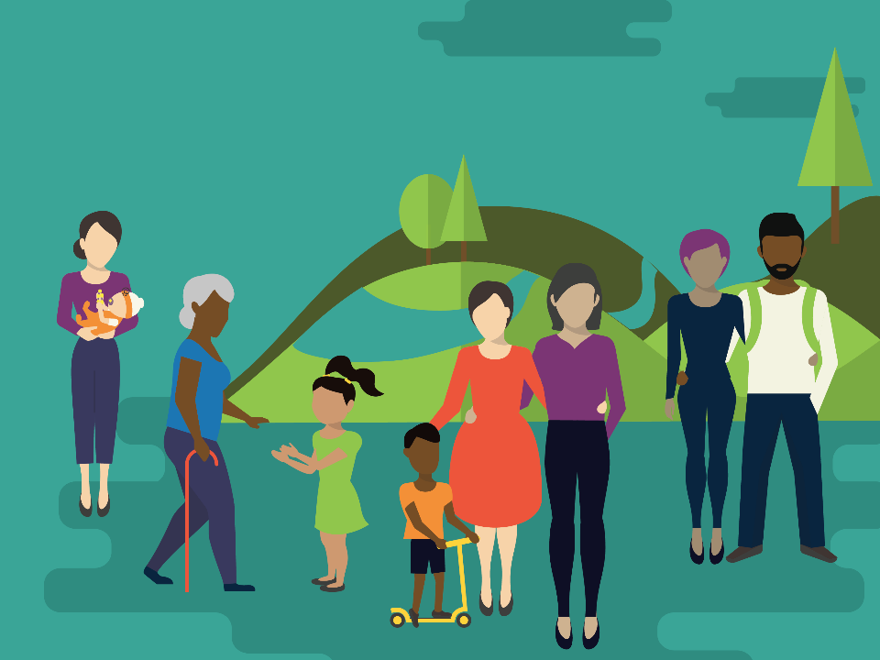
Sustainability
in all polices
Notes:
Script:
You might call it sustainability in all policies, wellness in all policies, or…

Slide 43
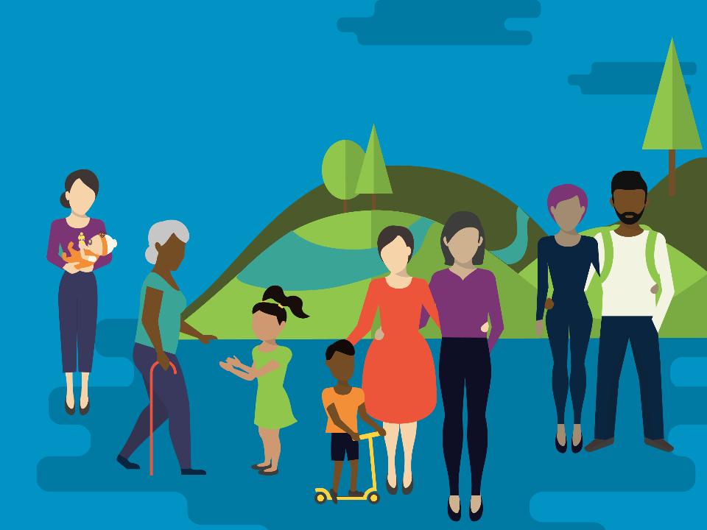
Equity
in all polices
Notes:
Script:
Even equity in all policies.

Slide 44
It all means one thing:
BRINGING PUBLIC
AGENCIES TOGETHER
Notes:
Script:
Ultimately, the name is actually less important than the underlying idea, which is to adopt a collaborative approach to improving the health of all people by incorporating health, sustainability, and equity considerations into decision-making across sectors and policy areas.
The bottom line is: You can’t get interdisciplinary solutions unless people talk to each other, and sometimes, we need a little nudge (and a meaningful directive) to make that happen.

Slide 45

A policy
sets the framework for the
new approach
Notes:
Script:
To implement Health in All Policies, local governments must adopt a new approach to decision-making, and many have found that they need an authorizing or implementing policy to do so. To achieve this, some communities have passed resolutions, some have ordinances, some use executive orders, and some embed the approach in policies like general plans.

Slide 46

2.
Engage & envision
3.
Make a plan
4.
Invest in change
1.
Convene & collaborate
5.
Track progress
5
Key Strategies
for Collaborative Health
Notes:
Script:
Whichever approach what a community chooses, what does a policy that formalizes Health in All Policies do?
The policy would require us to convene leadership from each of relevant government agencies in our community and require our leadership to work collaboratively to solve our biggest problems.
The policy would encourage us engage our community members and create a vision for a healthy community.
The policy would require us to make a plan for how we will achieve that vision and then invest in change by implementing that plan.
Lastly, the policy would allow us to track progress to see what has been accomplished and what we still need to do to make our community the strongest and healthiest community in the region.
Instructions for presenters:
Here presenters are encouraged to do research to see what kind of cross-agency collaborations may already exist. Many communities have existing multiagency task forces that may be tackling any number of community issues, such as teen pregnancy, juvenile justice, aging populations, obesity, and chronic disease prevention. Some communities may find they can expand an existing task force to take on Health in All Policies; however, there may be structural or other reasons why creating a new group makes more sense. If there are reasons for why a new task force is needed, you should be prepared to answer the question of how this new policy’s interagency task force is different from existing task forces. The answer, of course, being that a Health in All Policies task force has a broad scope and representation from all agencies.

Slide 47

Collaborative
HEALTH
Notes:
Script:
In sum, why should we adopt this kind of policy?
As covered, every government agency affects health and we need everyone working together to tackle our biggest challenges. However, there are many other reasons communities across the country are adopting this kind of policy including the fact that this kind of policy can:
Improve the health for all people in our community, especially those at highest risk for poor health. We are experiencing high social and economic costs of health inequities. Health inequities are differences in health associated with individual or group-specific attributes (e.g., income, education, or race/ethnicity) that are connected to social disadvantage as well as historical and contemporary injustices, and which can be minimized through changes to policy, programs, and practices. For example, African-Americans are far more likely to die as infants, die from heart attacks and stroke, and be murdered than Whites. Hispanics and Latinos are more likely to be hospitalized from a preventable cause than Whites. Low-income populations are more likely to suffer from asthma, be hospitalized for preventable causes, and be diagnosed with diabetes than wealthier people. Health inequities, such as these, are the result of social, physical, and economic conditions shaped by laws, policies, and ongoing practices. Those conditions determine whether someone can buy fresh fruits and vegetables in their neighborhood, walk safely to and from school and work, graduate from school and find a job, and live in a home free of pests and mold.
Improve the economic well-being of our community because healthier workers are more productive, have fewer sick days, and have decreased health care costs. Similarly, healthier students learn better and are more likely to graduate school. And healthy older adults live longer and require substantially less health care. Policies that make the community healthier have seen significant return on investment by reducing health care costs, creating jobs, and increasing tax revenue. Researchers have even suggested that more than 50 percent of economic growth in the U.S. during the 20th century was the result of improvement in population health. In just the area of obesity prevention, for every one dollar invested in obesity prevention, there is a return of an estimated $5.60.
Be a vehicle for improving government efficiency by creating greater efficiency and improving public agencies’ relationships with the community. After adopting a Health in All Policies approach, many communities have been able to streamline their services.
Sustain success over the long term. Adopting a community-wide policy will solidify our commitment to the initiative. A formal policy requires government agencies to collaborate and helps all agencies become full partners in creating healthier communities. A policy also ensures that support for the initiative is sustained over the long term. That early victories build toward lasting success. And that health is an enduring part of every departmental agenda.
Let’s join together to build a stronger, healthier, more vibrant community.
Instructions for presenters:
Above are the list of reasons that we have found encourage the adoption of a policy formalizing Health in All Policies. When preparing this presentation, presenters should select the reasons that will resonate most with their audience and add local data wherever appropriate.

