Slide 1
Advanced Legal Epidemiology Methods

Slide 2
ChangeLab Solutions Disclaimer
The information provided in this training is for informational purposes only and does not constitute legal advice. ChangeLab Solutions does not enter into attorney-client relationships.
ChangeLab Solutions is a nonprofit organization that educates and informs the public through objective, nonpartisan analysis, study, and research. The primary purpose of this discussion is to address legal and policy options to improve public health. There is no intent to reflect a view on specific legislation.
Copyright © 2021 ChangeLab Solutions

Slide 3
CDC Disclaimer
These course materials are for instructional use only and are not intended as a substitute for professional legal or other advice. While every effort has been made to verify the accuracy of these materials, legal authorities and requirements may vary from jurisdiction to jurisdiction. Always seek the advice of an attorney or other qualified professional with any questions you may have regarding a legal matter.
The contents of this presentation have not been formally disseminated by the Centers for Disease Control and Prevention and should not be construed to represent any agency determination or policy.

Slide 4
Competencies
Identify opportunities to address legal, health, or other issues
Understand study designs that show potential associations between law and health
Collect and analyze qualitative and quantitative study data
Interpret results, draw conclusions, and formulate key findings
Legal Epidemiology Competency Model, Domain 3, 2018

Slide 5
Overview
Recap of Legal Epidemiology
Phase 1: Planning
Phase 2: Operationalizing
Phase 3: Analyzing

Slide 6
What We’ll Discuss: Recap
Recap of Legal Epidemiology
Phase 1: Planning
Phase 2: Operationalizing
Phase 3: Analyzing

Slide 7
What We’ll Discuss: Three Phases
Recap of Legal Epidemiology
Three Phases of Legal Epidemiology Studies
  Phase 1: Planning
  Phase 2: Operationalizing
  Phase 3: Analyzing

Slide 8
What We’ll Discuss: Phase 1
Recap of Legal Epidemiology
Three Phases of Legal Epidemiology Studies
  Phase 1: Planning
  Phase 2: Operationalizing
  Phase 3: Analyzing

Slide 9
What We’ll Discuss: Phase 2
Recap of Legal Epidemiology
Three Phases of Legal Epidemiology Studies
  Phase 1: Planning
  Phase 2: Operationalizing
  Phase 3: Analyzing

Slide 10
What We’ll Discuss: Phase 3
Recap of Legal Epidemiology
Three Phases of Legal Epidemiology Studies
  Phase 1: Planning
  Phase 2: Operationalizing
  Phase 3: Analyzing

Slide 11
Recap Question:
What is legal epidemiology?

Slide 12
Recap Answer
What is legal epidemiology?
Scientific study and deployment of law
Uses transparent, scientific methods and rigorous quality control

Slide 13
Meet Wendy
Her task: determine whether distracted driving laws have an effect on health

Slide 14
Moving to Advanced Legal Epidemiology Studies

Slide 15
The Legal Epidemiology Study Team

Slide 16
Initial Study Questions
Which cell phone–related behaviors do distracted driving laws actually regulate (e.g., calling, texting, web surfing)?
What are the penalties associated with these laws?
Are these laws enforced?
Do the laws reduce crashes?
Do the laws reduce injuries and deaths caused by crashes?

Slide 17
Three Phases of an Advanced Legal Epi Study
Phase 1: Planning
Phase 2: Operationalizing
Phase 3: Analyzing

Slide 18
Phase 1: Planning

Slide 19
Phase 1: Planning
1: Review the evidence
2: Draft research questions
3: Identify laws and legal mechanisms
4: Develop a logic model
5: Check data sources
6: Select a research design

Slide 20
1: Review Evidence
Identify background research and findings to date

Slide 21
2: Draft a Research Question
Articulate a research question to be tested empirically

Slide 22
3: Identify a Law and Legal Mechanism
The presence or absence of a law in a jurisdiction
Features of laws across states

Slide 23
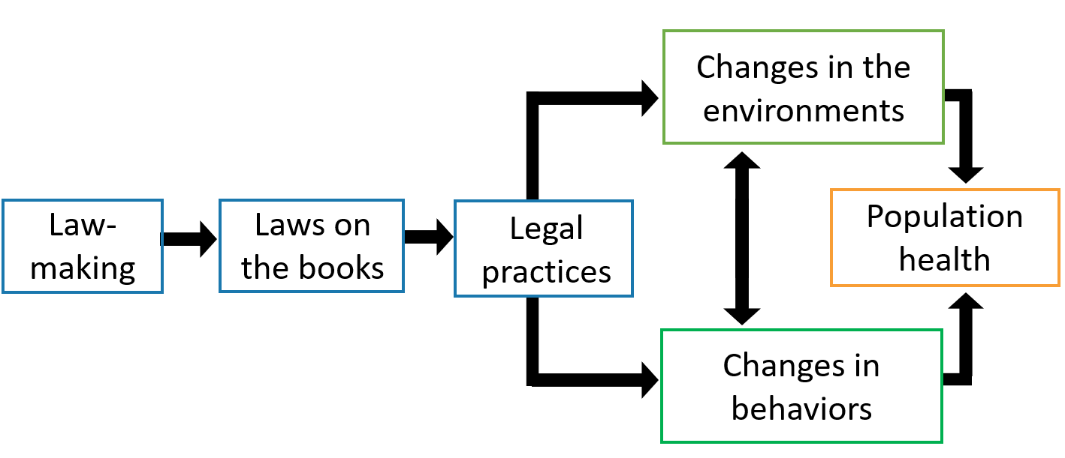
4: Develop a Logic Model
Source: Burris S, et al. Making the case for laws that improve health: a framework for public health law research. Milbank Quarterly. 2010;88(2): 169-210.

Slide 24
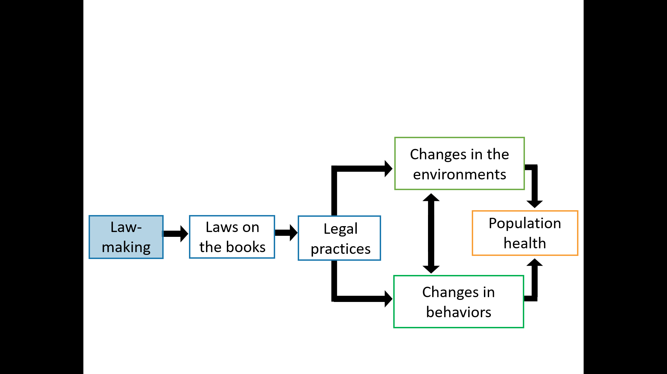
Develop a Logic Model:
Lawmaking Explained
Bill writing and editing
Public notice
Policy refinement
Lobbying
Executive review
Codification

Slide 25
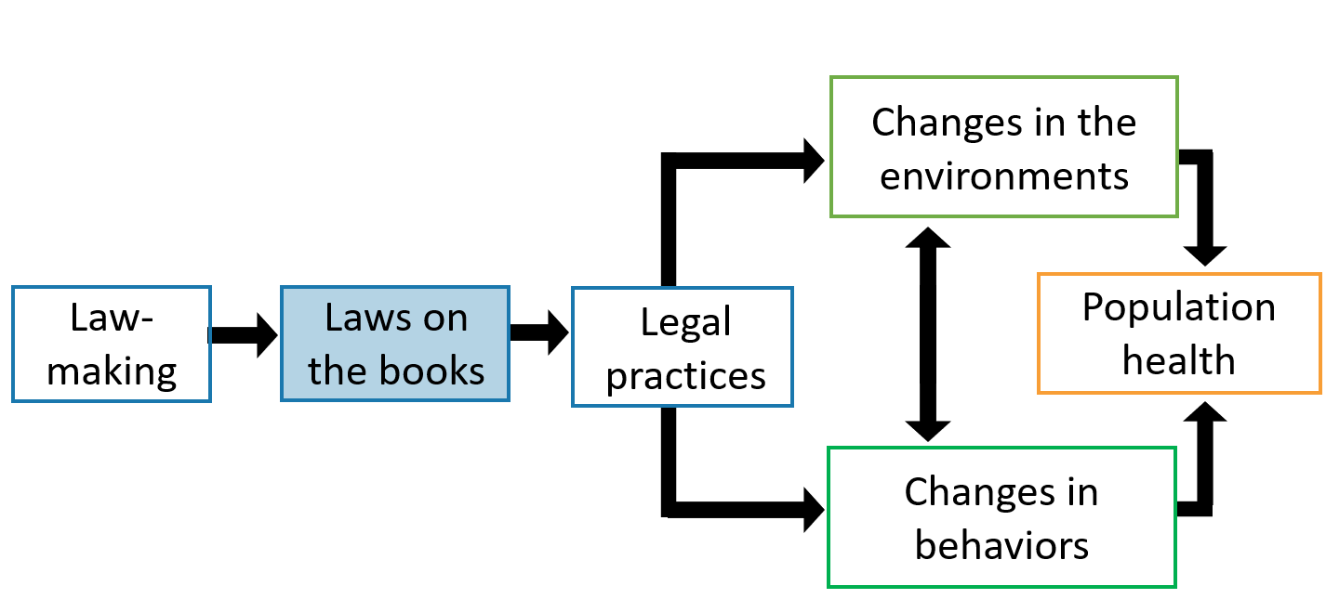
Develop a Logic Model:
Laws on the Books Explained
Statutes
Regulations
Case law
Executive orders
Administrative
rules

Slide 26
Question:
Which features of a law might Wendy want to study?

Slide 27
Answer:
Wendy might want to study the following topics:
Who does the law apply to?
What are the penalties?
Where is distracted driving prohibited?
What is the enforcement scheme?

Slide 28
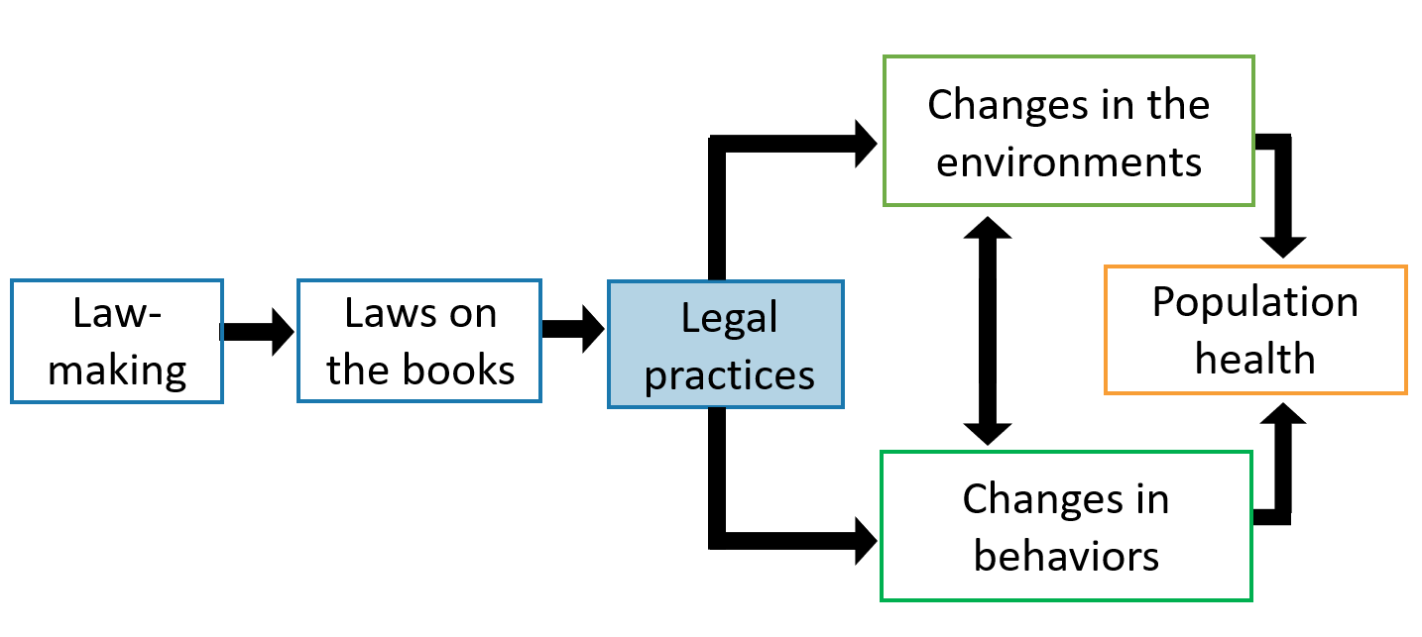
Develop a Logic Model: Legal Practices Explained
Appropriating funding
Implementation
Enforcement

Slide 29
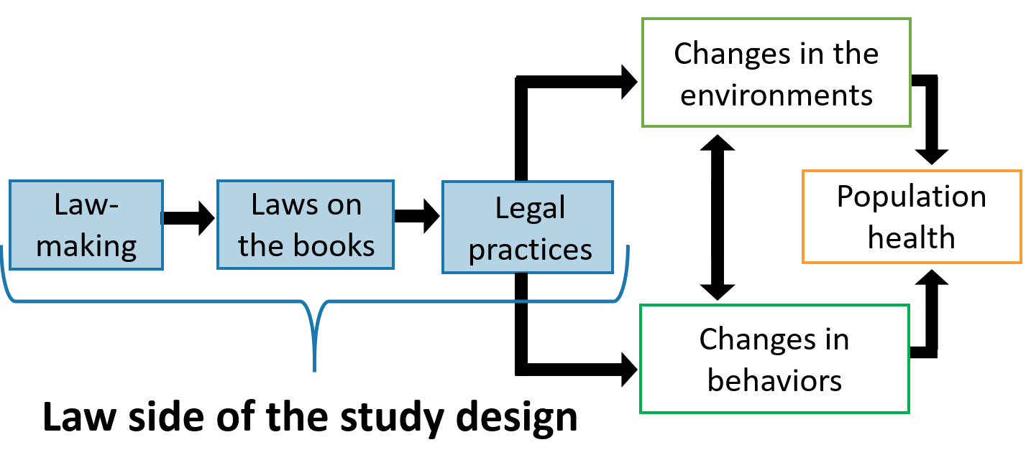
Develop a Logic Model:
Overview of the Law Side of the Study Design

Slide 30
Develop a Logic Model: Lawmaking
Example: Design a study of how a law gets passed

Slide 31
Develop a Logic Model: Laws on the Books
Example:
Design a study of the effects of a law on the books

Slide 32
Develop a Logic Model: Legal Practices (Implementation)
Example: Design a study of how laws are implemented differently across jurisdictions

Slide 33
Develop a Logic Model: Legal Practices (Enforcement)
Example: Design a study of how laws are enforced

Slide 34
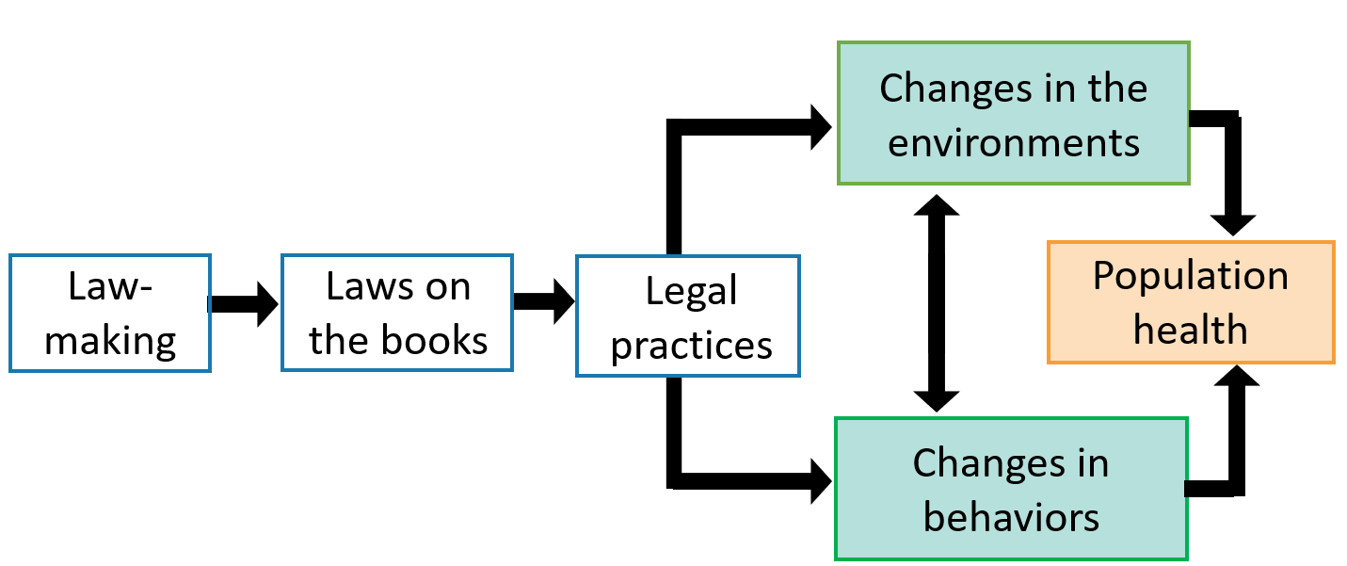
Develop a Logic Model:
Environment, Behavior, & Population Health

Slide 35
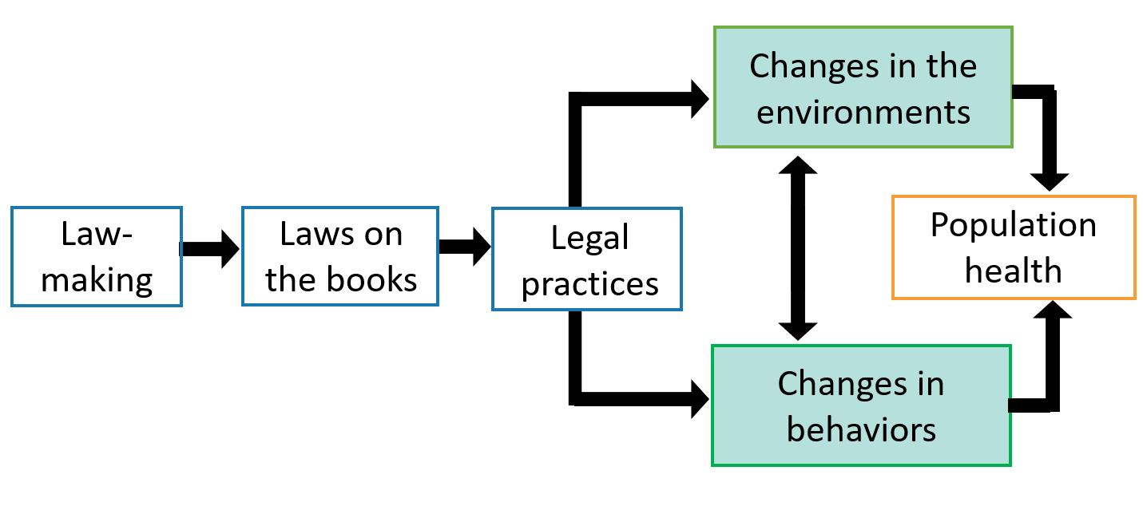
Develop a Logic Model:
Environments & Behaviors

Slide 36

Develop a Logic Model:
Laws on the Books & Distracted Driving

Slide 37
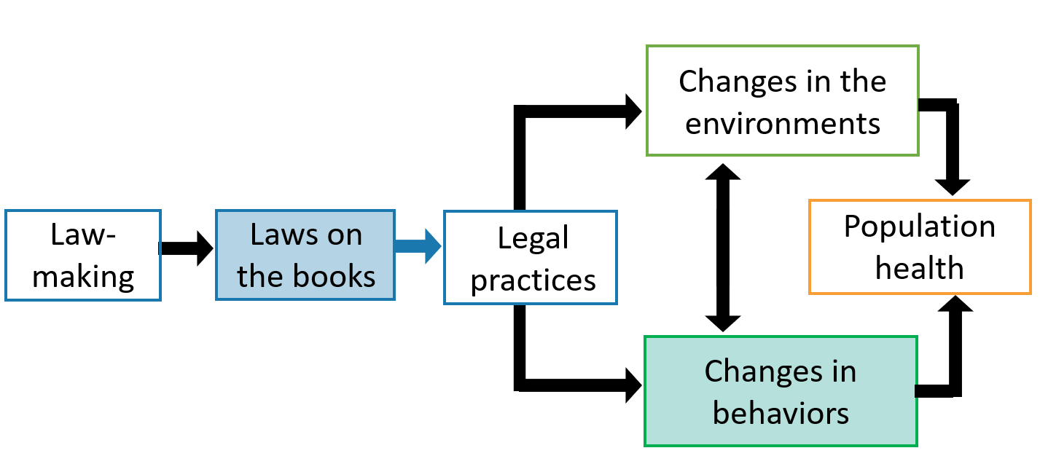
Develop a Logic Model: Distracted Driving Laws
Laws on the books (e.g., distracted driving laws)
Changes in behaviors (e.g., decrease in cell phone usage while driving)

Slide 38
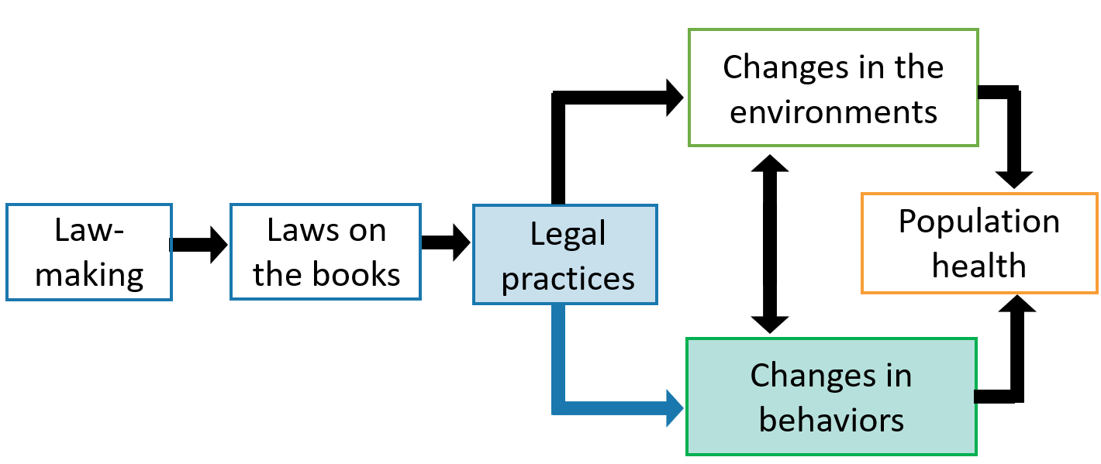
Develop a Logic Model: Distracted Driving Laws (continued)
Legal practices (e.g., citations and fines)
Changes in behaviors (e.g., decrease in cell phone usage while driving)

Slide 39
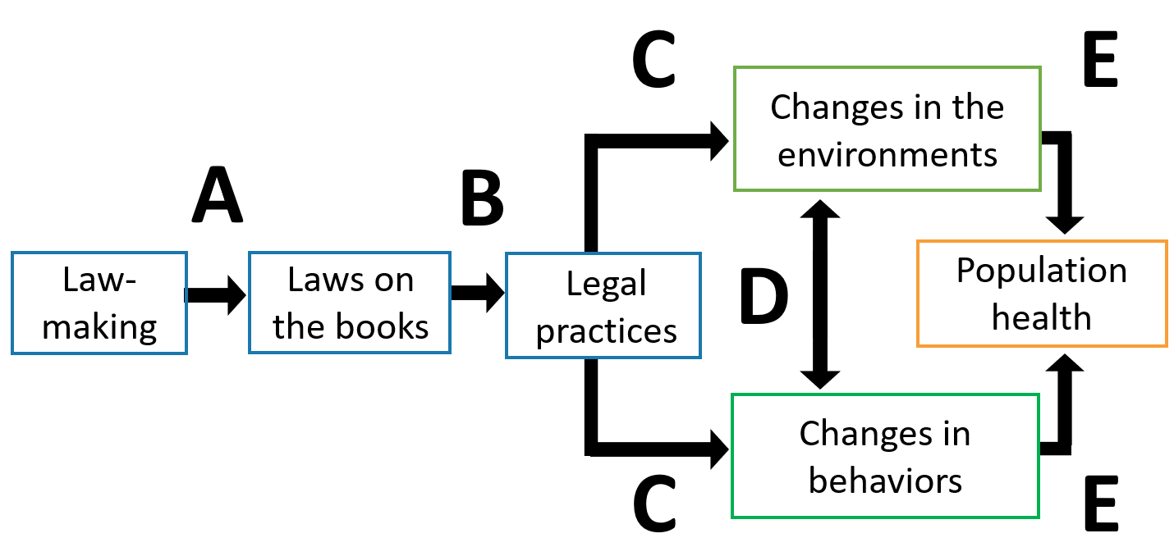
Definitions & Causal Pathways

Slide 40
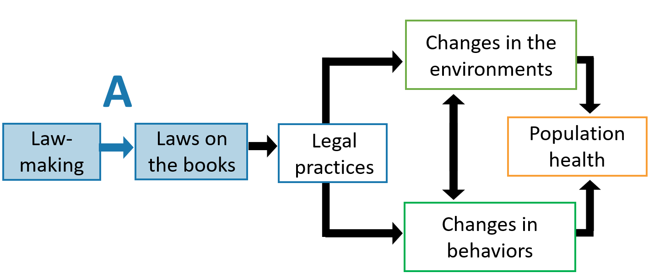
Definitions & Causal Pathways: A

Slide 41
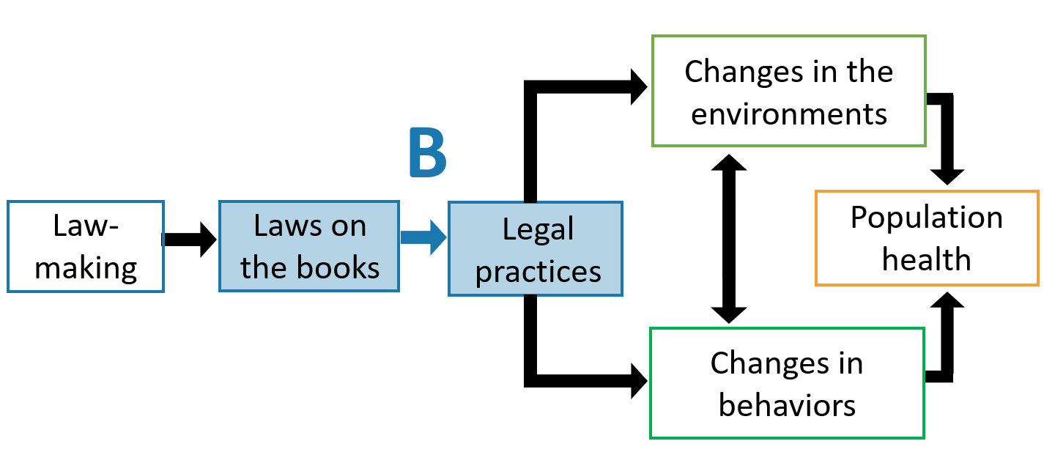
Definitions & Causal Pathways: B

Slide 42
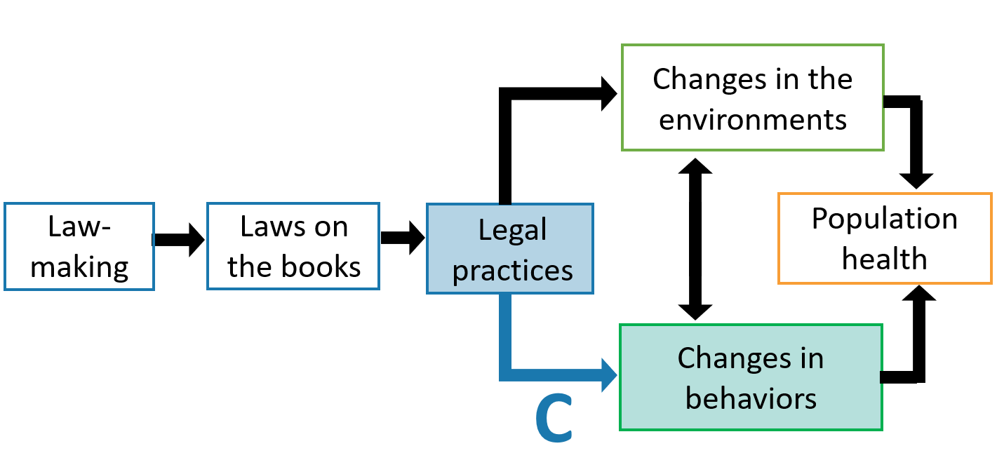
Definitions & Causal Pathways: C

Slide 43
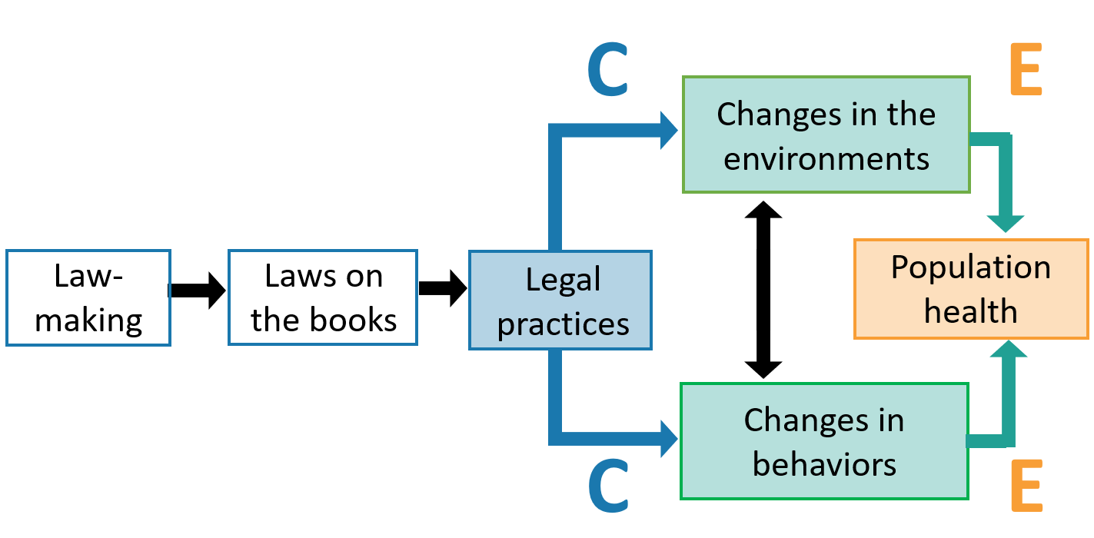
Definitions & Causal Pathways: C & E

Slide 44
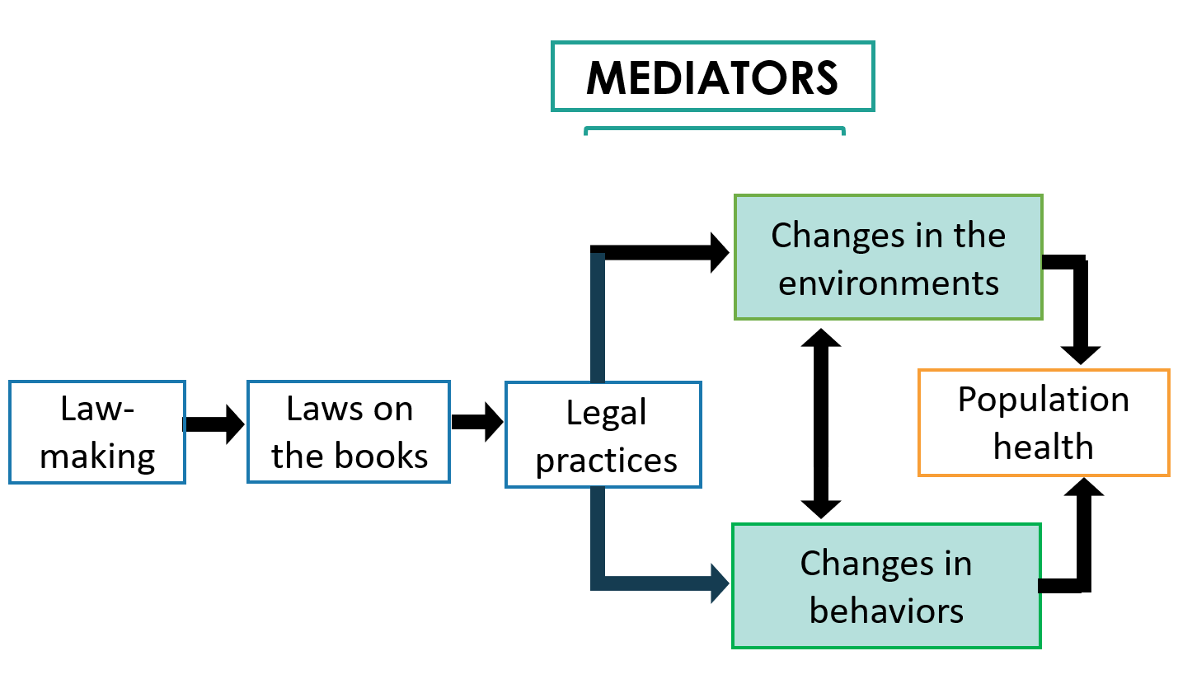
Definitions & Causal Pathways: Mediators

Slide 45
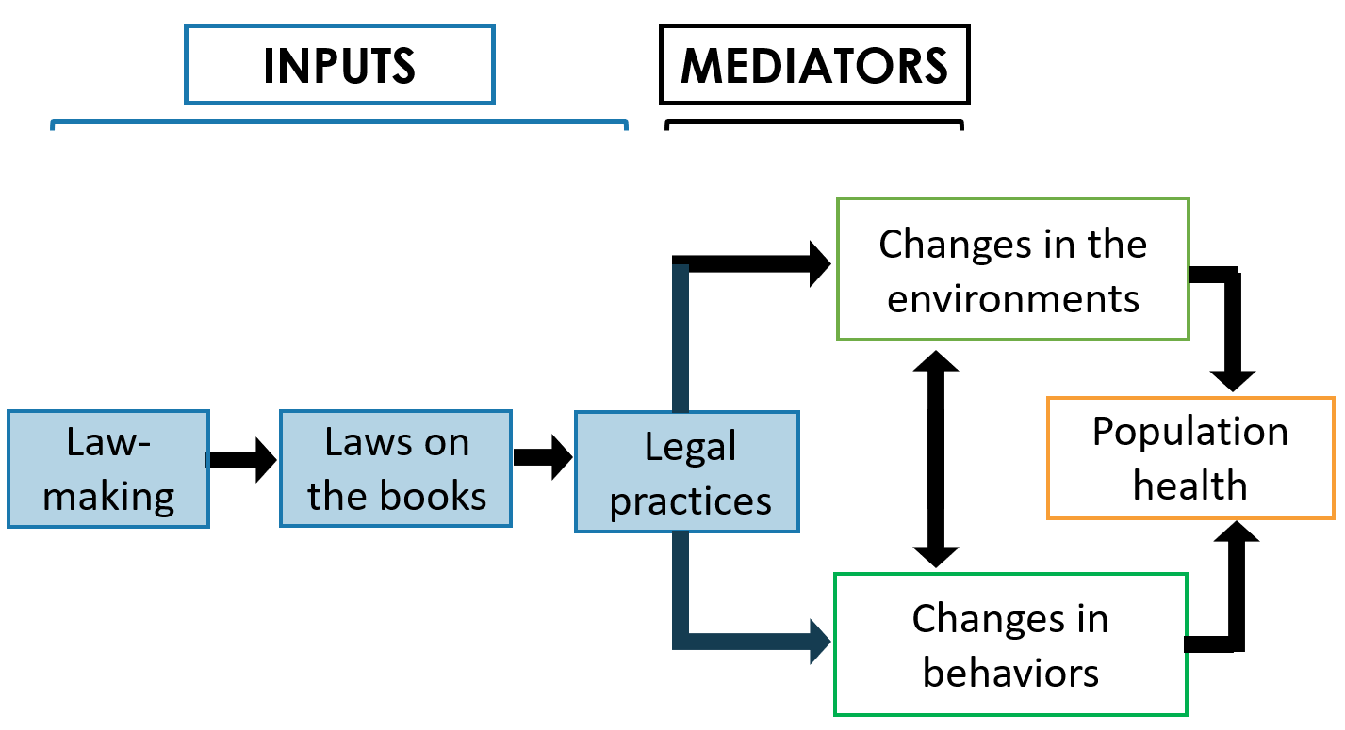
Definitions & Causal Pathways: Inputs

Slide 46
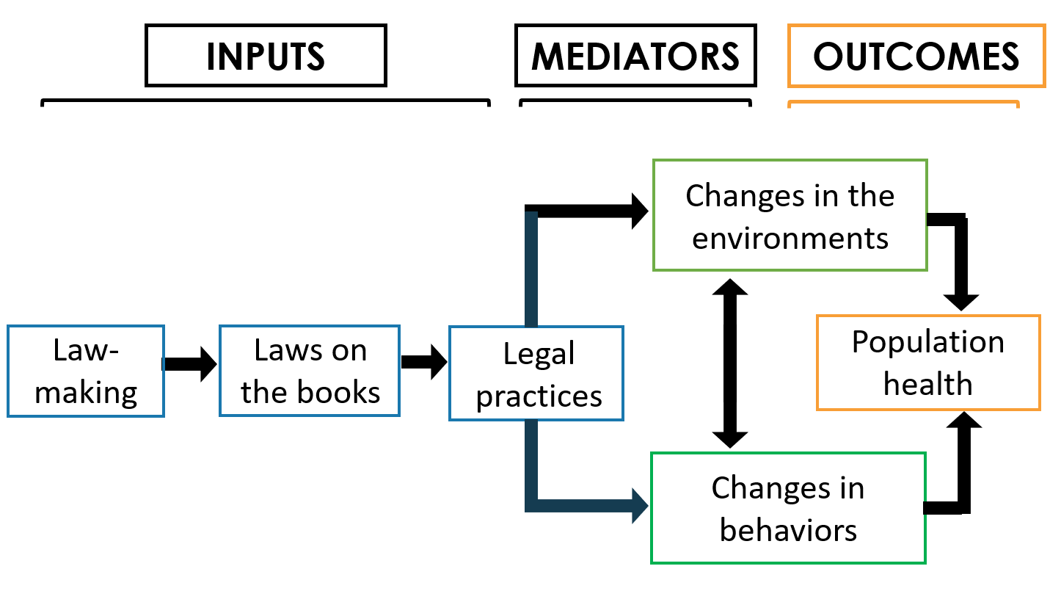
Definitions & Casual Pathways: Outcomes

Slide 47
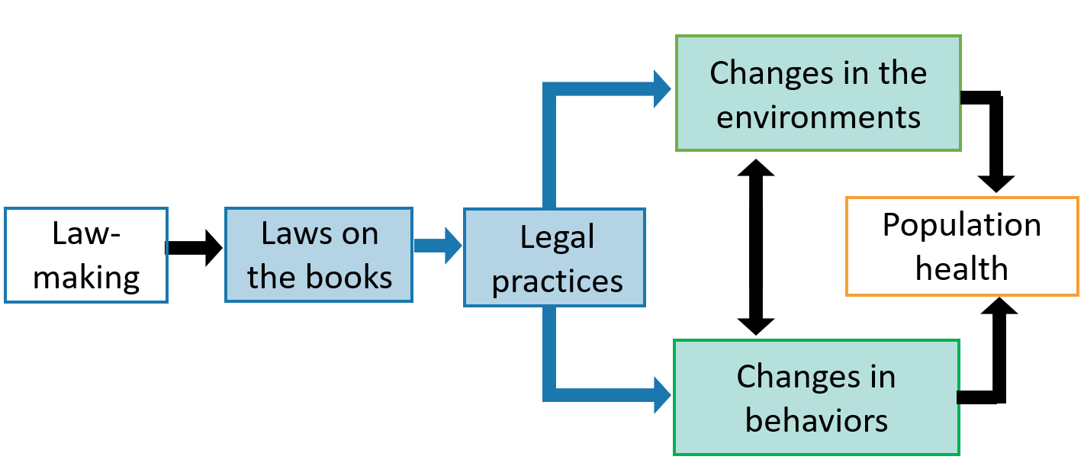
Definitions & Causal Pathways
Example: Seat Belt Law

Slide 48
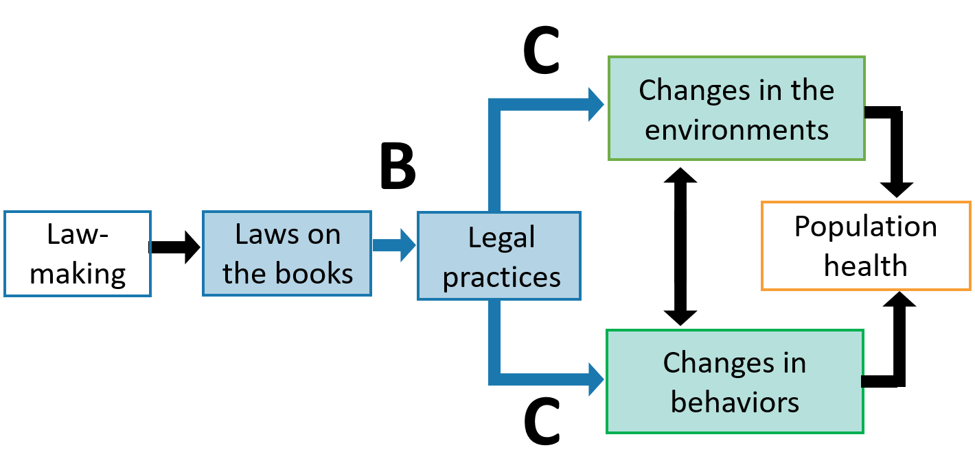
Definitions & Causal Pathways: B & C

Slide 49
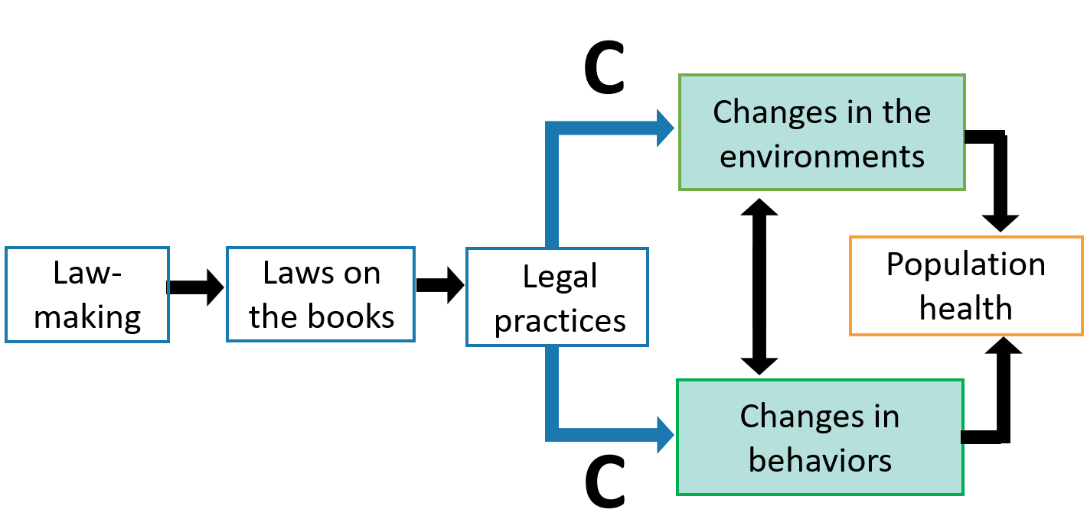
Definitions & Causal Pathways:
Proxies for Health Outcomes

Slide 50
Definitions & Causal Pathways:
Tobacco Warning Labels

Slide 51
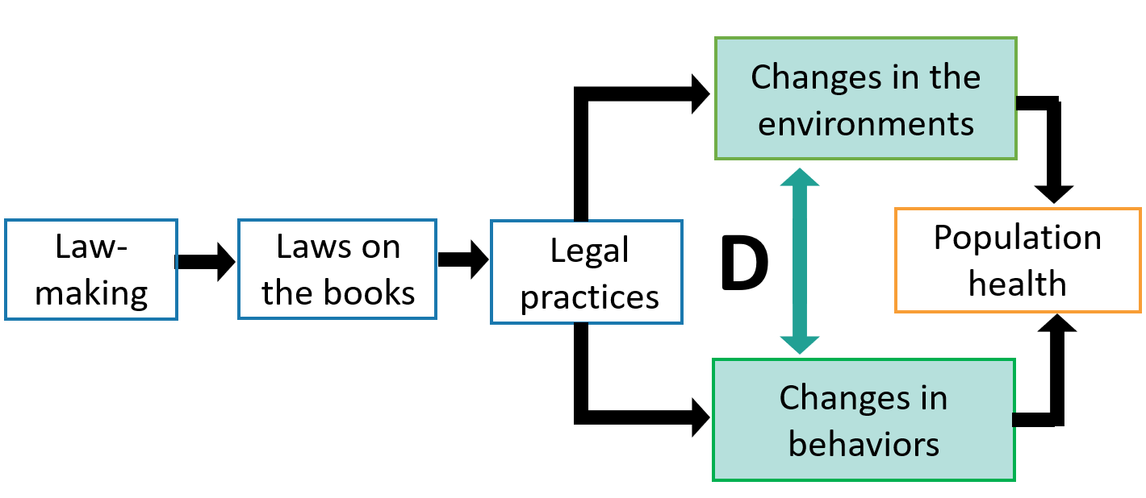
Definitions & Causal Pathways: D

Slide 52
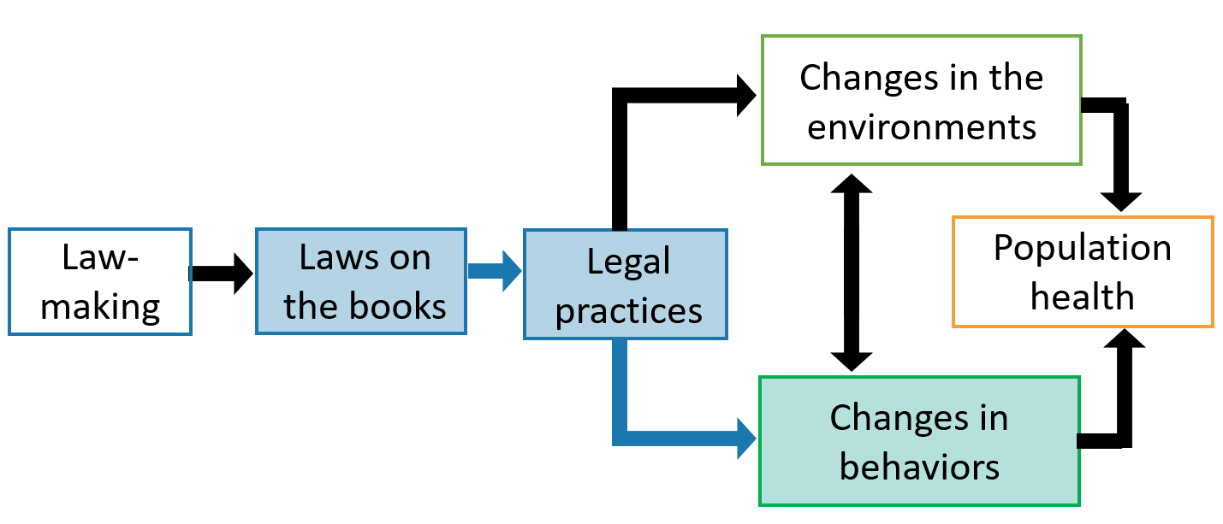
Definitions & Causal Pathways:
Seat Belt Laws & Individual Behavior

Slide 53
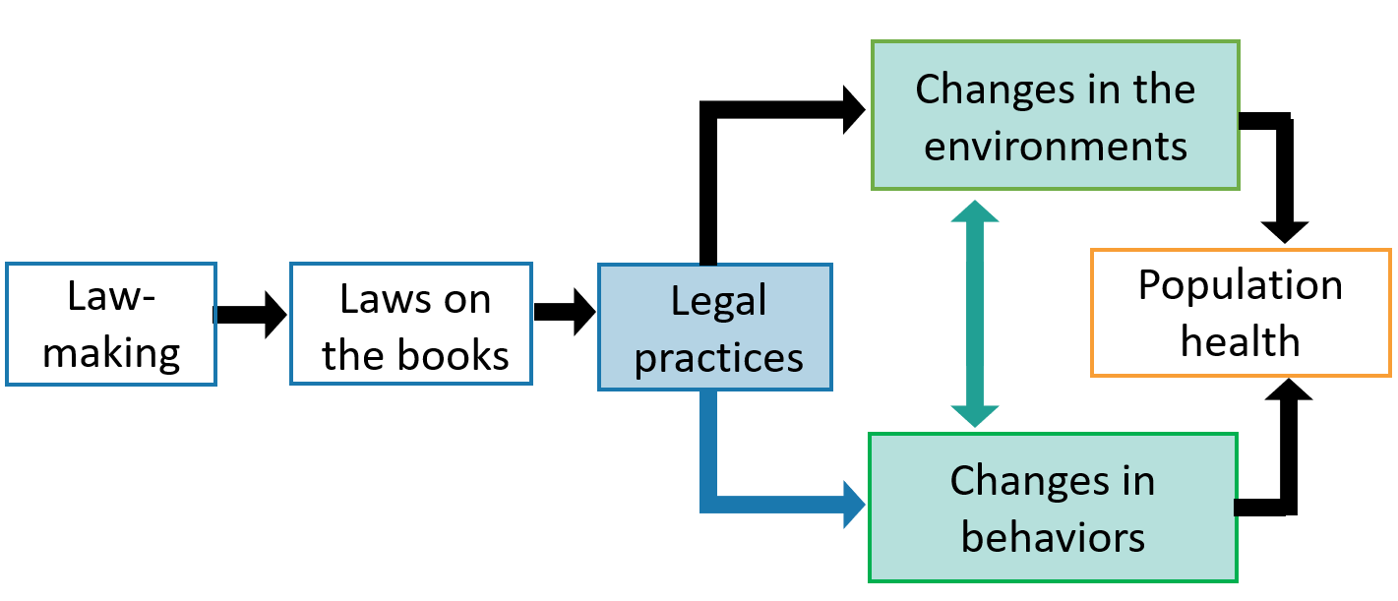
Definitions & Causal Pathways:
Social Norm Change

Slide 54
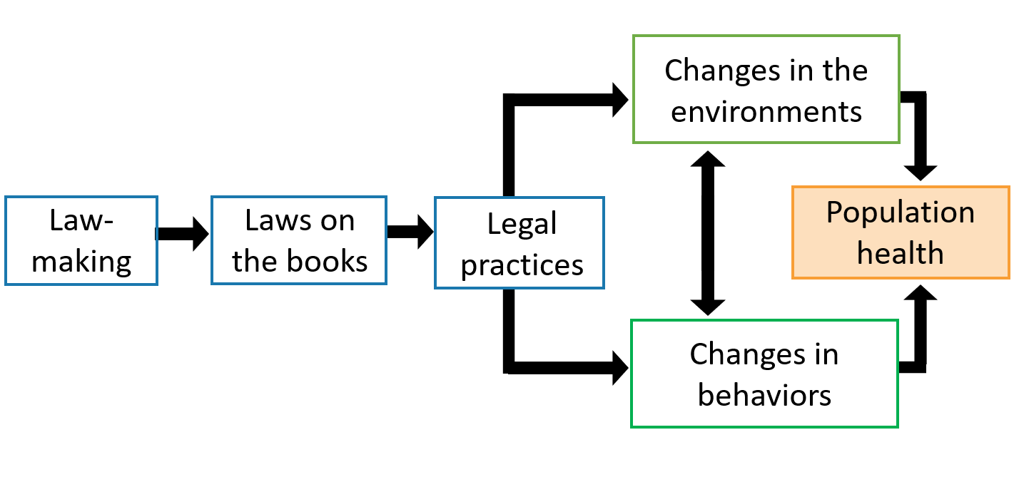
Definitions & Causal Pathways:
Population Health

Slide 55
How Do Laws Change Behaviors?
Socio-Legal Theories
Deterrence theory
Procedural justice theory
Theory of planned behavior

Slide 56
How Do Laws Change Behaviors?
Socio-Legal Theories - 1
Deterrence theory
Procedural justice theory
Theory of planned behavior

Slide 57
How Do Laws Change Behaviors?
Socio-Legal Theories - 2
Deterrence theory
Procedural justice theory
Theory of planned behavior

Slide 58
How Do Laws Change Behaviors?
Socio-Legal Theories - 3
Deterrence theory
Procedural justice theory
Theory of planned behavior

Slide 59
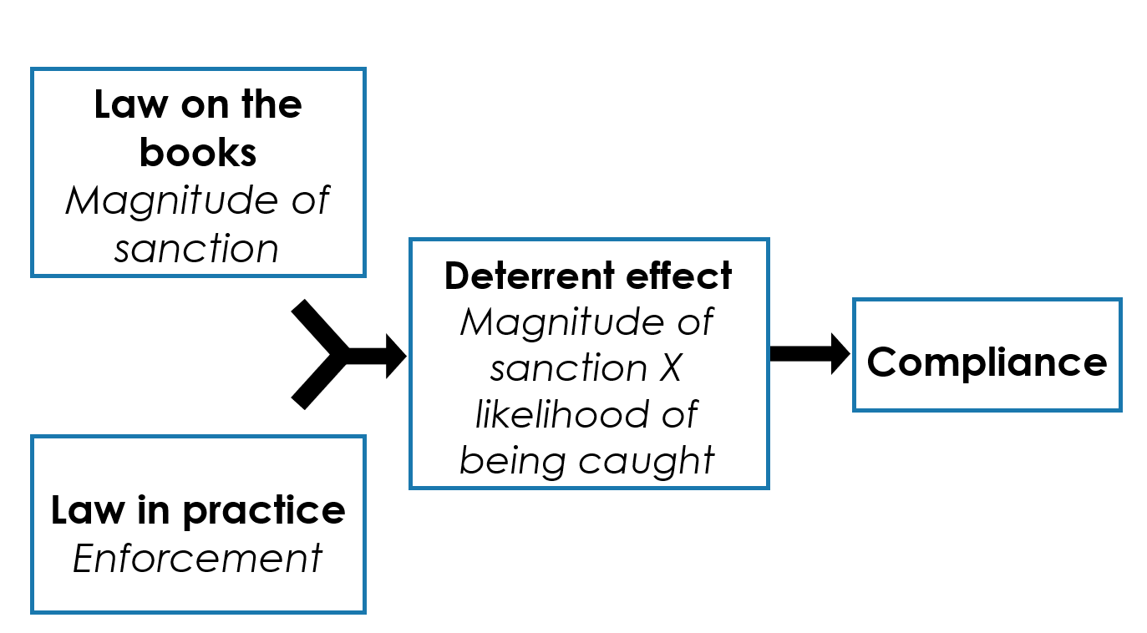
Deterrence Theory

Slide 60
Deterrence Theory: Example
For distracted driving laws to work (i.e., reduce crashes), drivers must perceive both the likelihood of getting caught and the resulting penalty as high.

Slide 61
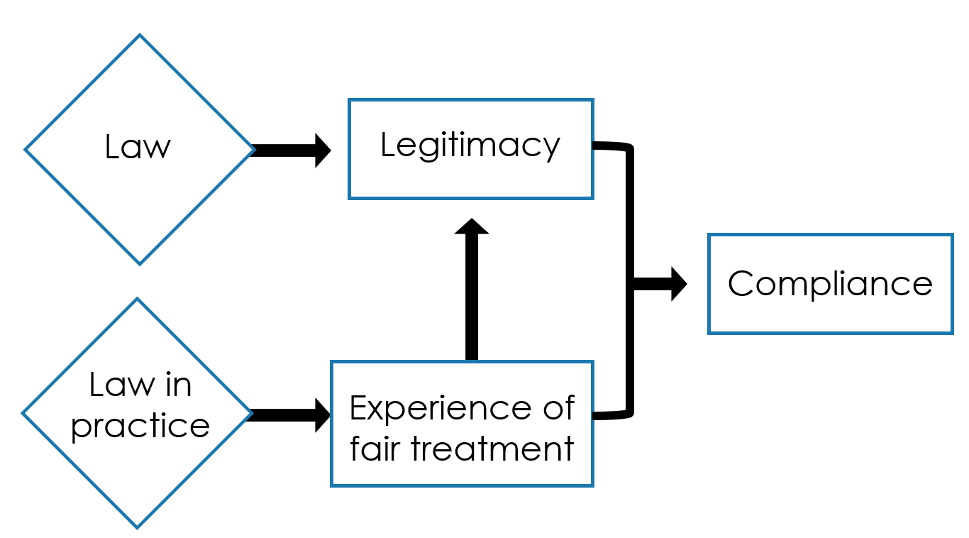
Procedural Justice Theory

Slide 62
Perceived Justice Theory: Example
•Disproportionate Terry stops

Slide 63
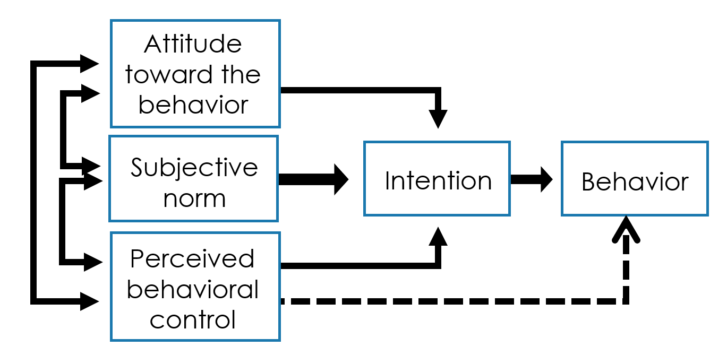
Theory of Planned Behavior

Slide 64
Theory of Planned Behavior: Example
•Texting and driving

Slide 65
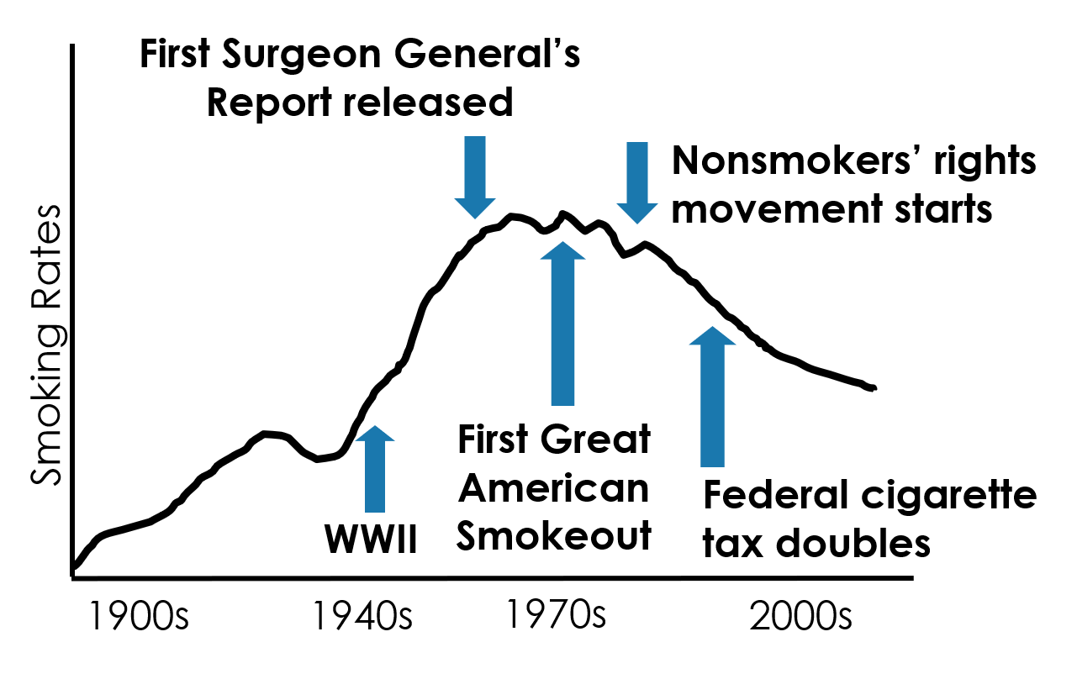
Example: Tobacco Use

Slide 66
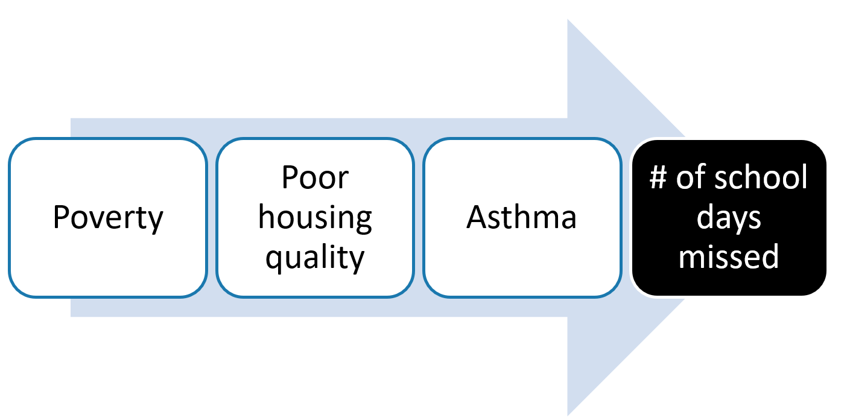
Logic Models - 1
Where does law play a role in this causal path?

Slide 67
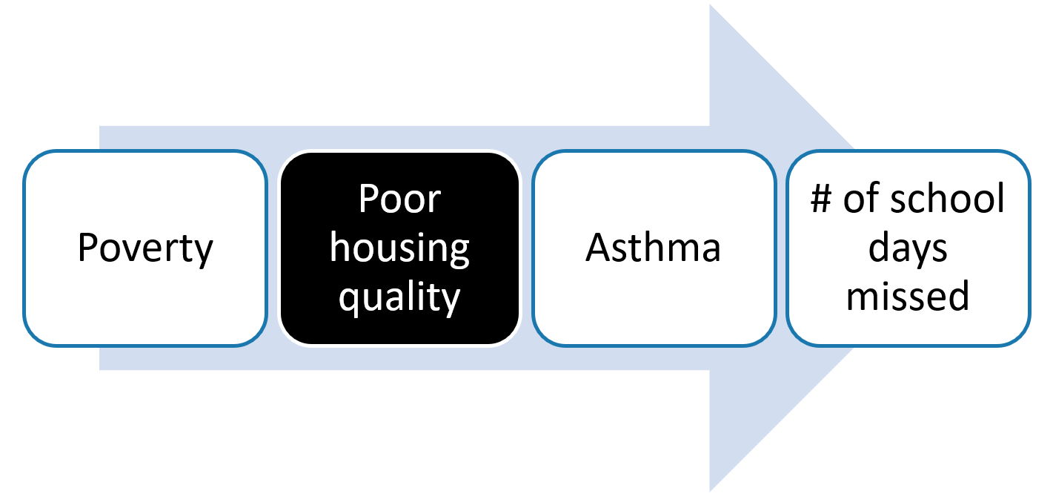
Logic Models - 2
Where does law play a role in this causal path?

Slide 68
Logic Models - 3
Where does law play a role in this causal path?
Poor housing quality
  Redlining
  Fair Housing Act
  Mandated mold remediation programs
  Housing court decisions
  Housing code enforcement

Slide 69
Different Types of Data
Cross-sectional
Data that are captured at one point in time
Longitudinal
Data that are captured over time

Slide 70
5: Check Data Sources:
Identify the Unit of Analysis
Legal Data
Example: State laws
Outcome Data
Example: The number of traffic fatalities

Slide 71
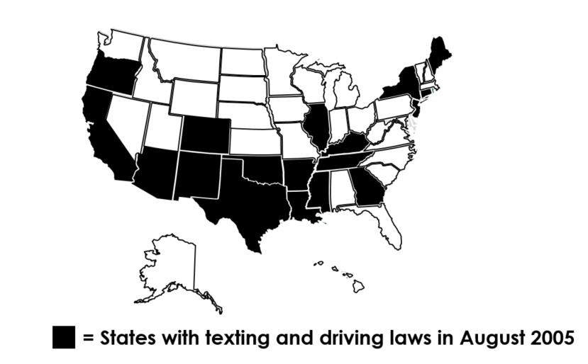
Natural (or Observational) Experiments
Changes in laws, regulations, or systems that affect population health provide opportunities for natural experiments.
  Example: Comparing jurisdictions with a certain law vs. jurisdictions without the law

Slide 72
End of section on
Logic Models &
Socio-Legal Theories
Questions?

Slide 73
What We’ll Discuss (Revisited)
Recap of Legal Epidemiology
Phase 1: Planning
Phase 2: Operationalizing
Phase 3: Analyzing

Slide 74
6: Select a Research Design
Experimental Research Design: “A” Causes “B”
Example: What are the effects of “Drug A” in reducing blood pressure?
  Group 1: Treatment group is exposed to Drug A
  Group 2: Control group is exposed to a placebo

Slide 75
Research Design: Quasi-Experiments
Example: What are the effects of seat belt laws?
  Group 1: Treatment group lives in a state with a seat belt law.
  Group 2: Control group lives in a state that does not have a seat belt law.

Slide 76
Quasi-Experimental Design Toolbox
The following research designs can produce strong evidence of how a law causes an effect:
Repeated measures
Time resolution
Functional form of effects
Comparison jurisdictions
Comparison groups
Comparison outcomes
Replications
Dose response

Slide 77
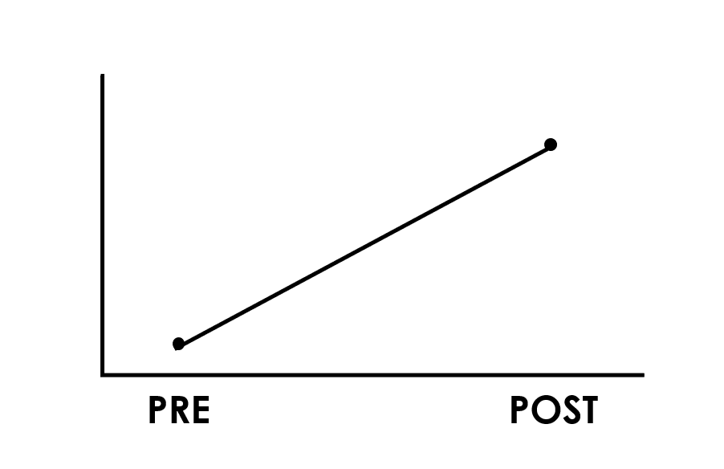
Repeated Measures: Observed Effect

Slide 78
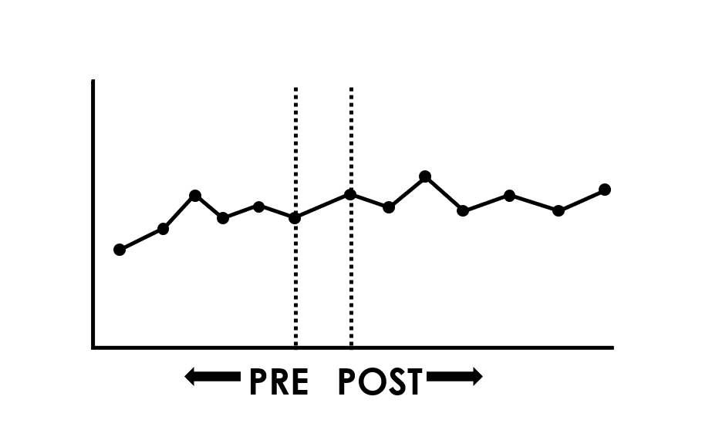
Many Repeated Measures: Same Observed Effect

Slide 79
Many Repeated Measures
Simple interrupted time series
O₁ O₂ O₃ O₄ O₅ X O₆ O₇ O₈ O₉ O₁₀

Slide 80
Time Resolution Considerations
Time Resolution
  Observations on a daily, weekly, monthly, or yearly basis
Considerations
  Speed
  Variation
  Scale
  Date
  Seasonality

Slide 81
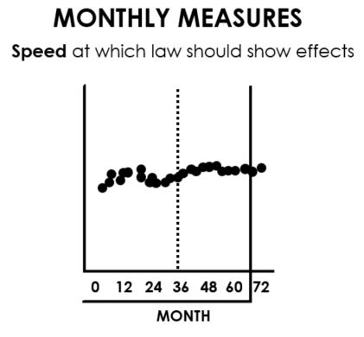
Time Resolution Consideration: Speed
The speed at which a new law is expected to show effects
Example: If effects are expected soon after the law’s implementation, use monthly rather than annual observations.

Slide 82
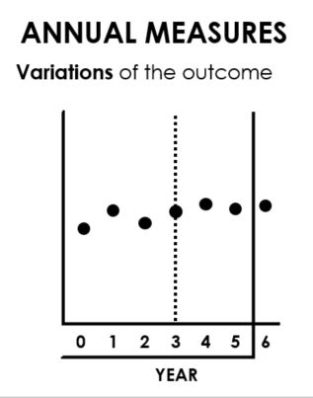
Time Resolution Consideration: Variation
The variation in the outcome
Example: If there is little to no variation in an outcome week by week, then monthly or annual measures might be more appropriate.

Slide 83
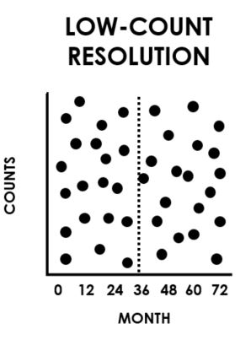
Time Resolution Consideration: Scale - 1
Example: Measuring the number of vaccines given monthly might create a cloudlike scatter (low-count resolution)

Slide 84
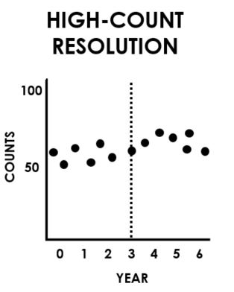
Time Resolution Consideration: Scale - 2
Example: On the other hand, reporting yearly counts for vaccines given will likely create a smoother curve (high-count resolution)

Slide 85
Time Resolution Consideration: Date
Example: A mid-year effective date often does not work well with annual data.

Slide 86
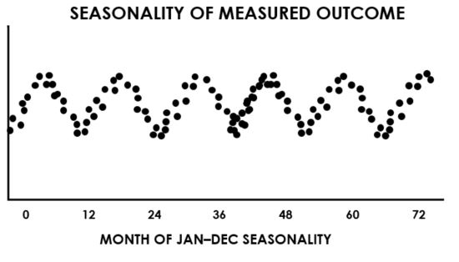
Time Resolution Consideration: Seasonality
Example: Behavior might be different in the summer than in the winter.

Slide 87
Functional Forms of Effects - 1
Thinking about what patterns in the data are expected leads to important questions that shape the design of the study:
  Do you expect the effect to show up as soon as the law takes effect? Or do you expect a delay as enforcement or other implementation systems are developed and ramped up?
  Do you expect an anticipatory effect before the legal effective date? Or do you expect the effect to emerge gradually?
  Do you expect the effect to be temporary, dissipating over time as organizations and individuals adapt to the new law in ways that maintain previous conditions?

Slide 88
Functional Forms of Effects - 2
Abrupt change
Temporary change
Delayed change
Accelerated change
Gradual effect
Change in variability
Partially decaying effect

Slide 89
Comparison Jurisdictions -1
Provide a basis for comparison
Improve causal inference

Slide 90
Comparison Jurisdictions - 2
Compare similar environments
Use multiple comparison sites to improve causal inference
Make sure you can attribute differences between jurisdictions to the law
Rule out alternative explanations

Slide 91
Comparison Groups
If a law is intended to affect particular groups, effects on those groups should be compared with effects on similar groups within the same jurisdiction that are not likely to be affected.
Most laws are inherently intended for certain groups, creating opportunities to incorporate relevant comparison groups.

Slide 92
Comparison Outcomes
Appropriate comparison outcomes are
related to the primary outcome but not
affected by the law under study.

Slide 93
Replications
Strengthen causal inference by
replicating the study across jurisdictions

Slide 94
Replications Across Time
Naturally occurring variations in law over time within a single jurisdiction can be used to strengthen causal inference.
Removed-Treatment Design
  O₁ O₂ O₃ X O₄ O₅ O₆ X O₇ O₈ O₉ O₁₀
Multiple Replications (ABAB) Design
  O₁ O₂ X_{A} O₃ O₄ X_{B} O₅ O₆ X_{A} O₇ O₈ X_{B} O₉ O₁₀

Slide 95
Dose Response
The dose of a regulatory approach may vary by jurisdiction.
Causal inference is strengthened if low-dose jurisdictions have small effects and high-dose jurisdictions have large effects.

Slide 96
Using Multiple Designs to Infer Causation:
First Level of Comparison
Example: What were the effects of raising the drinking age in states?
Treatment: Maine and Michigan, which kept the drinking age at 18 and older
Control: New York and Pennsylvania, which raised the drinking age to 21 and older

Slide 97
Using Multiple Designs to Infer Causation:
Second Level of Comparison
Example: What were the effects of raising the drinking age within states?
    Underage drinkers (ages 15-17)
    Focal group (ages 18-20)
    Comparison group (ages 21+)

Slide 98
Using Multiple Designs to Infer Causation:
Third Level of Comparison
Example: What were the effects of raising the drinking age within each age group?
    Alcohol-Related Crashes
    Police-reported drinking
    Nighttime, single vehicle
    Non-Alcohol-Related Crashes
    No police-reported drinking
    Daytime

Slide 99
Endogeneity - 1
Example: What led to an increase in seat belt use?

Slide 100
Endogeneity - 2
Example: What led to an increase in seat belt use?
Seat belt laws?

Slide 101
Endogeneity - 3
Example: What led to an increase in seat belt use?
Seat belt laws?
Seat belt alarms?

Slide 102
Research Design: Question
Which of the following strengthens a quasi-experimental design?
A. Using many repeated measures
B. Using highest time resolution possible
C. Comparing multiple jurisdictions
D. All of the above

Slide 103
Research Design: Answer
Which of the following strengthens a quasi-experimental design?
A. Using many repeated measures
B. Using highest time resolution possible
C. Comparing multiple jurisdictions
D. All of the above → CORRECT ANSWER

Slide 104
Phase 2: Operationalizing Research Designs

Slide 105
Phase 2: Operationalizing
1. Identify or build legal and outcome data
2. Identify analytical plan
3. Select variables
4. Merge data for analysis

Slide 106
Operationalizing Step 1:
Build Legal & Outcome Data - 1
Organize final data sources
Build legal data or download existing legal data
Collect outcome data
Begin to clean data sources

Slide 107
Operationalizing Step 1:
Build Legal & Outcome Data - 2
Organize final data sources
Build legal data or download existing legal data
Collect outcome data
Begin to clean data sources

Slide 108
Operationalizing Step 1:
Build Legal & Outcome Data - 3
Organize final data sources
Build legal data or download existing legal data
Collect outcome data
Begin to clean data sources

Slide 109
Operationalizing Step 1:
Build Legal & Outcome Data - 4
Organize final data sources
Build legal data or download existing legal data
Collect outcome data
Begin to clean data sources

Slide 110
Operationalizing Step 2:
Identify Analytical Plan - 1
Descriptive statistics: Describe the data; no statistical inference
Predictive analyses: Test hypotheses about relationships
Causal analyses: Test causal links in the logic model

Slide 111
Operationalizing Step 2:
Identify Analytical Plan - 2
The Most Common Analysis: Difference-in-Difference Model
Wendy’s team is conducting a two-state study that compares state X and state Y to determine whether distracted driving laws affect traffic deaths.
The number of traffic deaths is the outcome they are studying.

Slide 112
Operationalizing Step 2:
Identify Analytical Plan - 3
The Most Common Analysis: Difference-in-Difference Model
State X (distracted driving law) → Reduction in traffic fatalities
State Y (no distracted driving law) → No change

Slide 113
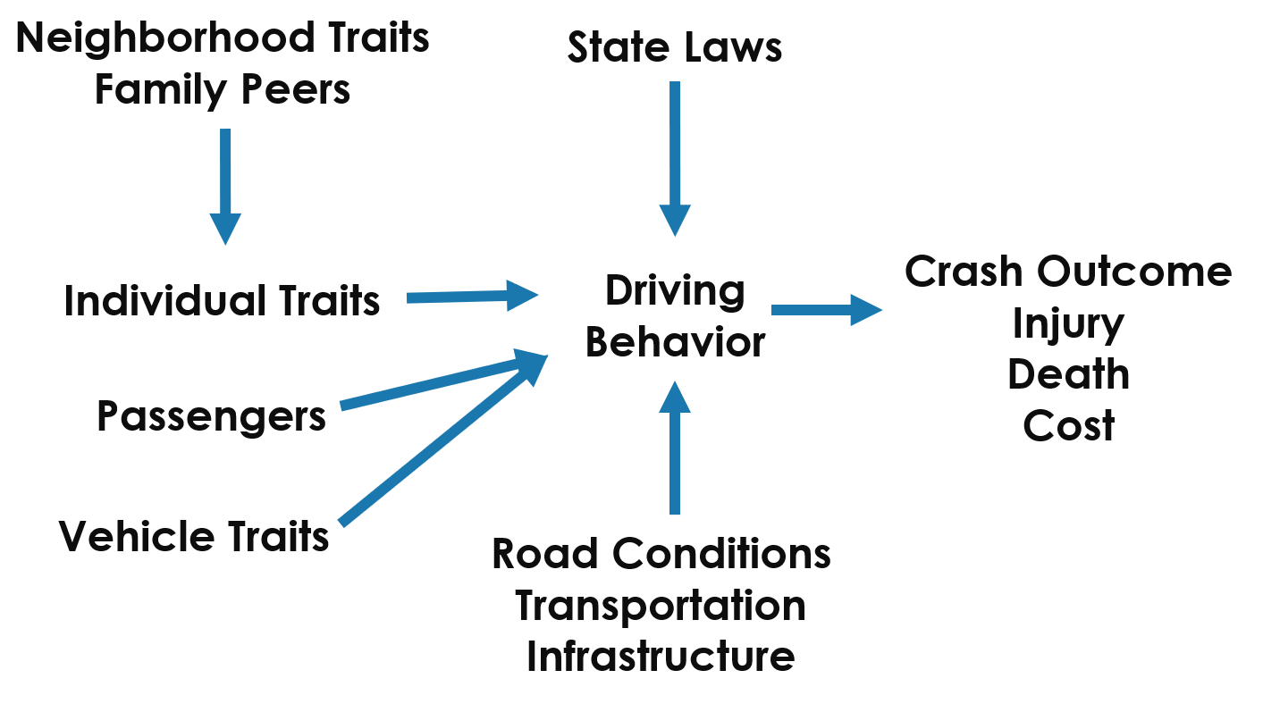
Operationalizing Step 3: Select Variables
Neighborhood Traits
  Family Peers
  Individual Traits
  Passengers
  Vehicle Traits
State Law
  Driving Behavior
  Road Conditions
  Transportation
  Infrastructure
Crash Outcome
  Injury
  Death
  Cost

Slide 114
Operationalizing Step 4:
Merge Data for Analysis
Use the specific data structure required by your software package
Merge legal and outcome data files

Slide 115
Phase 3: Analyzing Data

Slide 116
Phase 3: Analyzing
1. Run descriptive statistics
2. Run bivariate explanatory analysis
3. Run predictive/causal analysis
4. Interpret results
5. Discuss results
6. Translate into practice

Slide 117
Legal Epidemiology Study Analysis
Practice Tip: Team up with an epidemiologist or quantitative methodologist to carry out the causal analysis and interpretations.

Slide 118
Analyzing Step 1:
Run Descriptive Statistics
Measure of central tendency: mean, median, mode
Measure of spread: variance, standard deviation, range

Slide 119
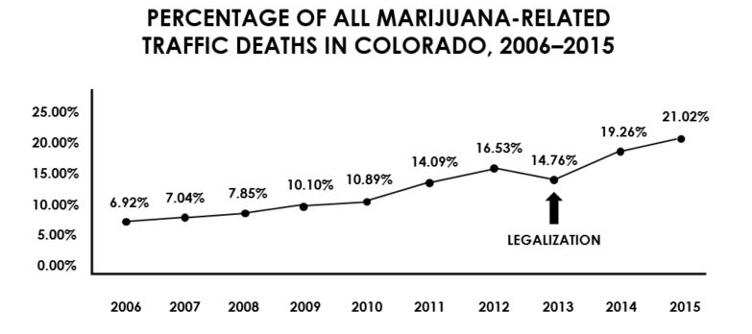
Analyzing Step 2:
Run Bivariate Explanatory Analysis
Source: National Highway Traffic Safety Administration, Fatality Analysis Reporting System (FARS), 2006–2011 and Colorado Department of Transportation, 2012–2015

Slide 120
Analyzing Step 3:
Run Predictive/Causal Analysis
Causal analysis can include these analytics:
Random coefficient models
Difference in difference
Interrupted time series
Regression discontinuity
Hierarchical linear modeling

Slide 121
Analyzing Step 4:
Interpret Results
Identify statistically significant relationships
Consider removing insignificant variables
What are the key takeaways for your variables of interest?

Slide 122
Analyzing Step 5:
Discuss Results
Evaluate statistical significance vs. practical significance
Discuss limitations of the study/data
Highlight key results
Identify where your results fill gaps in the current evidence base
Identify avenues for future research

Slide 123
Analyzing Step 6:
Translate into Practice
Practice Tip: Consult with communications and policy staff to identify key stakeholders and to determine how best to communicate with each of these audiences.

Slide 124
Final Review
Recap of Legal Epidemiology
Phase 1: Planning
Phase 2: Operationalizing
Phase 3: Analyzing

Slide 125
Funding
This publication was supported by the Centers for Disease Control and Prevention of the US Department of Health and Human Services (HHS) as part of a financial assistance award totaling $210,000 with 100 percent funded by CDC/HHS. The contents are those of the authors and do not necessarily represent the official views of, nor an endorsement, by CDC/HHS or the US Government.

Slide 126
Advanced Legal Epidemiology Methods
Questions?

