Slide 1
Introduction to Legal Epidemiology

Slide 2
ChangeLab Solutions Disclaimer
The information provided in this discussion is for informational purposes only, and does not constitute legal advice. ChangeLab Solutions does not enter into attorney-client relationships.
ChangeLab Solutions is a nonpartisan, nonprofit organization that educates and informs the public through objective, nonpartisan analysis, study, and/or research. The primary purpose of this discussion is to address legal and/or policy options to improve public health. There is no intent to reflect a view on specific legislation.
© 2017 ChangeLab Solutions

Slide 3
CDC Disclaimer
These course materials are for instructional use only and are not intended as a substitute for professional legal or other advice. While every effort has been made to verify the accuracy of these materials, legal authorities and requirements may vary from jurisdiction to jurisdiction. Always seek the advice of an attorney or other qualified professional with any questions you may have regarding a legal matter.
The contents of this presentation have not been formally disseminated by the Centers for Disease Control and Prevention and should not be construed to represent any agency determination or policy.

Slide 4
Four Competencies
Articulate the importance of legal epidemiology
Apply its principles to research studies, funding opportunities, and policy agendas
Communicate findings, methodologies, and recommendations
Analyze findings to inform health, fiscal, administrative, legal, social, & political activities
Legal Epidemiology Competency Model, Domain 1, 2018

Slide 5
What We’ll Discuss
How does law affect health?
What is legal epidemiology?
Why use legal epidemiology?
How is it used in practice?

Slide 6
How Does Law Affect Health?

Slide 7
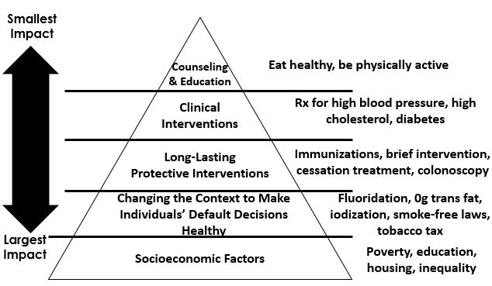
Health Impact Pyramid Overview

Slide 8
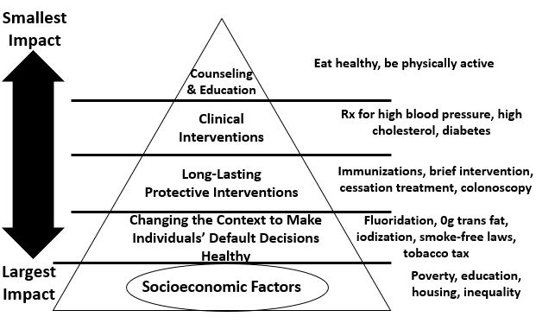
Socioeconomic Factors

Slide 9
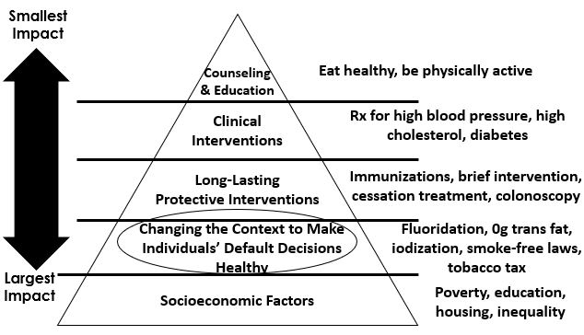
Changing the Context to Make Individuals’ Default Decisions Healthy

Slide 10
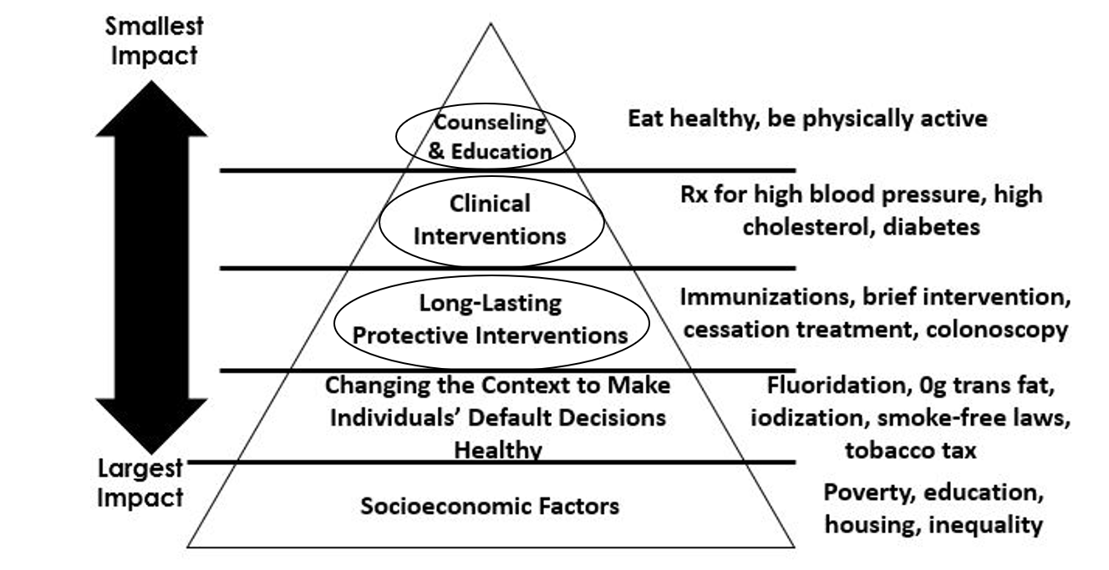
Top Three Tiers: Long-Lasting Protective Interventions, Clinical Interventions, and Counseling and Education

Slide 11
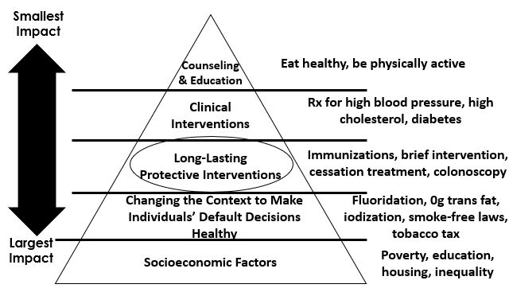
Long-Lasting Protective Interventions

Slide 12
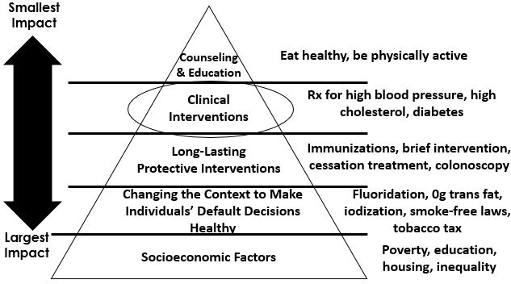
Clinical Interventions

Slide 13
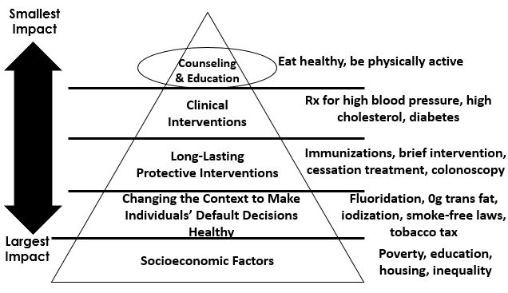
Counseling & Education

Slide 14
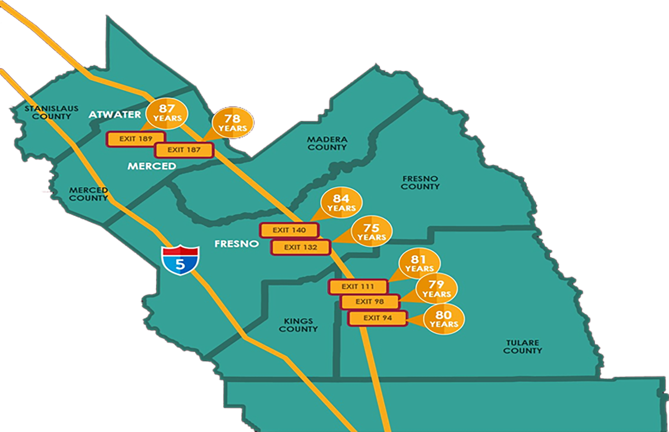
Law as a factor that affects health

Slide 15
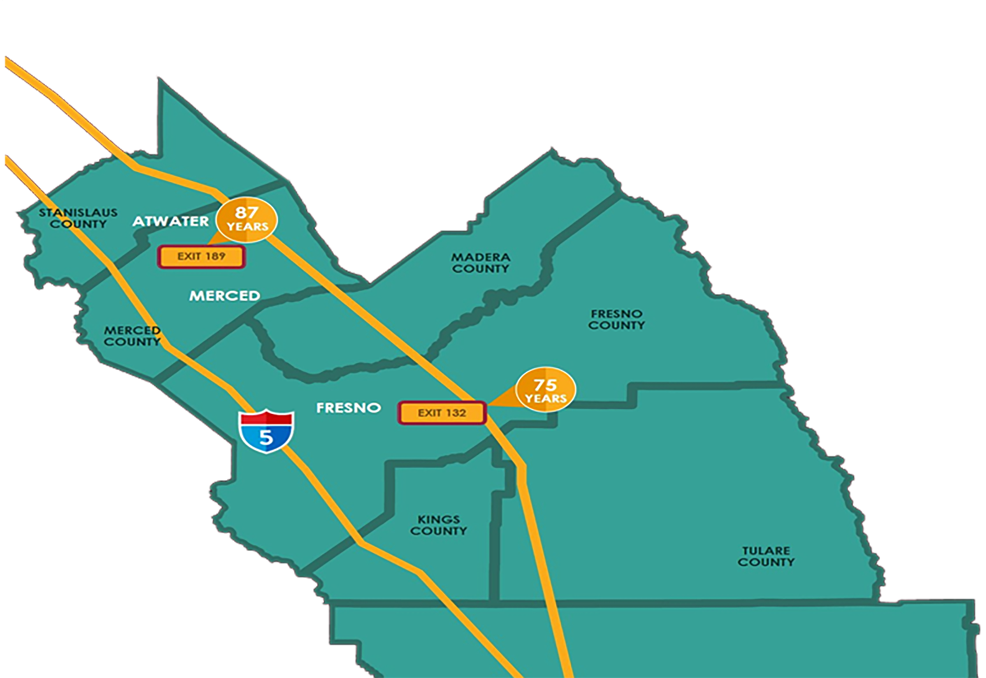
Law as a factor that affects health
Exit 189 v. Exit 132

Slide 16
Law as a natural experiment
Opportunities
Challenges

Slide 17
Opportunities
Jurisdictions passing the same law
Effects on health observed over time

Slide 18
Challenges
Rarely can be used in true experimental fashion
Implementation and outcome data hard to find

Slide 19
What do we mean by “law”?
Laws on the books
Legal practices
Legal perceptions

Slide 20
Laws on the books
What do we mean by “law”?

Slide 21
Legal Practices & Legal Perceptions
What do we mean by “law”?

Slide 22
Legal Practices
What do we mean by “law”?

Slide 23
Legal Perceptions
What do we mean by “law”?

Slide 24
Multiple Choice Question
Which of the following is/are true when it comes to studying the law?
A. The effects of law can be observed over time
B. Law establishes cause-and-effect relationships
C. Implementation and outcome data can be hard to find
D. A and B
E. A and C

Slide 25
Multiple Choice Answer
Which of the following is/are true when it comes to studying the law?
A. The effects of law can be observed over time
B. Law establishes cause-and-effect relationships
C. Implementation and outcome data can be hard to find
D. A and B
E. A and C → CORRECT ANSWER

Slide 26
What is Legal Epidemiology?

Slide 27
Legal Epidemiology
Scientific study and deployment of law as a factor in the cause, distribution, and prevention of disease and injury in a population.

Slide 28
Foundation Principles
Scientific
Systematic
Transparent
Replicable
Precise
Measurable

Slide 29
Legal Etiology
The study of laws and legal practices as causes of disease and injury.

Slide 30
Legal Prevention and Control
The study and application of laws and legal practices as interventions to prevent disease and injury.

Slide 31
Policy Surveillance
The ongoing systematic collection, analysis, and dissemination of information about laws and other policies important to health.

Slide 32
Three Basic Elements of Legal Epidemiology
Legal etiology
Legal prevention and control
Policy surveillance

Slide 33
“Law and Epidemiology” vs.
“Legal Epidemiology”
Lawyer
Public Health Practitioner
Researcher
Policy Analyst

Slide 34
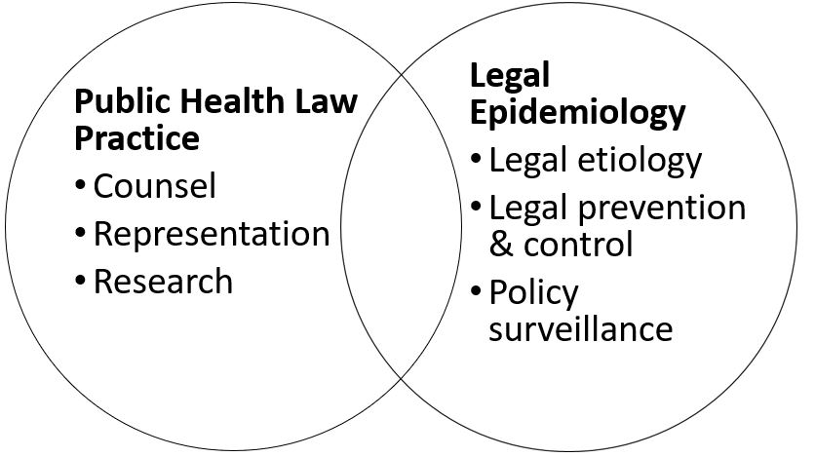
A Transdisciplinary Model

Slide 35
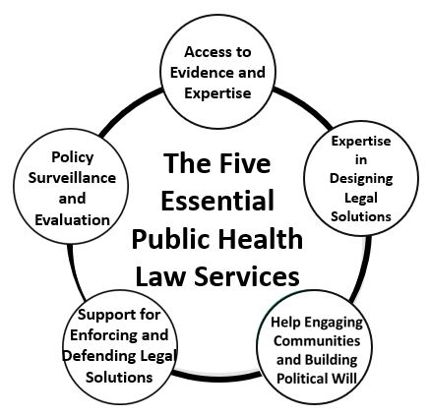
The Five Essential Public Health Law Services

Slide 36
Multiple Choice Question
Legal epidemiology is which of the following:
A. Scientific in its approach
B. Measurable
C. Traditional legal research
D. A and B
E. A and C

Slide 37
Multiple Choice Answer
Legal epidemiology is which of the following:
A. Scientific in its approach
B. Measurable
C. Traditional legal research
D. A and B → CORRECT ANSWER
E. A and C

Slide 38
Why use Legal Epidemiology?

Slide 39
Creates Results
Turns law into data
Creates sound studies
Tracks trends

Slide 40
Advances Research
Supports qualitative evaluation
Answers questions
Shows the impact and effectiveness of laws on health
Informs best practices

Slide 41
Multiple Choice Question
Why use legal epidemiology?
A. Creates valid, replicable studies
B. Tracks trends
C. Shows the impact and effectiveness of laws on health
D. A and B
E. A, B, and C

Slide 42
Multiple Choice Answer
Why use legal epidemiology?
A. Creates valid, replicable studies
B. Tracks trends
C. Shows the impact and effectiveness of laws on health
D. A and B
E. A, B, and C → CORRECT ANSWER

Slide 43
Legal Epidemiology in Practice

Slide 44
Legal Mapping
A process for capturing important features of laws and policies, and for identifying how they vary across jurisdictions or institutions over time.

Slide 45
Introduction to Legal Mapping – Overview
Legal Epidemiology
  Policy Surveillance
  Legal Assessment
Public Health Law Practice
  Legal Scan
  Legal Profile

Slide 46
Introduction to Legal Mapping
Legal Epidemiology
  Policy Surveillance
  Legal Assessment

Slide 47
Introduction to Legal Mapping – Policy Surveillance
Legal Epidemiology
  Policy Surveillance
    Collects data over time
    Creates longitudinal datasets
  Legal Assessment

Slide 48
Introduction to Legal Mapping – Legal Assessment
Legal Epidemiology
  Policy Surveillance
  Legal Assessment
    Collects data at one point in time
    Creates cross-sectional datasets

Slide 49
Ready, Set, Practice
Engage
Research
Study
Evaluate
Intervene
Stay Ahead

Slide 50
1. Engage
  Identify a public health problem through community engagement, stakeholders, epidemiology, and behavioral science.

Slide 51
2. Identify Research Needs
  Identify the need for evidence-based legal research to inform the process, nature, and impact of existing policies.

Slide 52
3. Study: Create Legal Data
Complete a legal mapping study to address specific research questions and create empirical legal data.

Slide 53
4. Evaluate
Complete a legal evaluation study to map trends and correlations between legal data and public health data.

Slide 54
5. Intervene
Guide policymakers to craft innovative legal interventions.

Slide 55
6. Stay Ahead
Think of common obstacles that occur at the end of lawmaking (enforcement, funding, implementation) to inform your entire legal epidemiology study.

Slide 56
Ready, Set, Practice – Your Turn!
Engage
Research
Study
Evaluate
Intervene
Stay Ahead

Slide 57
What We Discussed
How does law affect health?
What is legal epidemiology?
Why use legal epidemiology?
How is it used in practice?

Slide 58
Funding
Funding for this activity was made possible (in part) by CDC. The views expressed in activity materials or publications and by speakers and moderators do not necessarily reflect the official policies of the Department of Health and Human Services, nor does the mention of trade names, commercial practices, or organizations imply endorsement by the US government.
Written materials for this activity were supported by the Cooperative Agreement Numbers NU38OT000141 & NU38OT000307 from CDC’s Office for State, Tribal, Local and Territorial Support.

Slide 59
Introduction to Legal Epidemiology
Questions?

