Slide 1
Food Procurement for a
for a More Just Food System
June 18, 2020
For technical support, submit a question via the Q&A box
Notes:
[NBW] Welcome, thank you for joining us today. This is “Food Procurement for a More Just Food System.” My name is Nessia Berner Wong, and I’m a Senior Policy Analyst with ChangeLab Solutions.
Before getting started, I want to go over a few housekeeping notes for participants:
On the left-hand side of your screen is a Q&A box. If you are having any technical difficulties during the webinar, send a question through this box and we’ll try to help you out.
If time permits, we are also planning on answering a few of your questions at the end of the webinar.
Throughout the webinar, you can submit questions for presenters in the Q&A box. If your question is for a specific presenter, please remember to identify them in your question.
[If we don’t get to the Q&A before noon, we will stay on a little longer to answer a few questions, and you’re welcome to stay with us).
And finally, The webinar will be recorded and sent out to all webinar registrants.
That’s it!

Slide 2
Who we are
ChangeLab Solutions is a national organization that advances equitable laws and policies to ensure healthy lives for all. We prioritize communities whose residents are at highest risk for poor health.
Our multidisciplinary team of lawyers, planners, policy analysts, and other professionals works with state and local governments, advocacy organizations, and anchor institutions to create thriving communities.
Notes:
[NBW] A quick introduction to ChangeLab, if you’re not already familiar with us.
ChangeLab is national law and policy organization that’s located in Oakland, California. We work to advance equitable laws and policies to ensure healthy lives for all and prioritize communities whose residents are at highest risk for poor health.

Slide 3
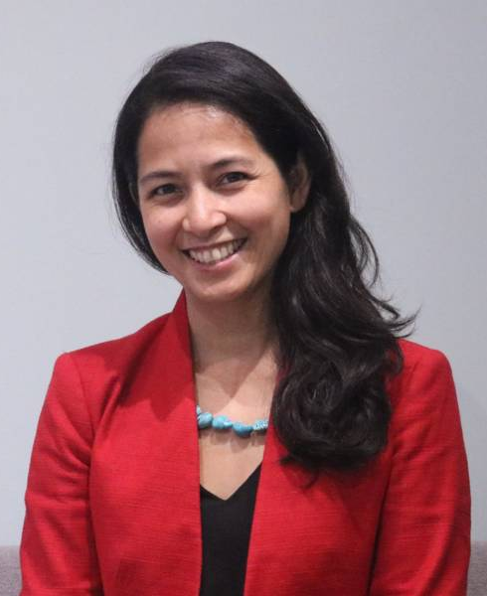
Nessia Berner Wong
ChangeLab Solutions
Elizabeth Reynoso
Living Cities
Notes:
[NBW] We are very excited to have a wonderful group of people with us today to speak about food procurement. I’ll have each speaker introduce themselves and their organization.
*Everyone introduces themselves (your name, who you are (2 sentences max), and a bit about your organization (2 sentences max)
Nessia, Senior Policy Analyst at ChangeLab, working on food systems policy including procurement. My background is in food security, public health, and federal nutrition programs.

Slide 4
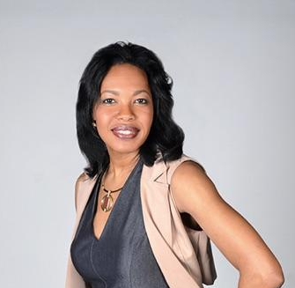
Jessica Gilbert
Partnership for the Public Good
Allison Dehonney
Urban Fruits & Veggies LLC
Notes:
[NBW]
Everyone introduces themselves (your name, who you are (2 sentences max), and a bit about your organization (2 sentences max)

Slide 5
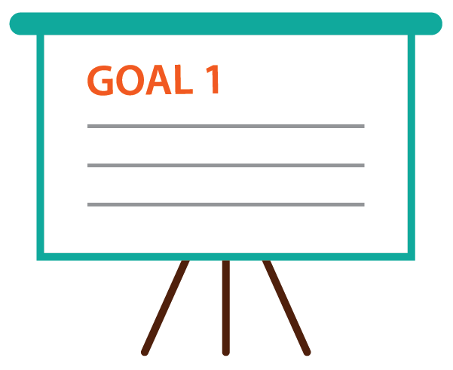
AGENDA
What is a ‘good food values’ approach to food systems?
How are procurement and health equity connected?
Local economies & a diverse workforce
Resources to put this type of policy into practice
Notes:
[NBW] Here’s a brief look at what we’ll cover today:
First we’ll look at food systems and a good food approach,
Then at how procurement fits into that and the connection between procurement and health equity
Next our speakers will dive into the good food values of local economies and a diverse workforce.
And finally we’ll share some resources and answer your questions.

Slide 6
A More Just Food System & Good Food Values
Notes:
[NBW]
And now to our just food system.
I can’t talk about food systems and certainly not about building a more just food system without honoring and acknowledging the communities across the nation that are protesting the recent murders of George Floyd, Ahmaud Arbery, Breonna Taylor, and sadly, countless others. The structural violence against Black people that protesters across the country are responding to is the result of a long history of laws and policies that discriminate and disenfranchise. These laws and policies, that have perpetuated a legacy of slavery, white supremacy, segregation, and disenfranchisement, are the most powerful risk factors in health. They are the same risk factors driving racial disparities in health and economic outcomes in the midst of the COVID-19 pandemic. Health equity cannot be achieved until we address this anti-blackness that results from insidious discriminatory systems, structures, and practices not just of the policing and criminal justice system, but in schools, healthcare, housing, and food systems.
Policies across the food system, including in procurement, can be leveraged in this effort. Policymakers and governments and funders and advocacy organizations and educators all play a critical role in the decisions that shape our communities and can push back at the fundamental drivers of health inequity.

Slide 7
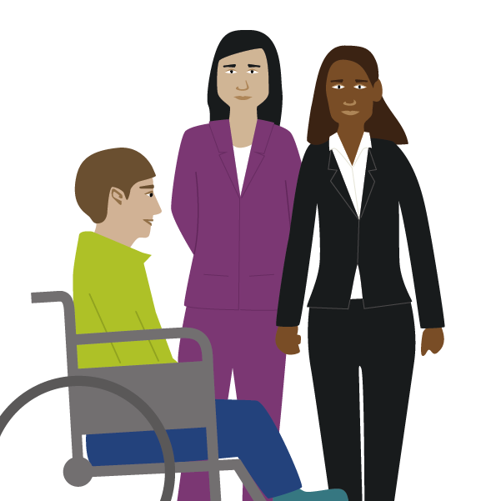
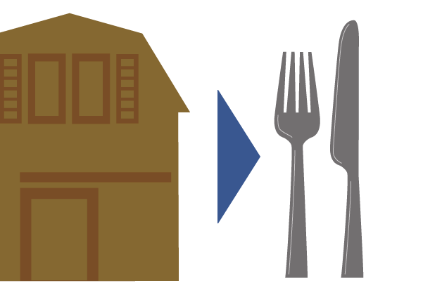
Notes:
[NBW] With that context, the food system provides a unique opportunity to shape the health, environment, social, and economic outcomes of communities. The food system is broad reaching, one of the largest industries in terms of employment, and a key ingredient in reversing the fundamental drivers of inequities. Each component of the food system – production, processing, distribution, consumption, and disposal – influences those outcomes. This, though, does not occur in a vacuum. The way that we approach food systems, the values that we place at the core of our approach, drive the activities across the food system supply chain. A food system that values local economies, values diversity in business, a valued workforce, nutrition, environmental sustainability, and animal welfare, can help to shape a communities or a region’s outcomes.

Slide 8
Procurement
&
Health Equity
Notes:
[NBW]
Let’s draw out the specific connection between procurement and health equity.
A definition we use for health equity, from the National Academies of Sciences, is the “the state in which everyone has the opportunity to attain full health potential and no one is disadvantaged from achieving this potential because of social position or any other socially defined circumstance.” And per everything I’ve said up until this point, I’d add, “because of systemic racism such as anti-blackness.”
The foundation of this concept and the concept of health disparities is the understanding that differences in health experienced by these populations are unjust, avoidable, and don’t result from genetics or biology but from systematic discrimination and social exclusion.
In the context of food procurement – addressing health equity requires a reframing of institutional purchasing that intersects with health in ways that go beyond nutrition and healthy food access.
To use it as a tool for achieving health equity and justice in food systems, we need to see procurement as a strategy for creating good jobs, economic development, racial equity, and environmental sustainability.

Slide 9
Notes:
[NBW] This is an infographic we developed with the center for good food purchasing (who is an organization leading the charge to shift institutions towards a values-based purchasing model) to demonstrate this framework for how equitable food procurement, as one activity occurring within food systems, can contribute to a more just food system.
It might be a little late here, but I want to clarify what we’re talking about when we say procurement. Procurement is the process of finding, contracting for, and acquiring goods or services. Local government agencies, school districts, and other large institutions like hospitals and universities are often some of the largest food purchasers in a community. They are also an important source of food for community members – Americans eat more than a third of their calories outside of the home. With this purchasing power, and the standards and criteria (driven by good food values) that they use to find and select their food supplies, they can move structural drivers of inequity like structural discrimination, income inequality, and disparities in opportunity.
So to go back to the idea of using good food values in procurement to drive food system activities, here are a few examples:
Valued workforce - One out of every 7 workers in the US works along the food chain, yet a lot of these jobs come with low pay, poor working conditions, and no benefits. Procurement policies can help to demand better conditions for these workers.
Environmental sustainability - If US public schools reduced their meat purchases by 30%, they could reduce their carbon footprints by 700 million kilograms at no extra cost.
Health and nutrition - consider who typically eats food served by governments and institutions. Most often this food is served to people from groups already at increased risk for – or overburdened with diet-related diseases like hypertension and obesity. Examples here include low-income seniors, children from food insecure households, and people living in institutional settings such as correctional facilities and psychiatric hospitals. Valuing health and nutrition can shape the food environment.

Slide 10
Notes:
[NBW]
Elizabeth, Jessica, and Allison are going to go deeper into two of the good food values – local economies and diversity in business. In the most simple sense, leveraging institutional dollars for local economies can keep dollars circulating in a region so that they can stabilize and grow local economies; and supplier diversity programs help counteract disparities in access to opportunity for diverse businesses, including ones that are owned by women, people of color, veterans, and people with disabilities.
There is a lot more to both of these values, so I’m going to pass it off to Elizabeth first to take us further into diversity in business, Jessica will follow-up with local economies, and Allison will take us into both of these values in action.

Slide 11
Diversity in Business:
Racial Equity & Inclusion
Elizabeth Reynoso
Living Cities
Notes:
[ER]

Slide 12
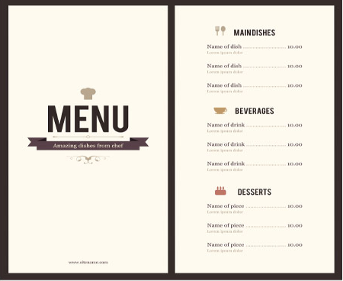

Slide 13
Disparities in Procurement: The Historical Context
Slavery
Jim Crow
Foundations of Equitable Procurement
Growth & Innovation in Equitable Procurement
1865-1950s
1960s – 1990s
2000s->
pre-1865
African Americans denied rights of citizenship
Slaves legally regarded as property
Wealth accumulation impossible for slaves
Jim Crow laws abridged rights of citizenship
Redlining, segregated schools, voter suppression
Black wealth accumulation actively suppressed
Voting Rights & Fair Housing Acts; affirmative action; small business funding
70s: minority contracting pioneers
Croson/Aderand cases
Growth of MBE inclusion programs
Innovation to reduce barriers, change culture

Slide 14
Local governments spend $1.5 trillion a year
on goods, services, and construction
General Services &
Repairs
Goods & Supplies
Fleet/Vehicle Purchase &
Repairs
Information Technology &
Professional Services
Construction, Engineering &
Operations
Notes:
Potential just for local govt: TYPES OF GOODS/SERVICES

Slide 15
Growing businesses that employ residents
Local supply chain development
Diverse vendors disrupting industries
Close the racial wealth income and gap
Support community wellness
THE CASE FOR EQUITABLE PROCUREMENT

Slide 16
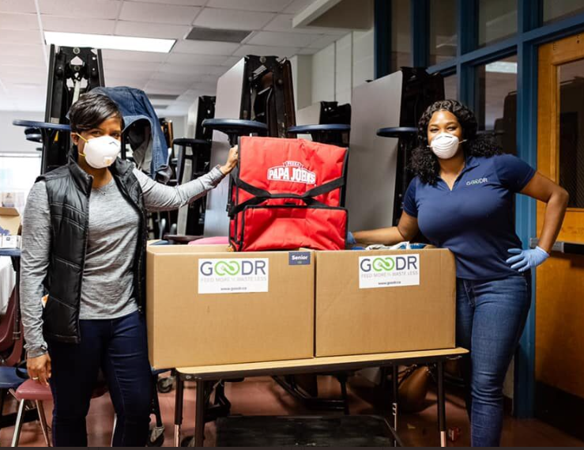
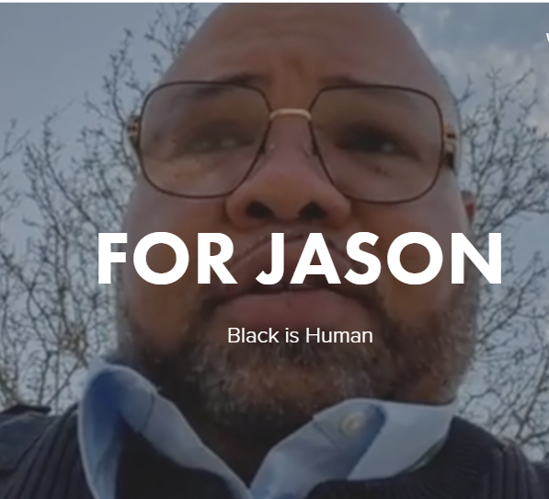
PROCUREMENT DURING COVID

Slide 17
Assessment of Local Vendors of COLOR (MBE): Availability & Capacity
Why?
Determination of what firms are available and capable of performing the scope of work.
How?
1. Analyze existing laws and policies and their impact on procurement
2. Conduct an availability analysis or disparity study:
A legal review of purchasing policies and practices
Interviews with the appropriate procurement staff
Interviews with the local contracting community

Slide 18
OUTREACH
Why?
Identification and engagement of MBEs with the desire, knowledge and financial capability to provide services.
How?
Outreach from municipality to vendors and vendors to potential partners/subcontractors.
Conduct contract forecasting and stakeholder engagement
Communicate opportunities to its MBE business community, including organizations and businesses

Slide 19
CERTIFICATION AND VERIFICATION
Why?
Verification of the race or ethnicity of firms to avoid fraudulent behavior in their diverse contracting programs (“Fronts” and “Pass-Throughs”)
Provides documentation to support determination of capacity, including the level of technical competence, capacity, financial capability, training needs and business acumen for each prospective MBE firm.
How?
Strong processes include:
Thorough documentation
Desk audits
Site visits
Review of “Commercially Useful Function”

Slide 20
PROCUREMENT
Why?
Development of carefully considered bid packages that support maximum opportunities for MBE participation.
PRE-BID BID PROCESS
How? How?
Breaking apart large contracts/bid packages
Solicitations and language clearly communicating MBE goals
Updates on status and timing of bid package release (ongoing outreach)
Use of MBE utilization plans
Submission of MBE subcontractor documents with the bid submission (to avoid bid shopping)
Bid incentives
Scoring MBE participation

Slide 21
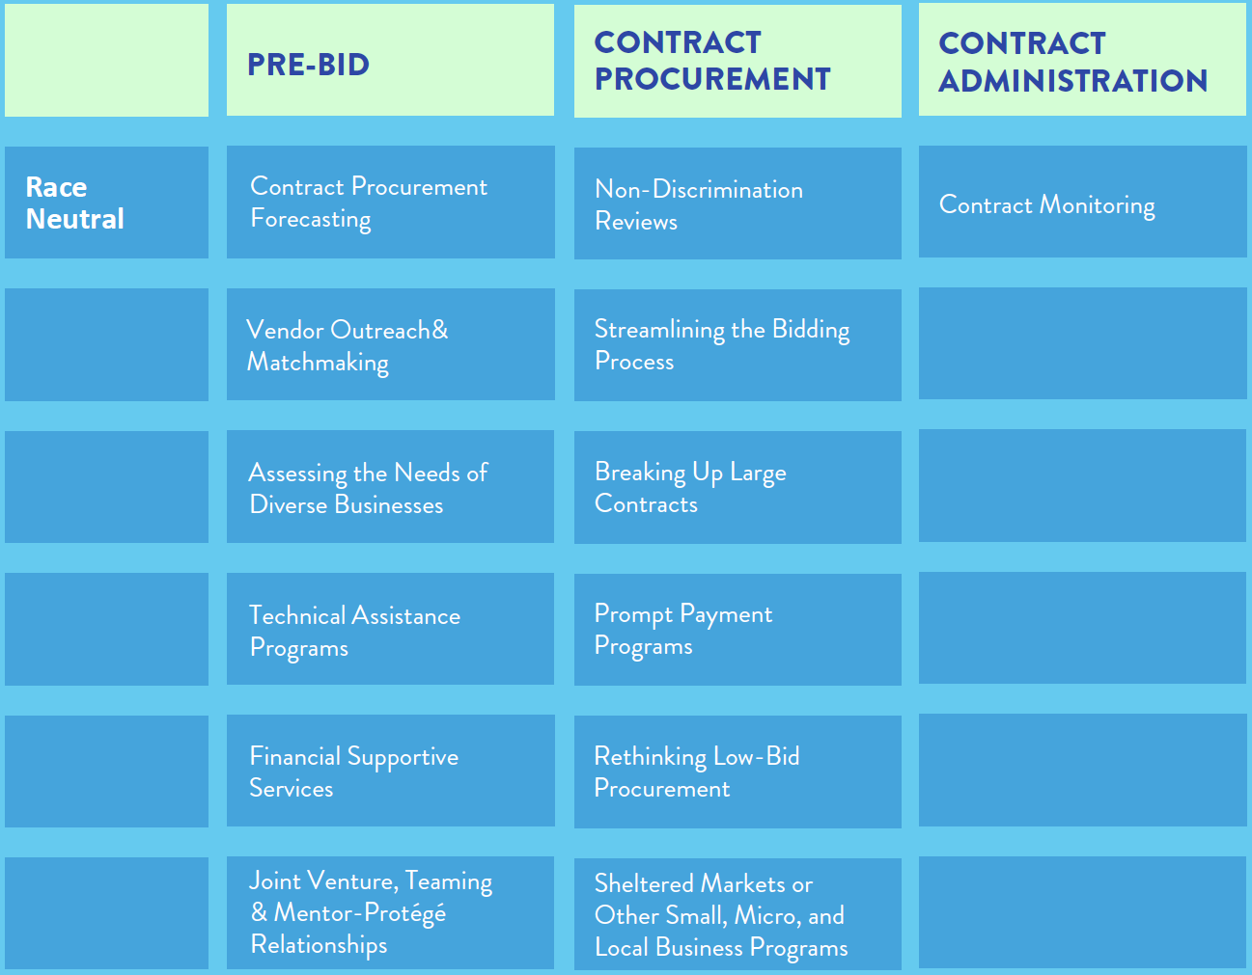
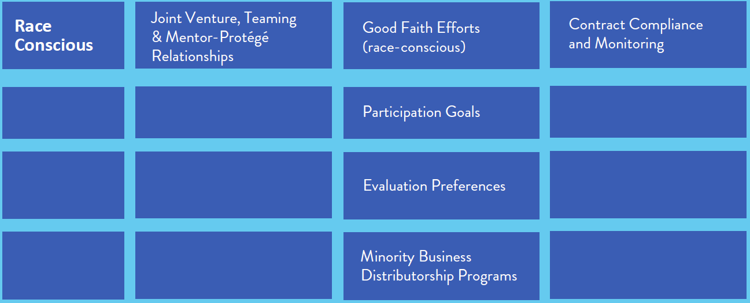
PROCUREMENT TOOLS

Slide 22
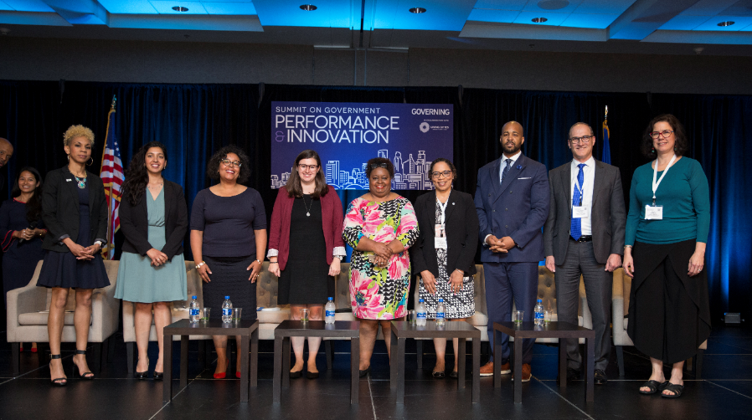
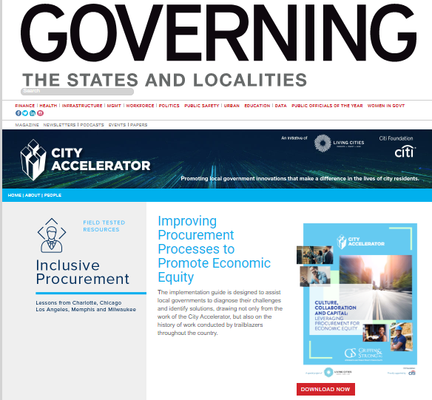
MORE RESOURCES AND STORIES
https://www.governing.com/cityaccelerator/
@Living_Cities #CityAccelerator

Slide 23
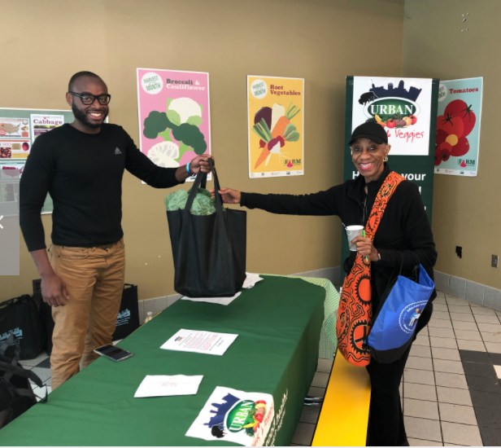
Local Economies
Jessica Gilbert
Partnership for the Public Good
Notes:
[JG]
Speaker 3 (Jess, PPG) [10 minutes]
Local economies
Overview of GFPP work
Why local economies are important
How local economies are supported by procurement policies
Procurement policy in practice
GFPP
How centering local economies in procurement policies supports COVID-19 response
Anything else?
COVID-19 has highlighted the very real ways the need for a resilient local food system.
Our FS was disrupted and food wasn’t traveling in the same way that it was beforehand
Consumers weren’t buying as much from restaurants which in turn weren’t buying as much from suppliers
Surpluses of food
Find examples
Local food has been filling in some of these gaps and can be rerouted to consumers via other avenues
Seeing

Slide 24
Every year, public institutions across the US spend billions on food purchases.
The GFPP helps these institutions to leverage their institutional procurement power to promote values-based procurement that prioritizes:
Nutrition ● Local economies ● Valued workforces Animal welfare ● Environmental sustainability

Slide 25
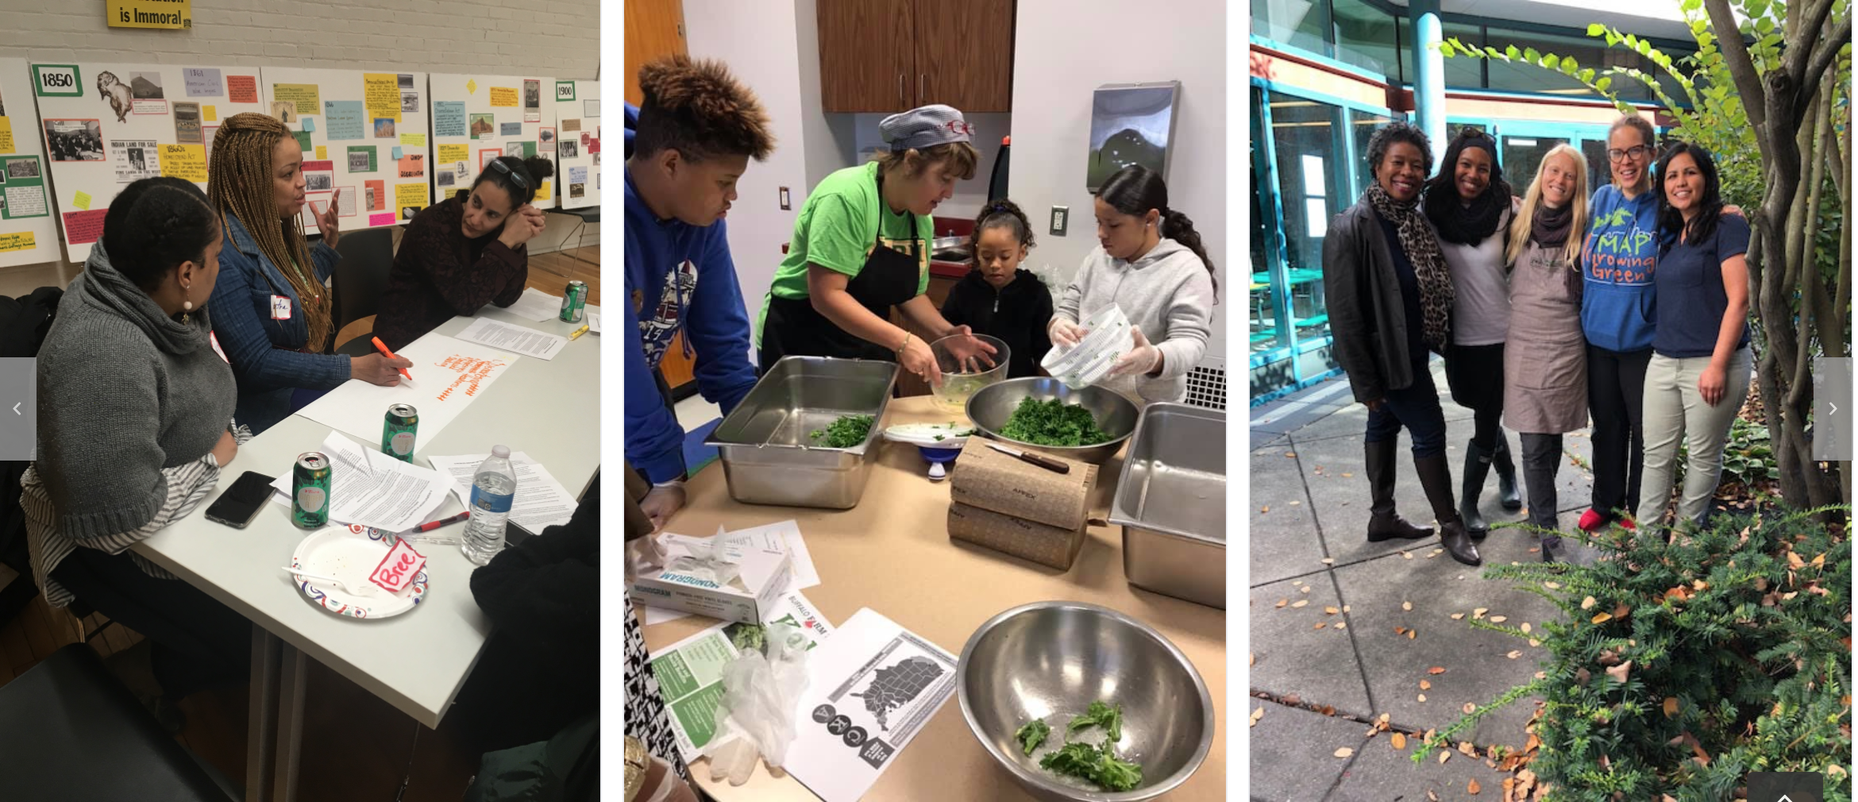
The Good Food Buffalo Coalition

Slide 26
The Good Food
Buffalo Coalition
Emphasizing racial justice
(as opposed to racial equity)
Both the process and the outcome must be just.

Slide 27
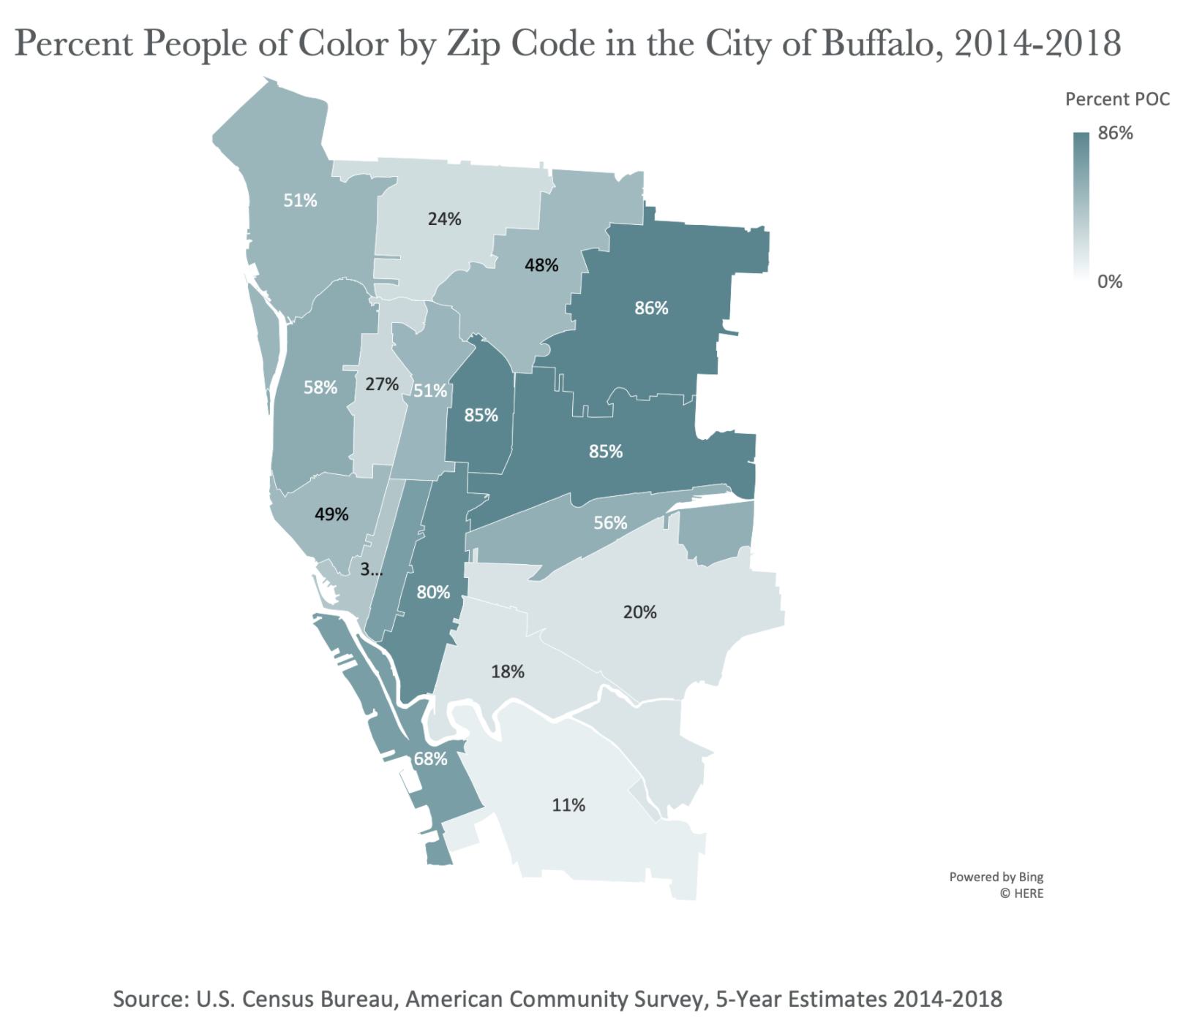
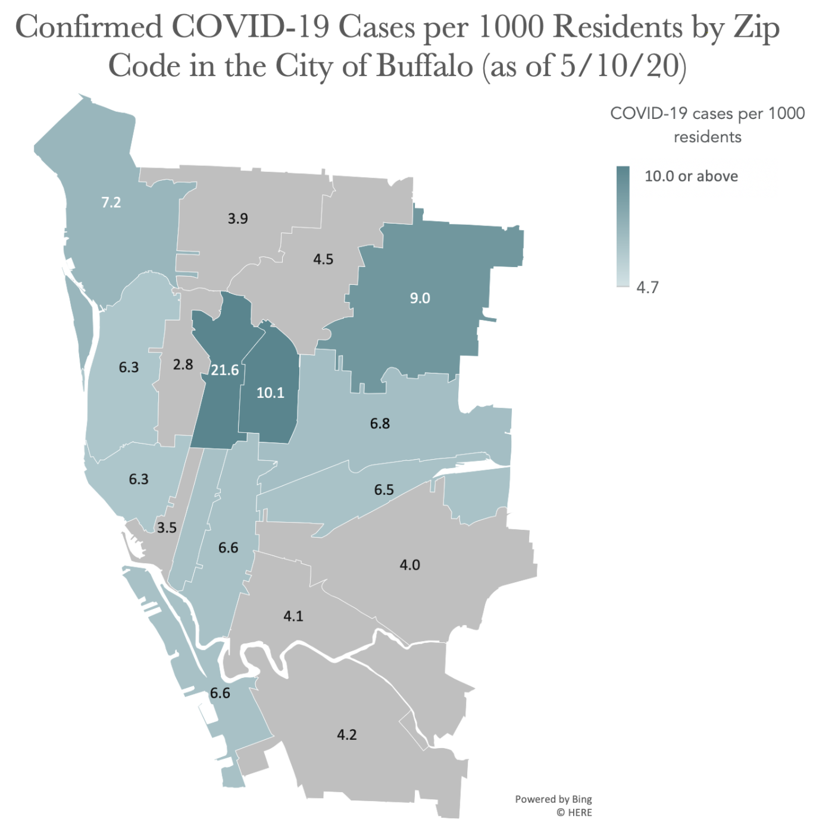
Notes:
[JG]
Source: Partnership for the Public Good (2020). “Mapping COVID-19 Cases and Other Local Data.” Retrieved from: https://ppgbuffalo.org/news-and-events/news/article:05-19-2020-12-00am-diving-into-the-data-covid-19-cases-and-other-local-data/.

Slide 28
COVID 19 has not created new problems in our food system; it has exposed the hidden, underlying systemic issues inherent to the industrial food system.

Slide 29
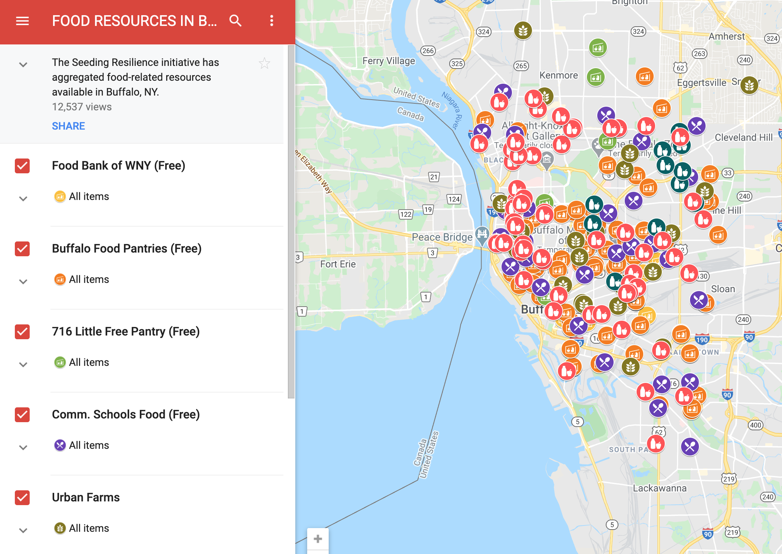
Seeding Resilience

Slide 30
The power of procurement
How can public institutions support local economies?

Slide 31
Process is critical for justice
How are we going about building our local food system?
Who needs to be at (and leading) the table?

Slide 32
NYS Policy: Geographic preference
NYS Policy: Lowest responsible bidder
BPS Policy: Contracting to MWBEs
Policy Barriers
Notes:
[JG]

Slide 33
Local economies & racial equity in action
Allison Dehonney
Urban Fruits & Veggies LLC
Notes:
[AD]

Slide 34
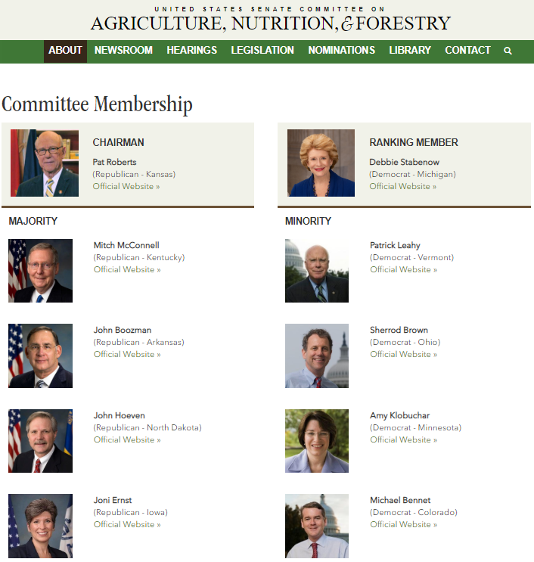
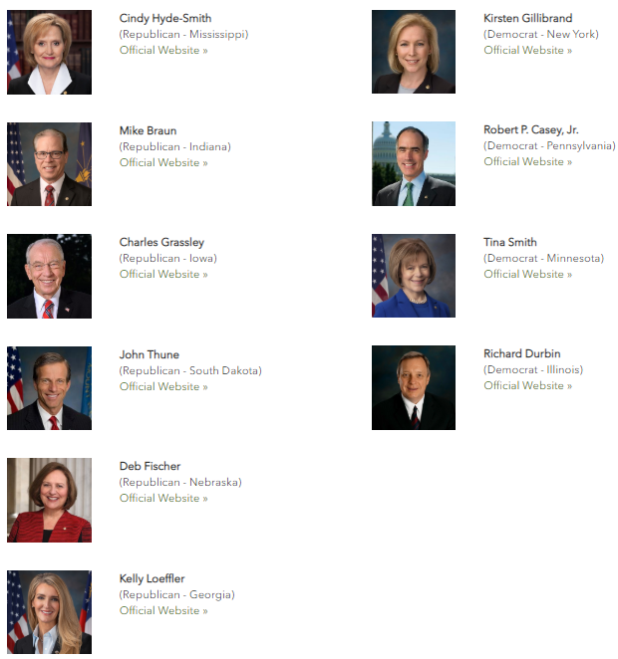

Slide 35
How do we grow without equity?
On average it takes
3-5 years for a new business to reach some level of stability.
For businesses lead by people of color and specifically women of color it takes
5-7 years…why??

Slide 36
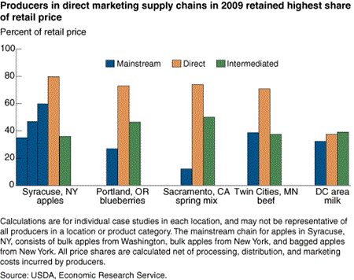

Slide 38
Community Impact: Public Health Benefit
If UFV received contracts:
Local government helps clients, public agency staff and other consumers gain improved access to healthier institutional meals that have been prepared with fresh, high quality and locally grown produce.
There is heightened attention to where one’s food comes from; this helps to bring greater awareness among community members and the greater public about the importance of strengthening sustainable and equitable local food systems.
Support for local food provides opportunities for additional programming and policies to encourage healthy eating, including nutrition education and food/vegetable prescription programming.

Slide 39
Benefits to Multiple Consumers
Public schools
Public hospitals
Child-care centers
Senior programs
Civil and municipal service facilities
State prison and juvenile facilities
State colleges and universities
Nonprofit contracts that provide food for federal programs

Slide 40
Building an Equitable Food System Requires a Focus on Race
People of color are a growing share of the nation’s consumers and workers but are the most negatively impacted by our inequitable food system - from health outcomes to poor wages
U.S. Obesity Rate
Food Workers Earning Subminimum Wages
An equitable Food system would produce different outcomes by making healthy food available to all, providing good jobs and fostering healthy neighborhoods. It would strengthen the economy by bolstering incomes, spurring business development and contributing to equitable economic development in segregated and long-distressed neighborhoods.

Slide 41
What’s next?
Notes:
[NBW] What are actions you can take? Who are the decision makers? Where do I find more information?

Slide 42
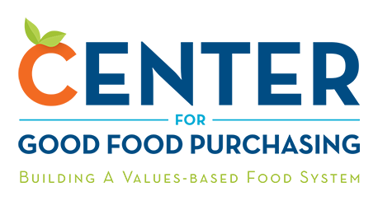
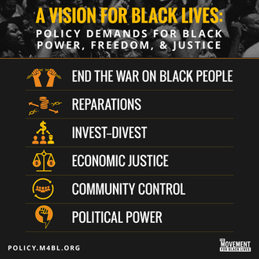
Resources for changemaking:
https://www.governing.com/cityaccelerator/
@Living_Cities #CityAccelerator
Notes:
Here we have a few resources from the organizations featured on this webinar and others.
The Center for Good Food Purchasing is a great source of resources and information on the Good Food Purchasing Program
Living Citie’s City Accelerator
Urban Fruits & Veggies
PPG’s Buffalo Commons
And finally the Movement for Black Lives’ policy platform, which we can use as a guide to centering a vision for black power, freedom, & justice in our policy work.

Slide 43
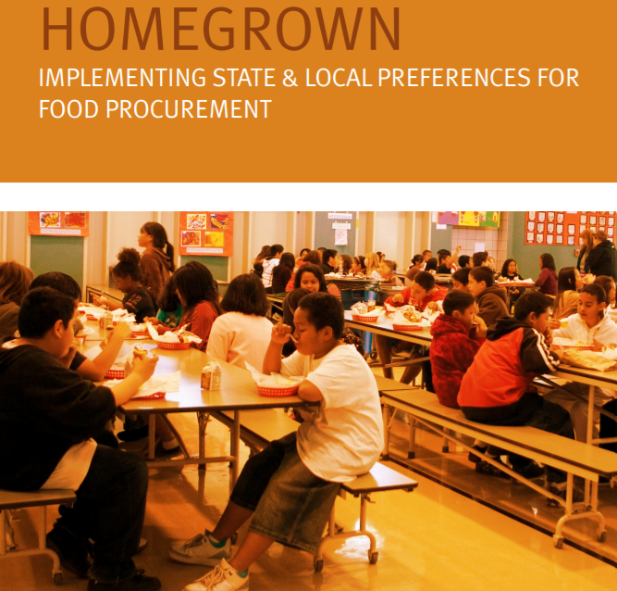
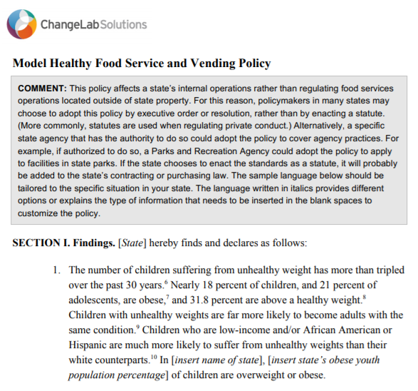
Resources for changemaking:
Notes:
[ADD PARTNER RESOURCES]

Slide 44
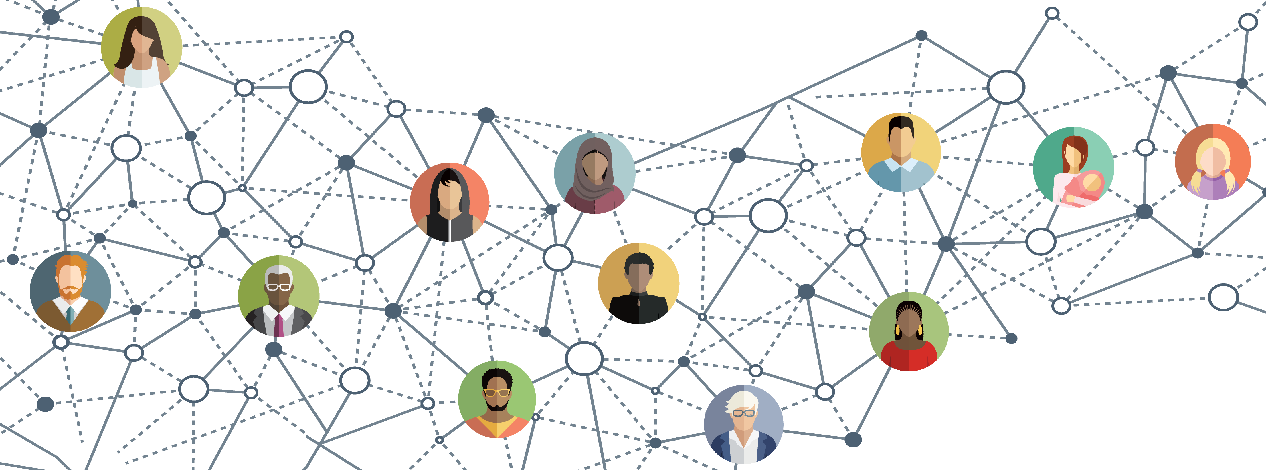
Thank you! Questions?
Keep the conversation going
Nessia Berner Wong: nbernerwong@changelabsolutions.org
Elizabeth Reynoso: Ereynoso@livingcities.org
Jessica Gilbert: jlgilber@buffalo.edu
Allison Dehonney: dehonn@outlook.com
Notes:
[CLS – NBW]
You may submit your questions via the Q&A box on the left side of your screen.
Feel free to get in touch and share your questions or comments with us. As soon as this webinar ends, you’ll be directed to a very quick follow up survey – please take just two of three minutes to share your feedback with us and help shape this conversation.
And the recording for this webinar will be available soon – you’ll receive a follow up email.
Thank you so much to everyone for joining us!

