Slide 1
Structure of Government
Exploring the Fabric and Framework of Public Health Powers

Slide 2
ChangeLab Solutions Disclaimer
The information provided in this discussion is for informational purposes only, and does not constitute legal advice. ChangeLab Solutions does not enter into attorney-client relationships.
ChangeLab Solutions is a non-partisan, nonprofit organization that educates and informs the public through objective, non-partisan analysis, study, and/or research. The primary purpose of this discussion is to address legal and/or policy options to improve public health. There is no intent to reflect a view on specific legislation.
© 2019 ChangeLab Solutions

Slide 3
CDC Disclaimer
These course materials are for instructional use only and are not intended as a substitute for professional legal or other advice. While every effort has been made to verify the accuracy of these materials, legal authorities and requirements may vary from jurisdiction to jurisdiction. Always seek the advice of an attorney or other qualified professional with any questions you may have regarding a legal matter.
The contents of this presentation have not been formally disseminated by the Centers for Disease Control and Prevention (CDC) and should not be construed to represent any agency determination or policy.

Slide 4
What We’ll Discuss
Basic Structure & Functions of Government
Separation of Powers
Expression of Power: Types of Laws
Governmental Public Health Authority
Intergovernmental Collaboration & Improved Health

Slide 5
Basic Structure & Functions of Government

Slide 6
Let’s explore the three levels of government and their sources of power

Slide 7
Federal Government
Enumerated powers
Implied powers
Concurrent powers

Slide 8
Examples of Enumerated Powers
The power to collect taxes
The power to raise and support armies
The power to establish post offices
The power to provide and maintain a navy

Slide 9
Enumerated Powers:
The Spending Clause
The power to spend money for the general welfare

Slide 10
Enumerated Powers:
The Commerce Clause
The power to regulate commerce (both domestically as well as globally)

Slide 11
Enumerated Powers:
The Necessary & Proper Clause
The authority to make all laws that are necessary and proper to ensure implementation of these powers

Slide 12
Broad interpretation has led to several implied powers…

Slide 13
Example of Concurrent Powers
Collect taxes
Build roads
Establish bankruptcy laws
Create lower courts

Slide 14
Supremacy Clause
Preemption: When the law of a higher jurisdiction invalidates the law of a lower jurisdiction

Slide 15
Examples of how preemption works in practice:
Preemption & Menu Labeling

Slide 16
Reserved Powers:
Powers that are reserved solely for the states

Slide 17
Public Health Powers: The Tenth Amendment
Under the Tenth Amendment, states retain the primary responsibility for protecting the public’s health

Slide 18
Public Health Powers: Examples
Example: States’ and local governments’ authority to prevent the spread of infectious disease
Example: A state or local law requiring nutrition standards for restaurant children’s meals

Slide 19
Power to Regulate Internal Affairs
  Conduct elections
  Establish local governments
  Regulate intrastate commerce, or business entirely within state boundaries
  Issue licenses (including for things like the medical profession, or assisted living and child care facilities) Affirm amendments to state constitutions

Slide 20
Local Powers
The powers of counties and cities
Varies greatly based on the delegation of power

Slide 21
Local Powers
Home Rule = Broad Authority
Some states—like Florida and Illinois—give local governments broad authority.
In those states, local governments can directly enact laws that affect the general public, without relying on a specific delegation of power from the state legislature

Slide 22
Local Powers
Dillon’s Rule = Narrow Authority
Other states, like Virginia, greatly limit local authority
Cities and counties are only allowed to act within the powers specifically granted to them by the state legislature

Slide 23
Local Powers
Somewhere in between
There are states, like California, that fall somewhere in between
These states grant some, but not all, of its local governments broad police powers

Slide 24
What’s the main takeaway?
If you work in local government, find out what type of authority you have!

Slide 25
How do the three levels of government work together in practice?
Example: Tobacco Control
Federal: Tobacco Control Act
State: Smoke-free workplace laws
Local: Comprehensive smoke-free laws

Slide 26
Federal: Tobacco Control Act
Gives the Food and Drug Administration authority to regulate the manufacture, distribution, and marketing of tobacco products

Slide 27
State: Smoke-free workplace laws
Eliminate smoking in private-sector worksites

Slide 28
Local:
Comprehensive smoke-free laws
Prohibit smoking in all indoor areas of private workplaces, restaurants, and bars, with no exceptions

Slide 29
Separation of Powers

Slide 30
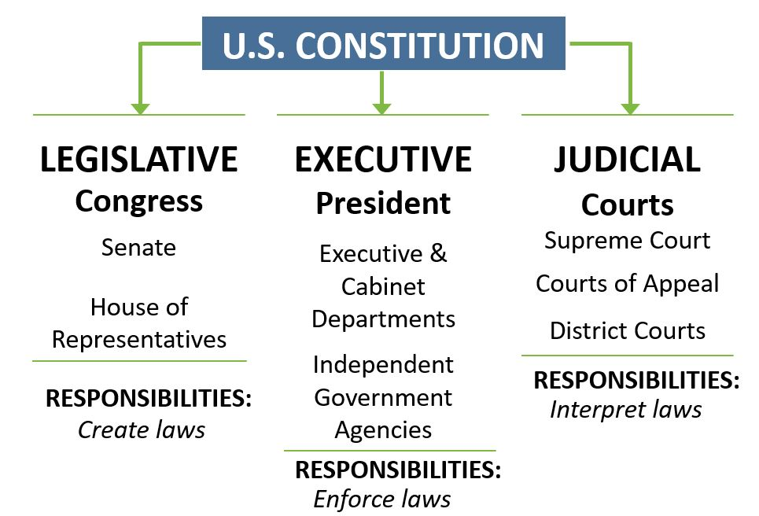
Three Branches of Government

Slide 31
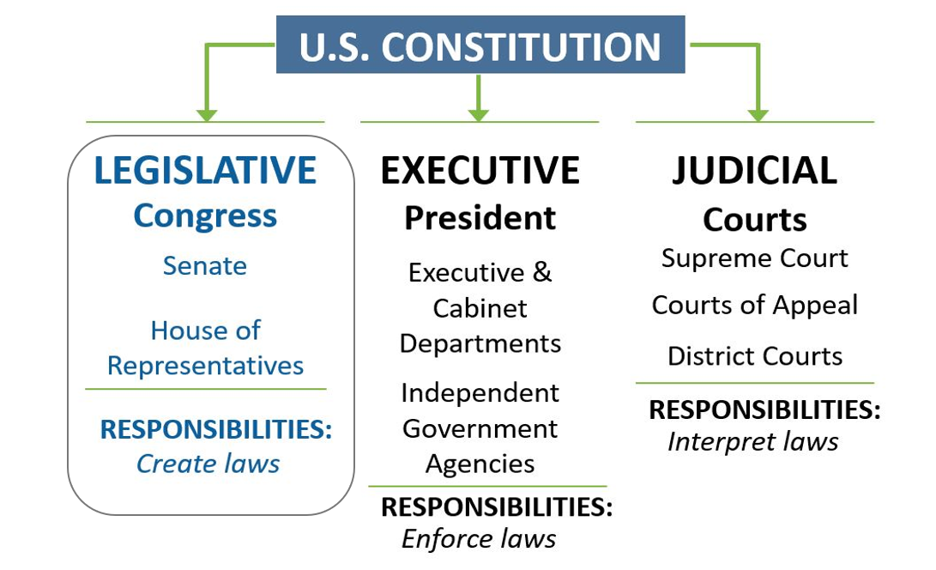
Three Branches of Government - Legislative

Slide 32
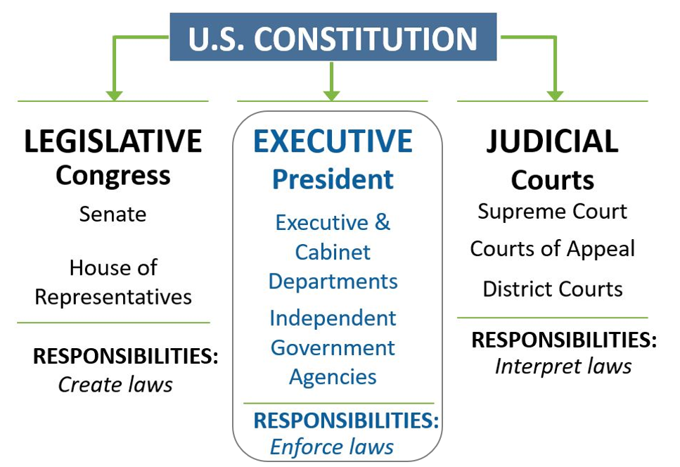
Three Branches of Government - Executive

Slide 33
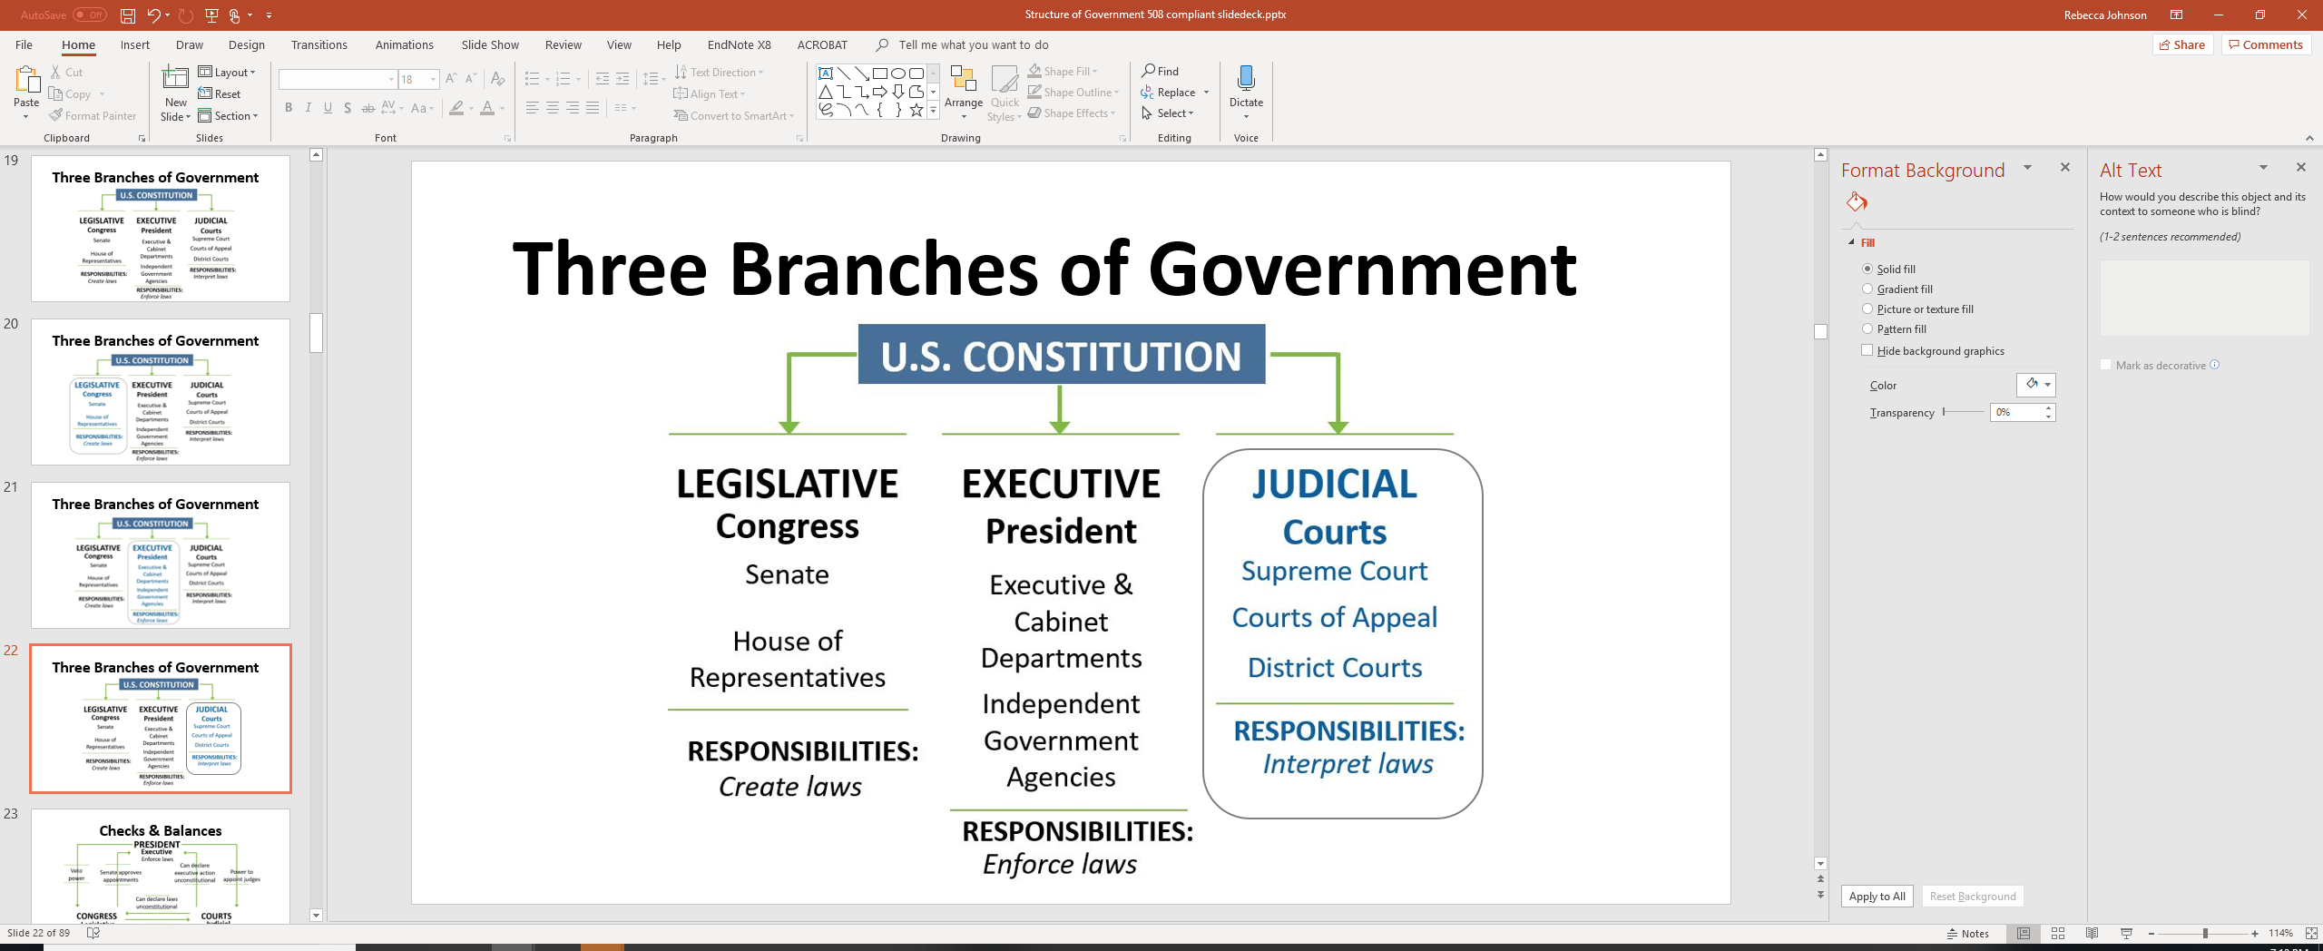
Three Branches of Government - Judicial

Slide 34
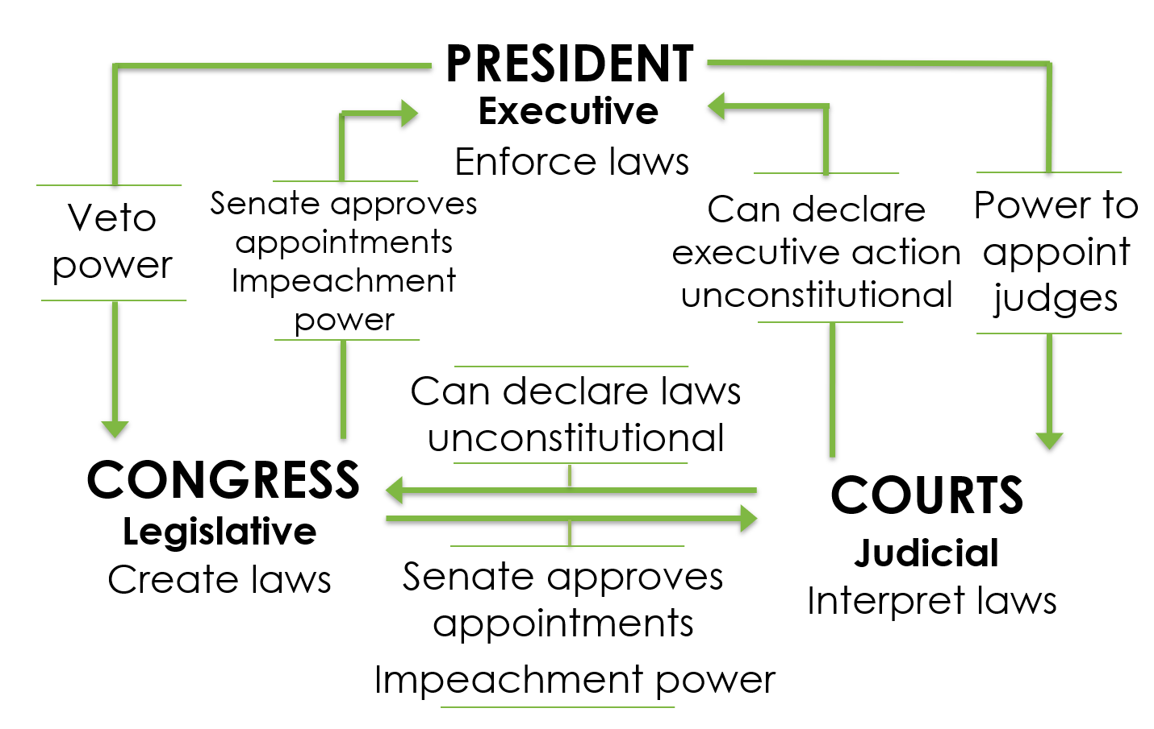
Intro: Checks & Balances

Slide 35
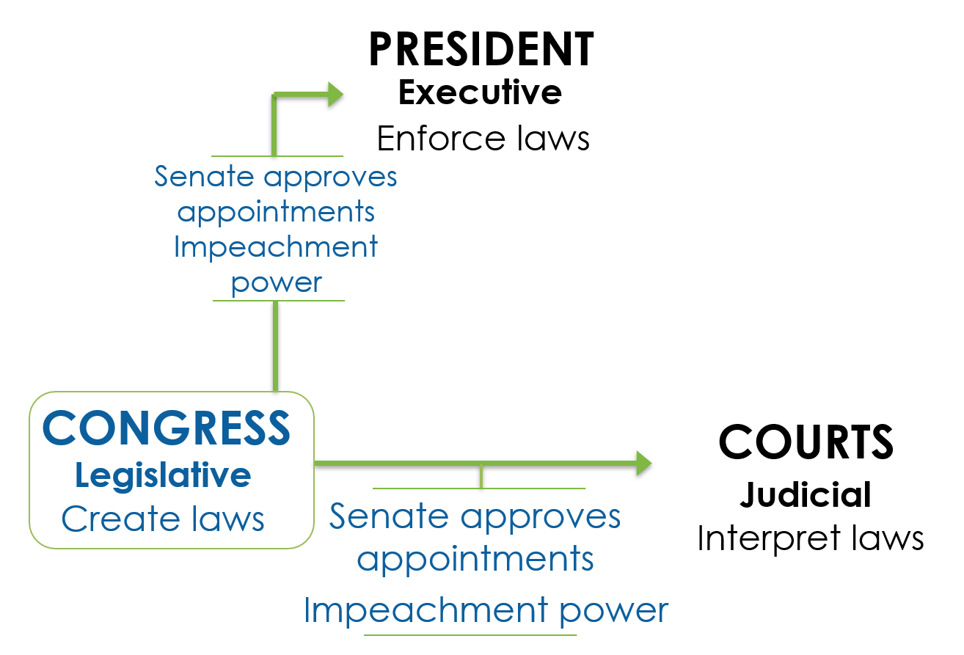
Powers of Congress

Slide 36
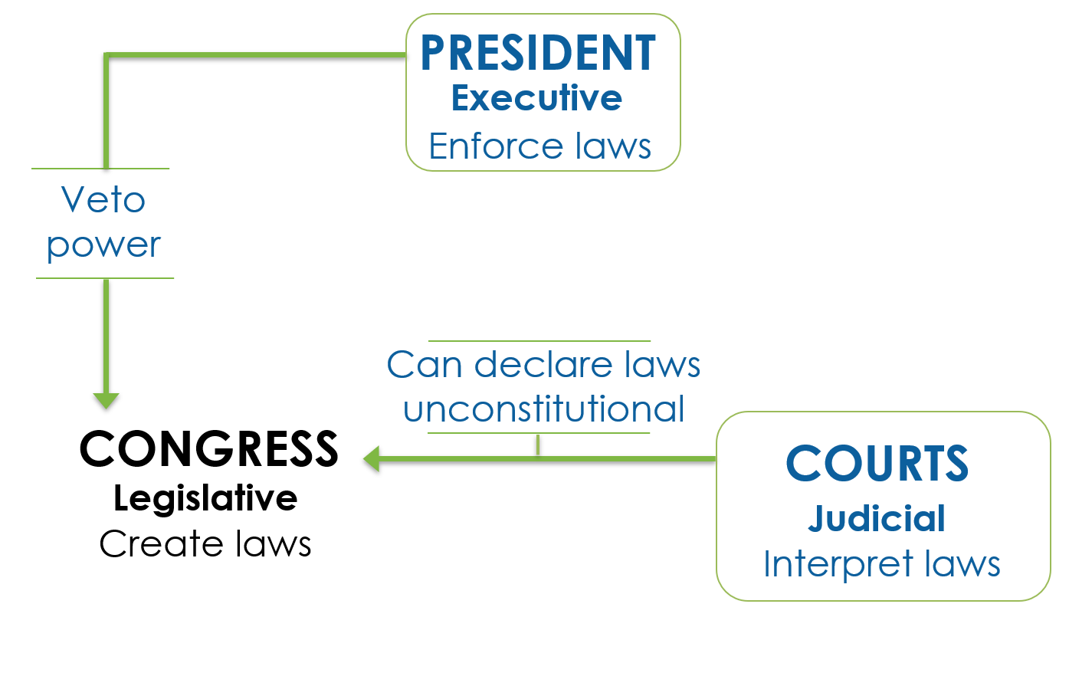
Checks on Congress

Slide 37
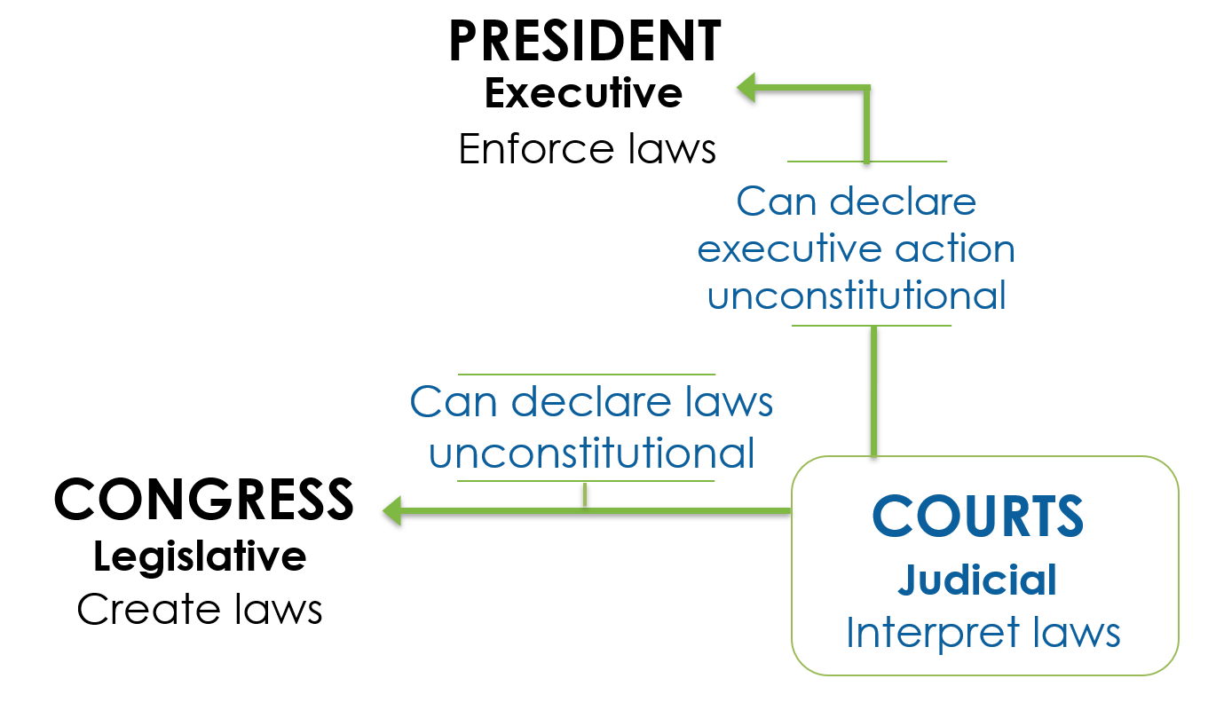
Powers of Courts

Slide 38
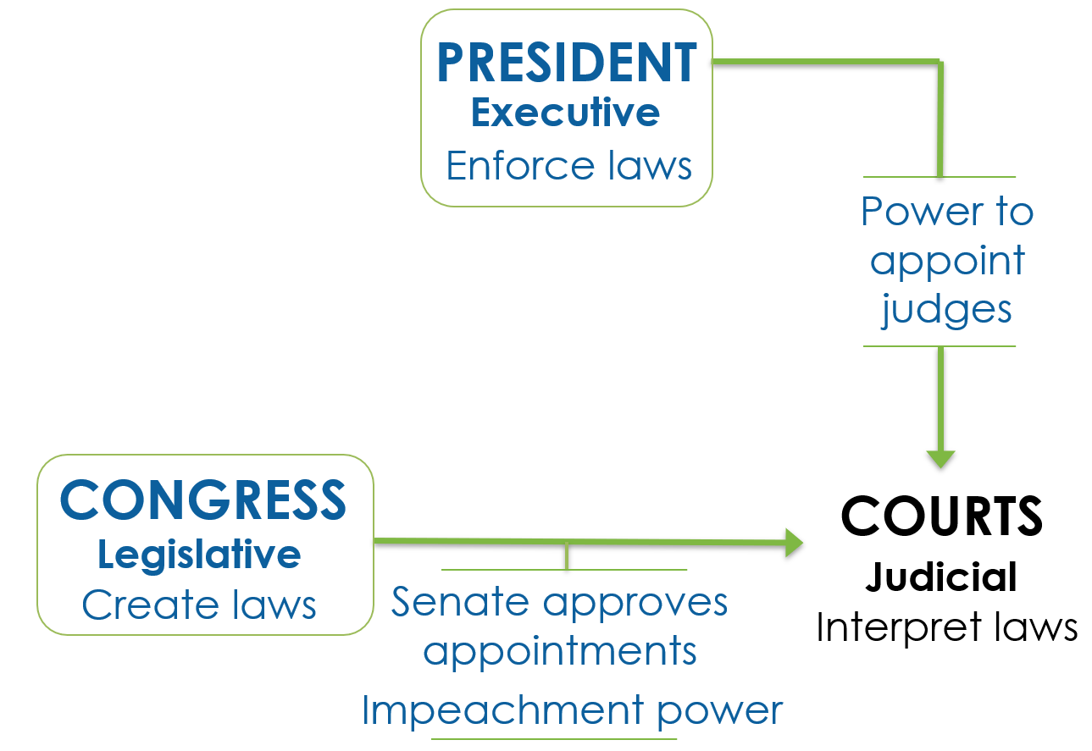
Checks on Courts

Slide 39
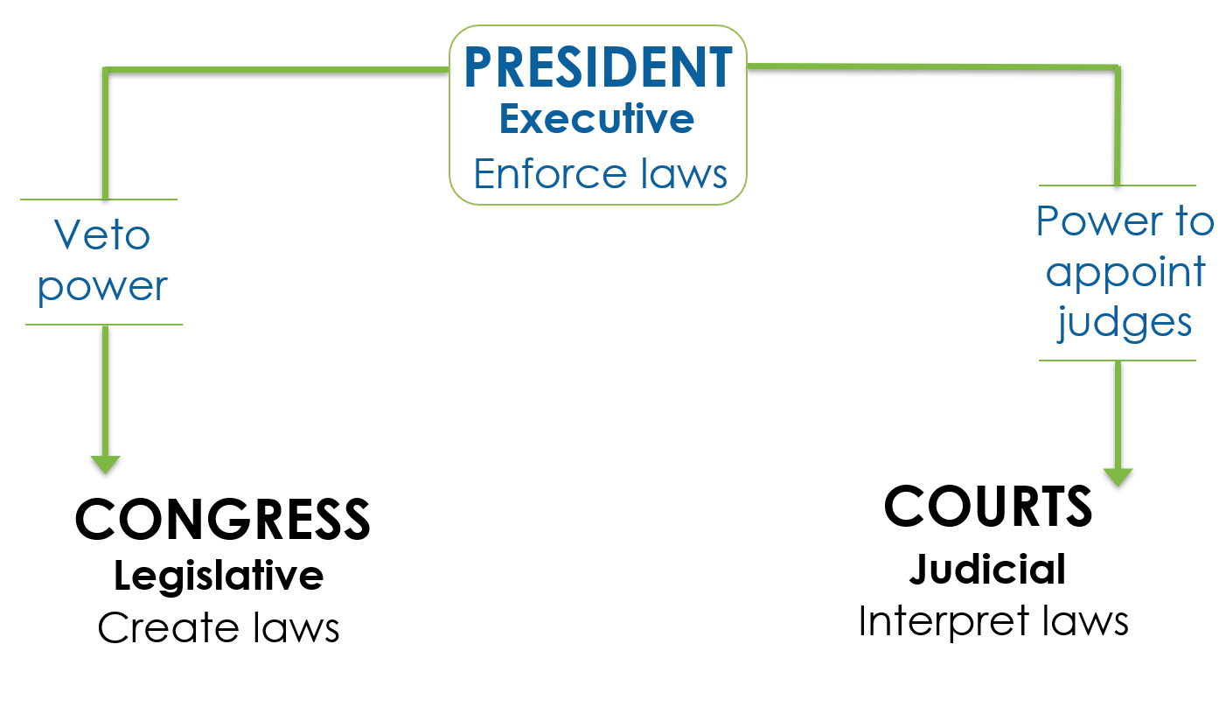
Powers of the President

Slide 40
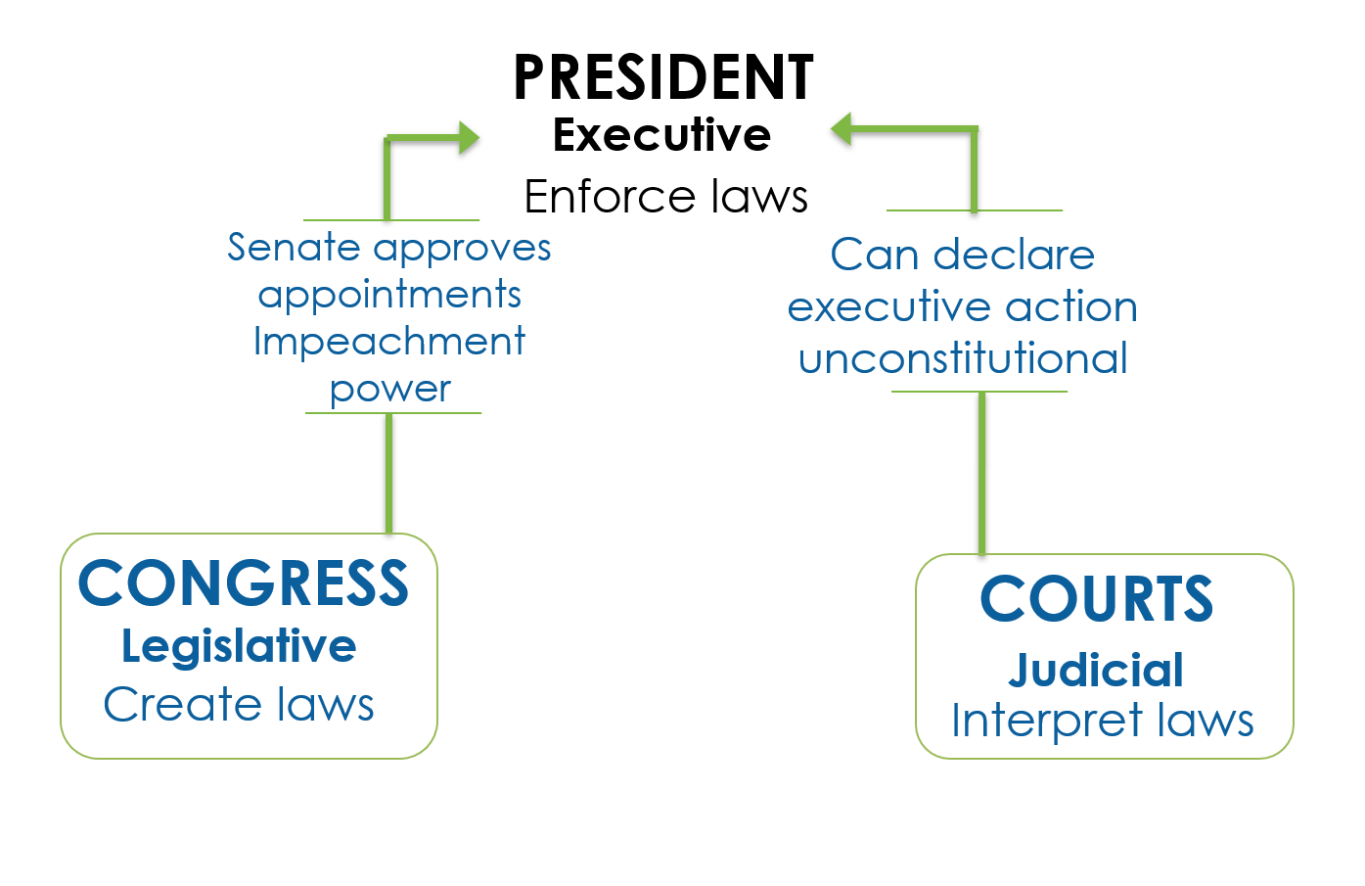
Checks on the President

Slide 41
Checks & Balances: Illinois
Instead of the legislative branch creating the laws, the executive branch has the rulemaking power.
And instead of the executive branch approving those rules, all rules must be approved by the legislative branch.

Slide 42
Structure of Local Governments

Slide 43
Counties

Slide 44
Counties Differ by State in Several Ways
Organization
Size
Number

Slide 45
Counties’ Responsibilities Often Include
Law enforcement and public safety
Transportation and infrastructure
Community health

Slide 46
Municipalities

Slide 47
Municipalities Differ by State in
Several Ways
Quantity
Designation
Incorporation Requirements

Slide 48
Municipalities Responsibilities Often Include
Police and fire
Animal control
Parks
Public works
Water

Slide 49
Trivia Question:
Which of these U.S. Cities is also a county?
Philadelphia
Denver
Louisville
New Orleans
Honolulu

Slide 50
Expression of Power:
Types of Laws

Slide 51
Two Types of Laws
Legislation
Regulation

Slide 52
Effect of Two Types of Laws
Legislation
Has the effect of: Law
Regulation
Has the effect of: Law

Slide 53
Two Types of Laws Are Introduced by
Legislation
Introduced by: Lawmakers
Has the effect of: Law
Regulation
Introduced by: Federal Agencies
Has the effect of: Law

Slide 54
Two Types of Laws Are Altered By
Legislation
Introduced by: Lawmakers
Altered by: Congress
Has the effect of: Law
Regulation
Introduced by: Federal Agencies
Altered by: The Public
Has the effect of: Law

Slide 55
Two Types of Laws Can Be Stopped By
Legislation
Introduced by: Lawmakers
Altered by: Congress
Can be stopped by: Stalling/Failing in Congress
Has the effect of: Law
Regulation
Introduced by: Federal Agencies
Altered by: The Public
Can be stopped by: Congress/ the Public
Has the effect of: Law

Slide 56
Two Types of Laws Are Finalized When
Legislation
Introduced by: Lawmakers
Altered by: Congress
Can be stopped by: Stalling/Failing in Congress
Finalized when: Passed by Congress & Signed by President
Has the effect of: Law
Regulation
Introduced by: Federal Agencies
Altered by: The Public
Can be stopped by: Congress/ the Public
Finalized when: Published
Has the effect of: Law

Slide 57
Statutes

Slide 58
Federal Regulations

Slide 59
Regulations can take many forms, such as:
Prescribing or proscribing conduct
Enforcing laws passed by the legislature

Slide 60
Executive Orders

Slide 61
Judicial Decisions

Slide 62
Administrative Law Decisions

Slide 63
Governmental Public
Health Authority

Slide 64
Federal Agencies
Public health powers derived from the powers to tax, spend, regulate interstate commerce, and regulate the interests of national security

Slide 65
Territorial & Tribal Health
Often work with federal and state agencies to provide public health services
However, both have independent authority to address public health concerns in their communities
In this respect, they are similar to states

Slide 66
State Health Departments
Require mandatory vaccinations
Require children to wear bicycle helmets
Invoke isolation and quarantine orders
Investigate disease outbreaks, and
Limit portion sizes of unhealthy foods and beverages

Slide 67
An example in Illinois

Slide 68
Structure of Public Health Governance
The extent of states’ authority over local health agencies,
Who has the authority to make budgetary decisions,
The powers that local governments are granted,
Who appoints top executives, and
What percentage of local health unit budget is provided by the state.

Slide 69
Structure of Public Health Governance:
Two State Examples
South Carolina
North Carolina

Slide 70
Structure of Public Health Governance:
South Carolina - Centralized
Snapshot: 4 regional health units led by state employees, serving 100% of population
Budgetary Authority: The state
Local Governments May: Implement public health orders issued by state
Top Executive Is Appointed & Approved by: The state
X% of Local Health Unit is Provided by State: 76%-100%

Slide 71
Structure of Public Health Governance:
North Carolina - Decentralized
Snapshot: 85 local health units led by local employees, serving 100% of the total state population
Budgetary Authority: Local gov’t (no state input)
Local Governments May: Establish taxes, establish fees w/o state approval, issue public health orders
Top Executive Is Appointed & Approved by: Local officials
X% of Local Health Unit is Provided by State: 0%-25%

Slide 72
Local Health Departments:
10 Essential Services
Monitor health status
Diagnose and investigate health problems
Inform, educate, and empower
Mobilize community partnerships and action
Develop policies and plans
Enforce laws and regulations
Link people to needed personal health services
Assure competent public and personal healthcare workforce
Evaluate effectiveness, accessibility, and quality of personal and population-based health services
Research for new insights and innovative solutions

Slide 73
Local Boards of Health
Review public health regulations
Provide oversight and guidance for local health departments
Recommend and set public health priorities for the community
Foster activities such as community health assessment, assurance, and policy development

Slide 74
What’s the Difference?
Local Boards of Health
Develop and adopt public health policies
Local Health Departments
Institute the programs and services to support those programs

Slide 75
Intergovernmental Collaboration &
Improved Health

Slide 76
FEDERAL: Controlling infectious disease
Safe Drinking Water Act
National Environmental Policy Act (NEPA)
Quarantine and isolation authority

Slide 77
STATE: Controlling infectious disease
Disease surveillance
Investigate outbreaks
Regulate drinking water and waste disposal
Quarantine and isolation authority
Licensing (health professionals)

Slide 78
LOCAL: Controlling infectious disease
Sanitary codes & drinking water standards
Quarantine and isolation authority
Zoning
Building codes
Inspection of food establishments

Slide 79
FEDERAL: Ensuring Food Safety
Federal Food, Drug, and Cosmetic Act
Public Health Services Act

Slide 80
STATE & LOCAL: Ensuring Food Safety
Inspection of food establishments
Laboratory analyses of foods and enforcement

Slide 81
Recap: What We Discussed
Basic Structure and Functions of Government
Separation of Powers
Expression of Power: Types of Laws
Governmental Public Health Authority
Intergovernmental Collaboration and Improved Health

Slide 82
Disclaimer
Funding for this activity was made possible (in part) by CDC. The views expressed in activity materials or publications and by speakers and moderators do not necessarily reflect the official policies of the Department of Health and Human Services, nor does the mention of trade names, commercial practices, or organizations imply endorsement by the US government.
Written materials for this activity were supported by the Cooperative Agreement Number U38OT000141 from CDC’s Office for State, Tribal, Local and Territorial Support.

Slide 83
Thank you! Questions?

Slide 84
Q. True or False? Enumerated Powers
All powers listed (or enumerated) in the Constitution are exclusive to the federal government.

Slide 85
A. True or False? Enumerated Powers
All powers listed (or enumerated) in the Constitution are exclusive to the federal government.
Answer: False

Slide 86
Q. Multiple Choice: Which of the following is an example of a state’s police power?
The power held by state police officers to stop a driver who is speeding
A state law requiring all passengers in a car to wear seatbelts
The power to raise state income taxes
Choices A) and B)

Slide 87
A. Multiple Choice: Which of the following is an example of a state’s police power?
The power held by state police officers to stop a driver who is speeding
A state law requiring all passengers in a car to wear seatbelts
The power to raise state income taxes
Choices A) and B) → Correct Answer

Slide 88
Q. True or False? Local Power
A local government has all powers that are not expressly granted to the state in the state’s constitution.

Slide 89
A. True or False? Local Power
A local government has all powers that are not expressly granted to the state in the state’s constitution.
Answer: False

Slide 90
Q. Multiple Choice. When it comes to ensuring safe drinking water, which of the following illustrates Congress’ responsibility?
Create a law regulating safe drinking water
Oversee the agency that enforces the safe drinking water law
Interpret a provision of the safe drinking water law
None of the above

Slide 91
A. Multiple Choice. When it comes to ensuring safe drinking water, which of the following illustrates Congress’ responsibility?
Create a law regulating safe drinking water → Correct Answer
Oversee the agency that enforces the safe drinking water law
Interpret a provision of the safe drinking water law
None of the above

Slide 92
Q. Multiple Choice: Which of the following is an example of checks and balances?
A court declaring an executive action unconstitutional
The President vetoing a piece of legislation
Congress’s impeachment power
Choices A) and C) only
Choices A), B), and C)

Slide 93
A. Multiple Choice: Which of the following is an example of checks and balances?
A court declaring an executive action unconstitutional
The President vetoing a piece of legislation
Congress’s impeachment power
Choices A) and C) only
Choices A), B), and C)→ Correct Answer

Slide 94
Q. True or False? Types of Laws -1
Only statutes and judicial opinions have the effect of law. Regulations do not.

Slide 95
A. True or False? Types of Laws -1
Only statutes and judicial opinions have the effect of law. Regulations do not.
Answer: False

Slide 96
Q. True or False? Types of Laws -2
Only the public can stop a regulation from becoming a law.

Slide 97
A. True or False? Types of Laws -2
Only the public can stop a regulation from becoming a law.
Answer: False

Slide 98
Q. True or False? Public Health Authority
The US government can quarantine individuals suspected of carrying communicable diseases across state lines or international borders.

Slide 99
A. True or False? Public Health Authority
The US government can quarantine individuals suspected of carrying communicable diseases across state lines or international borders.
Answer: True

Slide 100
Q. True or False? Intergovernmental Collaboration
The authority of local boards of health is the same in every state.

Slide 101
A. True or False? Intergovernmental Collaboration
The authority of local boards of health is the same in every state.
Answer: False

Slide 102
Q. Multiple Choice: Which level of government is responsible for controlling infectious disease?
Federal
State
Local
Choices A) and B) only
Choices A), B), and C)

Slide 103
A. Multiple Choice: Which level of government is responsible for controlling infectious disease?
Federal
State
Local
Choices A) and B) only
Choices A), B), and C) → Correct Answer

