Slide 1
Pharmacist Collaborative Practice Agreements
Who, What, Why, and How

Slide 2

Acknowledgments
This guide was developed by the Division for Heart Disease and Stroke Prevention within the Centers for Disease Control and Prevention in collaboration with ChangeLab Solutions, the National Alliance of State Pharmacy Associations, the American Pharmacists Association, the Network for Public Health Law – Eastern Region, and the University of Maryland Francis King Carey School of Law developed this guide.

Slide 3
Advancing Team-Based Care Through Collaborative Practice Agreements
https://www.cdc.gov/dhdsp/pubs/docs/CPA-Team-Based-Care.pdf

Slide 4
ChangeLab Solutions Disclaimer
The information provided in this discussion is for informational purposes only, and does not constitute legal advice. ChangeLab Solutions does not enter into attorney-client relationships.
ChangeLab Solutions is a non-partisan, nonprofit organization that educates and informs the public through objective, non-partisan analysis, study, and/or research. The primary purpose of this discussion is to address legal and/or policy options to improve public health. There is no intent to reflect a view on specific legislation.

Slide 5
CDC Disclaimer
These course materials are for instructional use only and are not intended as a substitute for professional legal or other advice. While every effort has been made to verify the accuracy of these materials, legal authorities and requirements may vary from jurisdiction to jurisdiction. Always seek the advice of an attorney or other qualified professional with any questions you may have regarding a legal matter.
The contents of this presentation do not necessarily represent the official position of the Centers for Disease Control and Prevention, and should not be construed to represent any agency determination or policy.

Slide 6
Learning Objectives
Define CPAs and identify their role in the provision of team-based care
Describe applications for CPAs in the outpatient setting
Consider approaches for developing a trusting relationship with another health care professional that may lead to the development of a CPA
Identify resources available for pharmacists looking to establish a CPA

Slide 7
Overview and Opportunity
Chronic disease and pharmacist’s care
About collaborative practice agreements
Getting started with a CPA
Adapting a template CPA
Other considerations
Resources

Slide 8
Chronic Disease and Pharmacists’ Care

Slide 9
Impact and Incidence of Chronic Disease
1 in 3 adults
has high blood pressure
1 in every 3 deaths
was from cardiovascular disease

Slide 10
The value of including pharmacists in team-based care

Slide 11
Pharmacists are highly accessible and underutilized

Slide 12
Support from Public Health

Slide 13
About Collaborative Practice Agreements

Slide 14
Collaborative Practice Agreements- 1
Establish a formal relationship

Slide 15
Collaborative Practice Agreements - 2
Establish a formal relationship
Delegate patient care functions

Slide 16
Collaborative Practice Agreements - 3
Establish a formal relationship
Delegate patient care functions
Contain negotiated conditions

Slide 17
Collaborative Practice Agreements - 4
Establish a formal relationship
Delegate patient care functions
Contain negotiated conditions
Improve outcomes

Slide 18
Question:
Collaborative Practice Agreements Are:
  an informal delegation of authority from a pharmacist to a technician
  a formal collaboration where a prescriber delegates authority to a pharmacist under negotiated conditions
  an informal collaboration between a physician and a pharmacist

Slide 19
Answer:
Collaborative Practice Agreements Are:
  an informal delegation of authority from a pharmacist to a technician
  a formal collaboration where a prescriber delegates authority to a pharmacist under negotiated conditions - CORRECT ANSWER
  an informal collaboration between a physician and a pharmacist

Slide 20
Terminology
Collaborative care agreement
Consult agreement
Physician delegation
Standing order or protocol
Physician-pharmacist agreement
Collaborative pharmacy agreement
Collaborative Practice Agreements are also called:

Slide 21
Enhancing Team-Based Care
Collaborative agreements are not the first step for collaborative care

Slide 22
However, collaborative agreements increase the efficiency of team-based care

Slide 23
Case Study

Slide 24
Logistical Challenges

Slide 25
As trust grows, a CPA is developed

Slide 26
Patient-centered, efficient care

Slide 27
Question: Collaborative practice agreements do which of the following?
  Enhance team-based care and create efficiencies in care delivery
  Serve as the first step in providing collaborative care
  Cause more administrative burden than they are worth
  Facilitate a new business arrangement between a pharmacist and a prescriber

Slide 28
Answer: Collaborative practice agreements do which of the following?
  Enhance team-based care and create efficiencies in care delivery – CORRECT ANSWER
  Serve as the first step in providing collaborative care
  Cause more administrative burden than they are worth
  Facilitate a new business arrangement between a pharmacist and a prescriber

Slide 29
CPA Laws Vary State-to-State

Slide 30
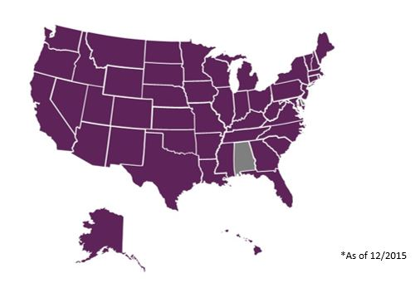
48 states have CPA Law*

Slide 31
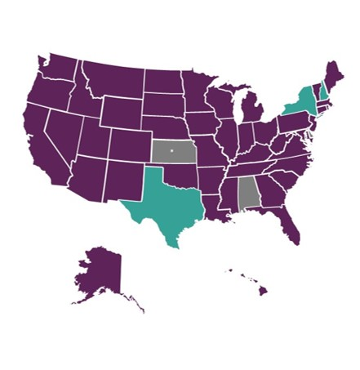
44 states allow CPAs in all practice settings*
*As of December 2015, Kansas had a state law, but had not finalized its regulations.
Centers for Disease Control and Prevention. Advancing Team-Based Care Through Collaborative Practice Agreements: A Resource and Implementation Guide for Adding Pharmacists to the Care Team. Atlanta, GA: Centers for Disease Control and Prevention, US Dept of Health and Human Services; 2017. Available at: www.cdc.gov/dhdsp/pubs/docs/CPA-Team-Based-Care.pdf

Slide 32
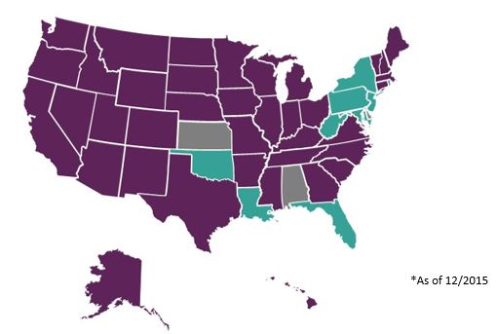
9 states prevent initiation of medications*

Slide 33
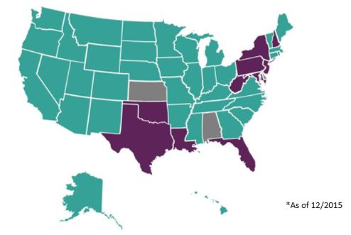
36 states allow initiation of medications in all practice settings*

Slide 34
Question: Nearly all states currently have some level of collaborative practice authority for pharmacists.
  True
  False

Slide 35
Answer: Nearly all states currently have some level of collaborative practice authority for pharmacists.
  True - CORRECT ANSWER
  False

Slide 36
Applications of CPAs
Refill authorization
Therapeutic interchange
Chronic disease management
Order laboratory tests

Slide 37
Refill Authorization

Slide 38
Therapeutic Interchange

Slide 39
Chronic Disease Management

Slide 40
Ordering Laboratory Tests

Slide 41
Other Patient Care Functions

Slide 42
Question: Collaborative practice agreements can be used for refill authorization, formulary management, and hypertension management.
  True
  False

Slide 43
Answer: Collaborative practice agreements can be used for refill authorization, formulary management, and hypertension management.
  True- CORRECT ANSWER
  False

Slide 44
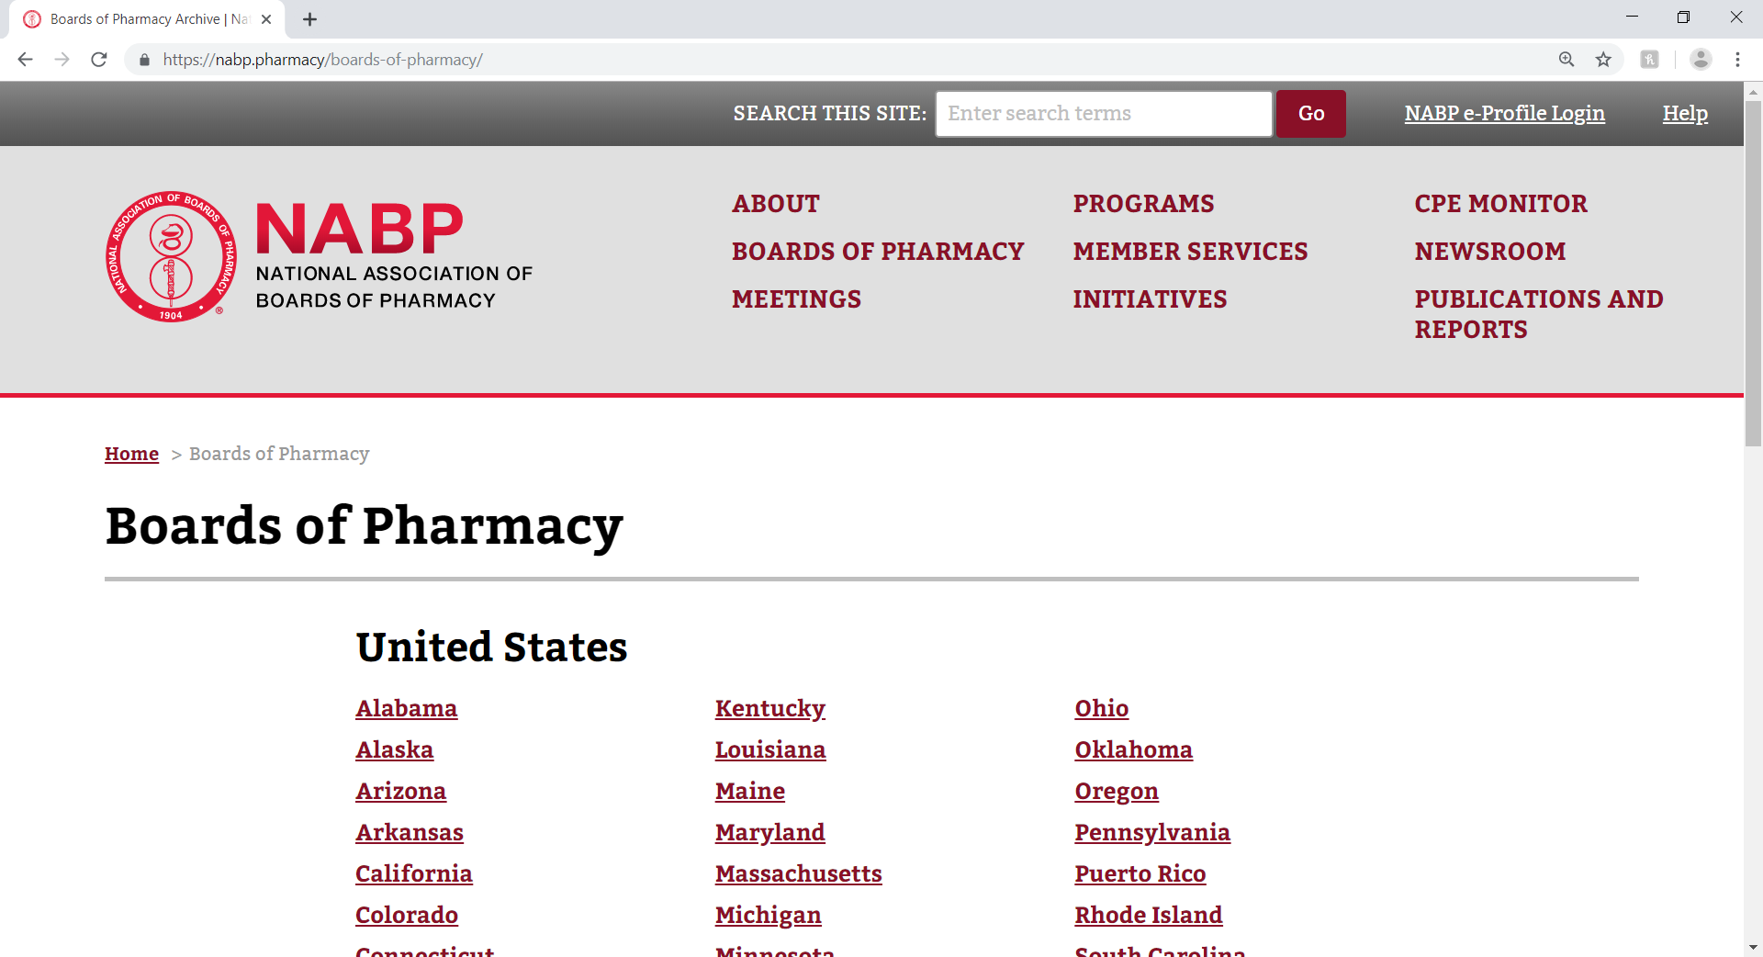
Understanding your state’s laws
www.nabp.pharmacy/boards-of-pharmacy

Slide 45
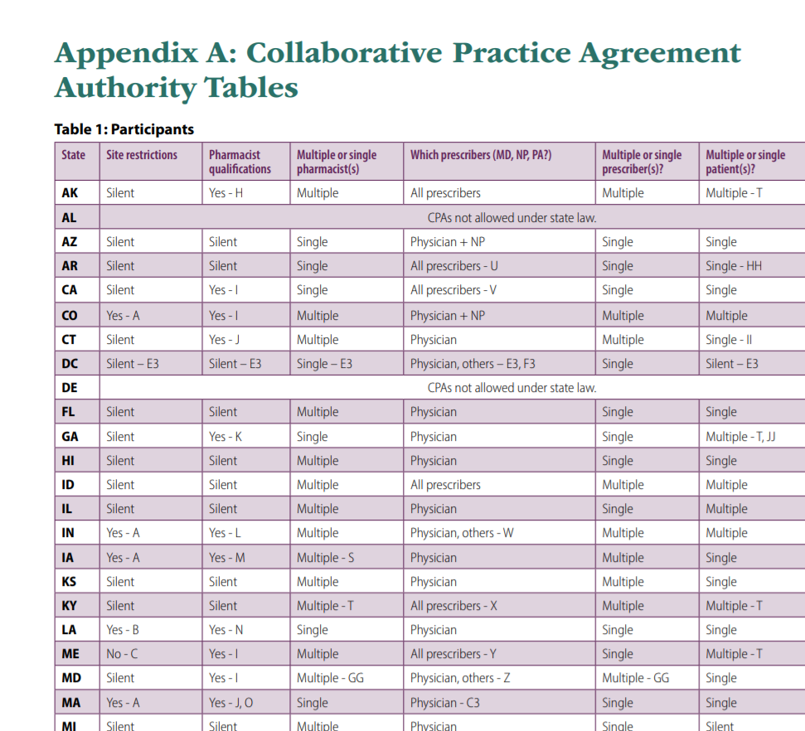
Using Appendix A
https://www.cdc.gov/dhdsp/pubs/docs/CPA-Team-Based-Care.pdf

Slide 46
Getting started with a CPA
Identifying partners
Initiating relationships
Anticipating provider questions

Slide 47
Identifying Partners

Slide 48
Identifying Partners - 1
Start with someone you know

Slide 49
Identifying Partners - 2
Start with someone you know
Identify prescribers with whom you share common goals or patient populations

Slide 50
Identifying problems and help solve them

Slide 51
Understanding quality metrics

Slide 52
Initiating the Relationship – 1,2
Take the first step
Meet in person

Slide 53
Initiating the Relationship – 3, 4
Take the first step
Meet in person
Focus on improving patient care
Identify mutual benefits

Slide 54
Initiating the Relationship - 5
Take the first step
Meet in person
Focus on improving patient care
Identify mutual benefits
Be prepared to answer questions

Slide 55
Question: When a pharmacist wants to develop a CPA, what should she NOT do?
  Reach out to a prescriber you already know
  Wait for a physician to take the first step
  Identify ways to help potential collaborators with quality metrics

Slide 56
Answer: When a pharmacist wants to develop a CPA, what should she NOT do?
  Reach out to a prescriber you already know
  Wait for a physician to take the first step - CORRECT ANSWER
  Identify ways to help potential collaborators with quality metrics

Slide 57
Anticipating prescriber questions

Slide 58
Anticipating prescriber questions -1
What kind of training and credentials does the pharmacist have?

Slide 59
Anticipating prescriber questions -2
What kind of training and credentials does the pharmacist have?
What experience does the pharmacist have in delivering various patient care services?​

Slide 60
Anticipating prescriber questions-3
What kind of training and credentials does the pharmacist have?
What experience does the pharmacist have in delivering various patient care services?​
What is the pharmacist scope of practice in our state?

Slide 61
Anticipating prescriber questions-4
What kind of training and credentials does the pharmacist have?
What experience does the pharmacist have in delivering various patient care services?​
What is the pharmacist scope of practice in our state?
What costs will be involved in this collaboration?

Slide 62
Anticipating prescriber questions-5
What kind of training and credentials does the pharmacist have?
What experience does the pharmacist have in delivering various patient care services?​
What is the pharmacist scope of practice in our state?
What costs will be involved in this collaboration?
Will the collaborating prescriber be taking on additional liability?

Slide 63
Anticipating prescriber questions-6
What kind of training and credentials does the pharmacist have?
What experience does the pharmacist have in delivering various patient care services?​
What is the pharmacist scope of practice in our state?
What costs will be involved in this collaboration?
Will the collaborating prescriber be taking on additional liability?
How will the pharmacist communicate with the prescriber?

Slide 64
Developing Relationships and Building Trust
Trustworthiness
Role Specification
Professional interactions

Slide 65
Developing Relationships and Building Trust-1
Trustworthiness
Role Specification
Professional interactions

Slide 66
Developing Relationships and Building Trust-2
Trustworthiness
Role Specification
Professional interactions

Slide 67
Developing Relationships and Building Trust-3
Trustworthiness
Role Specification
Professional interactions

Slide 68
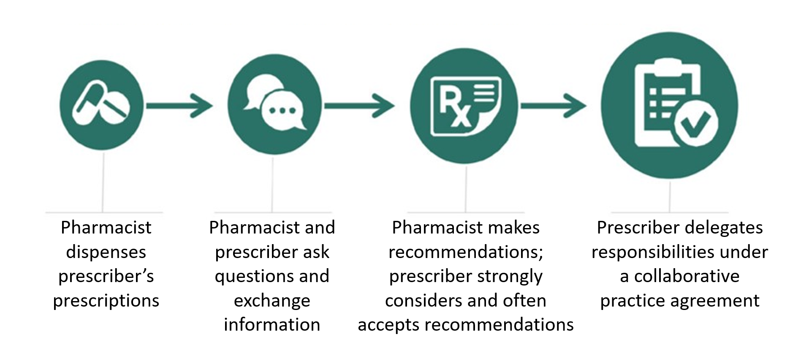
Increasing Trust Between Providers

Slide 69
Question: Signing a collaborative practice agreement is usually the first step for collaborative care delivery.
  True
  False

Slide 70
Answer: Signing a collaborative practice agreement is usually the first step for collaborative care delivery.
  True
  False - CORRECT ANSWER

Slide 71
Adapting a Template CPA for Hypertension and CVD

Slide 72
The CPA Toolkit
It contains examples of language that can be used and sample agreements to review
This language is just an example
Consult your state laws and regulations before drafting a CPA

Slide 73
Using Appendix A - Recap
https://www.cdc.gov/dhdsp/pubs/docs/CPA-Team-Based-Care.pdf

Slide 74
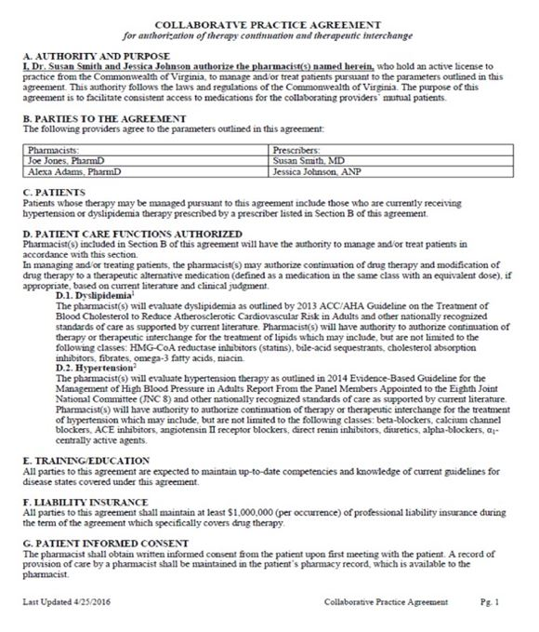
Sample CPA
https://www.cdc.gov/dhdsp/pubs/docs/CPA-Team-Based-Care.pdf

Slide 75
Suggested CPA Sections
Authority and Purpose
Parties to the agreement
Patients
Patient Care Functions Authorized
Training and Education
Liability insurance
Patient informed consent
Documentation
Communication
Quality improvement
Duration
Record retention
Rescindment
References
Signature

Slide 76
Authority and Purpose
Establish a purpose for the agreement

Slide 77
Parties to the Agreement
Identify the pharmacists and prescribers participating
The following parties agree to the parameters outlined in this agreement:
Pharmacists
Prescribers

Slide 78
Patients
Identify the specific patient or patient population

Slide 79
Patient Care Functions Authorized
Define the scope of patient care functions

Slide 80
Training and Education
Consider adding specific education and/or training requirements

Slide 81
True: Which of the following is false regarding pharmacist education and CPAs?
Additional training may be needed depending on the patient care services
Advanced education is always required to enter into a CPA
Some states require additional training in order to enter into a CPA

Slide 82
False: Which of the following is false regarding pharmacist education and CPAs?
Additional training may be needed depending on the patient care services
Advanced education is always required to enter into a CPA - CORRECT ANSWER
Some states require additional training in order to enter into a CPA

Slide 83
Liability Insurance
Maintain liability insurance and
consider adding it as a requirement to the agreement

Slide 84
Patient Informed Consent
Ensure patients understand how their care is being delivered

Slide 85
Documentation
Critical to care delivery
In some states, the laws and regulations will determine the approach
May depend on available technologies

Slide 86
Communication
Essential to building trust and providing high-quality care

Slide 87
Question: Communication between the pharmacist and collaborating prescriber is critical to care coordination and should be discussed when developing a CPA.
  True
  False

Slide 88
Answer: Communication between the pharmacist and collaborating prescriber is critical to care coordination and should be discussed when developing a CPA.
  True - CORRECT ANSWER
  False

Slide 89
Quality Improvement
Incorporate continuous quality improvement into your practice

Slide 90
Agreement Review and Duration
Maximum length of time the agreement is valid

Slide 91
Record Retention
How long and in what manner patient records are maintained

Slide 92
Rescindment or Amendment of Agreement
Allow providers to withdraw from or change the agreement

Slide 93
References
Include any clinical guidelines referred to within the agreement

Slide 94
Agreement Signatures
Some states require patients to sign the agreement as well

Slide 95
Sample CPA
Recap
https://www.cdc.gov/dhdsp/pubs/docs/CPA-Team-Based-Care.pdf

Slide 96
Other considerations

Slide 97
Registering with State Agencies

Slide 98
Data Sharing

Slide 99
Updating an NPI
https://nppes.cms.hhs.gov

Slide 100
Sustainability of Services

Slide 101
Recap:
Patient-centered, efficient care

Slide 102

More resources
https://www.cdc.gov/dhdsp/pubs/docs/CPA-Team-Based-Care
https://www.cdc.gov/dhdsp/pubs/docs/CPA-Translation-Guide.pdf

Slide 103
Funding
Funding for this activity was made possible (in part) by the CDC. The views expressed in activity materials or publications and by speakers and moderators do not necessarily reflect the official policies of the Department of Health and Human Services or the Centers for Disease Control and Prevention, nor does the mention of trade names, commercial practices, or organizations imply endorsement by the US government.
Written materials for this activity were supported by the Cooperative Agreement Numbers NU38OT000307 and NU38OT000141 from the CDC’s Center for State, Tribal, Local, and Territorial Support.

Slide 104
Pharmacist Collaborative Practice Agreements:
Who, What, Why, and How

