Slide 1
Introduction to Legal Mapping

Slide 2
ChangeLab Solutions Disclaimer
The information provided in this discussion is for informational purposes only and does not constitute legal advice. ChangeLab Solutions does not enter into attorney-client relationships.
ChangeLab Solutions is a nonprofit organization that educates and informs the public through objective, nonpartisan analysis, study, and research. The primary purpose of this discussion is to address legal and policy options to improve public health. There is no intent to reflect a view on specific legislation.
Copyright © 2017 ChangeLab Solutions

Slide 3
CDC Disclaimer
These course materials are for instructional use only and are not intended as a substitute for professional legal or other advice. While every effort has been made to verify the accuracy of these materials, legal authorities and requirements may vary from jurisdiction to jurisdiction. Always seek the advice of an attorney or other qualified professional with any questions you may have regarding a legal matter.
The contents of this presentation have not been formally disseminated by the Centers for Disease Control and Prevention and should not be construed to represent any agency determination or policy.

Slide 4
Competencies
1. Identify opportunities for legal mapping to inform the process, nature, and impact of policies and laws on public health
2. Develop policy surveillance or legal assessment studies to address specific research questions
3. Analyze laws, policies, and political and programmatic priorities
4. Validate and synthesize results that compare and contrast meaningful variations in law and policy related to health
Legal Epidemiology Competency Model, Domain 2, 2018

Slide 5
What We’ll Discuss
What is legal mapping?
Why use legal mapping?
What kinds of legal mapping options exist?
How does legal mapping work in practice?

Slide 6
Legal Mapping
A process for capturing important features of laws and policies and identifying how they vary over time and across jurisdictions or institutions

Slide 7
Why Use Legal Mapping?

Slide 8
Synthesizes Data in a Simple & Accessible Way
Is there a state law on cell phone use while driving?
Yes – SAMPLE ANSWER
No
1a. Are local governments allowed to regulate drivers’ cell phone use?
Yes
No – SAMPLE ANSWER

Slide 9
Emphasizes Transdisciplinary Research

Slide 10
Tracks Laws Over Time

Slide 11
Creates Reliable Data

Slide 12
What Are Different Legal Mapping Options?
Policy surveillance
Legal assessments
Legal scans
Legal profiles

Slide 13
Types of Legal Mapping

Slide 14
Policy Surveillance & Legal Assessments

Slide 15
Similarities
Shared components:
Require a transdisciplinary team
Use rigorous scientific process to produce robust data
Track laws across multiple jurisdictions

Slide 16
Differences
Policy Surveillance
Tracks laws over time

Slide 17
Differences (continued)
Policy Surveillance
Tracks laws over time
Legal Assessments
Examine laws at one point in time

Slide 18
Types of Legal Mapping in Public Health Law Practice

Slide 19
Types of Legal Mapping: Legal Scan
Legal Scan
Quick scan of a topic or law

Slide 20
Types of Legal Mapping: Legal Profile
Legal Scan
Quick scan of a topic or law
Legal Profile
More in-depth information on multiple topics

Slide 21
Review of the Types of Legal Mapping

Slide 22
Meet Wendy!
What is her task?
To determine whether distracted driving laws have an effect on health

Slide 23
Wendy’s Hypothesis
Strict bans on texting while driving have a positive effect on public health.

Slide 24
Question: What should Wendy do?
A: Legal epidemiology
B: Public health law practice
C: Take a long vacation

Slide 25
Types of Legal Mapping (review)

Slide 26
Answer: What should Wendy do?
A: Legal epidemiology → CORRECT ANSWER
B: Public health law practice
C: Take a long vacation

Slide 27
Recap: What is Legal Epidemiology?
Scientific study and deployment of law
Created for research
Uses transparent scientific methods and rigorous quality control

Slide 28
Next, Wendy must choose a legal epidemiology study design

Slide 29
Question: Which legal mapping model should Wendy use?
Policy Surveillance
Tracks laws over time
Legal Assessments
Examine laws at one point in time

Slide 30
Remember:
Wendy’s boss asked her to report on the effects of these laws since they were first passed.

Slide 31
Answer: Which legal mapping model should Wendy use?
Legal Epidemiology
Policy Surveillance OR Legal Assessments
Answer: Wendy must conduct policy surveillance.

Slide 32
To conduct policy surveillance, Wendy creates a multidisciplinary team.

Slide 33
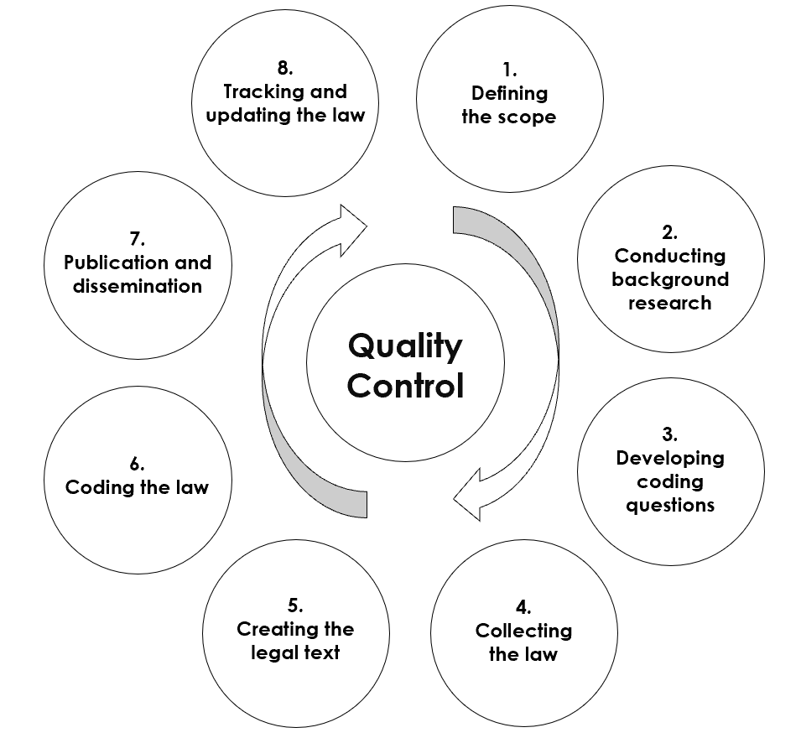
Policy Surveillance

Slide 34
Step 1: Defining the Scope
Identify the topic and parameters of your project

Slide 35
Step 1: Defining the Scope
Scoping with Wendy
What is the goal?
Who is the audience?
Are the laws accessible?
Do we have the resources we need?
Do we use a legal assessment or policy surveillance?

Slide 36
Step 1: Defining the Scope - GOAL
Scoping with Wendy
What is the goal?

Slide 37
Step 1: Defining the Scope- audience
Scoping with Wendy
What is the goal?
Who is the audience?

Slide 38
Step 1: Defining the Scope - ACCESSIBILITY
Scoping with Wendy
What is the goal?
Who is the audience?
Are the laws accessible?

Slide 39
Step 1: Defining the Scope - resources
Scoping with Wendy
What is the goal?
Who is the audience?
Are the laws accessible?
Do we have the resources we need?

Slide 40
Step 1: Defining the Scope - type
Scoping with Wendy
What is the goal?
Who is the audience?
Are the laws accessible?
Do we have the resources we need?
Do we use a legal assessment or policy surveillance?

Slide 41
Step 1: Defining the Scope Redefining the Scope
The scope of the project might change throughout the process.
Background research helps define and redefine the scope.

Slide 42
Step 2: Conducting Background Research - purpose The Team Conducts Background Research
Develop a clear statement of purpose
Investigate the legal landscape
Identify key features of the law and any variations

Slide 43
Step 2: Conducting Background Research – legal landscape The Team Conducts Background Research
Develop a clear statement of purpose
Investigate the legal landscape
Identify key features of the law and any variations

Slide 44
Step 2: Conducting Background Research – key features The Team Conducts Background Research
Develop a clear statement of purpose
Investigate the legal landscape
Identify key features of the law and any variations

Slide 45
Step 2: Conducting Background Research The Team Conducts Background Research
Develop a clear statement of purpose
Investigate the legal landscape
Identify key features of the law and any variations

Slide 46
Step 2: Conducting Background Research In-Depth Background Research: Six Steps
Identify reliable secondary sources
Draft a background memorandum
Draft a five-state memorandum
Compile a sample of relevant laws
Refine search strategy
Identify features of the law

Slide 47
Six Steps of Background research Step 1: Identify Reliable Secondary Sources
Example: CDC provides important background information and statistics on injuries resulting from distracted driving.

Slide 48
Six Steps of Background research Step 2: Draft a Background Memorandum
A paper that summarizes and synthesizes information on the legal landscape

Slide 49
Goals for the Background Memorandum
Become familiar with the topic
Find gaps in existing resources
Discover unforeseen challenges
Identify key trends over time

Slide 50
Background Memorandums
By reading the memorandums and consulting with subject matter experts, Wendy discovers that distracted driving is regulated at the state level and preemption is not an issue.

Slide 51
Six Steps of Background research Step 3: Draft a Five-State Memorandum
A five-state memo summarizes laws in five jurisdictions that are relevant to the project’s topic.

Slide 52
Goals of a Five-State Memorandum
Identify the source and structure of the law
Present a sample of laws relevant to the topic
Identify variations in the law

Slide 53
Five-State Memorandum
After reading her team’s five-state memos, Wendy knows that in 1996, Arizona became the first state to enact a distracted driving law.

Slide 54
Six Steps of Background research Step 4: Compile a Sample of Laws
Legal researchers collect a sample of relevant laws from each of the jurisdictions assigned for their five-state memos.

Slide 55
Six Steps of Background Research Step 5: Refine Search Strategy
Use multiple search terms
Develop a solid search string

Slide 56
Search Fail!
Wendy’s team began the search by using the term “Distracted Driving.”
Yield: 42,577 results. Help!

Slide 57
Search Success!
Wendy’s team then search “driving/50 cell phone.”
This search yields 523 results!

Slide 58
What is a Research Protocol?
A research protocol outlines the methodology and process of a project.

Slide 59
Quality Control: Redundant Legal Research
Researcher 1 records citations
Researcher 2 records citations
Redundant Legal Research

Slide 60
Quality Control: Redundant Legal Research (continued)
Researcher 1 records citations
Researcher 2 records citations
Citations of all relevant laws are captured
Wendy compares and reviews citations

Slide 61
Rate of Redundancy
The rate of redundancy indicates the number of identical jurisdictions that both researchers must independently review.
Must be 100% at the beginning of any study

Slide 62
Rate of Redundancy (continued)
Rate | Description
100% | 100% redundant coding until the rate of divergence is below 5%
50% | Then the redundancy drops to 50% of jurisdictions until the rate of divergence is below 5%
20% | Then the redundancy drops to 20% of the remaining jurisdictions

Slide 63
Rate of Redundancy: When to Use 100%
However, if research results differ more than 5% of the time, the rate of redundancy must revert to 100%.

Slide 64
six Steps of Background Research Step 6: Identify Features of the Law
Features, also known as variables, are important attributes of a law that can vary from state to state.

Slide 65
Wendy Must Narrow Down Her List Features initially observed in the law:
Devices prohibited
Prohibited behavior
Age for prohibition
Driving record
Type of driver
Penalties

Slide 66
Wendy Must Narrow Down Her List
Features initially observed in the law:
Devices prohibited
Prohibited behavior
Age for prohibition
Driving record
Type of driver
Penalties
Features after narrowing the scope:
Devices prohibited
Prohibited behavior
Type of driver
Penalties

Slide 67
Wendy Must Narrow Down Her List: Expert Review
Features initially observed in the law:
Devices prohibited
Prohibited behavior
Age for prohibition
Driving record
Type of driver
Penalties
Features after narrowing the scope
Devices prohibited
Prohibited behavior
Type of driver
Penalties
Stop and consult an expert!

Slide 68
Step 3: Developing Coding Questions

Slide 69
Step 3: Developing coding questions Goals of Question Development
Use Q&A format
Measure the law through observation (rather than interpretation)
Write questions that mirror health outcome data

Slide 70
Track Laws Through Q&A Format: Example
Is there a state law on cell phone use while driving?
Yes – SAMPLE ANSWER
No
1a. Are local governments allowed to regulate drivers’ cell phone use?
Yes
No – SAMPLE ANSWER

Slide 71
Track Laws Through Q&A Format: Example
Is there a state law on cell phone use while driving?
Yes No
1a. Are local governments allowed to regulate drivers’ cell phone use?
Yes No

Slide 72
Track Laws Through Q&A Format: Preemption
Exercise
Is there a state law on cell phone use while driving?
Yes No
1a. Are local governments allowed to regulate drivers’ cell phone use?
Yes No

Slide 73
Step 3: Developing coding questions Goals of Question Development
Use Q&A format
Measure the law through observation (rather than interpretation)
Write questions that mirror health outcome data

Slide 74
Measure the Law Through Observation (Rather Than Interpretation)
Observation
Definition: Information from things we can measure (facts)
Example: Does the jurisdiction have a law on texting while driving?
Interpretation
Definition: Conclusions we derive from those observations (opinions)
Example: Does the jurisdiction have a strict law on texting while driving?

Slide 75
Step 3: Developing coding questions Goals of Question Development
Use Q&A format
Measure the law through observation (rather than interpretation)
Write questions that mirror health outcome data

Slide 76
Finding Unexpected Responses
Penalty for 1st violation
Fine
License points
Other
Penalty for 1st violation
Fine
License points
License suspension
Imprisonment

Slide 77
Types of Coding Questions
Conditional
Text field
Binary – mutually exclusive fields
Categorical – “select all that apply” fields
Categorical – mutually exclusive fields

Slide 78
Types of Coding Questions: Conditional
Conditional
Text field
Binary – mutually exclusive fields
Categorical – “select all that apply” fields
Categorical – mutually exclusive fields

Slide 79
Types of Coding Questions: Text Field
Conditional
Text field
Binary – mutually exclusive fields
Categorical – “select all that apply” fields
Categorical – mutually exclusive fields

Slide 80
Types of Coding Questions: Binary
Conditional
Text field
Binary – mutually exclusive fields
Categorical – “select all that apply” fields
Categorical – mutually exclusive fields

Slide 81
Types of Coding Questions: Categorical (Select All That Apply)
Conditional
Text field
Binary – mutually exclusive fields
Categorical – “select all that apply” fields
Categorical – mutually exclusive fields

Slide 82
Types of Coding Questions: Categorical (Mutually Exclusive)
Conditional
Text field
Binary – mutually exclusive fields
Categorical – “select all that apply” fields
Categorical – mutually exclusive fields

Slide 83
Review: Types of Coding Questions
Conditional
Text field
Binary – mutually exclusive fields
Categorical – “select all that apply” fields
Categorical – mutually exclusive fields

Slide 84
Step 4: Collecting the Law
Always record these items:
Legal citation
Effective date
Statutory history
The body of the law

Slide 85
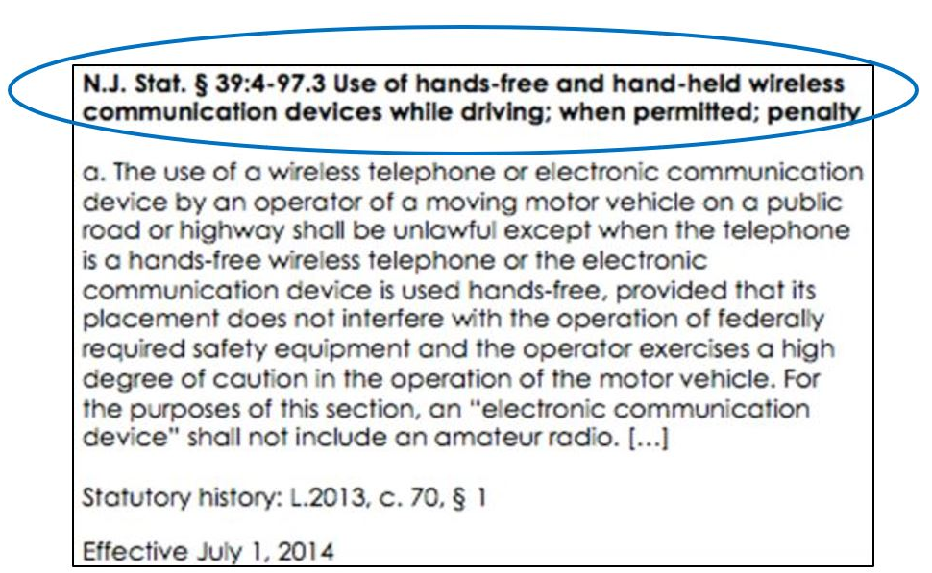
Step 4: Collecting the Law – Legal Citation
Always record these items:
Legal citation
Effective date
Statutory history
The body of the law

Slide 86
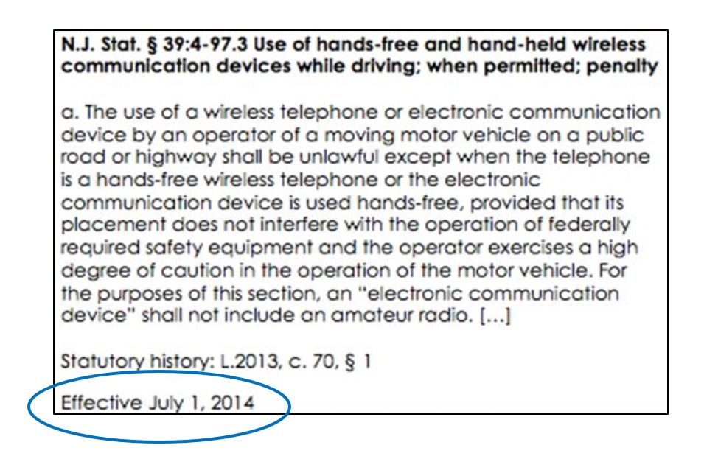
Step 4: Collecting the Law – Effective Date of Law
Always record these items:
Legal citation
Effective date
Statutory history
The body of the law

Slide 87
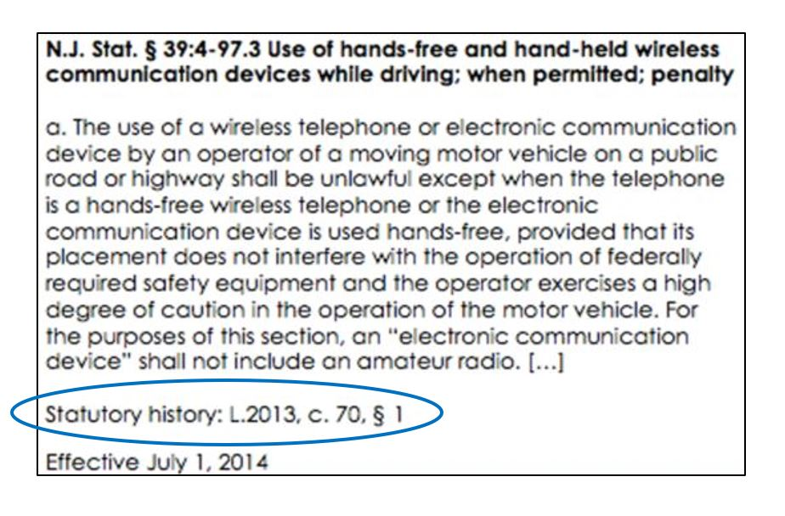
Step 4: Collecting the Law – Statutory History
Always record these items:
Legal citation
Effective date
Statutory history
The body of the law

Slide 88
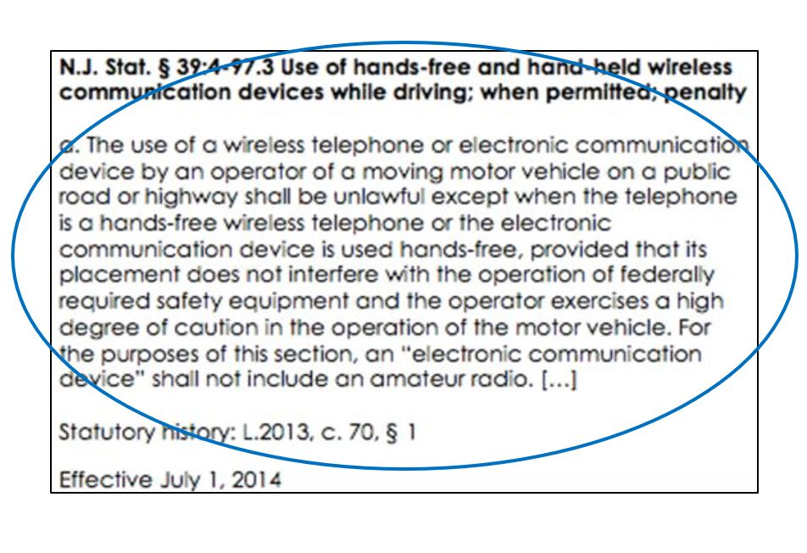
Step 4: Collecting the Law – the Body of the Law
Always record these items:
Legal citation
Effective date
Statutory history
The body of the law

Slide 89
Practice Tips
Carefully review the terms of service of legal databases
Check state legislative websites for copyright restrictions

Slide 90
Step 5: Creating the Legal Text
Compile and organize the relevant law(s) for each jurisdiction
Example: All of Alaska's relevant statutes for distracted driving as of August 1, 2017

Slide 91
Remember, Wendy chose policy surveillance
Across space: All US states and Washington, DC
Over time: 1996 to present day

Slide 92
Record Changes in the Legal Text Over Time Example: New Jersey Distracted Driving Law
2010 Version
d. A person who violates this section shall be fined $100
2014 Version
d. A person who violates this section shall be fined as follows:
(1) For a first offense, not less than $200 or more than $400;
(2) For a second offense, not less than $400 or more than $600; and
(3) For a third or subsequent offense, not less than $600 or more than $800.
N.J. Stat. § 39:4-97.3 Use of hands-free and hand-held wireless communication devices while driving; when permitted; penalty

Slide 93
Step 6: Coding the Law
Code answers to questions based on collected law:
Read
Observe
Record

Slide 94
Coding the Law in Practice Example: Alaska Distracted Driving Law
Question: What behaviors are restricted while driving?

Slide 95
Coding the Law in Practice Example Overview: Alaska Distracted Driving Law
Legal Text: Alaska Stat. § 28.35.161 Use of electronic devices while driving; unlawful installation of television, monitor, or similar device
(a) A person commits the crime of driving while texting, while communicating on a computer, or while a screen device is operating if the person is driving a motor vehicle, and . . . the person is reading or typing a text message or other nonvoice message or communication on a cellular telephone, personal data assistant, computer, or any other similar means capable of providing a visual display that is in view of the driver in a normal driving position while the vehicle is in motion and while the person is driving.

Slide 96
Coding the Law in Practice Example Question: Alaska Distracted Driving Law
What behaviors are restricted while driving?
Handheld electronic messaging
Handheld calling
Hands-free electronic messaging
Hands-free calling

Slide 97
Coding the Law in Practice Example Review: Alaska Distracted Driving Law
Legal Text: Alaska Stat. § 28.35.161 Use of electronic devices while driving; unlawful installation of television, monitor, or similar device
(a) A person commits the crime of driving while texting, while communicating on a computer, or while a screen device is operating if the person is driving a motor vehicle, and . . . the person is reading or typing a text message or other nonvoice message or communication on a cellular telephone, personal data assistant, computer, or any other similar means capable of providing a visual display that is in view of the driver in a normal driving position while the vehicle is in motion and while the person is driving

Slide 98
Coding the Law in Practice Example Answer: Alaska Distracted Driving Law
What behaviors are restricted while driving?
Handheld electronic messaging - CORRECT ANSWER
Handheld calling
Hands-free electronic messaging
Hands-free calling

Slide 99
Remember the Research Protocol
The process is iterative
Record all changes
Revisit and recode if changes are made

Slide 100
Quality Control: Redundant Coding

Slide 101
Rate of Redundancy (Review)
The rate of redundancy is the percentage of identical records that both researchers must independently code.
Must be 100% at the beginning of any study

Slide 102
Redundant Coding Process
Rate | Description
100% | 100% redundant coding until the rate of divergence is below 5%
50% | Then the redundancy drops to 50% of jurisdictions until the rate of divergence is below 5%
20% | Then the redundancy drops to 20% of the remaining jurisdictions

Slide 103
Rate of Redundancy
However, if the results differ more than 5% of the time, the rate of redundancy reverts to 100%.

Slide 104
Policy Surveillance: Redundant Coding
Remember that in policy surveillance projects, researchers must code every amendment or newly enacted law over time.
However, in legal assessments, researchers code the law as it exists at one point in time.

Slide 105
Post-Production Statistical Quality Control
At the end of the coding process, select a random sample of coding instances to be redundantly coded.

Slide 106
Preparing Data for Advanced Research Methods

Slide 107
Codebook
A document that defines the features and values included in the project

Slide 108
Step 7: Publication & Dissemination

Slide 109
Step 7: Publication & Dissemination
Keep the data internal?
How should we present this information?

Slide 110
Step 7: Publication & Dissemination (continued)
What data should we highlight?
Who is our target audience?

Slide 111
What does Wendy do next?

Slide 112
Step 8: Tracking and Updating the Law
To maintain the dataset, check periodically for new laws or updates to existing laws that were included in the project

Slide 113
What Worked?
Visualize the impact of law on public health outcomes
Analyze trends
Recommend changes in the law
Stay informed and track laws as they evolve

Slide 114
Up next: Advanced Legal Epidemiology Methods!

Slide 115
Looking Ahead
Wendy’s report is done, and her office has published it.
Take a look at the report by visiting the link below:
http://lawatlas.org/datasets/distracted-driving-1470663668

Slide 116
What We Discussed
What is legal mapping?
Why use legal mapping?
What are different legal mapping options?
How does legal mapping work in practice?

Slide 117
Funding
This publication was supported by the Centers for Disease Control and Prevention of the US Department of Health and Human Services (HHS) as part of a financial assistance award totaling $210,000 with 100 percent funded by CDC/HHS. The contents are those of the authors and do not necessarily represent the official views of, nor an endorsement, by CDC/HHS or the US Government.

Slide 118
Introduction to Legal Mapping Questions?

